Slide 1


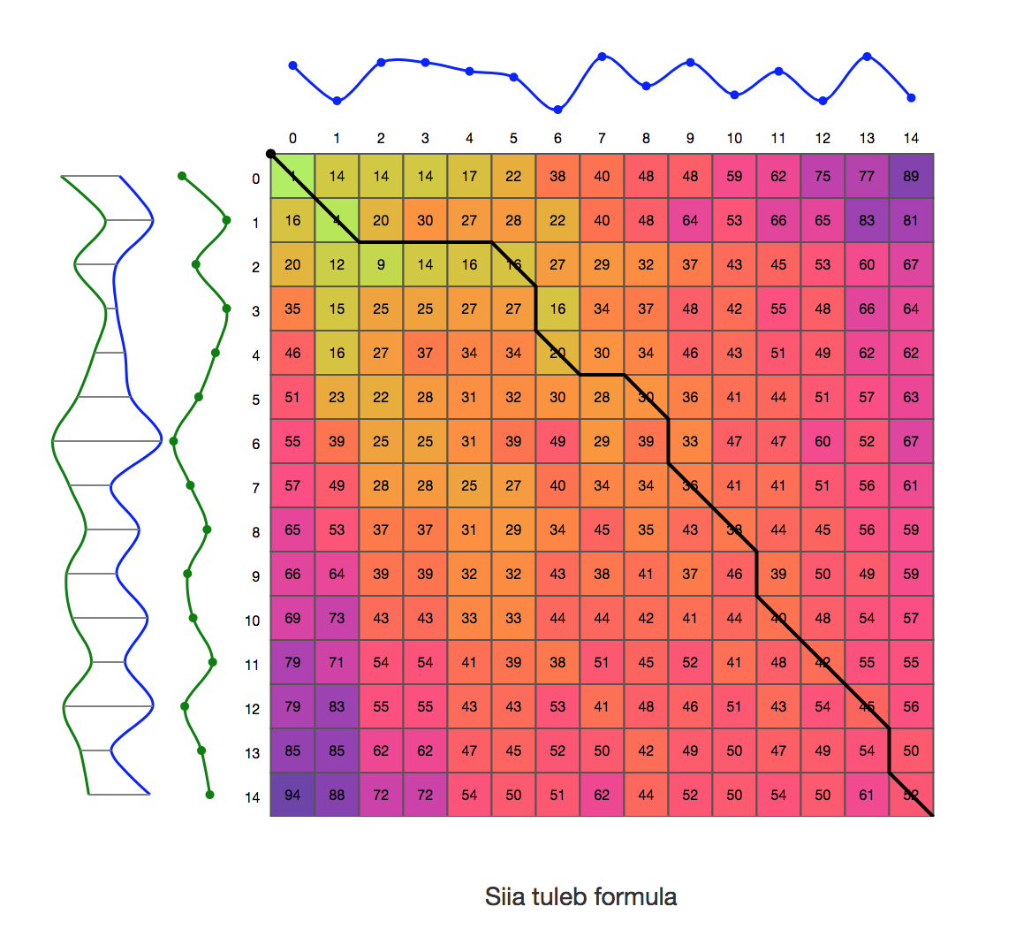
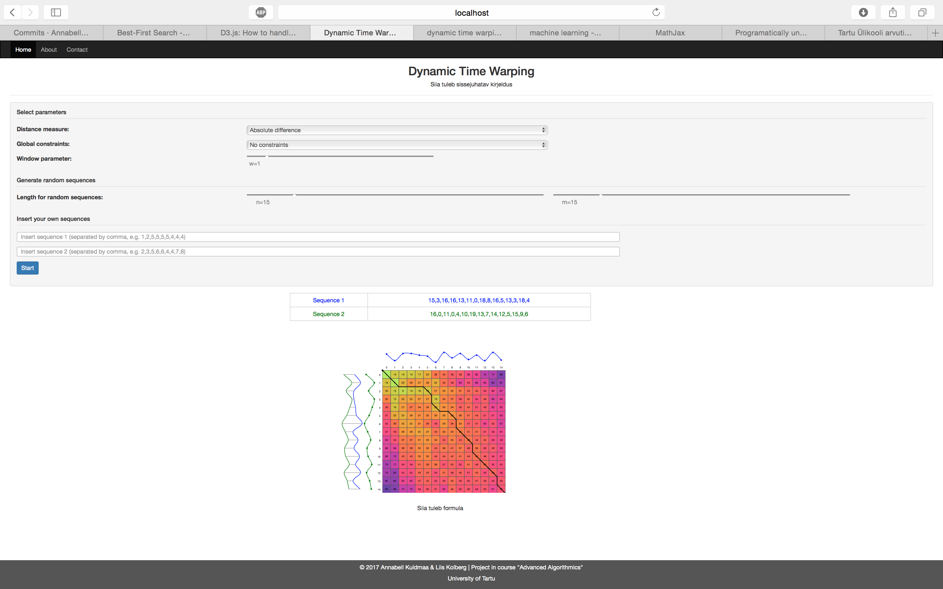
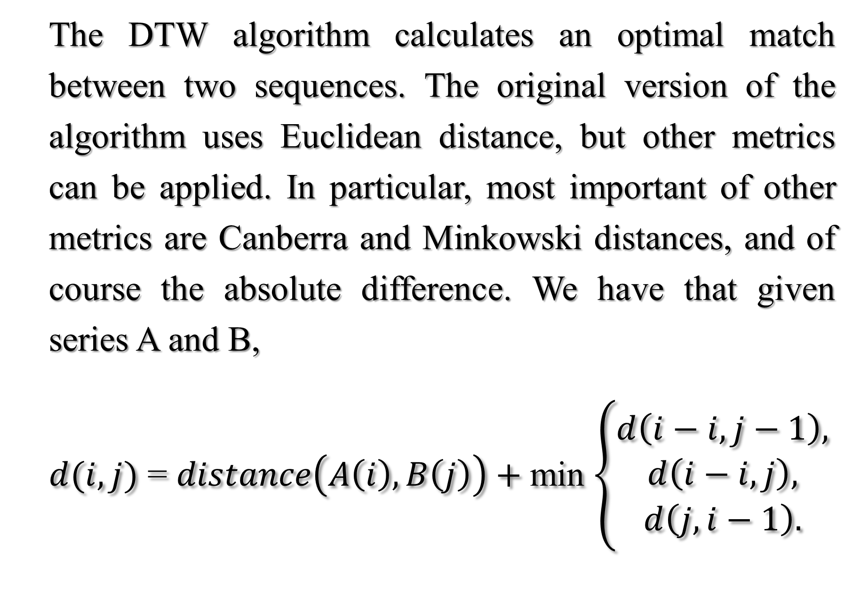
Visualization of Dynamic Time Warping
Annabell Kuldmaa, Liis Kolberg
Institute of Computer Science University of Tartu
INTRODUCTION
VISUALIZATION
The goal of this project is a web tool for vizualizing the Dynamic Time Warping (DTW) for educational purposes- The task of (DTW) algorithm is to measure the similarity between two sequences. DTW algorithm was introduced in [SC78] for speech recognition and since then has been applied to different problems in various fields. The algorithm is one of the most important dynamic programming algorithms and it is crucial to understand its steps.
To speed up the DTW calculation and prevent pathological warpings, different constraints for warping window have been introduced. A global constraint constraints the indices of the warping path. Most important window constraints are briefly described below. For Sakoe-Chiba and Itakura sequenced of equal length are required.
Sakoe-Chiba Band
Sakoe-Chiba band was introduced by Sakoe and Chiba in [SC78] for speech community. It runs along the main diagonal having fixed window width.
Itakura Parallelogram
Itakura parallelogram was introduced by Itakura in [Ita75]. The warping window constrains the slope of a warping path, i.e., the Itakura parallelogram consists of all cells that are traversed by some warping path having a slope (S = 2).
Slanted Band
Slanted band is a modification of Sakoe-Chiba band for the case where input sequences are of different length. Instead of main diagonal here slanted diagonal is used
CONCLUSIONS
The source code of the implementation is available at: https://github.com/AnnabellKuldmaa/aa16.
The tool can be used in various algorithmics courses that consider dynamic programming. Students can play with different parameters and learn important aspects of DTW while having fun.
DYNAMIC TIME WARPING
The DTW algorithm calculates an optimal match between two sequences. The original version of the algorithm uses Euclidean distance, but other metrics can be applied. In particular, most important of other metrics are Canberra and Minkowski distances, and of course the absolute difference. We have that given series A and B,
$d(i,j)$ = $distance\left(A\left(i\right), B\left(j\right)\right)+$min $\left\{\begin{aligned}d\left(i−i, j−1\right), \\ d\left(i−i, j\right), \\ d\left(j, i−1\right).\end{aligned}\right.$
REFERENCES
[Ita75] F. Itakura. Minimum prediction residual principle applied to speech recognition. IEEE Transactions on Acoustics, Speech, and Signal Processing, 23(1):67-72, Feb 1975.
[SC78] Hiroaki Sakoe and Seibi Chiba. Dynamic programming algorithm optimization for spoken word recognition, 1978.
[SC71] Hiroaki Sakoe and Seibi Chiba. A dynamic programming approach to continuous speech recognition. In Proceedings of the Seventh In-
ternational Congress on Acoustics, Budapest, volume 3, pages 65-69, Budapest, 1971.
Itakura Parallelogram
Sakoe Chiba Band

