Slide 1


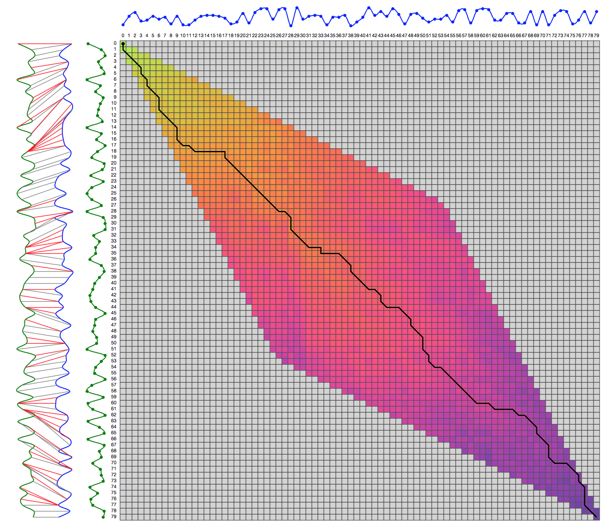
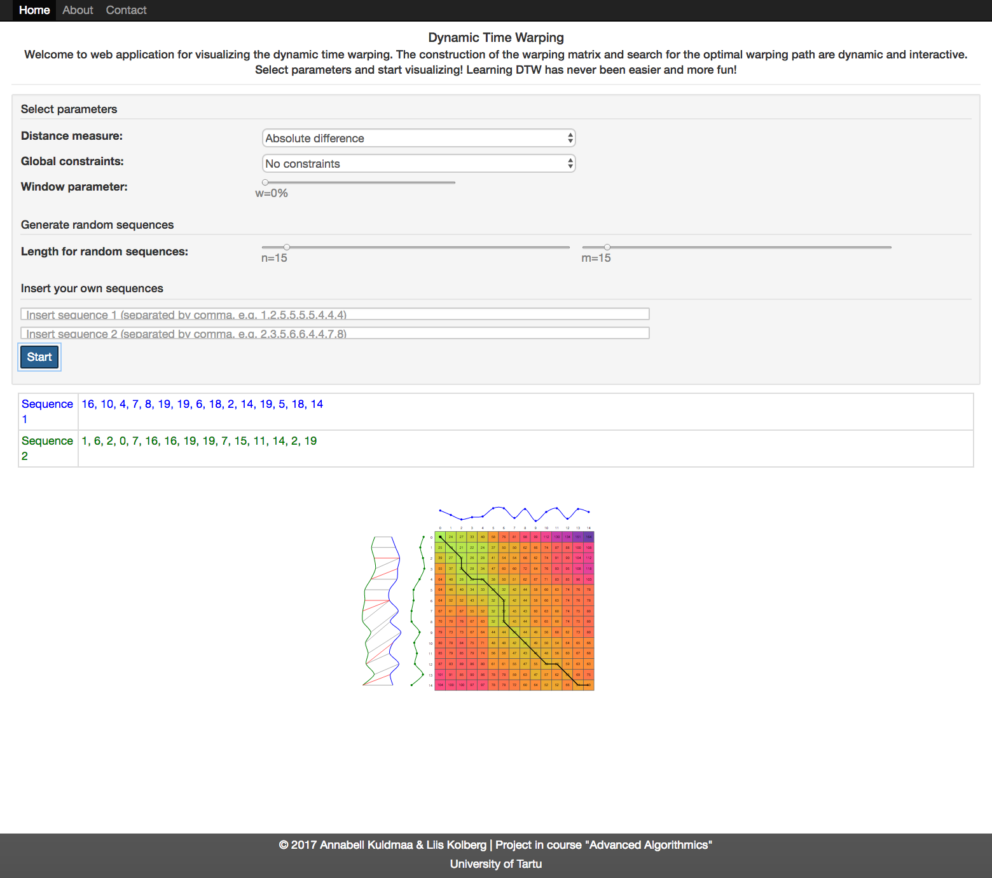
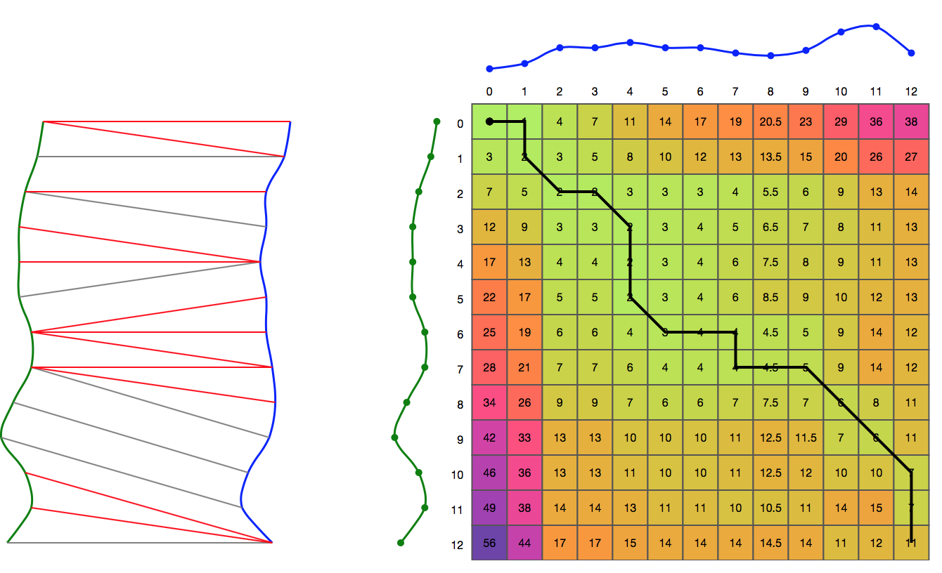
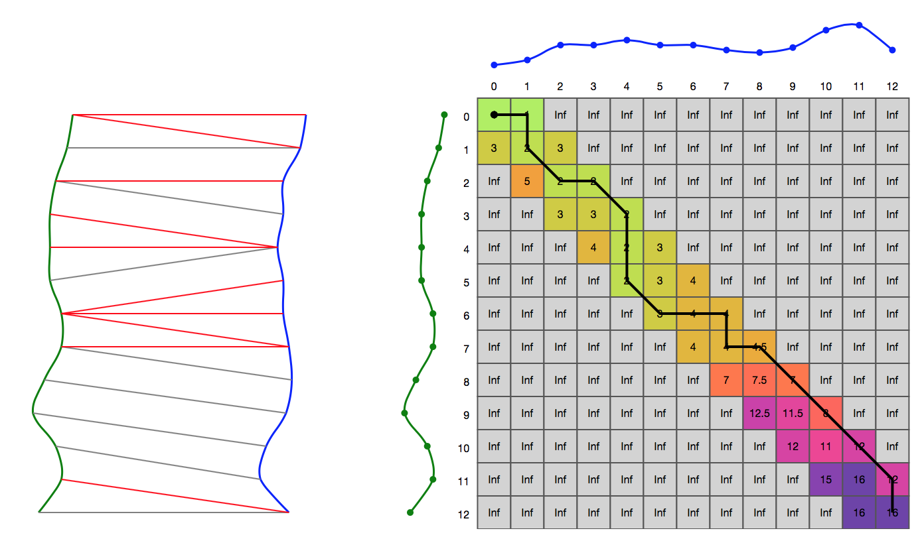
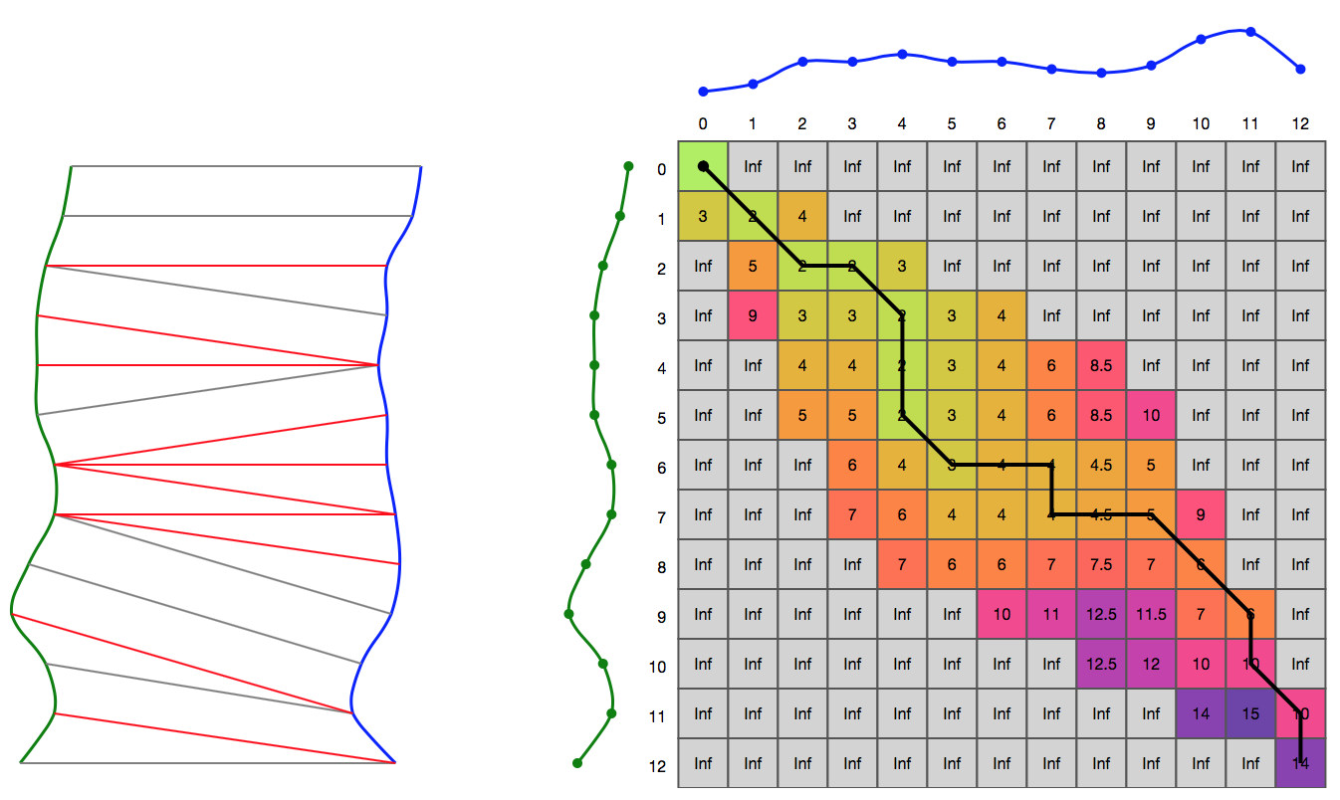
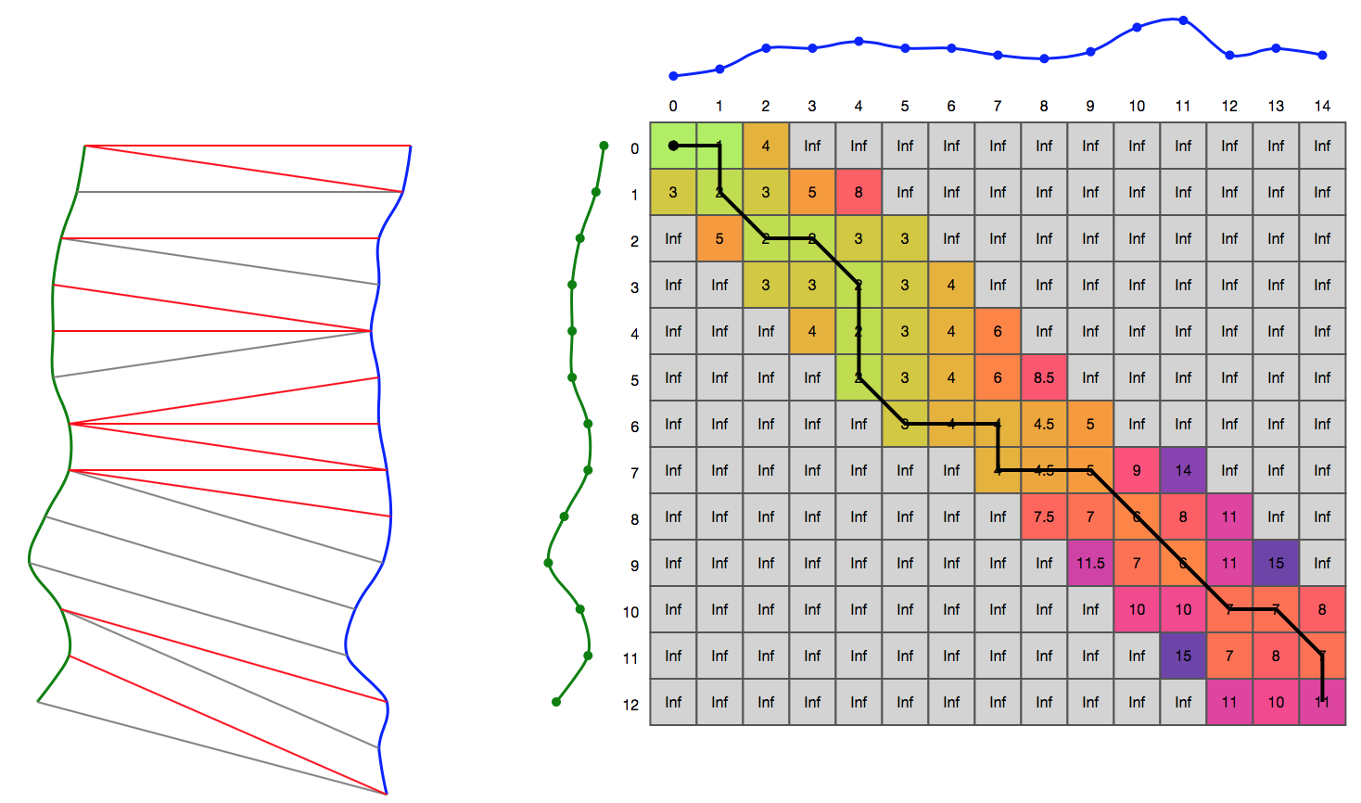
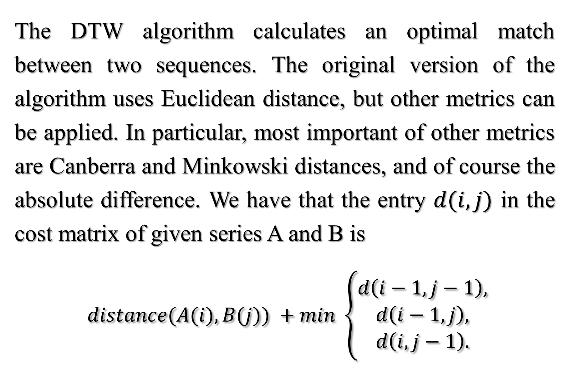
Visualization of Dynamic Time Warping
Annabell Kuldmaa, Liis Kolberg
Institute of Computer Science University of Tartu
INTRODUCTION
VISUALIZATION
The goal of this project is a web tool for vizualizing the Dynamic Time Warping (DTW) for educational purposes. The task of DTW algorithm is to measure the similarity between two sequences. DTW algorithm was introduced in [SC71] for speech recognition and since then has been applied to different problems in various fields. The algorithm is one of the most important dynamic programming algorithms and it is crucial to understand its steps.
The construction of the warping matrix and search for the optimal warping path is animated, the resulting alignment is dynamically shown. Users can insert their own series or use random data. Different parameters, including global contraints can be selected.
To speed up the DTW calculation and prevent pathological warpings, different constraints for warping window have been introduced. A global constraint constraints the indices of the warping path. Most important window constraints are Sakoe-Chiba Band [SC78], Itakura Parallelogram [Ita75], Slanted Band.
CONCLUSIONS
The source code of the implementation is available at: https://github.com/AnnabellKuldmaa/aa16.
The tool can be used in various algorithmics courses that consider dynamic programming. Students can play with different parameters and learn important aspects of DTW while having fun.
No constraints, absolute difference
Sakoe-Chiba Band, absolute difference, 5%
DYNAMIC TIME WARPING
REFERENCES
The DTW algorithm calculates an optimal match between two sequences. The original version of the algorithm uses Euclidean distance, but other metrics can be applied. In particular, most important of other metrics are Canberra and Minkowski distances, and of course the absolute difference. We have that the entry $d(i,j)$ in the cost matrix of given series A and B is
$distance(A(i), B(j)) +min \left\{\begin{aligned}d\left(i−1, j−1\right), \\ d\left(i−1, j\right), \\ d\left(i, j−1\right).\end{aligned}\right.$
[Ita75] F. Itakura. Minimum prediction residual principle applied to speech recognition. IEEE Transactions on Acoustics, Speech, and Signal Processing, 23(1):67-72, 1975.
[SC71] Hiroaki Sakoe and Seibi Chiba. A dynamic programming approach to continuous speech recognition. In Proceedings of the Seventh International Congress on Acoustics, Buda- pest,volume 3, pages 65-69, Budapest, 1971.
[SC78] Hiroaki Sakoe and Seibi Chiba. Dynamic programming algorithm optimization for spoken word recognition, 1978.
Itakura Parallelogram, absolute difference
Slanted Band, absolute difference, 10%, different length series

