Slide 1


CloudCmp: Comparing Public Cloud Providers
Ang Li Xiaowei Yang Srikanth Kandula Ming Zhang

Slide 2







Cloud computing is growing rapidly
IDC: public IT cloud market will grow from $16B to $55.5B in five years
However…

Slide 3


Slide 4

Choosing the best cloud is hard
Who has the best computation performance?
We have 2.5 “ECU”!
Joe
As fast as 1.2G Intel!
We have 4 virtual cores!
Notes:
Different implementations, marketing strategies, bell and whistles features. Simple end-to-end metrics. Predictive value for applications.
What is the state-of-the-art?
Mention “other aspects also have the same problem”

Slide 5
Goals
Make cloud providers comparable
Relevant to application performance
Comprehensive
Fair
Lightweight
Notes:
“To address the difficulty we just mentioned, the goal of this work is to blablabla…”
Combine this with key challenges.

Slide 6
CloudCmp: systematic comparator of cloud providers
Cover four common cloud services
Encompass computation, storage, and networking
Nine end-to-end metrics
Simple
Has predictive value
Abstracts away the implementation details
Notes:
Mention how each design decision helps us achieve the aforementioned goals
“encompass the three most important categories: computation, storage, networking”

Slide 7
Summary of findings
First comprehensive comparison study of public cloud providers
Different design trade-offs
No single one stands out
Cloud performance can vary significantly
30% more expensive -> twice as fast
Storage performance can differ in magnitudes
One cloud’s intra-data center bandwidth can be 3X higher than the other

Slide 8
Cloud providers to compare
New + full service
Largest number of web apps
C1
C2
PaaS provider
C3
C4
Snapshot comparisons from March to Sept
Results are inherently dynamic
Notes:
Make sure we say something to summarize the motivation loop
We compare four major providers…

Slide 9

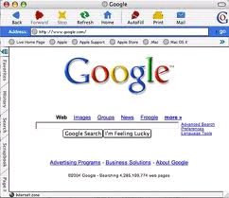


Identifying the common services
Four common services
Wide-area network
Intra-cloud network
Virtual instance
Blob
Table
Queue
Compute cluster
Storage service
“Elastic”
Notes:
Say this is a simplified view
Show something for “elastic”

Slide 10
Comparing compute clusters
Instance performance
Java-based benchmarks
Cost-effectiveness
Cost per benchmark
Scaling performance
Why is it important?
Scaling latency
Notes:
Scaling performance: windows/linux does not belong here (seems). Can say something about why scaling speed is important

Slide 11
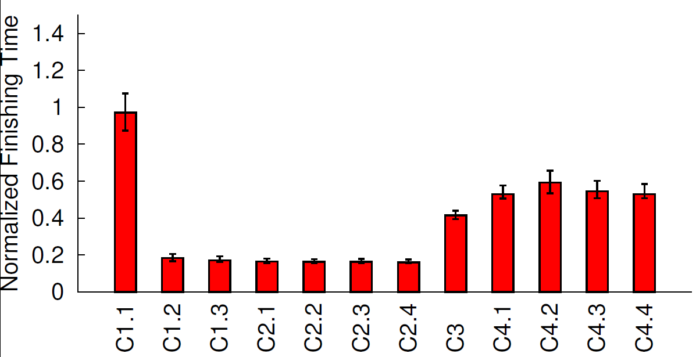
Which cloud runs faster?
Reason: work-conserving policy
C2 is perhaps lightly loaded
Hard to project performance under load
Notes:
Describe single thread first and then present multi-threaded?
Hide the results during presenting the axes.

Slide 12
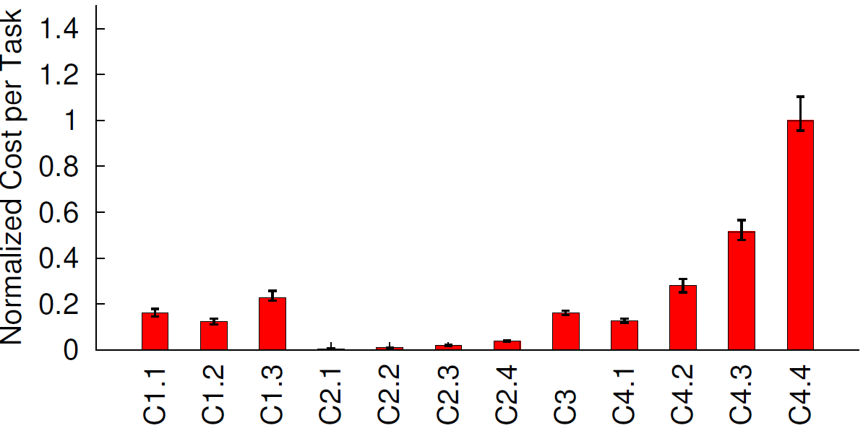
Which cloud is more cost-effective?
Larger instances are not cost-effective!
Reasons: single thread can’t use extra cores, low load
Notes:
Can go if out of time

Slide 13
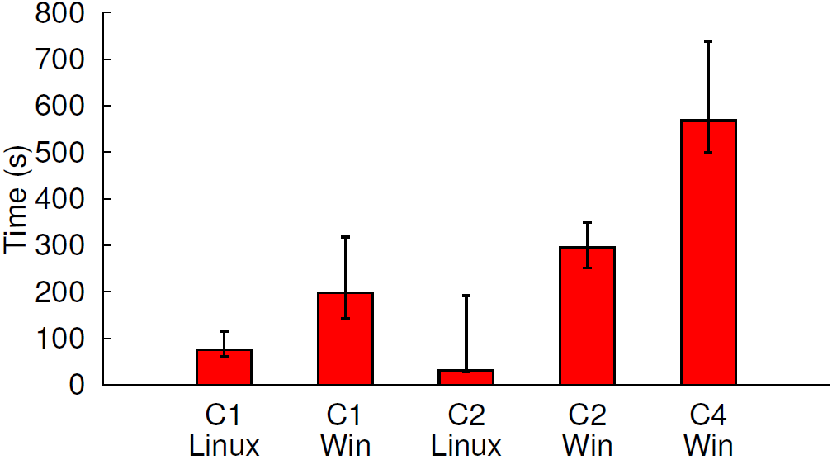
Which cloud scales faster?
Test the smallest instance of each provider
<10mins
<100s
Different providers have different scaling bottlenecks

Slide 14
Comparing storage services
Cover blob, table, and queue storage services
Compare “read” and “write” operations
Additional “query” operation for table
Metrics
Operation latency
Cost per operation
Time to consistency

Slide 15
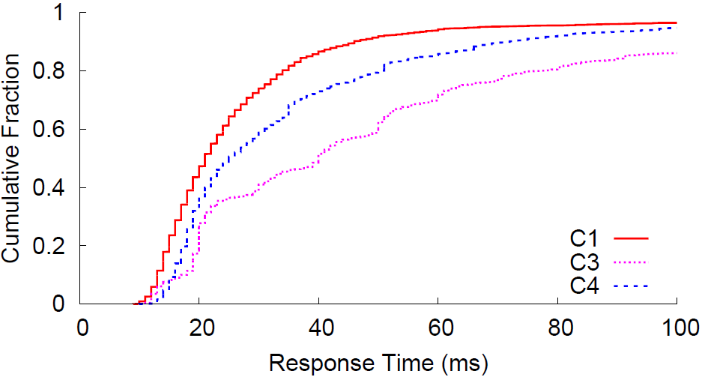
Which storage service is faster?
Table get operation
High latency variation
Notes:
Need to mention other services/operations have different results. Omitted here.
Change to “get”

Slide 16
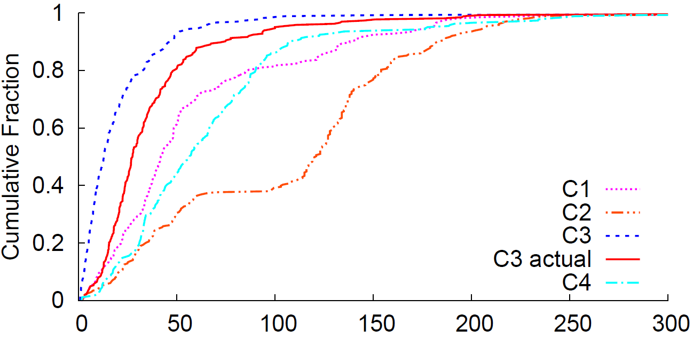
Comparing wide-area networks
Network latency to the closest data center
From 260 PlanetLab vantage points
Large number of presences (34 IP addresses)
Only two DCs Both are in US

Slide 17
From comparison results to application performance

Slide 18
Preliminary study in predicting application performance
Use relevant comparison results to identify the best cloud provider
Applied to three realistic applications
Computation-intensive: Blast
Storage-intensive: TPC-W
Latency-sensitive: website serving static objects
Notes:
Mention our future work

Slide 19
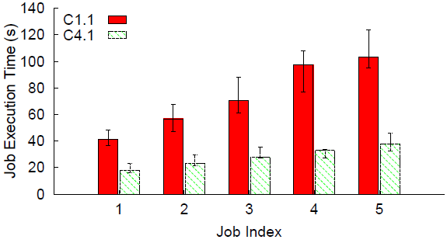
Computation-intensive application
Blast: distributed tool to align DNA
Similar in spirit to MapReduce
$0.085/hr
$0.12/hr
Benchmark finishing time
Actual job execution time
Notes:
Mention what is the bottleneck

Slide 20
Conclusion
Comparing cloud providers is an important practical problem
CloudCmp helps to systematically compare cloud providers
Comparison results align well with actual application performance
Notes:
Relevant to real providers (providers have approached us)

Slide 21
Thank you
http://cloudcmp.net
angl@cs.duke.edu
Questions?

Slide 22
CloudCmp: systematic comparator of cloud providers
Cover common services offered by major providers in the market
Computation, storage, and networking
Both performance and cost-related metrics
Applied on four major cloud providers
Performance differs significantly across providers
30% more expensive -> twice as fast!
No single winner
Notes:
Mention the three services are key to support many different types of applications

Slide 23
Backup slides

Slide 24


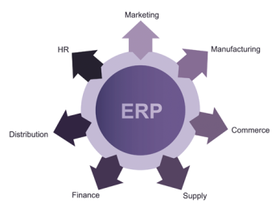


What is cloud computing?
Cloud application
Cloud platform
On-demand scaling
Pay-as-you-go

Slide 25
What is cloud computing?
Cloud application (SaaS)
+
Cloud platform
(utility computing)
On-demand scaling
Pay-as-you-go

Slide 26
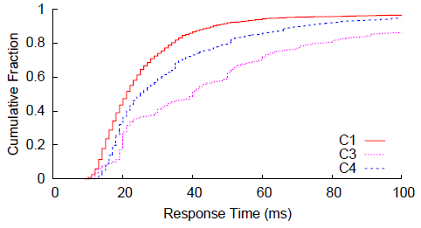
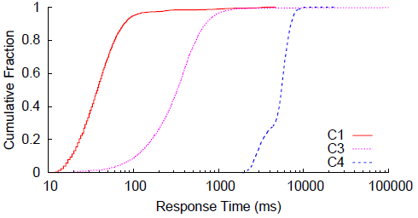
Storage performance
Table get
Table query
Operation response time has high variation
Storage performance depends on operation type

Slide 27
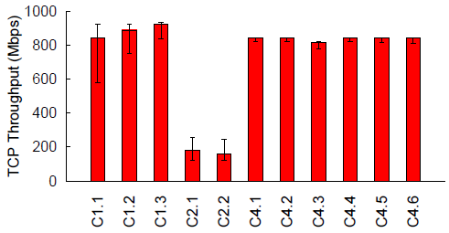
Intra-datacenter network capacity
Intra-datacenter network generally has high bandwidth
Close to local NIC limit (1Gbps)
Suggests that the network infrastructures are not congested

Slide 28
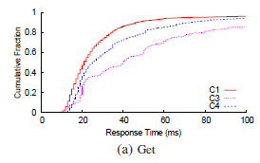
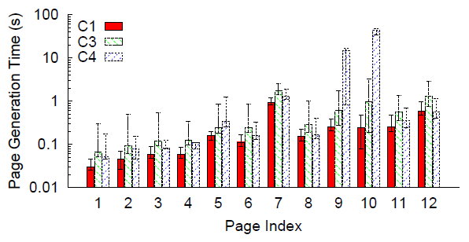
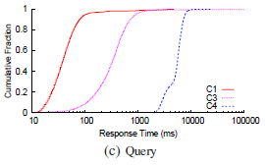
Storage-intensive web service
C1 is likely to offer the best performance

Slide 29

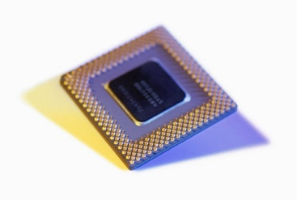
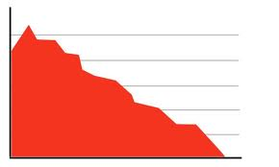
Difficult to pin-point the under-performing services
“Cloud X”

Slide 30
Which one runs faster?
Cannot use standard PC benchmarks!
Sandboxes have many restrictions on execution
AppEngine: no native code, no multi-threading, no long-running programs
Standard Java-based benchmarks
Single-threaded, finish < 30s
Supported by all providers we measure
CPU, memory, disk I/O intensive
Notes:
AppEngine: Programs have a cut-off in how long they can run.

Slide 31

Which one is more cost-effective?
Recall providers have different charging schemes
Charging-independent metric: cost/benchmark
Charge per instance-hour: running time X price
Charge per CPU cycle: CPU cycles (obtained through cloud API) X price

Slide 32
Which one scales faster?
Why does it matter?
Faster scaling -> can catch up with load spikes
Need fewer instances during regular time
Save $$$
Metric: scaling latency
The time it takes to allocate a new instance
Measure both Windows and Linux-based instances
Do not consider AppEngine: scaling is automatic

Slide 33
Recap: comparing compute clusters
Three metrics
Benchmark finishing time
Monetary cost per benchmark
Scaling latency

Slide 34
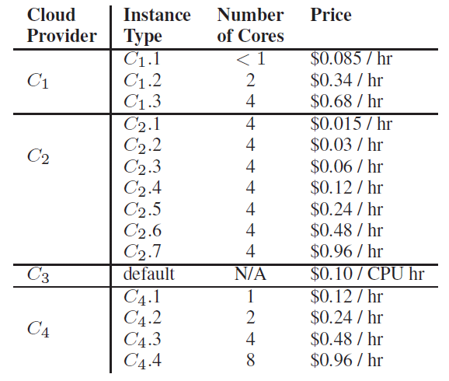
Instance types we measure
$
$$$

Slide 35
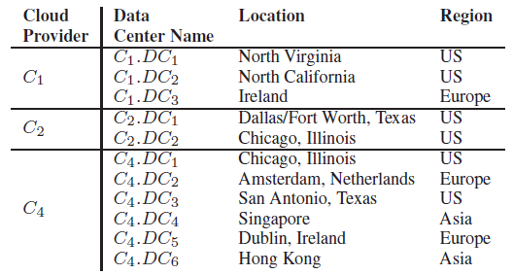
Recap: comparing wide-area networks
Latency from a vantage point to its closest data center
Data centers each cloud offers (except for C3):

Slide 36

Comparing wide-area networks
Metric: network latency from a vantage point
Not all clouds offer geographic load-balancing service
Solution: assume perfect load-balancing
California
Virginia
Texas
Cloud X
Cloud Y
New York
Notes:
Remember to summarize what we have just presented.

Slide 37
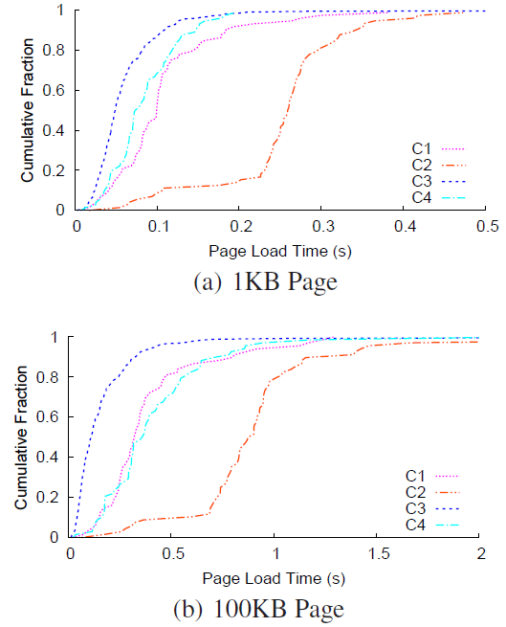
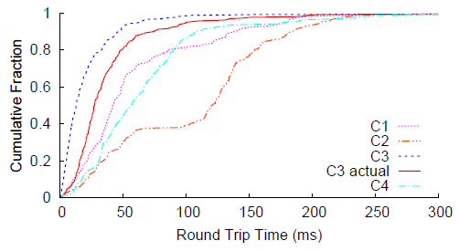
Latency-sensitive application
Website to serve 1KB and 100KB web pages
Wide-area network comparison results

Slide 38
Comparison results summary
Cloud service
Compute cluster | C2 (+C1 for scaling)
Wide-area network | C3
Storage | It depends
Intra-cloud network | C1 and C4
No cloud aces all services!
Notes:
Re-order C3

Slide 39
Key challenges
Clouds are different
Different service models
IaaS or PaaS
Different charging schemes
Instance-hour or CPU-hour
Different implementations
Virtualization, storage systems
Need to control experiment loads
Cannot disrupt other applications
Reduce experiment costs
Notes:
Clients have to be similar across providers.
Reasonable benchmarks
Experiments are costly – thoroughness vs. expense
We don’t do anything with interference?

