Slide 1
Positional
Embeddings
aka positional encodings

Slide 2
Table of Contents
01 | Positional Embeddings
02 | Transformers and need of positional embeddings
03 | Requirements of a good Positional Embedding
04 | Absolute Positional Embeddings
05 | Relative Positional Embeddings
06 | Rotary Positional Embedding
07 | Learned Positional Embedding
08 | References

Slide 3
Introduction
Positional embeddings play a crucial role in the world of Natural Language Processing (NLP), particularly in the context of transformer-based models. These models have revolutionized NLP tasks but lack inherent knowledge of word order, necessitating the incorporation of positional information. In this comprehensive set of notes, we will delve into the fundamental importance of positional embeddings in transformers. We will explore the requirements for effective positional embeddings, including the widely used sine and cosine-based absolute positional encodings, and delve into relative positional encodings, which are vital for understanding the contextual relationships between tokens. Additionally, we will touch upon the innovative concept of rotary positional embeddings that have emerged to further enhance the capabilities of these models.

Slide 4
Positional Embedding
01
Definitions and intuition

Slide 5
Positional Embedding
Positional embedding is used to provide the positional information of the input to the non-recurrent architecture of multi-head attention.
In NLP - represent relative or absolute positions of words in a sentence.
also used in Time series data, DNA sequences, Graphs etc.
Integrating - add the tensor (of same shape as input) that contains the relevant information to the input sequence. (add vs concatanate discussed later)

Slide 6
02
Transformers and need of Positional Embeddings

Slide 7
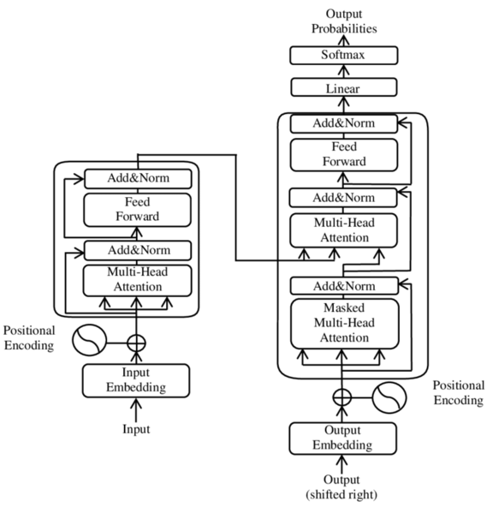
Positional embedding in Transformers
In Recurrent neural networks (RNNs) , input sequential order implicitly defined.
However, In Transformer's Multi-Head Attention layer processes the entire sequence simultaneously, which means it lacks inherent knowledge of the order. It treats each element in the sequence independently, which can result in the loss of context related to their order.
This issue also applies to convolutional layers, which have a limited local context for sequential ordering determined by their kernel size, making them less suitable for tasks that require capturing long-range dependencies in the data.

Slide 8
Requirements of a good Positional Embedding
03

Slide 9
Challenges and requirements of Positional Embeddings
Varying sequence length is challenge encountered here.
Trials: Absolute index (size could go very high) , normalized index (meaning changes with varying length) etc.
Need:
Input length independent
Input content independent
Unique embedding
The positional informations should not be prioritized over the semantics, that could defeat the purpose.
Need:
small values (relative to input)

Slide 10
Absolute Positional Embeddings
04

Slide 11

Absolute positional embedding
Absolute positional encoding assigns a unique label to each position in a sequence based on its distance from the beginning of that sequence, creating a global coordinate system relative to the sequence's start.
Trials:
Absolute index (large values for longer sequences)
normalized index (length dependent embedding)
Authors of [Vaswani et al., 2017] however proposed a different absolute positional encoding based on the sine and cosine functions:
pos = position in time/sequence
d_{model} = dimension index

Slide 12
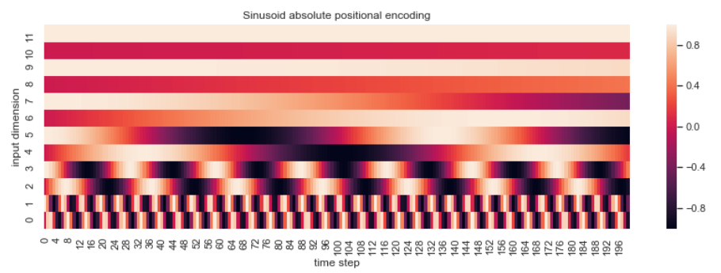
Sinusoid absolute positional embedding
Credits: https://www.inovex.de/de/blog/positional-encoding-everything-you-need-to-know/

Slide 13
Challenge
learning difference for different positions:
Even if the dataset had an equal distribution of sequence lengths, the model would still favor the initial positions, because shorter sequences appear more frequently during training.
Potentially leads to suboptimal performance for longer sequences during testing or real-world use.
Add vs concatenate embedding:
Adding : need balance between input info and positional info)
Concatenating (need more computational expense -extra dimensions)
Following the initial research, a subsequent study by [Shaw et al. , 2018] addressed the challenge of adapting to various input sequence lengths. In this study, they introduced relative positional encoding as a solution to this issue.

Slide 14
Relative Positional Embeddings
05

Slide 15
Relative Positional Embeddings
Relative Positional Embeddings are based on the relative distance between the elements in sequence (or graph etc), rather than their absolute order.
Rather than a single positional embedding for an element in sequence, here they can have as many embeddings as the total number of elements in the sequence, each characterizing the relative positional relationship. (including itself)
Here, (as in [Shaw et al. , 2018] ), the relation to itself is taken as w₀ and w₊₁, w₊₂ to the right and w₋₁ , w₋₂ to the left.
These embeddings, ( ……w₋₁ , w₋₂ , w₀ , w₋₁ , w₋₂ ,..... ) doesnt change its value regardless of the element it is representing. This takes care of the sequence length as well as the requirement for the good positional embedding.

Slide 16
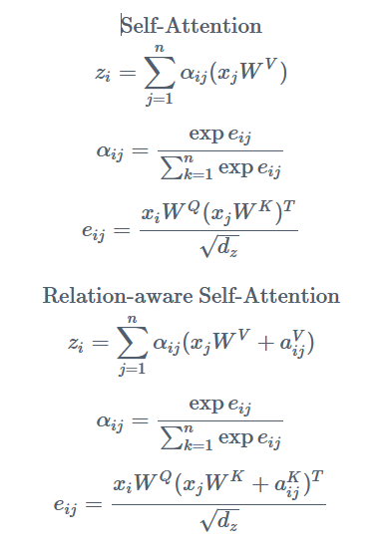
Additionally, they have also done clipping, in which after certain distance, the positional embedding remain the same, reducing the total number of embeddings required.
For Integrating this, we modify the self attention: [ a_{(i,j)} = a_{(pos, related pos)} ]

Slide 17
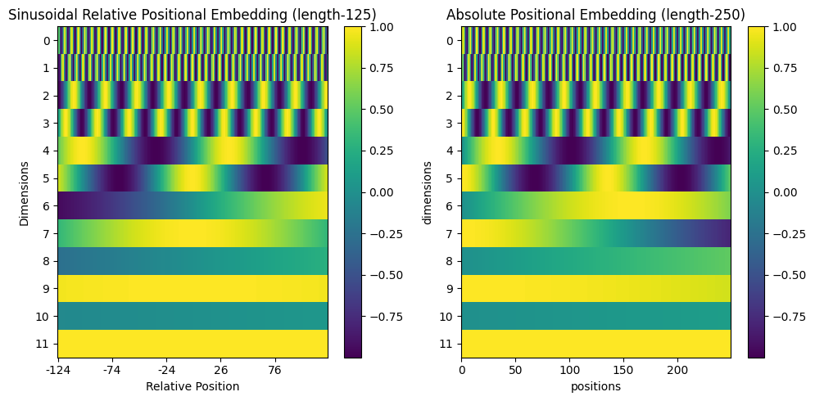
Comparison: Absolute vs relative (both sinusoidal)

Slide 18
Features of the sinusoidal relative embedding
Uniqueness:
Since its not symmetric through origin, the relative positions to left and right can be differentiated.
Input length independence:
SInce the relative positions are always from the origin, the embeddings arent dependent on input length.

Slide 19
Rotary Positional Embeddings
05

Slide 20
Rotary Positional Embeddings (RoPE)
Relative positional embeddings are slower due to the additional step in the self attention layer. RoPE is a combination of relative and absolute positional embedding ideas. [Su, Jianlin et al. 2021]. The embeddings are applied with rotation depending upon their distance from the beginning.
For representation, consider an element in sequence represent in 2 dimension, the rotary embedding rotates the element embedding by (m*theta)
m = position
Theta = fixed small angle
The relative position is conserved here, as the relative rotations angles corresponds to the relative distances of the words. Adding words before or after doesn't affect it.
E.g. He is Adhil. (relative angle: 2*theta)
They know that he is adhil. (relative angle: 2*theta)

Slide 21
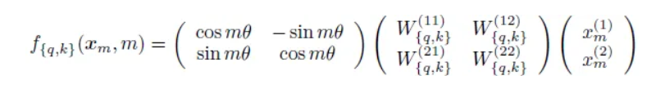
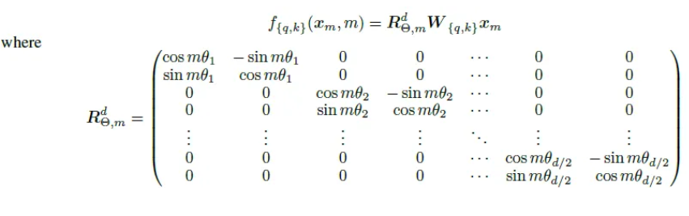
The example case equation.
In general dimensions:

Slide 22
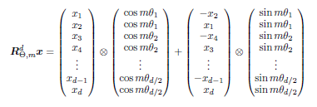
Computer efficient general form of Rotational matrix:
:

Slide 23
Learned Positional Embeddings
07

Slide 24
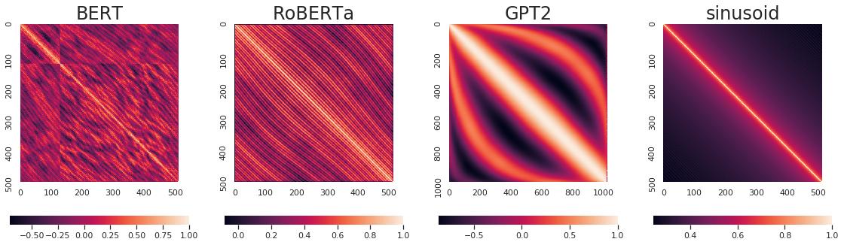
Learned Positional Embedding
Instead of crafting the positional embedding manually, we can treat those as any other parameter and learn using SGD and backpropagation.
This has been implemented in BERT, RoBERTa, GPT2 etc. [Wang et. al. 2020]
Cosine similarity of positional embeddings at different positons

Slide 25
References
08

Slide 26
References
Ashish Vaswani, Noam Shazeer, Niki Parmar, Jakob Uszkoreit, Llion Jones, Aidan N. Gomez, Łukasz Kaiser, and Illia Polosukhin. 2017. Attention is all you need. In Proceedings of the 31st International Conference on Neural Information Processing Systems (NIPS'17). Curran Associates Inc., Red Hook, NY, USA, 6000–6010.
Peter Shaw, Jakob Uszkoreit, and Ashish Vaswani. 2018. Self-Attention with Relative Position Representations. In Proceedings of the 2018 Conference of the North American Chapter of the Association for Computational Linguistics: Human Language Technologies, Volume 2 (Short Papers), pages 464–468, New Orleans, Louisiana. Association for Computational Linguistics.
Yu-An Wang and Yun-Nung Chen. 2020. What Do Position Embeddings Learn? An Empirical Study of Pre-Trained Language Model Positional Encoding. In Proceedings of the 2020 Conference on Empirical Methods in Natural Language Processing (EMNLP), pages 6840–6849, Online. Association for Computational Linguistics.
Su, Jianlin, Yu Lu, Shengfeng Pan, Bo Wen and Yunfeng Liu. 2021. RoFormer: Enhanced Transformer with Rotary Position Embedding. ArXiv abs/2104.09864

