Slide 1
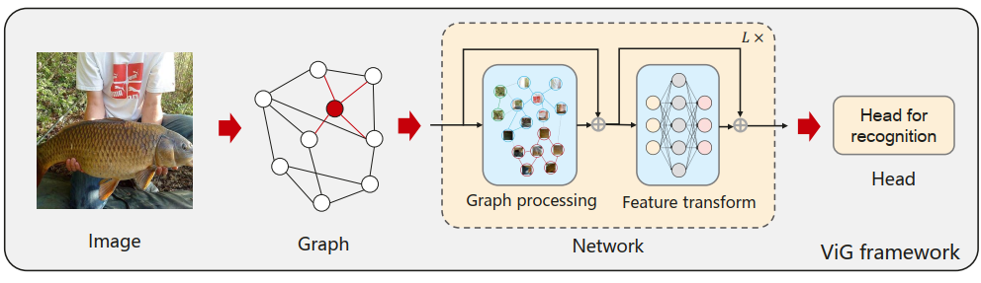
Vision GNN-Powered Object Detection
Sagar Prakash Barad
Harnessing Vision GNNs as Backbone Feature Extractors for RetinaNet and Mask R-CNNs
RetinaNet
ResNet + FPN + Focal Loss
Vision GNN
Dataset(s) – COCO Dataset, PubTables 1M Dataset, FinTab Dataset
Wang, X., Liu, Z., Zhang, S., Li, B., Wang, T., & Zhang, J. (2022). Vision GNN: An Image is Worth Graph of Nodes. Advances in Neural Information Processing Systems, 35. Retrieved from https://arxiv.org/abs/2206.00272

Slide 2
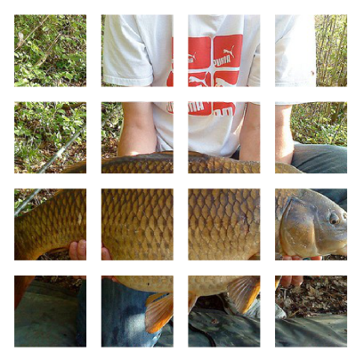

Vision GNN Works by…
CNN
Feature Extractor
1
2
3
4
N-1
N

Slide 3
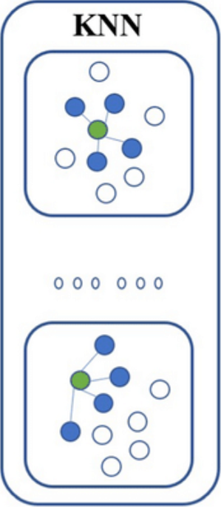
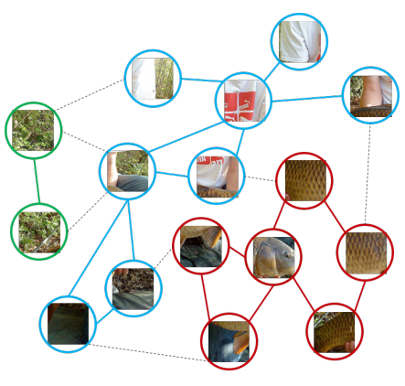
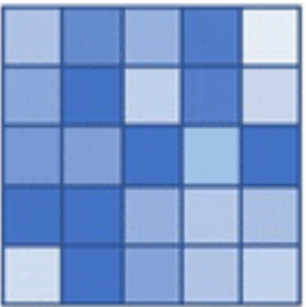
Graph Represnation
Directed Graph
Benefits
Generalized Data Structure
Flexibility for Complex Objects
Part-Object Relationships

Slide 4
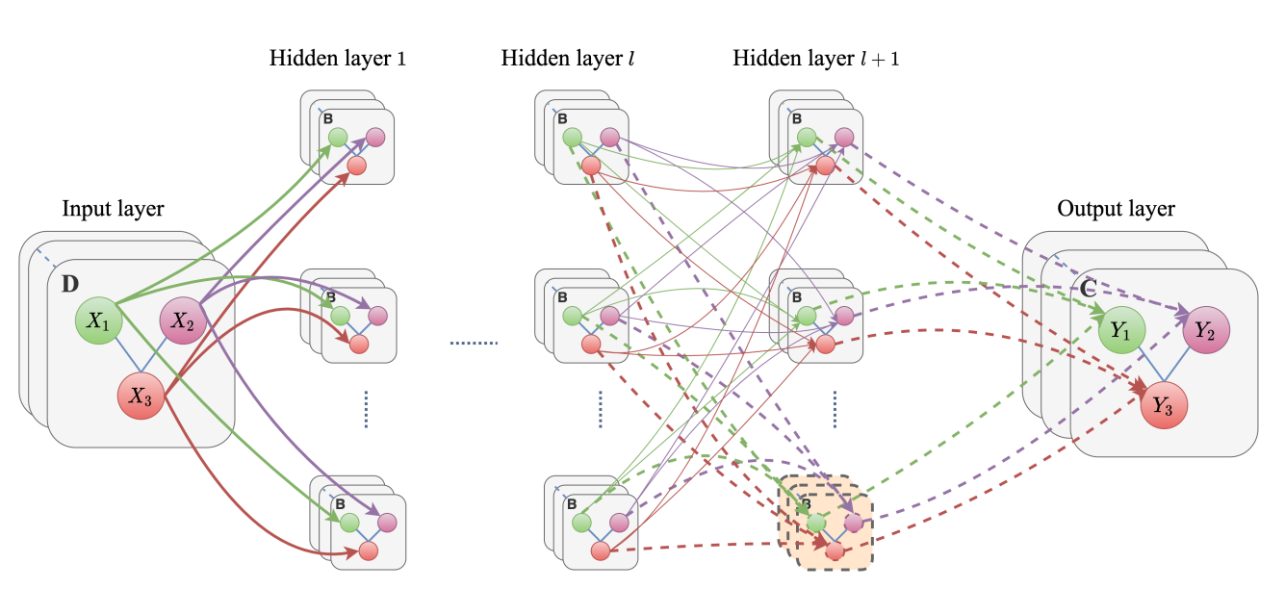
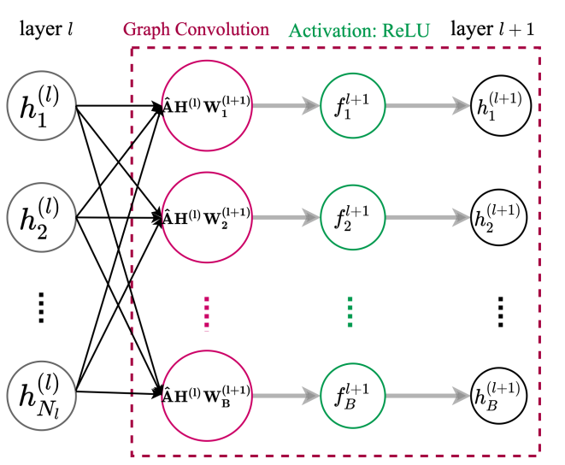
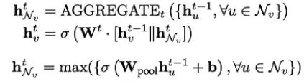
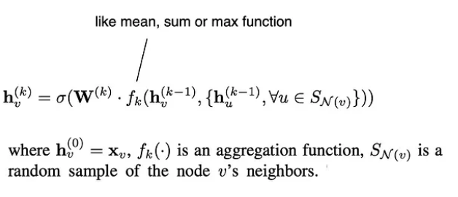
Graph Convolution
Heidari, N. (2020, March 27). Progressive Graph Convolutional networks for Semi-Supervised Node Classification. arXiv.org. https://arxiv.org/abs/2003.12277

Slide 5
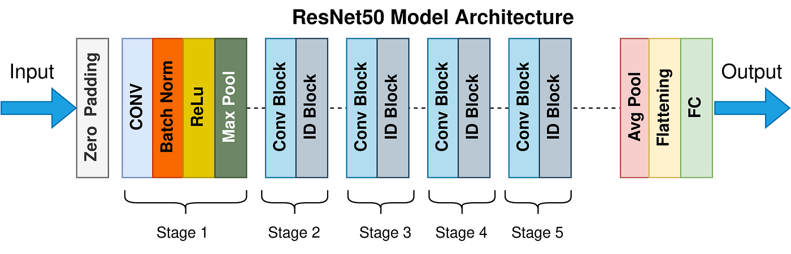
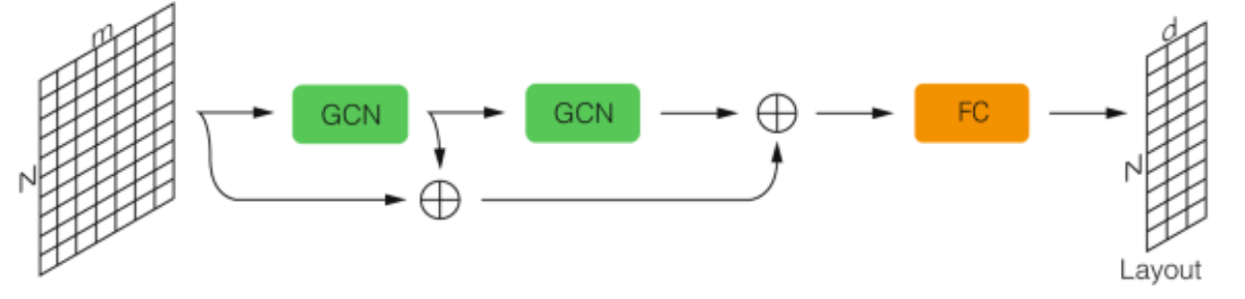
Comparision with CNNS
Sapireddy, S. R. (2023, July 1). ReSNEt-50: Introduction - Srinivas Rahul Sapireddy - Medium. Medium. https://srsapireddy.medium.com/resnet-50-introduction-b5435fdba66f
Both, C., Dehmamy, N., Yu, R. et al. Accelerating network layouts using graph neural networks. Nat Commun 14, 1560 (2023). https://doi.org/10.1038/s41467-023-37189-2

Slide 6
ViG Models
ViG-Ti
Flops(B): 1.3
Params(M): 7.1
ViG-S
Flops(B): 4.5
Params(M): 22.7
ViG-B
Flops(B): 17.7
Params(M): 86.8
ResNet -18
Flops(B): 1.82
Params(M): 11.7
ResNet -50
Flops(B): 3.86
Params(M): 25.6
ResNet -101
Flops(B): 7.1
Params(M): 44.6
Model | Depth | Dimension D
ViG-Ti | 12 | 192
ViG-S | 16 | 320
ViG-B | 16 | 640

Slide 7
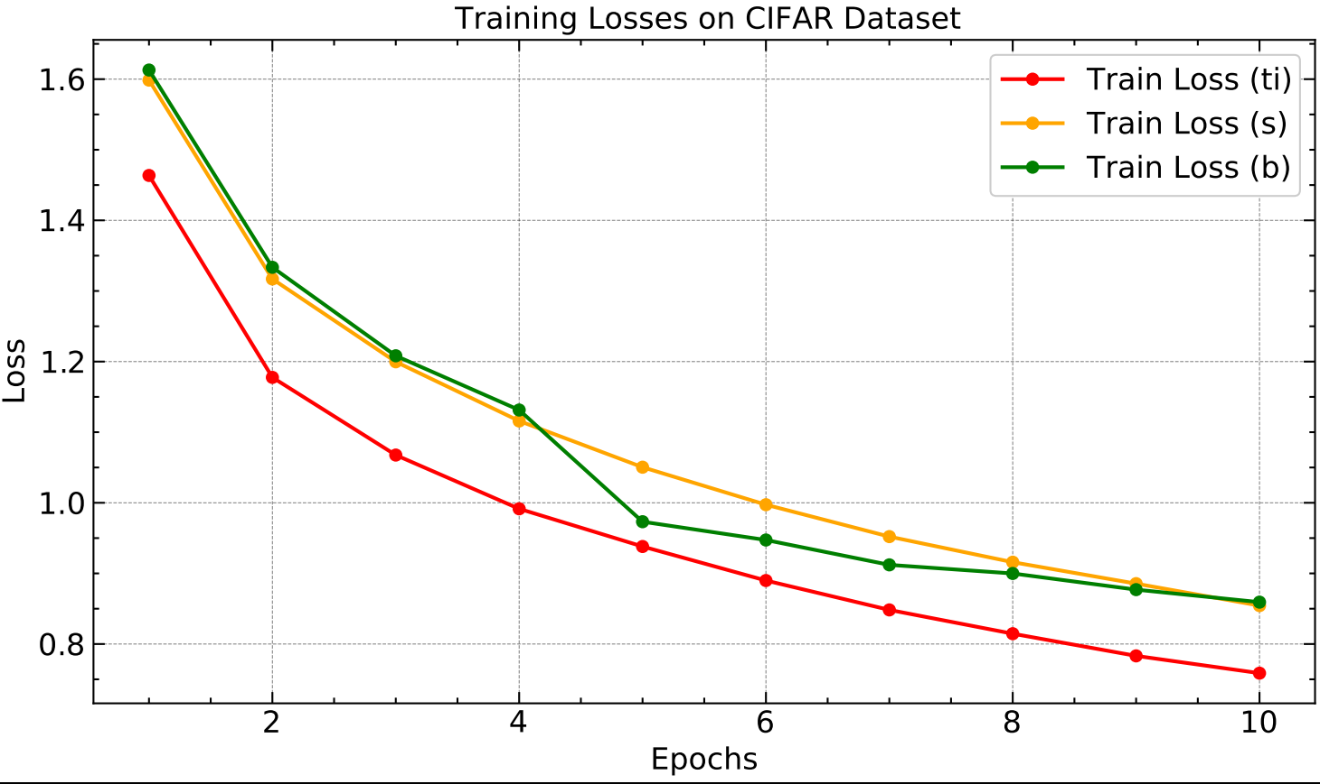
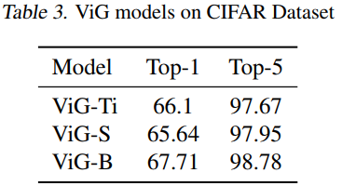
Results on CIFAR

Slide 8
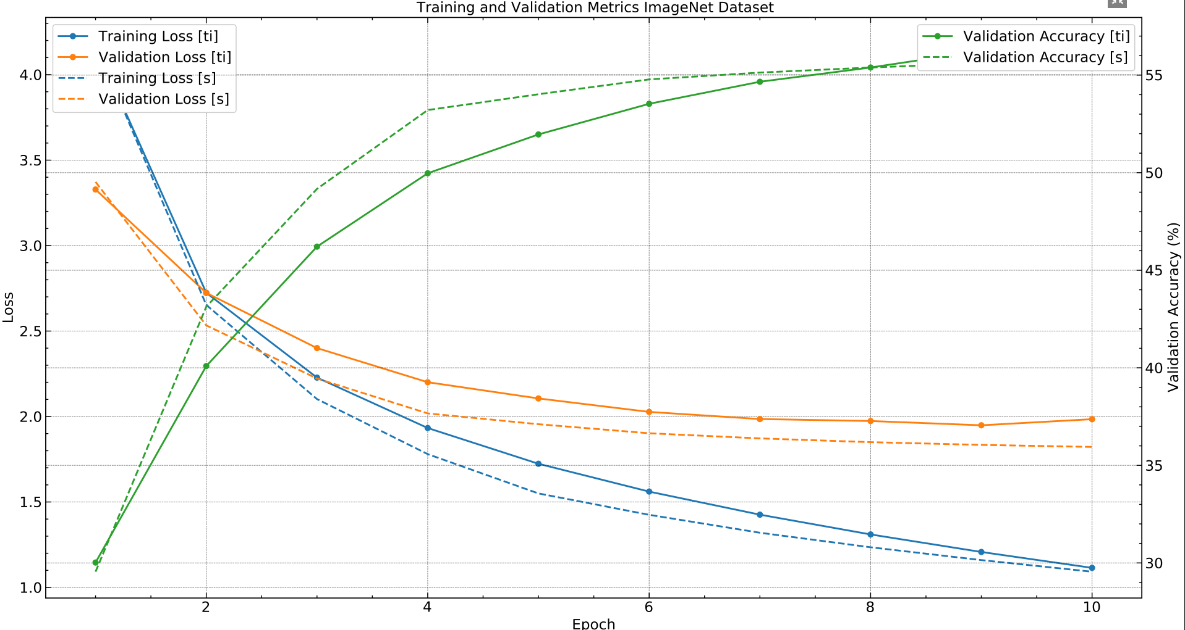
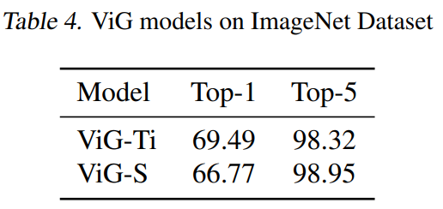
Results on ImageNet 1k

Slide 9
Conclsuion
ViG models (ViG-Ti, ViG-S, ViG-B) show promise in our training, with potential for comparable or superior performance to ResNet variants (ResNet-18, ResNet-50, ResNet-101) as we increase training epochs.
2. ViG models match ResNet models in size (FLOPs and parameters) but outperform them in image classification.
3. Future plans include training on coco, FinTab and Pubtables dataset. Also, implementing LT GNN for better transfer learning.

