Slide 1
Neural networks through matrix operations
Affine maps, backpropagation, PCA and SVD
UE25MA242A | Mathematical Foundation for AI & Data Science
Notes:
Introduce the research question: how do nonlinear activations extend affine classifiers, and how can matrix decompositions describe the learned maps? Everything is implemented in NumPy with explicit gradients. The project also relies on calculus, probability and optimization. The two spirals on the right are the dataset we classify.

Slide 2
What are we doing?
The puzzle
1
Sort red dots from blue dots when they wind around each other
The catch
2
A single straight line cannot split them cleanly
The trick
3
Two spirals, two colors
Stack simple steps with one twist (ReLU), so it learns a winding boundary by trial and error
Finally, we use PCA and SVD to look inside and see what it learned
Notes:
Plain-language version: imagine two spiral arms made of red and blue dots, wound around each other. We want a computer to tell red from blue just by looking at where a dot sits. A single straight line cannot split them cleanly. So we let the computer draw a bent, winding line instead. It does this by stacking simple matrix steps with one small twist, called ReLU, and learning from its mistakes thousands of times. At the end we use PCA and SVD to look inside and see what it learned.

Slide 3
Why this project?
A typical project
This project
One tool at a time
For example, PCA on faces or SVD image compression
Run once and read the answer
Three course topics working together
A neural network built from scratch in pure NumPy, no PyTorch or TensorFlow
Watch it learn, then look inside with PCA and SVD
The question: why can't a straight line separate two spirals? Adding ReLU, a simple switch that bends the line, lifts test accuracy from about 59% to 90%.
Notes:
Most projects in this course use one tool at a time, like PCA for faces or SVD for image compression. We wanted to see how they work together inside a real learning system. So we built a neural network from scratch, using only NumPy. It starts with a simple question: why can't a straight line separate two intertwined spirals? Adding one small ingredient, ReLU, lets stacked matrix transformations bend the boundary, and test accuracy jumps from about 59% to 90%. Then we use PCA and SVD to look inside the network and see what it learned. If time allows, the repository includes a live demo that trains the network in the terminal.

Slide 4
Built on three course projects
Matrix transformations
PCA
SVD compression
Each layer is an affine map: multiply, then shift
Principal directions of centered data
Rank-k approximation of a matrix
In our work: Each layer is a weight matrix
In our work: PCA of hidden activations
In our work: Rank truncation of W2 (16 x 16)
An inspired extension of the supplied problem sheet, not a literal listed problem
Notes:
The supplied sheet lists 14 projects and none is a neural-network problem. Present this as an inspired extension of Projects 10, 11 and 14 (Zemlyanova adapted manual), and have instructor confirmation of extensions ready if asked. Course code UE25MA242A.

Slide 5
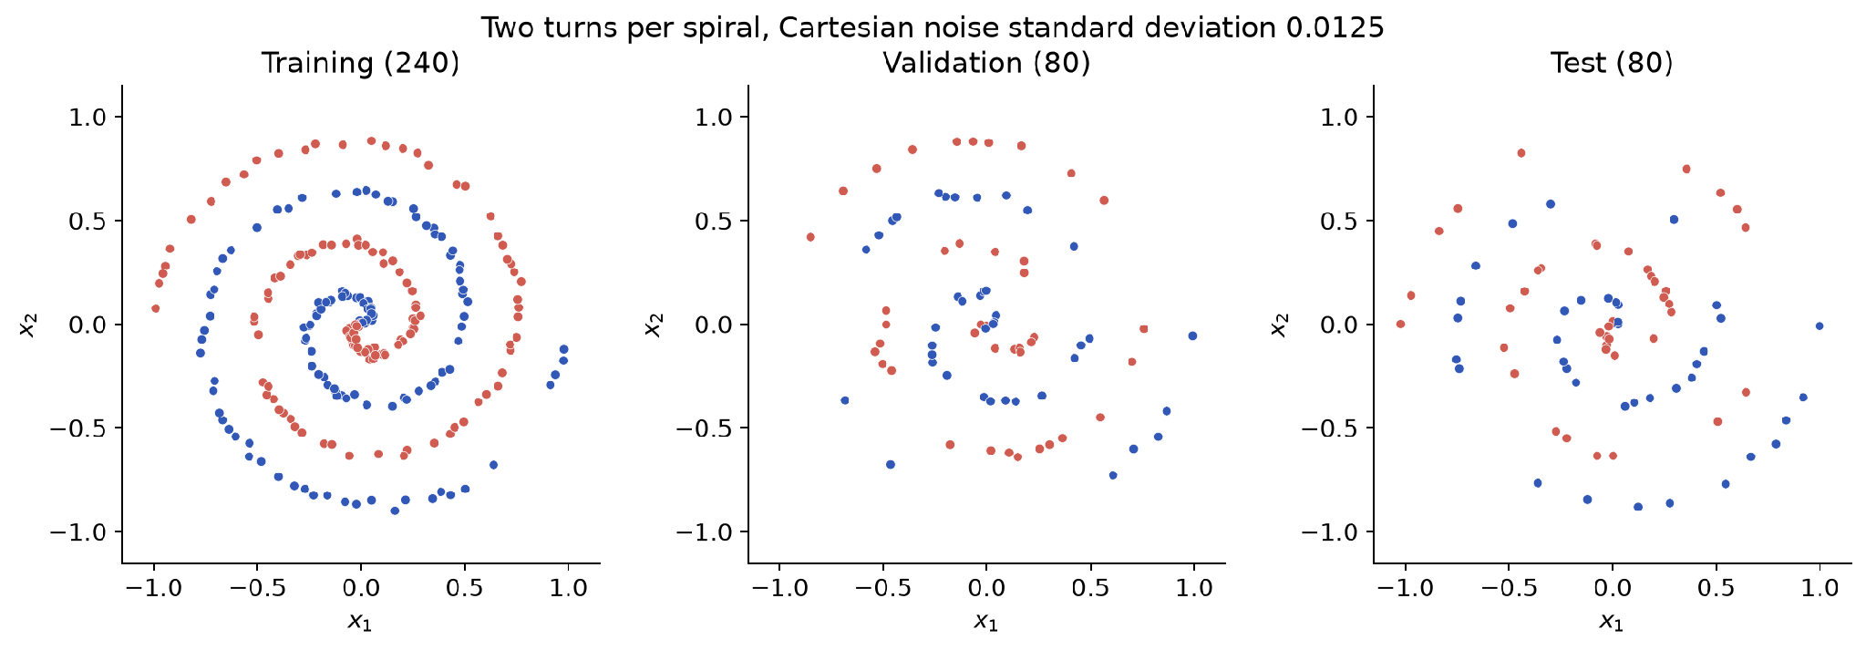
Two spirals, three disjoint splits
400 points, two turns per arm
Noise standard deviation 0.0125
240 / 80 / 80 train / val / test
Notes:
Data seed 42, split seed 2026. Every sample is a column of X. Test data never take part in training or checkpoint selection. Coordinates are already roughly inside the unit disk, so we do not normalize. Test points assess generalization within this synthetic generator only.

Slide 6
A line cannot separate every point
1
A straight-line rule (an affine map) draws a straight boundary
2
Two same-class segments cross each other across classes
Shared point
3
Our code computes this crossing point exactly, and it lies in both convex hulls
4
One point cannot take opposite signs, so perfect separation is mathematically impossible
Impossible perfect separation does not mean a 50% accuracy ceiling
Notes:
Use the saved convex hull witness in metrics.json. An affine score preserves convex combinations, so the shared intersection point could not receive opposite signs. This proves perfect strict classification is impossible on these points. It does not cap affine accuracy at 50%: the measured linear test score is above 50%.

Slide 7
A 2-16-16-2 network with 354 parameters
Input
2
W1: 16 x 2
Hidden 1
16, ReLU
W2: 16 x 16
Hidden 2
16, ReLU
W3: 2 x 16
Output
2, softmax
Weights are adjustable dials, biases are shifts, and ReLU is a switch that bends the line.
Map | Weights | Biases | Parameters
Input to hidden 1 | 16 x 2 | 16 x 1 | 48
Hidden 1 to hidden 2 | 16 x 16 | 16 x 1 | 272
Hidden 2 to output | 2 x 16 | 2 x 1 | 34
Total | 320 entries | 34 entries | 354
Notes:
Three trainable affine maps, two ReLU hidden layers, softmax output. Parameters: 48 + 272 + 34 = 354, made of 320 weights and 34 biases. Hidden weights use He variance scaling and output weights use 1/fan_in scaling. Initialization is a heuristic, not a guarantee of spectral stability.

Slide 8
How data flows through the network
Multiply
Add
Bend (ReLU)
Decide
Weights are dials: how much each input counts
A bias is a shift added to the result
A switch: keeps positives, zeroes negatives
Softmax turns scores into percentages
Why ReLU matters
Without it, all the layers collapse into one straight line. With it, the line can bend and wind.
Notes:
Each layer does the same four things: multiply by weights, add a bias, apply ReLU, and pass the result on. In formulas: Z = W A + b, A = max(0, Z), and finally P = softmax(Z3). Training uses 240 samples at once, one per column, so the whole batch is one matrix product. Without hidden nonlinearities, the three affine maps collapse into one effective W and b, which is still a straight-line classifier. ReLU breaks that collapse and gives piecewise affine logits.

Slide 9
How the network learns
Measure the error
Send it backwards
1
2
Compare the prediction with the true class
Each layer learns how much it contributed
Work out the nudge
Update and repeat
3
4
Every weight gets a small correction
12,000 rounds of small steps
Every step is plain matrix multiplication; transposes carry the error backwards
Notes:
This is backpropagation. In formulas: D3 = P - Y at the output; D_l = (W_(l+1)^T D_(l+1)) * 1[Z_l > 0] for hidden layers; grad(W_l) = D_l A_(l-1)^T / m and grad(b_l) = D_l 1 / m. D is the unaveraged logit error, so divide by m exactly once. The transpose comes from the chain rule and is the Euclidean adjoint, not an inverse. Each sample contributes a rank-one outer product. ReLU's derivative at zero is chosen as zero. Source: Goodfellow et al., Deep Learning, Chapter 6.

Slide 10
Double-checking our math
35
~0
7
weights tested one by one
largest difference found (9.89e-11)
separate math checks passed
We tested our math a second, independent way, and the answers match.
Notes:
We compared our calculated gradients with centered finite differences: (L(theta + h*e_i) - L(theta - h*e_i)) / (2h). They agree away from ReLU kinks, handled explicitly; 0 kink crossings were skipped. Largest absolute error 9.89e-11. Other tests cover an identity-activation model, extreme-logit loss, stratified splitting, affine collapse with biases and spectral identities. Source: Stanford CS231n, gradient checking.

Slide 11
The error falls as the network practices
12,000
rounds of practice
Blue vs red
practice data vs separate check data
11,950
round we kept: lowest error on check data
Notes:
Plain-language framing: the error is cross-entropy loss; blue is the training data the network practises on, red is validation data used only to pick the best round. Metrics at epoch k describe exactly k completed updates, with 12,000 full-batch updates at learning rate 0.1 and a checkpoint every 50. The selected checkpoint minimizes validation loss, and can precede the final epoch. The full trajectory can contain loss increases at this learning rate, for example near epoch 11,650. The test set is absent from the optimization curves.

Slide 12
Deep network: 90% test accuracy
Model | Params | Train | Val | Test | Epoch
Linear | 6 | 50.00% | 45.00% | 58.75% | 4500
Shallow | 82 | 57.50% | 51.25% | 58.75% | 50
Deep | 354 | 97.08% | 93.75% | 90.00% | 11950
72/80
test predictions correct
Plausible range: about 81% to 95%
The goal is to show that ReLU breaks the straight-line limit, not to chase a leaderboard score. Same split and budget for every model; not a capacity-matched comparison.
Notes:
All rows use initialization seed 42, the same split and the same update budget. Train, validation and test accuracies are separate. Differences reflect architecture and parameter count together, so this is not a capacity-matched comparison. Framing: this is a linear algebra course project, not a Kaggle contest; the thesis is that ReLU breaks the affine collapse, and 90% demonstrates it. The Wilson 95% interval is approximate because the grid is structured.

Slide 13
Deep results depend on the seed
Linear mean
SD 1.91 pp
59.17%
Shallow mean
SD 3.15 pp
58.33%
Deep mean
SD 7.32 pp
87.08%
All three seeds shown, not just the best: 78.75% to 92.5%
Notes:
Mean and sample standard deviation describe sensitivity to random initialization on one fixed split. All three runs are reported; the main run is declared as seed 42, not the best test score. Sampling uncertainty, new splits and distribution shift are outside this study.

Slide 14
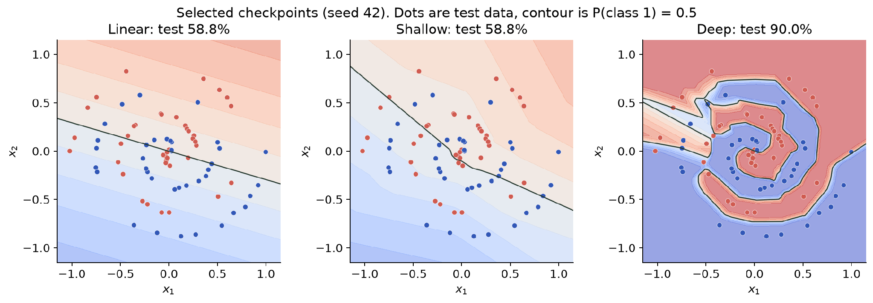
The learned decision boundaries
Dots are test points; the black line is where the network is 50/50. Linear and shallow stay near 59%.
Notes:
The ReLU model has piecewise affine logits, so its binary equal-logit boundary is piecewise linear. The comparison shows a learned winding boundary, not proof that every deep network succeeds or that every shallow network fails. The color surface is not evidence of probability calibration.

Slide 15
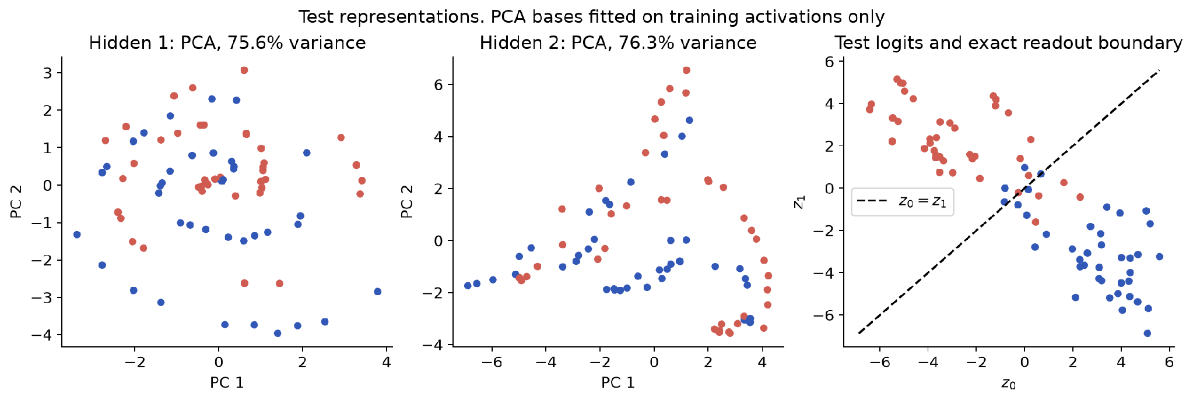
Looking inside with PCA
PCA squeezes 16 numbers per point into a 2D picture, so some detail is lost.
Notes:
We center the training activation matrix, take its thin SVD, and use the first two left singular vectors as the PCA basis. Test activations use the same training mean and basis. Retained-variance ratios concern activation matrices, not weight matrices. The first two components keep 75.6% (hidden layer 1) and 76.3% (hidden layer 2) of variance, and a projection can hide useful directions. The output boundary is the diagonal z0 = z1.

Slide 16
What the weights do: stretch and squeeze
1.2
198
16 to 2
Layer 1
Layer 2
Layer 3
stretches evenly
stretches very unevenly
squeezes 16 numbers into 2 scores
SVD measures how much a weight matrix stretches its input. The big number is the stretch ratio: biggest stretch divided by smallest.
Notes:
Singular values measure how much a weight matrix stretches its input in each direction. Stretch ratio s_max/s_min: W1 (16 x 2) 1.190, W2 (16 x 16) 197.537, W3 (2 x 16) 13.287. Ranks 2, 16 and 2; input nullity 0, 0 and 14. A full-row-rank 2 x 16 output map still has input nullity 14, so its ratio concerns the nonzero directions only. SVD factors are not unique. Full weight rank does not prove every neuron is active, and a large ratio does not by itself describe training behavior. Source: NumPy documentation for numpy.linalg.svd.

Slide 17
Shrinking a layer: half is enough
The idea
Keep only a layer's most important parts and see if it still works.
The result
Half the parts (8 of 16) still reach 90%. Too few (2) drops to 65%.
Notes:
Fixed-rank truncations of the 16 x 16 matrix W2, with no retraining and no ranks chosen from test accuracy. Energy retained at ranks 2, 4, 8, 12, 16: 64.47%, 83.11%, 95.61%, 99.72%, 100%. Dense W2 has 256 entries; a rank-k factorization would store 32k entries, excluding biases, so rank 8 saves no storage and rank 4 halves it, at 77.5% test. Our measurements materialize the approximation rather than saving compressed factors. The Frobenius error equals the square root of the discarded squared singular values. Extends Project 14.

Slide 18
Conclusions and limits
1
A ReLU network learns the winding spiral boundary: 90% test versus about 59% for the baselines
Limits
One split, three seeds
Small synthetic data, no hyperparameter search
Shallow failure here does not mean shallow networks must fail
2
Our hand-built matrix gradients pass an independent check
3
PCA describes activations and SVD describes weights: different objects
github.com/Annadata-Aniketh/Neural-Net-Maths
Notes:
Make a precise claim: this configuration learns a nonlinear boundary, and independent numerical checks support the gradient implementation. Do not claim linear algebra alone creates AI, that depth is mandatory, or that weight spectra prove data-manifold recovery. A sufficiently wide shallow network can be expressive; its failure here depends on width, learning rate and budget. Further detail: docs/REPORT.md and docs/VIVA_GUIDE.md in the repository.

