Slide 1
Credit card default
General Assembly DATR-318 Remote
Anna Huang

Slide 2
Problem and impact
Do you want to identify profitable customers to grow your business?
Do you want to target potential fraudsters?
Do you want to know how well the economy is doing?
Goal
Predict if an individual is defaulting on his/her credit card payment
Impact
Financial Institutions maximize revenue or minimize loss by implementing credit strategies
Impact
Indication of a potential upcoming recession
Notes:
In order for financial institutions to better maximize their revenue or minimize loss, we need to find out earlier if people are defaulting on their credit card payments.
If more people are defaulting on their credit card payments, it could potentially be a good indication of an upcoming recession. For financial institutions, predicting defaults could help with building credit strategies to determine whether to provide a credit line increase or decrease.

Slide 3
Metrics and assumptions
Assumption: If a customer is paying consistently, he/she have a lower probability of default
Did you know?
Demographics Data
Marriage, Education, Age, Gender
Payment Data
Credit Line, Bill Amount, Payment Amount, Payment Status
Predicted:
No Default
Predicted:
Yes Default
Actual:
No Default
True
Negative
False
Positive
Actual:
Yes Default
False
Negative
True
Positive
Notes:
Change it to Assumptions + Data?
22500 rows and with 14 features (~ features = payment data)
ECOA = Equal Credit Opportunity Act – can not discriminate against sex, martial status, age but did not say education
ALLL

Slide 4
Approach and process
1.
Bill Payment Data (month)
-
Payment Amount (month)
=
Total Debt
1I.
Credit Line
=
Total Available Credit
III.
Bill Payment Data (month)
-
Payment Amount (month)
=
Credit Utilization Rate
Credit Line
Notes:
I thought about not putting the demographics data into my model but I don’t think I will have enough variables.
- Bill Payment and Payment Amount by itself do not do anything.
How much you owe this month
Credit Utilization Rate
Umm… this one I made up… tackling the payment status on top of it lolol… pretty sure it doesn’t exist LOL

Slide 5
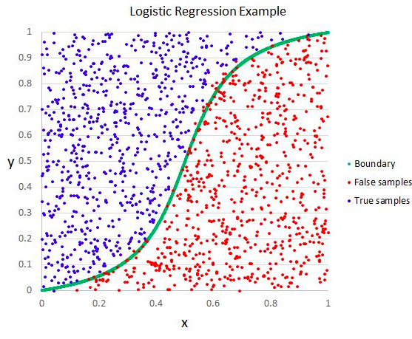
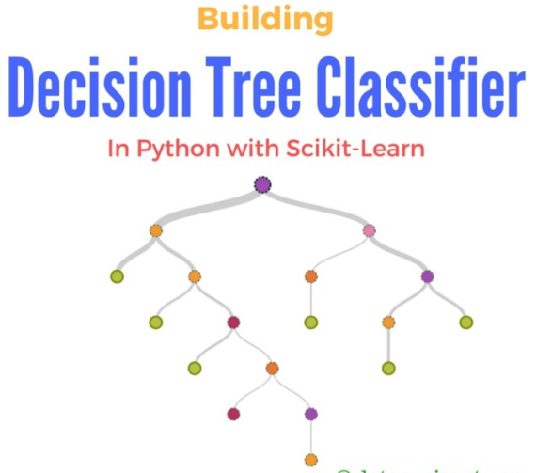
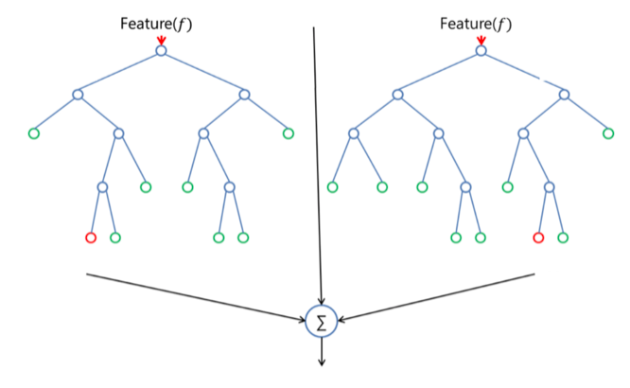
Model and solution
1. Logistic Regression
II. Decision Tree Classifier
III. Random Forest

Slide 6
PERFORMANCE EVALUTION
1. Logistic Regression
II. Decision Tree Classifier
III. Random Forest
Predicted:
No Default
Predicted:
Yes Default
Predicted:
No Default
Predicted:
Yes Default
Predicted:
No Default
Predicted:
Yes Default
Actual:
No Default
176
4168
Actual:
No Default
2602
1742
Actual:
No Default
1721
2600
Actual:
Yes Default
21
1260
Actual:
Yes Default
340
941
Actual:
Yes Default
171
1133
Accuracy Score: 0.2552
Precision Score: 0.2321
Recall Score: 0.9836
F2 Score: 0.5970
Accuracy Score: 0.6298
Precision Score: 0.3507
Recall Score: 0.7345
F2 Score: 0.6027
Accuracy Score: 0.5073
Precision Score: 0.3035
Recall Score: 0.8688
F2 Score: 0.6330

Slide 7
recommendations

Slide 8
Questions?

