Slide 1

FINAL PROJECT
IT-330 Database Management Systems
Ana Kuridze, Euklid Pllumbaj,
Hannah-Tavier Chevannes, Jovy Theodore, Jhadaine Shepherd

Slide 2

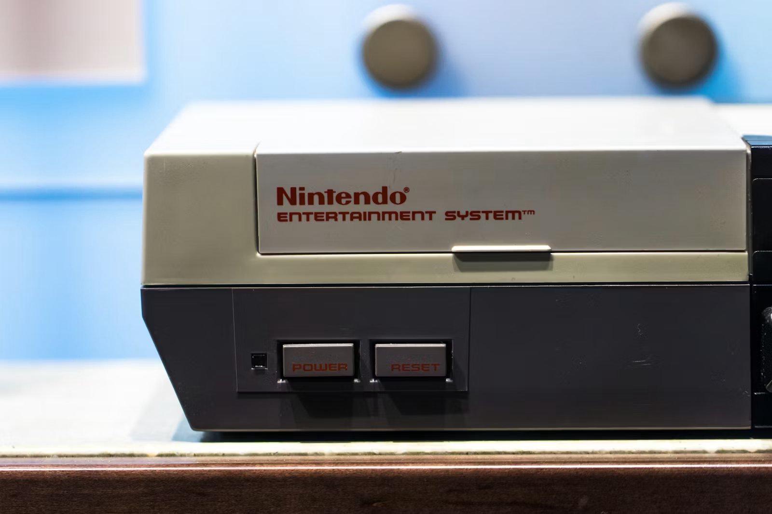
COMPANY OVERVIEW - NINTENDO
Nintendo is a global leader in the video game industry based in Kyoto, Japan.
They design and manufacture popular gaming hardware like Nintendo Switch.
Thet created world-famous characters such as Mario, Link and Pikachu.
The company focuses on delivering unique and innovative enternainment experiences for all ages

Slide 3
DATA SOURCE & SCREEN ANALYSIS
  Scope: Identified 5 core entities (Product, Customer, Order, Shipping, Retailer)across 10 functional screens.

Slide 4
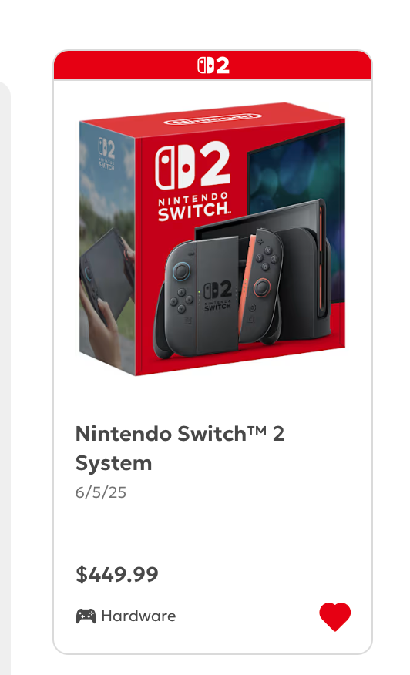

DATA SOURCE & SCREEN ANALYSIS
  Scope: Identified 5 core entities (Product, Customer, Order, Shipping, Retailer)across 10 functional screens.

Slide 5
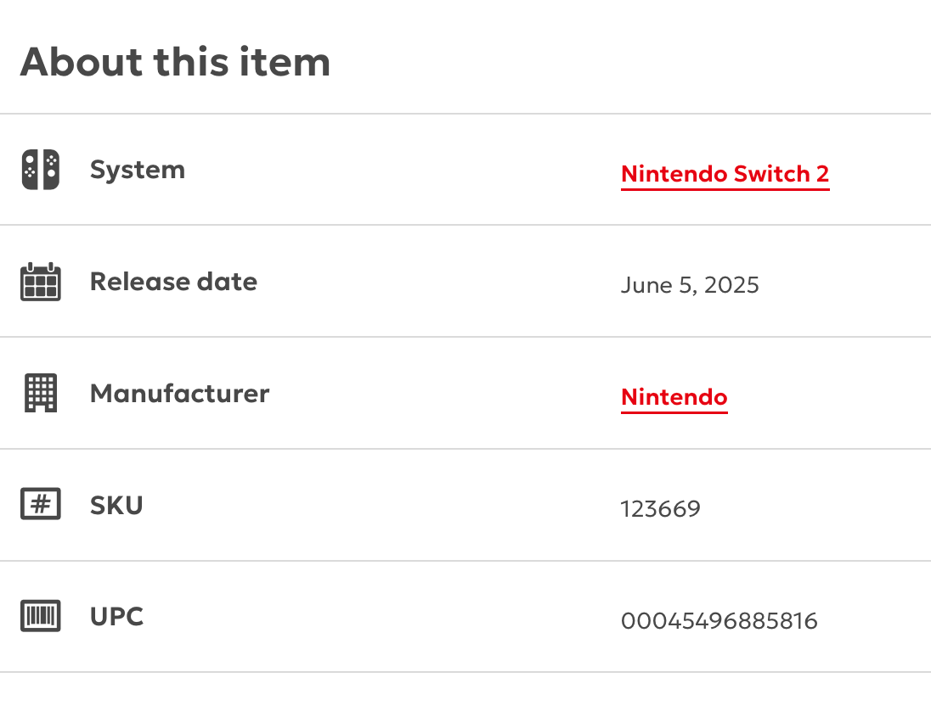
DATA SOURCE & SCREEN ANALYSIS
  Scope: Identified 5 core entities (Product, Customer, Order, Shipping, Retailer)across 10 functional screens.

Slide 6
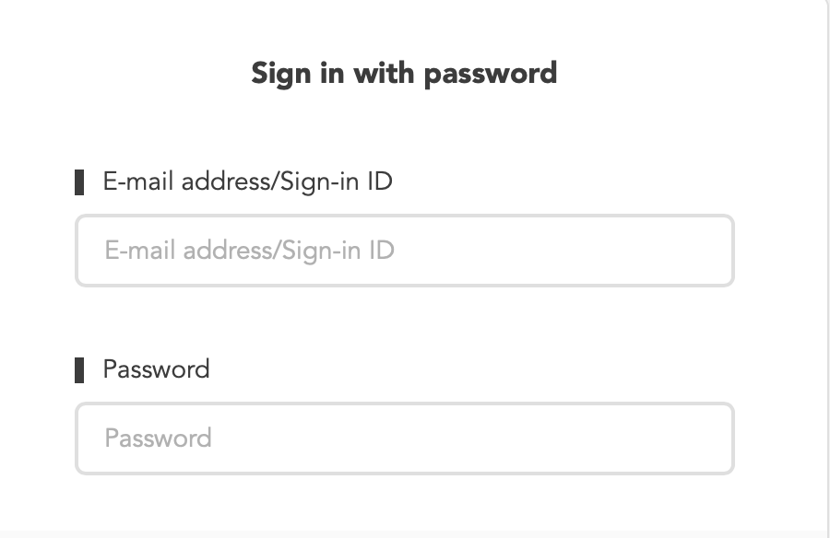
DATA SOURCE & SCREEN ANALYSIS
  Scope: Identified 5 core entities (Product, Customer, Order, Shipping, Retailer)across 10 functional screens.

Slide 7
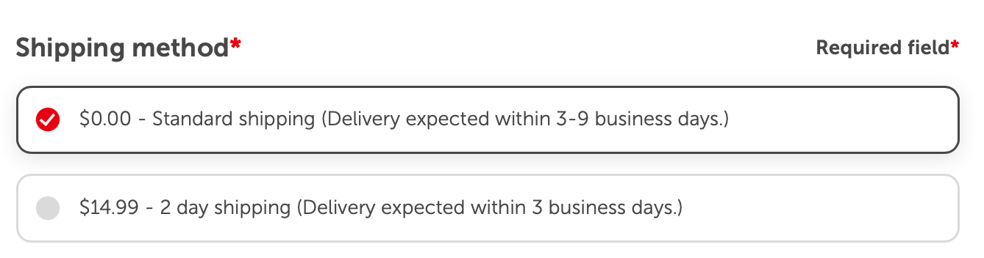
DATA SOURCE & SCREEN ANALYSIS
  Scope: Identified 5 core entities (Product, Customer, Order, Shipping, Retailer)across 10 functional screens.

Slide 8
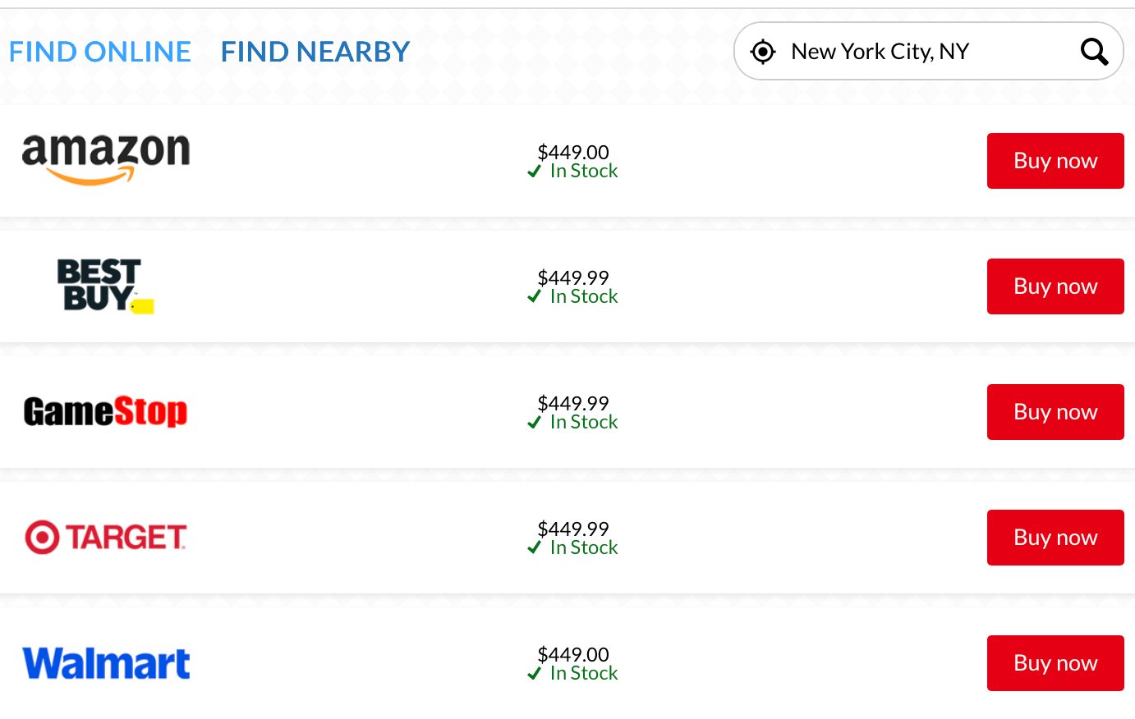
DATA SOURCE & SCREEN ANALYSIS
  Scope: Identified 5 core entities (Product, Customer, Order, Shipping, Retailer)across 10 functional screens.

Slide 9
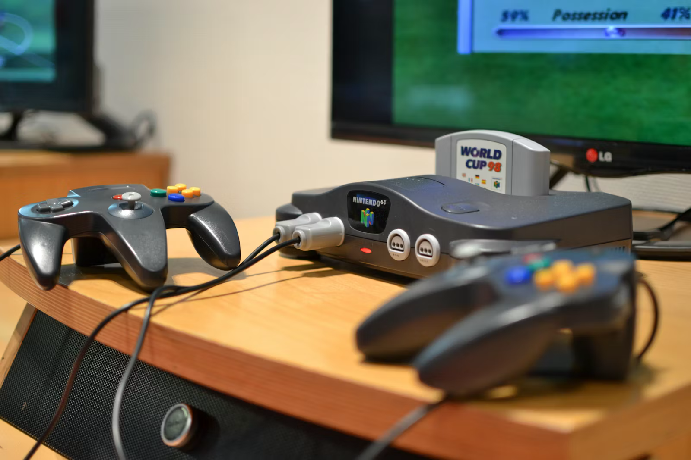
BUSINESS RULES & LOGIC
  Every product must have a unique PRD_ID for inventory tracking.
  A customer must have a registered CST_ID before finalizing a purchase.
  An order can contain multiple products, but is illed as a single total.
  The model includes external Retailers to track physical store availability and hours.
Notes:
These are the "laws" of the Nintendo shop that govern how our tables connect. They ensure data stays accurate and prevents errors like duplicate orders.

Slide 10
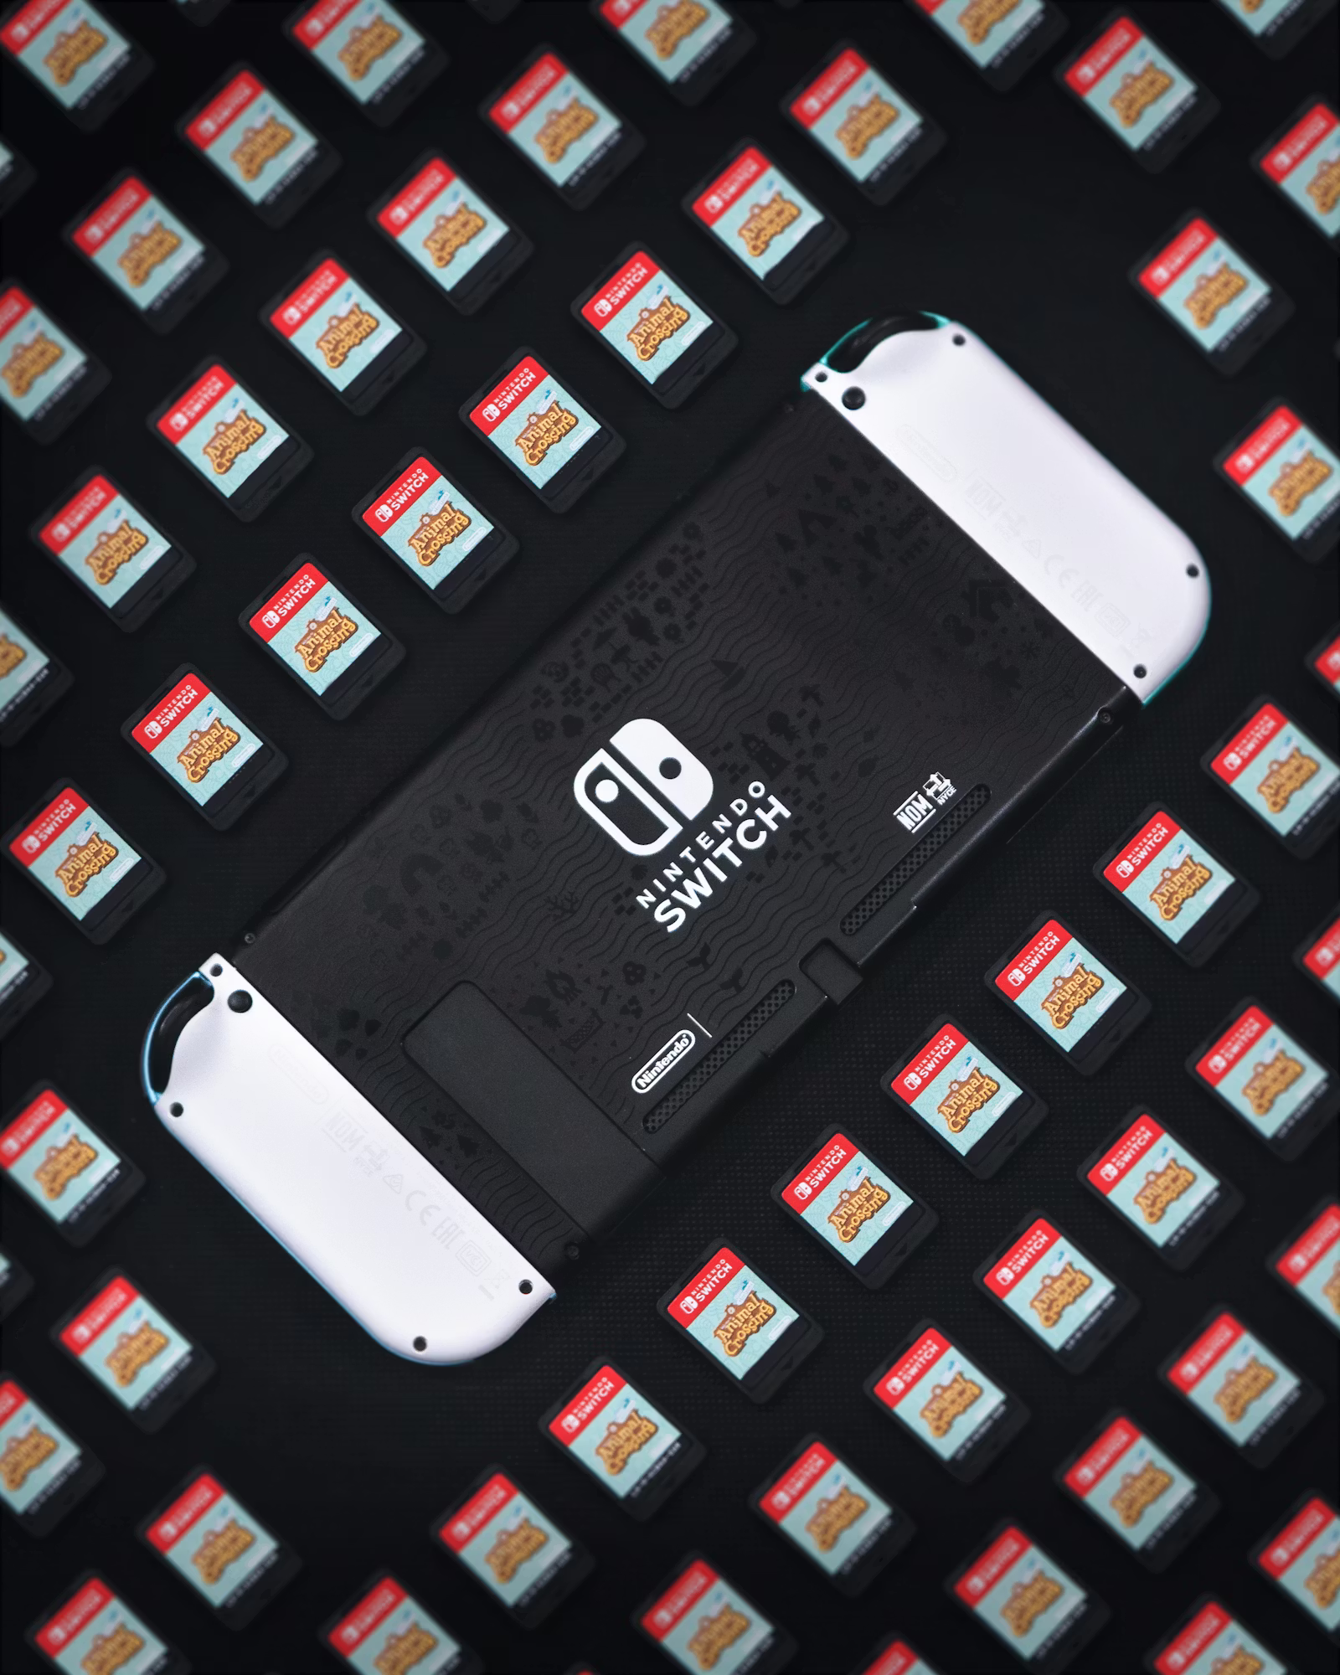
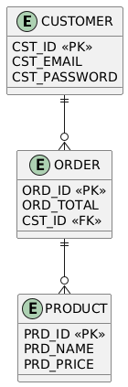
FIRST NORMAL FORM (1NF)
DATA REQUIREMENTS & DISCOVERY
The Goal: Getting the data "organized and atomic."
  Eliminated Repeating Groups.
  Every cell contains exactly one piece of information.
  Established PRD_ID and CST_ID to ensure every row is unique and searchable.
Notes:
To start our database journey, we moved into First Normal Form. Think of this as cleaning up a messy spreadsheet. We made sure every single piece of data, like a game's price or a customer's email, has its own dedicated cell. No more lists of items stuffed into one box. We also assigned unique IDs for every product, so the system never confuses a 'Switch OLED' with a 'Switch Lite'.
The Goal: Getting the data "organized and atomic."
Eliminated Repeating Groups: Instead of having one "Order" row with a list of five games, every item gets its own space.
Data Atomicity: Every cell contains exactly one piece of information (e.g., one Product Name, one Price).
Primary Key Identified: Established PRD_ID and CST_ID to ensure every row is unique and searchable.
Example: If a customer buys a Nintendo Switch and Mario Kart, 1NF ensures these are treated as distinct data points, not lumped into a single "Purchased Items" text box.

Slide 11
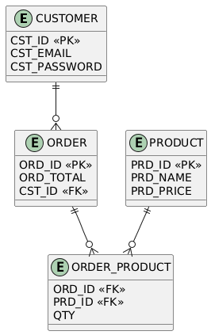
FIRST NORMAL FORM (2NF)
DATA REQUIREMENTS & DISCOVERY
The Goal: Removing "Partial Dependencies."
  We broke the 1NF table into three main "homes": Products, Customers, and Orders.
  Removing Redundancy: Data that only relates to a product.
  In our 'Order_Product' table, we ensured that every detail relates to the entire transaction, not just one part of it.
Notes:
In Second Normal Form, we started grouping related data together. Before this, we were repeating the same product info every time a sale happened. Now, we have a 'Master List' for Products and a 'Master List' for Customers. If Nintendo changes the price of a console, we only have to update it in one place,the Product table,instead of hunting through thousands of individual orders. It’s all about efficiency and reducing double-work.
Example: A Nintendo Switch’s price ($299) belongs in the Product table. We shouldn't store that price in the Order table every single time someone buys it; we just link to the Product ID.

Slide 12
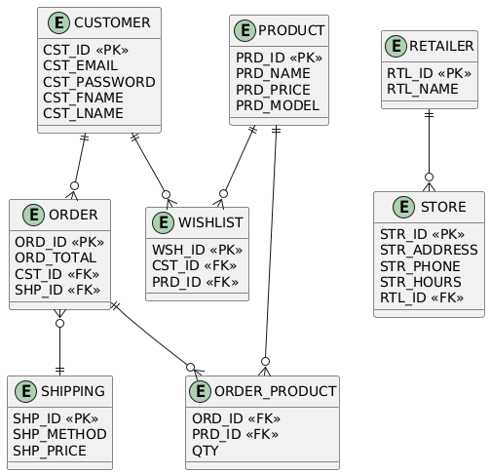
FIRST NORMAL FORM (3NF)
DATA REQUIREMENTS & DISCOVERY
The Goal: Removing "Transitive Dependencies."
  Every column must depend only on the PK.
  Created the Shipping and Retailer tables.
  Adressing the Zip Code Issue.
Notes:
Finally, we reached Third Normal Form, which is the gold standard for database design. Here, we removed what we call 'middleman' relationships. For example, a customer's city is actually tied to their Zip Code, not their personal ID. By moving shipping and retail details into their own specific tables, we ensure that the database is perfectly streamlined. Every attribute now depends on 'the key, the whole key, and nothing but the key.
Addressing the Zip Code Issue: In the 2NF model, 'City' was tied to the Customer. But 'City' actually depends on 'Zip Code.' We moved this to a Shipping table to keep the Customer table clean.
Example: A retail store's "Opening Hours" depends on the Retailer ID, not the Product ID. We separated these so the database stays fast and logical.

Slide 13

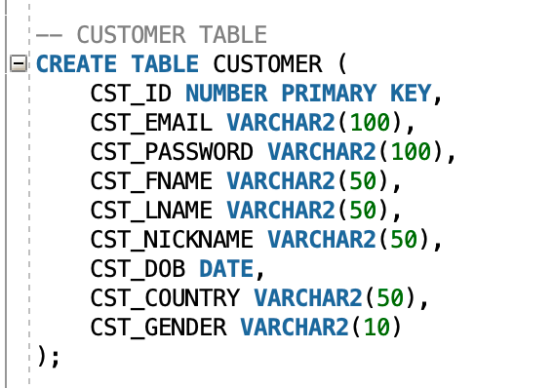

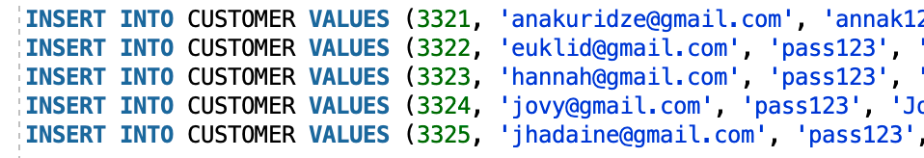
SQL IMPLEMENTATION | TABLES
DATA REQUIREMENTS & DISCOVERY
Customer Table
Inserted Data
Notes:
After finalizing our 3NF design, the next step was moving from theory to reality using SQL. On this slide, you can see how we translated our entities into actual physical tables.
For example, we used the CREATE TABLE command to define our 'Customer' table, We didn't just name the columns; we assigned specific data types. and also we inserted data as you see.

Slide 14
SQL IMPLEMENTATION | TABLES
DATA REQUIREMENTS & DISCOVERY
Product Table
Filter Table
Customer_Orders Table
Wishlist Table
Order_Product Table
Store Table
Retailer Table
Shipping Table
Notes:
Other tables we also have created are following

Slide 15

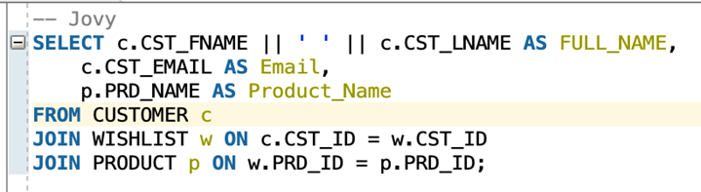
CUSTOMER ENGAGMENT & INTEREST (JOVY)
Customer wishlists

Slide 16
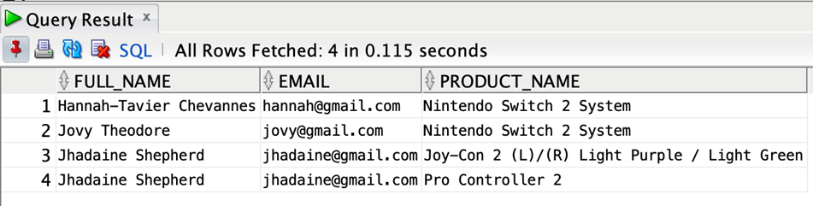
CUSTOMER ENGAGMENT & INTEREST (JOVY)
Query Results

Slide 17
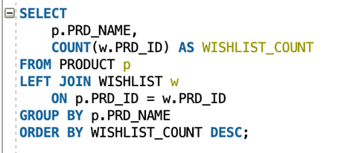
CUSTOMER ENGAGMENT & INTEREST (JOVY)
Wishlist Popularity

Slide 18
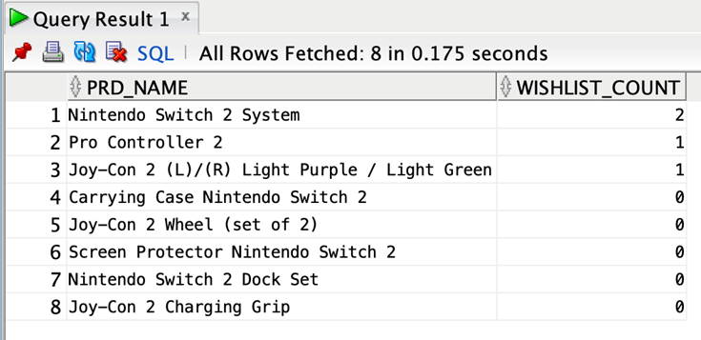
CUSTOMER ENGAGMENT & INTEREST (JOVY)
Query Results

Slide 19
SALES & LOGISTICS OPERATIONS (EUKLID)
All orders with customer name and shipping method

Slide 20
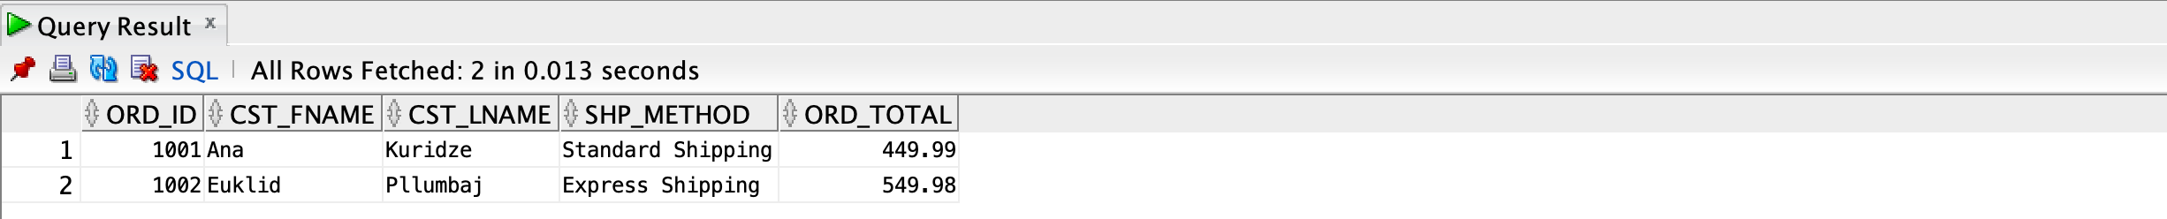
SALES & LOGISTICS OPERATIONS (EUKLID)
Query Results

Slide 21
SALES & LOGISTICS OPERATIONS (EUKLID)
Total quantity sold per product

Slide 22
SALES & LOGISTICS OPERATIONS (EUKLID)
Query Results

Slide 23
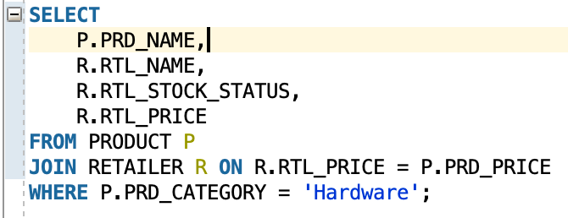
RETAIL ANALYTICS & HIGH-VALUE CUSTOMERS (ANA)
Comparing Store Prices for Hardware
Notes:
For my first query, I focused on our retail partners. This code pulls a list of all our hardware, specifically the Nintendo Switch systems, and matches them with external retailers. It tells us which stores have the items in stock and what they are charging. This is how Nintendo ensures that our products are available to customers at the correct price across all different stores.
What it does: This query looks at all "Hardware" (like the Nintendo Switch console) and compares Nintendo’s official products with external Retailers to see their stock status and pricing.
Simple Logic: It joins the PRODUCT and RETAILER tables to make sure our partners are selling our consoles at the right price.

Slide 24
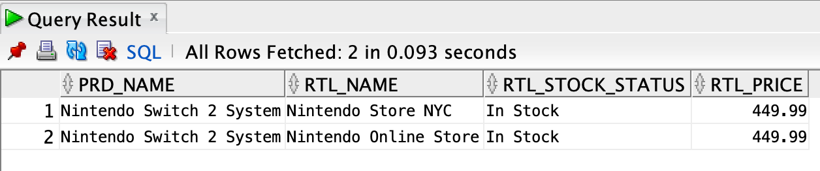
RETAIL ANALYTICS & HIGH-VALUE CUSTOMERS (ANA)
Query Results
Notes:
Other tables we also have created are following

Slide 25
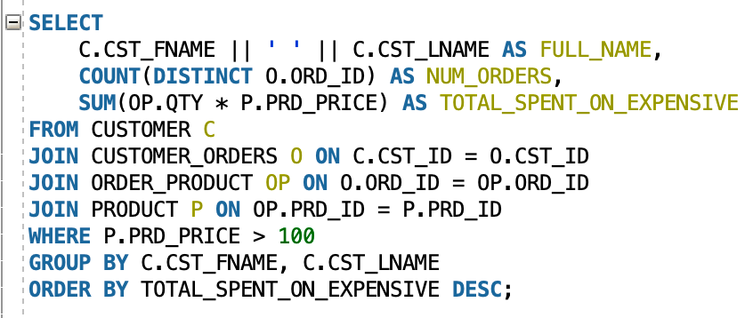
RETAIL ANALYTICS & HIGH-VALUE CUSTOMERS (ANA)
Tracking Our Top-Spending Fans
Notes:
My second query is all about our 'VIP' customers. I wrote this code to find users who buy our high-end products, like consoles and limited-edition bundles priced over $100. It calculates the total amount each person has spent. This data is incredibly valuable because it helps the business identify our most loyal fans so we can offer them special rewards or early access to new releases.
What it does: This query finds customers who have spent money on "expensive" items (anything over $100). It calculates their full name, how many orders they’ve placed, and exactly how much they’ve spent.
Simple Logic: It connects CUSTOMER, ORDERS, and PRODUCTS to find our most loyal, high-spending users.

Slide 26
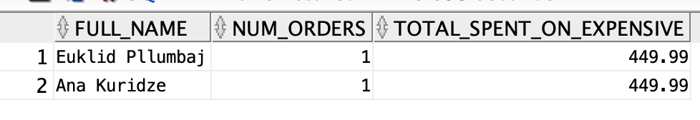
RETAIL ANALYTICS & HIGH-VALUE CUSTOMERS (ANA)
Query Results
Notes:
Other tables we also have created are following

Slide 27
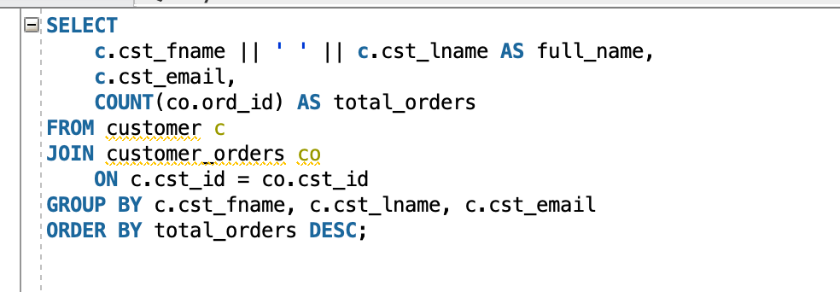
ORDER FREQUENCY & PRODUCT OERFORMANCE (JHADAINE)
Customers and how many orders they placed
Notes:
Other tables we also have created are following

Slide 28
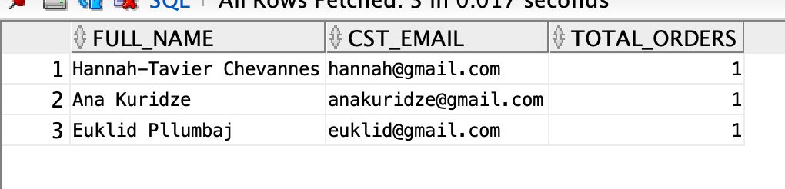
ORDER FREQUENCY & PRODUCT OERFORMANCE (JHADAINE)
Query Result
Notes:
Other tables we also have created are following

Slide 29
ORDER FREQUENCY & PRODUCT OERFORMANCE (JHADAINE)
Products and which are ordered the most t
Notes:
Other tables we also have created are following

Slide 30
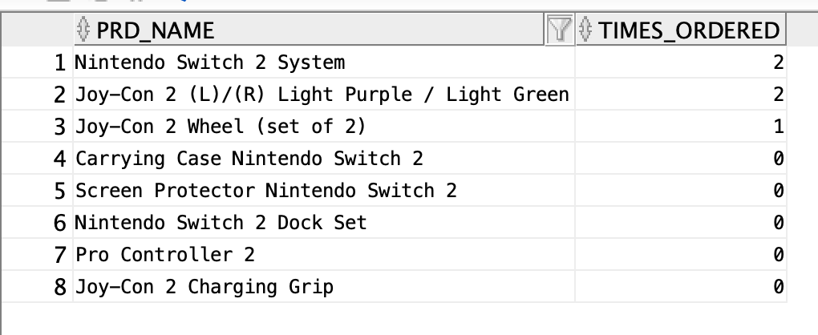
ORDER FREQUENCY & PRODUCT OERFORMANCE (JHADAINE)
Query Result
Notes:
Other tables we also have created are following

Slide 31
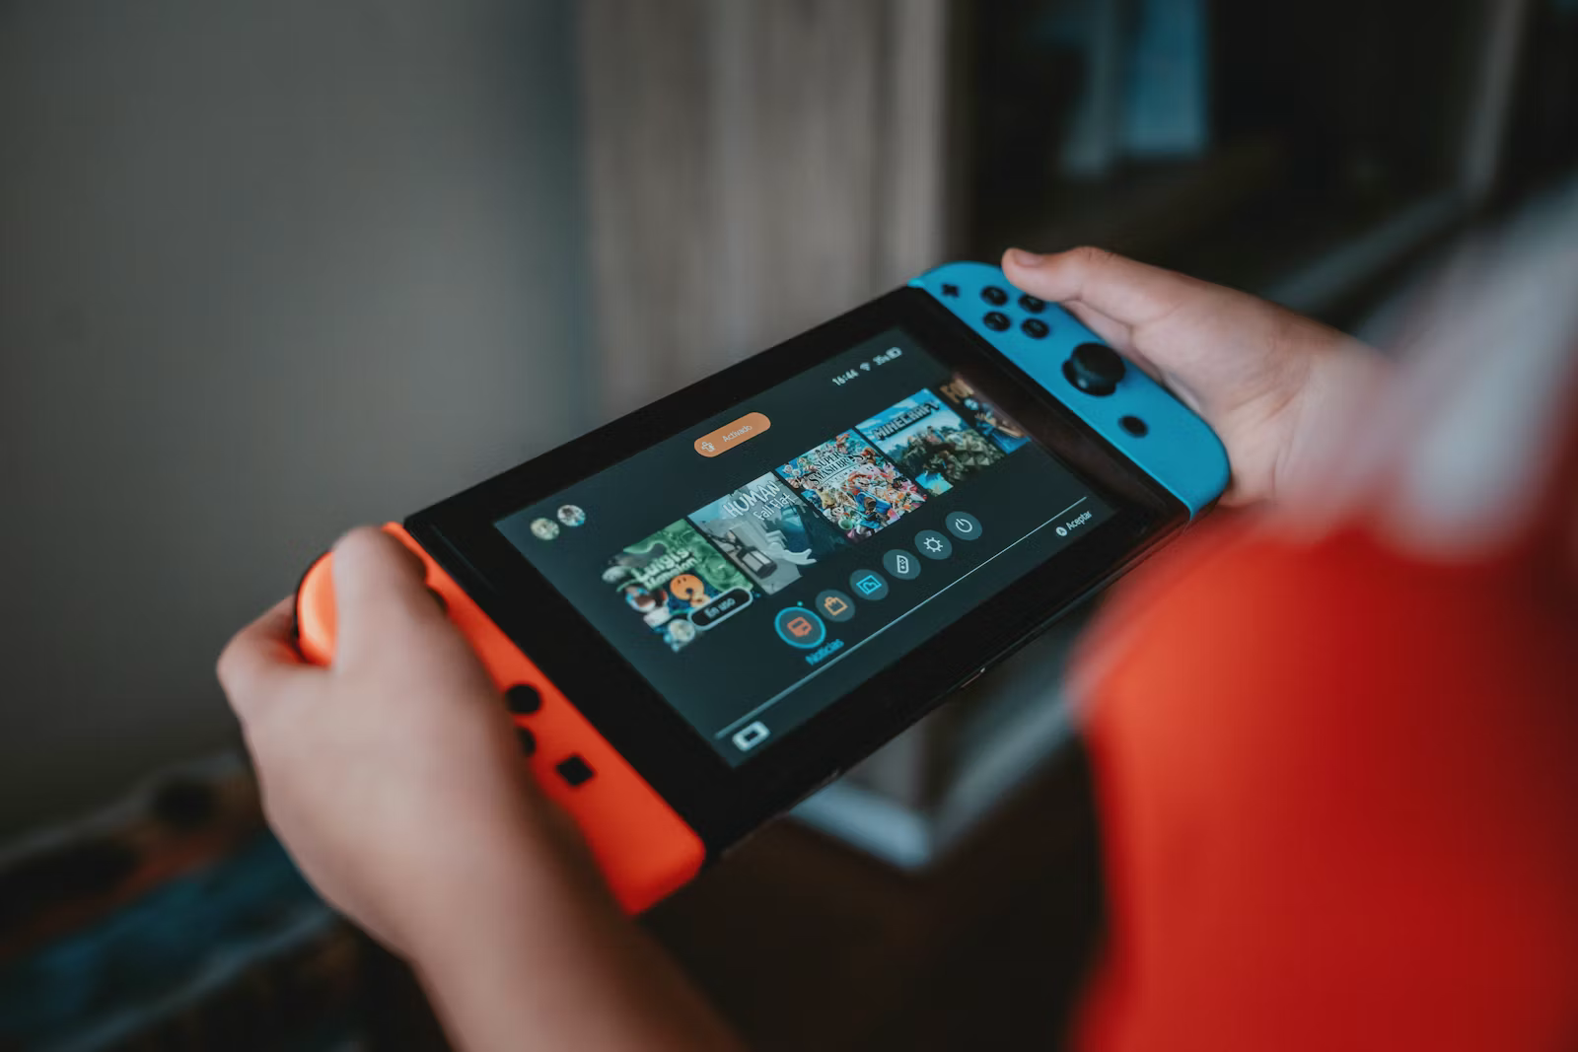
THANK YOU
FOR YOUR ATTENTION
ANY QUESTIONS?

