Slide 1
Final project: ryanair database
Annalisa ranzenigo, 03/04/2024

Slide 2

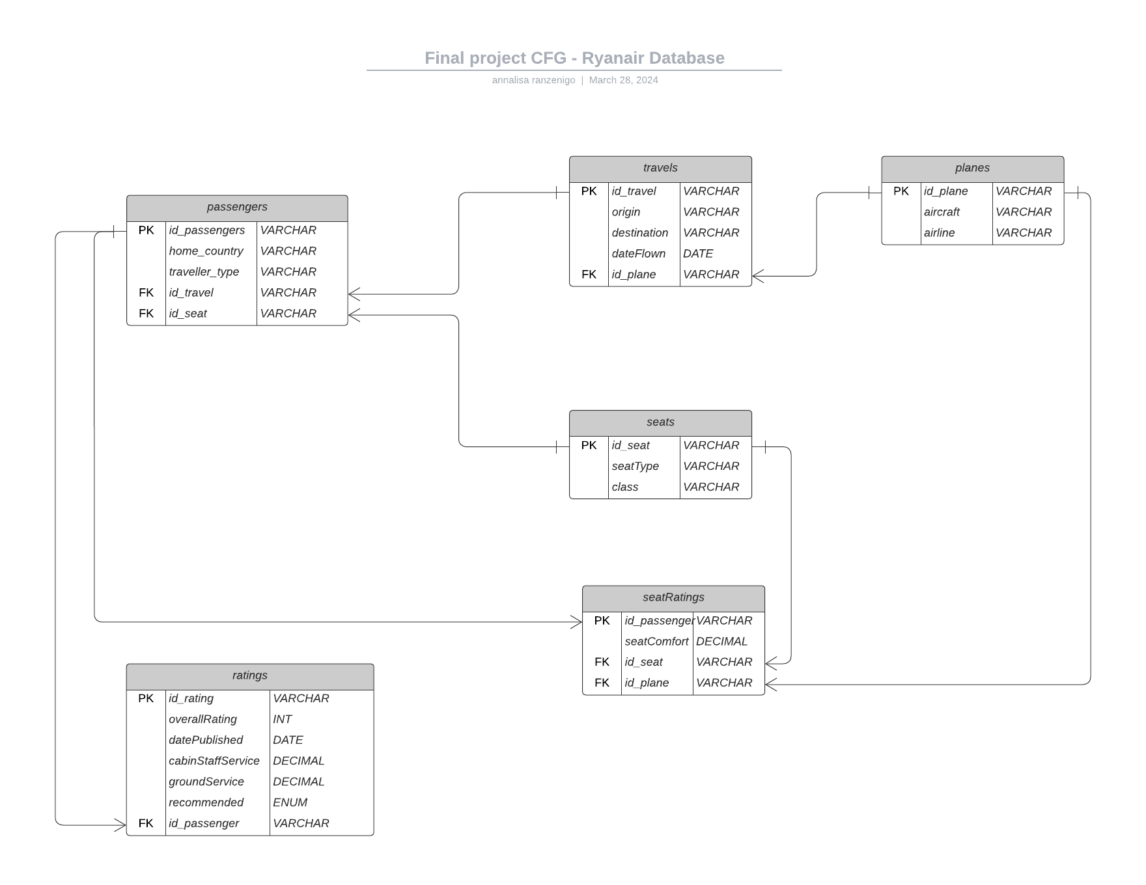
Data:
From Kaggle
https://www.kaggle.com/datasets/cristaliss/ryanair-reviews-ratings?resource=download
I have selected 20 rows from the Ryanair Reviews Dataset and slightly modified some data to fit the purpose of this project.
Structure:
One to many
One to one

Slide 3
Database analysis 1
Stored function and JOIN:
Find matches between passenger country and travel origin / destination.
8/20 passengers leave from home.
2/20 passengers return home.
Subquery:
Families gave on avarage a higher rating than passengers travelling for business purposes.
Family leisure: avarage of 6.4 rating.
Business: avarage of 1.0 rating.

Slide 4
Database analysis 2
GROUP BY HAVING:
The overall rating in the database is selected by the passenger (not calculated).
Therefore, I found the discrepancies between the overall rating and the avarage of individual ratings (cabinStaff, groundService, seatComfort):
Discrepancies on 12/20 ratings.

Slide 5
Database analysis: VIEW
Passengers
Travels
Ratings
Id_Passenger
HomeCountry
TravellerType
Origin
Destination
DateFlown
OverallRating
DatePublished
From the view I calculated the avarage time it took for the passengers to leave a review: 2 weeks.

Slide 6


THANK YOU!

