Slide 1
Debugging

Slide 2
Definition Of Debugging
Debugging, in computer programming and engineering, is a multistep process that involves identifying a problem, isolating the source of the problem, and then either correcting the problem or determining a way to work around it.
To start debugging, select F5, or choose the Debug Target button in the Standard toolbar, or choose the Start Debugging button in the Debug toolbar, or choose Debug > Start Debugging from the menu bar.

Slide 3
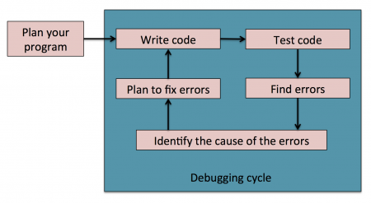

Process Of Debugging
The Debugging can be stopped by using the stop button

Slide 4
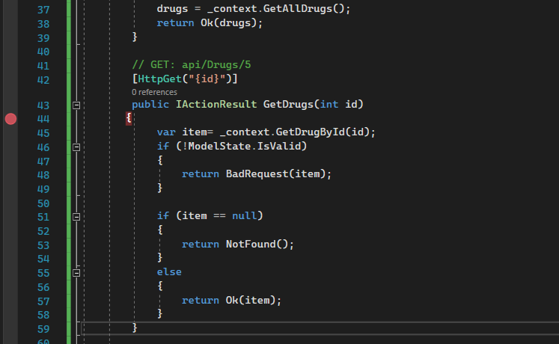
Example Of Debugging
We need to set a break point and make the project run.

Slide 5
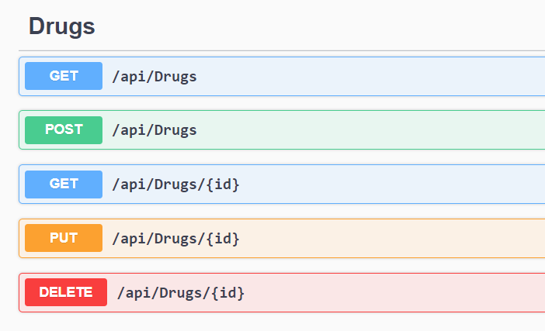
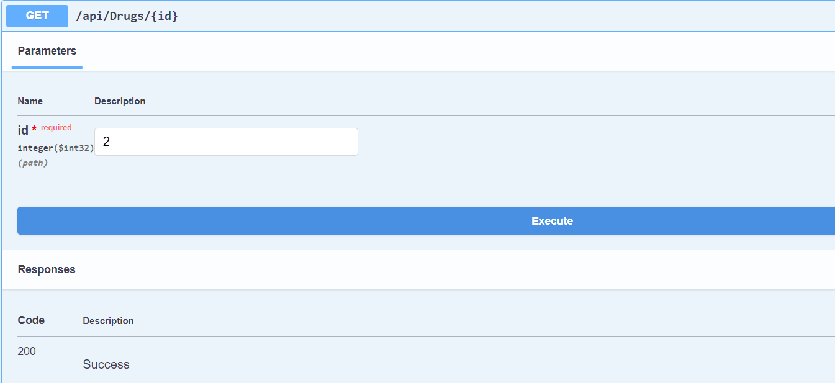
Then Select the method that we previously kept break point in the VS Code and give all inputs required to the function and the click Execute.

Slide 6
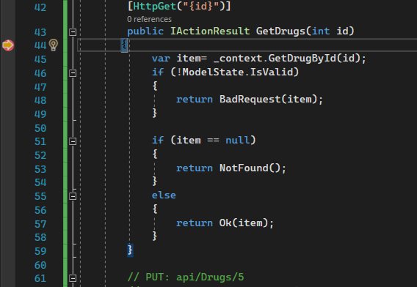
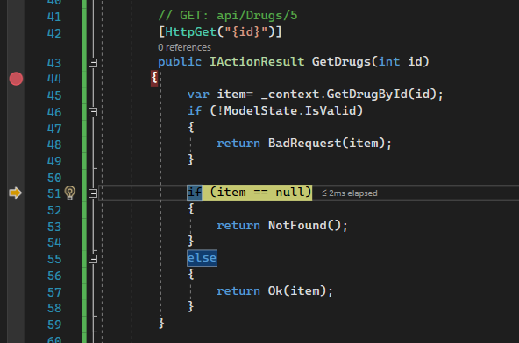
Using the keys F10 and F11 To Navigate into the function and methods in the function and click on stop debugging by clicking the stop button

Slide 7


