Slide 1

ADO.NET
ENTITY FRAMEWORK
Presented By - PRASUNA ANNAM

Slide 2

What Is ADO.NET?
ADO stands for (ActiveX Data Object)
Provide access to the data sources.
Endow multiple providers for different databases.
Root classes are found in System .Data
Classified into Couple of Architectures
Connection Oriented Architecture
Disconnection Oriented Architecture

Slide 3
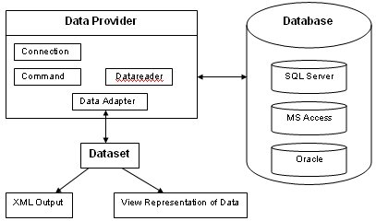
Data Provider <-> Database

Slide 4
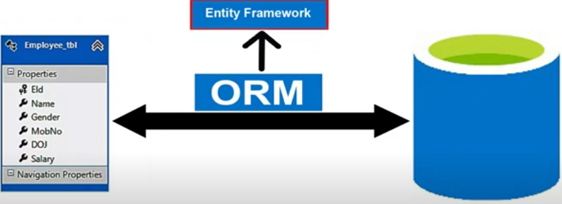
Entity Framework
why Entity Framework emerged as an alternative to ADO.NET:
Object relational Mapping(ORM)
Productivity And Rapid Development
Maintainability
Cross Database Compatibity.

Slide 5
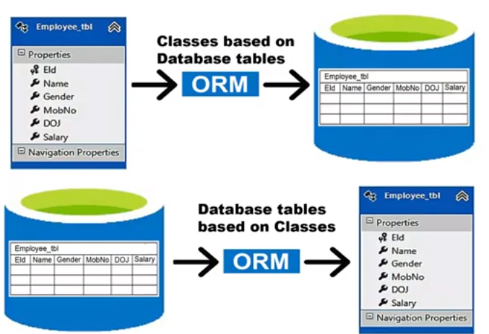
Entity Framework Approaches
EF is Classified into three approaches
1.Data Base First Approach
2.Code First Approach
3.Model First Approach

Slide 6
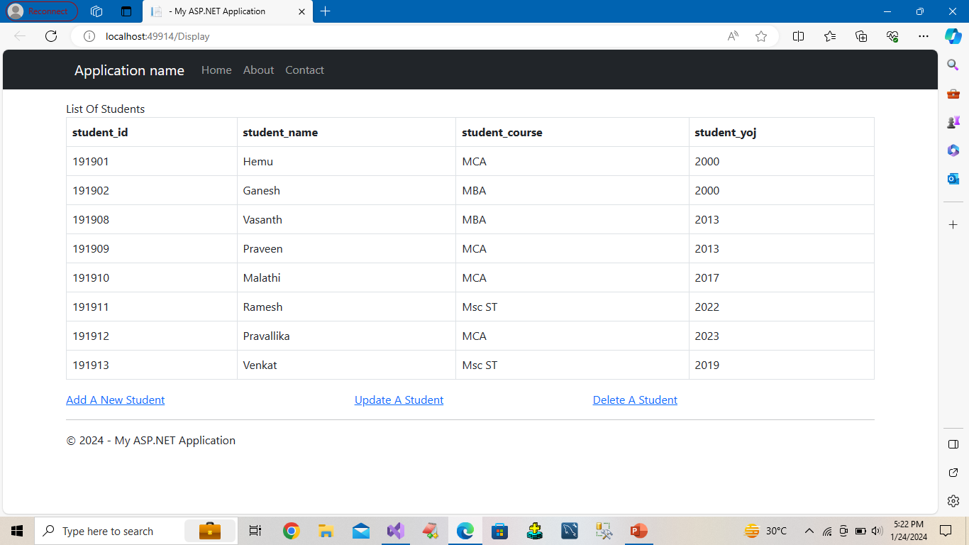

Slide 7
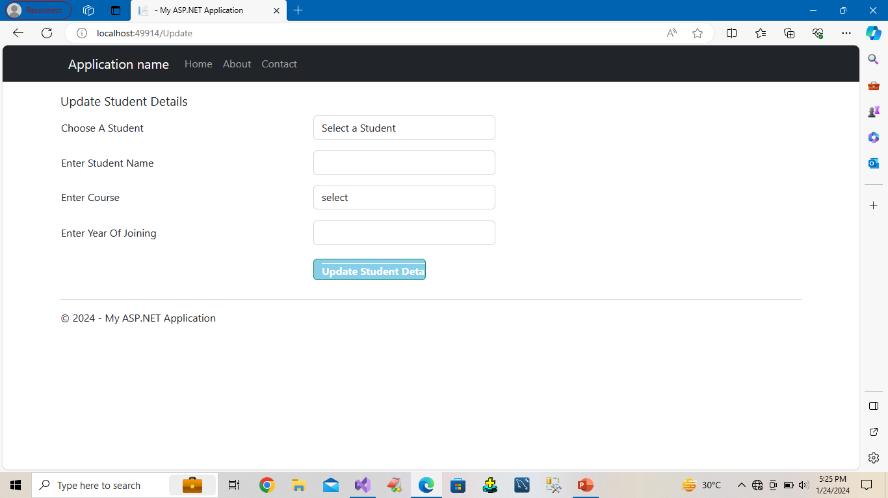

Slide 8
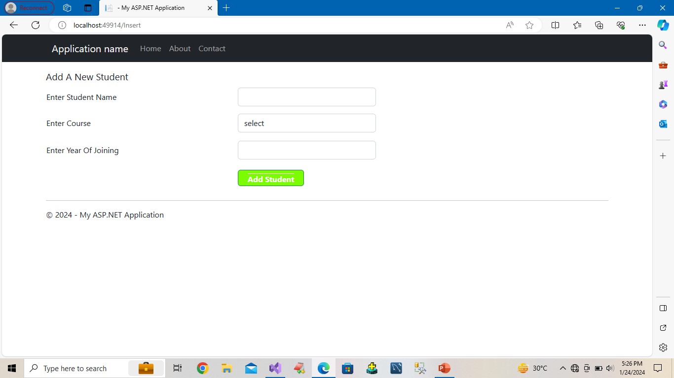

Slide 9
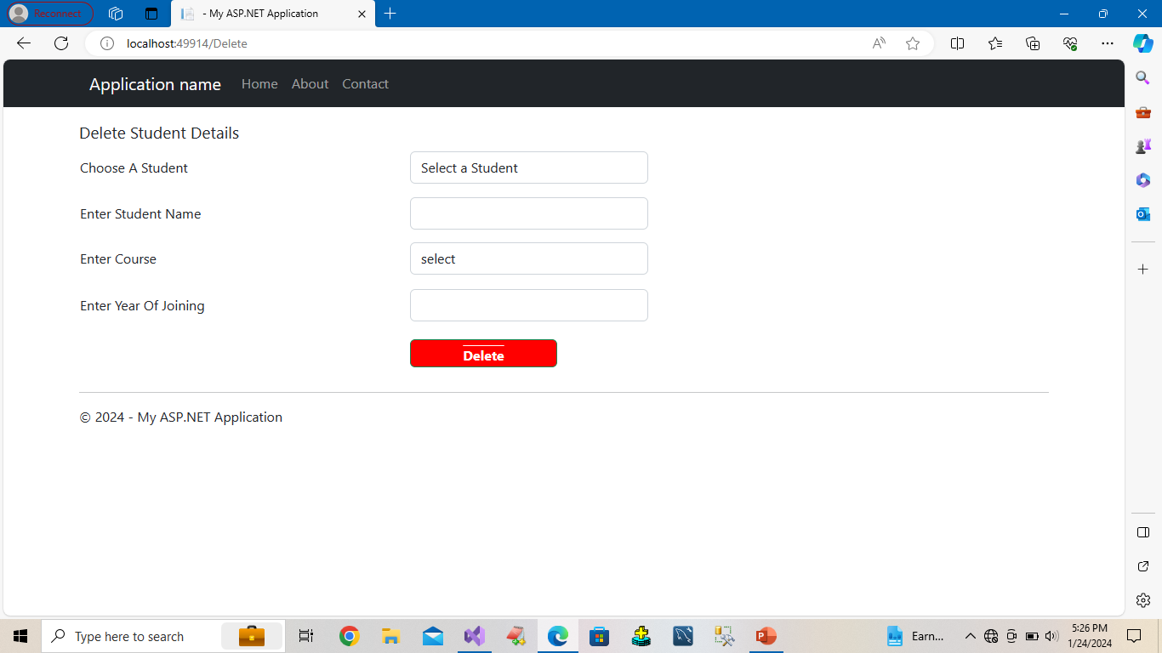

Slide 10


