Slide 1
Learning
Why do some of us learn to be afraid of spiders?
How do we learn to be diligent and disciplined with some Professors?

Slide 2
Goals
Learn how we modify behaviour, skills and acquire knowledge.

Slide 3
Learning
A relatively permanent change in behavior brought about by experience or as a result of practice
  Change in behavior (better/worse)
  Changes due to practice and experience (not changes due to growth and maturation)
  The change should be relatively permanent

Slide 4
Behaviorsim and behavior analysis
Learning has roots in Watson’s work.
Rejected introspection and contents of sensation, images and feelings as subject matter of psychology.
Emphasized the study of observable behavior.
Skinner later formulated radical behaviorism.
Evolution provides us with a repertory of behaviors and all behavior beyond that is learned.

Slide 5
Skinner emphasized causes of behavior do not lie in inner states or mental events but lie in environmental stimuli.
Behavior analysis attempts to discover environmental determinants of learning and behavior.
All animal species posses the elementary processes of learning.

Slide 6
Classical Conditioning, Pavlov (1849-1936) also called Pavlovian Conditioning
  In classical conditioning two stimuli are presented to the learner
  A neutral stimulus gradually brings a response after it is paired with a stimulus (e.g., food) that naturally brings about that response

Slide 7
Pavlovian Experiment
  Bell ringing – neutral stimulus
  Food (Meat) – Unconditioned Stimulus (UCS)
  Food leads to salivation the Unconditioned Response (UCR)
  Gradually after learning happens, salivation in response to the bell ringing – Conditioned Response (CR)
  Bell ringing → Conditioned Stimulus (CS)

Slide 8
Core of Classical Conditioning are reflex responses- an unlearned response such as salivation, pupil contraction, eye blinking.
These are naturally elicited (evoked) by stimuli, biologically relevant.
These do not require learning for the stimulus to control the behavior.

Slide 9
On the first conditioning trials
  The CS and UCS are paired but no conditioning has yet occurred
Stimuli Response
  CS followed by UCS → UCR
  ----------------------------Repeated Pairings----------------------
Test trial after repeated pairings
  CS presented alone
Stimuli Response
  CS → CR

Slide 10

Course of Conditioning
Trials

Slide 11
Some more concepts
Extinction
  Occurs when in classical conditioning CS is presented alone without the UCS for a couple of trials.
  The CR gradually decreases and finally stops Extinction is not forgetting
  After rest when CS is again presented CR occurs-Spontaneous recovery.
  Reconditioning is quicker.

Slide 12

CS Alone
Reconditioning
Trials
Rest
Trials

Slide 13
Stimulus Generalization
  The subject tended to generalize the conditioned response to other stimuli that are somewhat similar to the original conditioned stimulus Similarity ↑ Generalization ↑
Stimulus Discrimination
  Learning to make one response to one stimulus and no response or another response to another stimulus.
Balance required between the two, allows creatures to react efficiently to their environments

Slide 14
The presentation of CS and UCS must be close in timing. Different temporal patterns have been used.
  Delay conditioning, where the CS comes on prior to the UCS and stays on at least until the UCS is presented.
  Trace conditioning, where the CS is discontinued before the UCS is presented.
  Simultaneous conditioning, where both CS and UCS are presented together.
  Backward conditioning when CS is presented after the UCS.

Slide 15
Theories of Classical Conditioning
Stimulus Substitution- CS
  Simply as a result of pairing with a UCS, acquires the capacity to substitute for a UCS in evoking response
  CR is not the same as UCR
Information and expectation
  CS becomes a signal for the UCS thus the learner responds with this expectation.
  A CS should be intense and contrast with other stimuli.

Slide 16
Significance of Classical Conditioning
  Our violent emotions to subtle moods – all could be conditioned
  Learned very quickly
  Behavior Modification therapy

Slide 17
Operant Conditioning/Instrumental Conditioning
Some action of the learner is instrumental in bringing about a change in the environment that makes the action more or less likely to occur again.
Thorndike gave the Law of effect- behavior and its consequences.
Skinner developed a Skinner box (pigeon taught to peck a key to get food).
An operant is any behavior that is emitted by an organism & can be characterized in terms of observable effect on the environment.

Slide 18
Learning occurs as an association between stimuli in the situation and a response that an animal learned to make. S-R connections
Cat learned to produce an appropriate response (pressing a lever) in the stimulus circumstances(confinement in a puzzle box) that led to a desired outcome (Consequence)

Slide 19

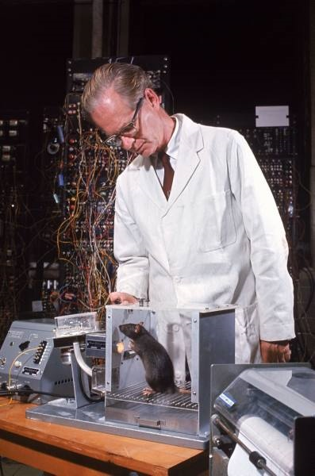
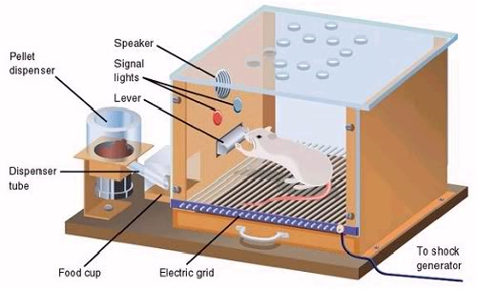

Slide 20
Reinforcers- An environmental event that is the consequence of an instrumental response more likely to occur again
  Positive reinforcer is a stimulus or event which when it follows a response increases the likelihood of it occurring again.
  Negative reinforcer is a stimulus, the cessation or termination of which when contingent on a response, increases the likelihood that the response will occur again.

Slide 21
Punishment - Different from negative reinforcers. A stimulus the onset of which when contingent on a response decreases the likelihood that the response will occur again
Omission training (Negative punishment) – Positive reinforcement is withdrawn following a response. The effect of the omission of the reinforcement is to decrease the likelihood of the response which led to the removal of the positive reinforcement.

Slide 22
3 classes of stimuli
Some that you are neutral to.
Appetitive stimulus- you have an appetite for them.
Aversive stimulus- you seek to avoid them.
Not the same for all individuals.

Slide 23
Negative reinforcers are generally noxious events or a painful experience
  Escape learning- escaping an aversive stimulus.
  Avoidance learning- Avoiding a noxious stimulus

Slide 24
Types of Reinforcement and Punishment
EFFECT ON BEHAVIOR
Procedure | Increases | Decreases
Presentation of Stimulus | Positive reinforcement: Example: Giving a raise for good performance Result: Increase in frequency of response (good performance) | Positive punishment: Example: Giving a spanking following misbehavior Result: Decrease in frequency of response (misbehavior)
Removal of Stimulus | Negative reinforcement: Example: terminating a headache by taking aspirin Result: Increase in frequency of response (taking aspirin) | Negative punishment: Example: Removal of favorite toy after misbehavior Result: Decrease in frequency of response (misbehavior)

Slide 25
Operant conditioning in your life
Appetitive Stimulus
Aversive Stimulus
Positive Reinforcement | Positive punishment
Negative Punishment | Negative Reinforcement
Deliver
Remove

Slide 26
Properties of reinforcers
Primary Reinforcer – Satisfies some biological need, works naturally- food, water, shelter etc.
Secondary Reinforcer (conditioned reinforcer) – Becomes reinforcing because of association with a primary reinforcer. Praise, encouragement, money.

Slide 27
Schedules of reinforcement
  Fixed-Ratio Schedule – The response must occur a certain number of times before reinforcement occurs
  Fixed-Interval Schedule – No reinforcement until a certain interval of time elapsed
  Variable-Ratio Schedule – Subjects are reinforced after a variable number of responses
  Variable-Interval Schedule – Time intervals between responses that are reinforced is variable

Slide 28
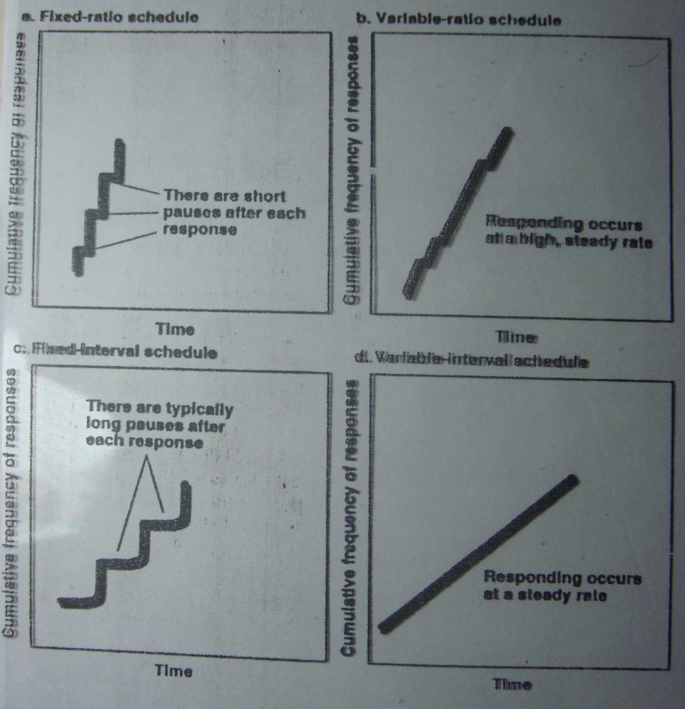

Slide 29
Rate of Learning in Different Schedules of Reinforcement
  FR – A pause in responding after each reinforced response and then a rapid run until the next reinforcement response
  FI – Long pause and gradual acceleration of responding
  VR and VI – generate a steady rates of response

Slide 30
Stimulus generalization
  If the stimulus situation is changed the response still occurs but less readily than it did in the original stimulus situation
Stimulus Discrimination
  A process of learning to make one response to one stimulus and another to another stimulus (achieved by simply by reinforcing a particular response to one stimulus and not reinforcing the same response to another stimulus)

Slide 31
Shaping – Method of successive approximations (Reinforcing the steps that lead to the desired response and that response eventually occurs)
Operant Extinction- Behavior does not produce predictable consequences it returns to the level before conditioning.

Slide 32
When punishment works?
  More intense punishment is effective, in human it can lead to strong emotional conditioned responses/will be developed (mild punishment is the best in the long run)
  Consistent punishment should be administered
  Contingent upon the occurrence of some response
  Stronger the response tendency less effect punishment (mild) would be
  People and animals adapt to punishment
  Positive reinforcement should be given along with punishment

Slide 33
Use of punishment
  When a child does something which can be dangerous – strong punishment should be used
  Should be given immediately in response to the behavior
  Simple explanation should follow
  While punishing for incorrect behavior is important to positively reinforce alternative behavior
  Do not use punishment as the only means of controlling behavior

Slide 34
Uses of Instrumental Conditioning
  Our beliefs, customs, and goals may be learned by instrumental conditioning.
  Child is socialized- unknowingly reinforcing certain behaviors.
  Positive reinforcement used in organizations to increase employee productivity
  Used for behavior modification
    Quitting habits like smoking
    Helping mild-mannered people to be more assertive
    Treating psychological disorders.
  Behaviors are maintained because they get attention and sympathy

Slide 35
Species- specific tendencies
Operant conditioning experiment (Breland& Breland, 1951) a racoon required to pick and deposit a coin.
Would rub the coins, dip them in toy bank and pull them out.
Not all aspects of learning under the control of the experimenter. Biological constraints exist.
Species-specific tendencies overide changes in behavior brought by operant learning.

Slide 36
Taste/Food aversion
On consuming any substance if it makes one ill we do not consume that substance again.
Instance of classical conditioning more powerful than others, even one pairing- taste aversion is learned.
Despite a long interval of 12 hrs.
Biological preparedness – a particular species has evolved so that members of the species require less learning experience than normal to acquire a CR.

Slide 37
  Application of the laws of learning must take into account the characteristics of both learner and the reaction being learned
  Prepared behaviors – Predisposed to learn some things easily (e.g., learned flavor aversion)
  Unprepared behavior – Can be learned with moderate amount of difficulty
  Contraprepared behavior - learned with great difficulty

Slide 38
Cognitive Learning
Experiments on rats in a maze by Tolman indicated they had a cognitive map.
Cognitive Learning is a change in the way information is processed as a result of experience a person or animal has had
  Due to experience the meaning and significance of the events changes
  New associations are formed and stored in the memory

Slide 39
  Cognitive learning involves forming the perceiving of new relationships among events (cognition is the processing of information about the environment received from the senses). They involve:
    Selection of information
    The making of alteration in the selected information
    The association of items of information with each other
    Elaboration of information in thought
    Storage and retrieval from memory

Slide 40
Latent learning – Learning which occurs but is not evident in behavior until later, when conditions for its appearance are favorable
  Occurs without reinforcement of particular responses
  Changes in the way information is processed
  Eg : Cognitive Maps

Slide 41
Insight Learning – A person is posed with a problem, a period of time follows in which no apparent progress is made and then the solution comes suddenly
  ‘Aha’ experience
  For sometime zero learning on the curve and all of a sudden the learning is complete
  Great deal of generalization
  Solution comes suddenly
  Perceptual rearrangement helped
  Solution once arrived can be generalized a lot

Slide 42
Imitation Learning/ Observational learning by Bandura occurs when we imitate another individual called a model (4 steps):
  Paying attention and perceiving the behavior
  Remembering the behavior
  Reproducing the action
  Being motivated to learn and carry out the behavior
Applied to studies of aggression learned from TV

