Slide 1
Emotions

Slide 2
What are emotions?
A complex pattern of bodily and mental changes that includes physiological arousal, feelings, cognitive processes, visible expressions and specific behavioral reactions to situations perceived as personally significant.
Why are they complex?
Say something about the way you feel
Gives the bodily basis for the emotion
Includes the effect of emotion on perception, thinking.
Motivational properties of emotions
Expressed in language, facial expressions and gestures

Slide 3
Functions of emotions–
Give richness to our interactions with others; and also guide how we behave on perceiving certain emotions in others.
Motivate us, providing us with an impetus to act. all goal-directed behavior is emotionally toned.
Have a cognitive function by influencing what you pay attention to, affect influences our learning, memory, social judgments and how we organize and categorize information from our life experiences.

Slide 4
Experience of emotions is universal
Emotional responses of new born show innate emotional responses.
Consistency of facial expressions.

Slide 5
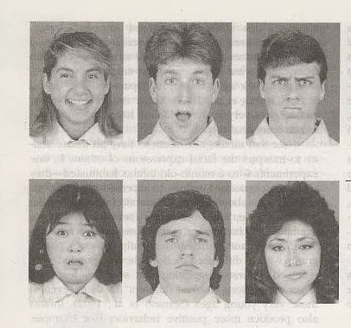
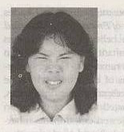
Identify the emotions in these facial expressions

Slide 6
Are emotional expressions universal?
Focused on set of seven emotions.
Not all facial expressions are universal.
Does cultural constrain emotional expressions
Culture establishes social rules for when people may express certain emotions and social appropriateness of certain types of emotional displays by particular people in specific settings.
Difference in expressions of negative emotions in Individualistic/Collectivistic cultures.

Slide 7
Emotions & Physiology
Our emotions have a physiological basis; some of which we are aware of; others we are not aware.
Role of the Autonomic nervous system- through the sympathetic system increases the heart rate, raises blood pressure, increases glucose levels, secretions of hormones epinephrine and norepinephrine.
In calm state it’s the parasympathetic system that is activated slows the heart rate, reduces blood pressure, increases blood supply to the digestive tract.

Slide 8
The somatic nervous system activates the muscles in the arms, legs and the breathing muscles.
Different parts of the brain namely the hypothalamus, the limbic structure and brain cells in the cerebral cortex are parts of the brain involved in the perception and evaluations of situations that give rise to emotions.
Stimulation of cells in different parts leads to experience of different feelings.

Slide 9
James-Lange theory of emotions
Emotional experience is a reaction of bodily changes
Every emotion is accompanied by a physiological or gut reaction. This helps us label our emotional reaction.
We perceive a situation that will produce a situation
We react to the situation
We notice our reaction

Slide 10
Drawback
Limited range of physiological changes
Wide range of emotions
Difficult to ascertain patterns for subtle and less intense emotions.
Our perception of internal changes is not very acute.

Slide 11
Cannon-Bard Theory
Felt emotion and bodily reaction are independent of each other but triggered together.
On perceiving a situation the Hypothalamus sends signals to
Message to the cerebral cortex where the pattern of discharge from the thalamus is perceived as felt emotion
Autonomic nervous system; Physiological Response and external muscles for bodily expression of emotions

Slide 12
Schachter-Singer Theory
Emotion is experienced because of a “stirred up” bodily state.
Same for most emotions.
Emotions are felt differently because of the way we interpret or label this physiological arousal.
Perception of potential emotion-producing situation.
An aroused bodily state which is ambiguous.
Interpretation and labeling of this bodily state that fits the perceived situation.

Slide 13
Cognitive Appraisal theory
Contemporary theories provide the two responses are not independent.
Perception of emotion is the joint effect of physiological arousal and cognitive appraisal.
All arousal is general & undifferentiated which is the first step.
You appraise this arousal in an effort to discover what you are feeling. What label best fits and what your reaction means in the setting.

Slide 14
Cognitive appraisal theory
Lazarus states that emotional experience grows out of ongoing transactions with the environment that are evaluated
Appraisal occurs without conscious thought.
Memories of past encounters, dispositions to respond in certain ways enter into the appraisal system.

Slide 15
Reappraisal of potentially emotion-producing situations is an important aspect of this theory.
Eg. Meeting with the Dean.
Important in coping with stressful situations.
May use defense mechanisms of denial, intellectualization etc for reappraising a situation; reduces the intensity of disturbing emotional feelings that accompany stressful situations.

Slide 16
Relationships among emotions
Emotions are constantly changing and intermingled hence difficult to study.
Plutchik discusses primary emotions and how they mix.
Emotions differ in three ways
Intensity
Similarity to one another
Polarity or Oppositeness which are conflicting emotions.
8 primary emotions that are an outcome of evolution hence have adaptive nature.

Slide 17
Non-verbal behavior
Communicates messages through many channels; understood across cultures
Facial affect programme- universally present at birth
Activates a set of nerve impulses that make the face display an appropriate expression
Display rules – guidelines that govern the appropriateness of showing emotion nonverbally
Facial feedback hypothesis- facial expressions not only reflect emotions, they also help determine how people experience and label emotions

