Slide 1
Motivation
The driving and pulling forces which result in persistent behavior towards particular goals.
Process involved in starting, directing & maintaining our physical & psychological activities.
Can’t be observed directly
Inferred from behavior
Unconscious motivation however if inferred correctly- explain a lot.

Slide 2
Functions of motivational concepts
Relate biology to behavior- Internal states of deprivation trigger bodily responses that motivate you to take action to restore balance.
Account for behavioral variability- helps psychologists explain variations in people’s performance in motivational explanataions

Slide 3
Functions…..
Help infer private states from public acts- observing people’s or own behavior we conclude about some internal cause or external motivation.
Assign responsibility for actions- Importance to personal responsibility; people are judged less responsible when external forces were powerful or actions were influenced by alcohol/drugs.

Slide 4
Functions…
Explain perseverance despite adversity- why do people persevere despite adversity?

Slide 5
Theories of Motivation or sources of motivation
Drive theories of motivation- pushed towards the goal
Internal driving state is aroused, the individual engages in behavior that leads to the goal reducing the drive state.
Driving state, goal directed behavior initiated by the driving state, the attainment of an appropriate goal, reduction of the driving state and subjective satisfaction
Inborn driving mechanisms & Learned drives

Slide 6
The internal state arises in response to an animal’s physiological needs.
Organisms seek to maintain a state of equilibrium of biological conditions- homeostasis.
Drives are aroused when deprivation occurs causing disequilibrium or tension activating behavior that is tension reducing.

Slide 7
Incentive theories
Stimulus characteristics of the goal can sometimes start a train of motivated behavior
“Pull theories” of motivation
Certain characteristics of the goal pull one towards it.
Goal objects that motivate are known as “incentives”.

Slide 8
Optimal-Level Theories
Certain optimal level of arousal that is pleasurable.
Motivated to behave in ways that maintain that optimal level of arousal.
“Just-right” theories.
If too low, a person seeks stimulation or stimuli to increase it and if too high then behavior is directed to decreasing it.

Slide 9
Reversal Theory
Michael Apter et.al.
Rejects the idea of motivation as tension reduction instead hypothesizes 4 states of “metamotivational states”.
Only one of the two states in each pair can be operative. Explain motivation as reversal from one to the other opposing state.

Slide 10
Principal Characteristics of the Four Pairs of Metamotivational States
Telic | Paratelic
Serious Goal oriented Prefers Planning Ahead Anxiety Avoiding Desires progress-achievement | Playful Activity oriented Living for the moment Excitement seeking Desires fun and enjoyment
Conformist | Negativistic
Compliant Wants to keep to rules Conventional Agreeable Desires to fit in | Rebellious Wants to break rules Unconventional Angry Desires to be independent
Mastery | Sympathy
Power oriented Sees life as struggle Tough minded Concerned with control Desires dominance | Care oriented Sees life as cooperative Sensitive Concerned with kindness Desire affection
Autic | Alloic
Primary concern with self Self centered Focus on own feelings | Primary concern with others Identifying with others Focus on others’ feelings

Slide 11
Biological Motives
Rooted in the physiological state of the body
Hunger, thirst, desire for sex, temperature regulation, sleep, pain avoidance and need for oxygen.
Aroused because of the body’s urge to maintain homoeostasis.

Slide 12
Social Motives
Complex motive states or needs that are wellsprings of many human actions.
Social because they are learned in social groups, part of growing up in the family, involving other people.
General states that lead to many particular behaviors.
Help explain a lot of what a person does.
These persist over a period of time, never fully satisfied.
Become persistent characteristics of individuals hence part of personality

Slide 13
3 social motives
Need for Affiliation
Need for Achievement
Need for Power

Slide 14
Need for affiliation
Concern for establishing, maintaining and repairing friendly relations
Makes more phone calls, visits, seeks approval, dislikes disagreeing with strangers.

Slide 15
Achievement Motivation
Need for achievement studied by McClelland et al. (1953).
People in whom this need is strong seek to become accomplished and improve their task performance.
Task oriented and prefer to work on tasks that are challenging and on which their performance can be evaluated in some way.
Can be seen on the job, in school, in home-making, athletics.

Slide 16
Sources of Achievement Motivation
Why are people different. Since these are learnt motives early life experiences lead to variations.
Children learn by copying the behavior of parents and other people who serve as role models.
Parents expectations are important in the development of achievement motivation.

Slide 17
Achievement Motivation and behavior
Degree of expression depends on fear of failure, when fear of failure is relatively low
High n-ach people prefer to work on moderately challenging tasks.
High n-ach people like tasks in which there is feedback on the performance
Tend to be persistent on tasks they perceive as career related
On experiencing success raise their levels of aspiration realistically
Not Gamblers

Slide 18
Gender differences exist in the expression of need for achievement
Research found that people scoring high on achievement motivation score low on competitive motivation
Competitive motivation improves performance for people with low achievement motive and lowers performance in people high in achievement motivation
McClelland said achievement is related to societies economic growth.

Slide 19
Power Motivation
Social power as “the ability or capacity of a person to produce intended effects on the behavior or emotions of another person”
Attempt to influence, control, cajole, persuade, charm others and enhance one’s own reputation in the eyes of other people.
Strength differs in person to person.

Slide 20
Expression of Power Motivation
Expression depends on
  Socio economic status
  Level of Maturity
  Gender
  Degree to which individual fears his or her own power motivation

Slide 21
Power motivation is expressed by
  Impulsive and aggressive actions (Men in lower SES).
  Participation in competitive sports like football.
  Joining and holding office in organizations.
  Among men by drinking and dominating women.
  Obtaining and collecting possessions like fancy cars.
  By associating with people who are not high on need for power and perhaps more easily controlled.
  Occupations like teaching, diplomacy, clergy etc.
  Building and disciplining their bodies.

Slide 22
Machiavellianism
People who express their power motivation by manipulating and exploiting others in a deceptive and unscrupulous manner.
Little warmth in their relationships, weakly guided by morality, reality oriented and little interest in ideologies, use lies to manipulate others, make and break interpersonal relationships in an opportunistic manner

Slide 23
Human Aggression
Aggress verbally or by actions.
Instrumental aggression and hostile aggression.
Hostile aggression has its goal in harming another person.
In Instrumental aggression the individual uses aggression to satisfy some other motive, eg. Child wants aggression.
Hostile aggression can be active or passive, physical or verbal, direct or indirect.

Slide 24
Active/ Passive- Difference between overt action and a failure to act
Direct aggression- means face to face aggression and indirect is without any contact with the person being attacked
Physical and verbal- distinction between bodily harm and attack with words

Slide 25
Aggression is understood as “the nature of the beast”.
  According to Freud man possess an aggressive instinct.
Environmental and Social Causes of Human Aggression.
  Frustration aggression hypothesis.
    Frustration occurs when motivated behavior is thwarted or blocked.
    This leads to aggressive behavior and that all aggressive behavior is caused by frustration.
  People do not always react with aggression, it depends on two factors.
    Frustration must be intense, thwarting of high expectation can result in aggression.
    Frustration must be perceived as unjustified and arbitrary action.

Slide 26
Everyday sources of aggression
Common everyday source is a verbal insult and counteragression occurs.
Compliance to authority
Unpleasant environmental conditions
Presence of weapons
Violence in the media
  Influences acquiring new ways of assaulting others
  OK to respond with aggression
  Steady exposure desensitizes

Slide 27
Learning and Human aggression
Importance of imitation
Modeling is most effective - aggressive behavior is justified, achieves the desired reward and the watcher is already angry.
Direct observers' attention to one of several possible behavior sequences.
show the observer that certain behaviors are all right, decreasing inhibitions.
Enhance emotional arousal that can facilitate aggression
Show some specific aggressive acts that can be copied

Slide 28
Role of learning
Instrumental conditioning
  when the aggressive behavior pays off it becomes a habitual response in many situations.

Slide 29
Controlling aggression
Reducing opportunities for imitation.
Punishment using fines, loss of social acceptance, embarrassment, imprisonment.
Works best when punishment is strong, immediately follows the behavior, instigation for aggression was relatively week, payoff of aggression was not great and the person perceives the punishment as legitimate.
When punishment is used ineffectively frustrates the aggressor hence increasing aggression.

Slide 30
Catharsis.
Awareness of the reasons of aggression reduce our counter-aggression.
Certain feelings and emotions are incompatible with anger and aggression.

Slide 31
Motive to know and be effective
Some motives that are persistent and powerful are the motives of seeking variety in stimulation, processing information about the world around oneself, to explore and to be effective in mastering challenges from the environment.
Amount of time, effort and money spent into looking at things, travelling or exploring the environment.
Experiments on monkeys showed that they learned to bang open doors of closed boxes which would let them just look outside.

Slide 32
Effectance Motivation
  A general motive to act competently and effectively when interacting with the environment.
  More evident when baby tries to overcome the environment. As one grows older difficult to differentiate.
Intrinsic Motives and Extrinsic Motives
  Intrinsic motivation is about internal feelings of effectiveness, competence and self-determination.
  Extrinsic motivation is directed towards goals external to the person like money or grades.
  Extrinsic rewards may stifle performance as people may adopt strategies of doing the minimum.

Slide 33
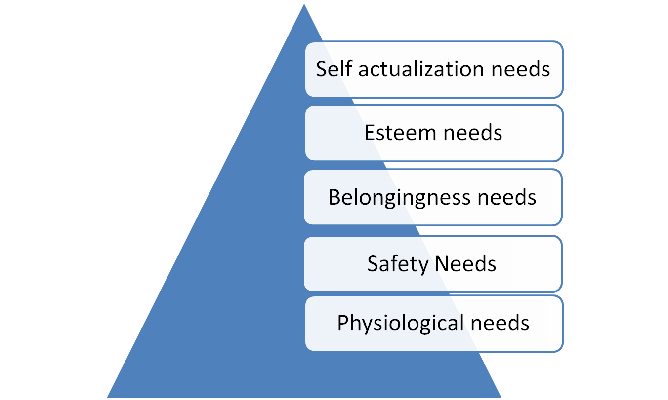
Self-Actualization Motivation by Maslow

Slide 34
Frustration and Conflict of Motives
Sources of frustration
  Environmental Frustration
  Personal Frustration
  Conflict –produced Frustration- motivational conflict, expression of one motive interferes with the expression of other motives
      Approach-Approach Conflict
      Avoidance-Avoidance Conflict ( Vacillation or attempt to leave the conflict situation)
      Approach- Avoidance Conflict
      Multiple Approach-Avoidance Conflicts

Slide 35
Measurement of Social Motives
Find themes or common threads in samples of action
Use “Projective tests” for themes of imagined action or paper and pencil questionnaires for preferences or observations of actual behavior in certain types of situations to bring out expressions of social motives

Slide 36
Projective Tests
Ambiguous or unstructured stimuli people read their own feelings and needs into the ambiguous material.
Thematic Apperception Test

Slide 37
Personality Questionnaire
People answer questions about the strength of their social motives.
Called questionnaires or inventories.
Situational Tests
Creating a situation in which a person’s actions will reveal his or her dominant motives.
Children’s aggressiveness can be measured by giving the child dolls to play with and observing the number of aggressive responses they make.

Slide 38


