Slide 1

PLACEMENT-PROJECT
“STUDENT-PORTAL”
Full-stack web application
NAME:Annamalai ajay .D REG NO: 43130026 BRANCH :BE DEPARTMENT:ECE BATCH:SIST-2027-JFS-02

Slide 2
Abstract:
Project: A full-stack web application called "Student Portal."
Purpose: To centralize and digitize common college services.
Features: Provides students with a single platform for:
Library Book Reservation
Canteen Ordering & Billing
College Event Announcement
Goal: To replace manual processes with an efficient, accessible, and user-friendly online system

Slide 3
Existing System:
Manual Processes: Students must physically visit the library to check book availability.
Inefficient: Long queues at the canteen for placing orders and billing.
Scattered Information: Event and holiday announcements are spread across physical notice boards and emails.
Lack of Centralization: No single, unified platform for student services.
Time-Consuming: Simple tasks require significant manual effort and time.

Slide 4
Proposed System
Centralized Hub: A single web portal for all student-facing services.
User Authentication: Secure registration and login for all students.
Digital Library:
View a live list of all books.
Check real-time availability ("Available" or "Reserved").
Reserve a book online with a single click.
Digital Canteen:
Browse the full canteen menu with prices.
Add items to a digital bill.
Instantly see the total bill amount calculated.
Events Dashboard:
A single, up-to-date feed for all college announcements, fests, and holidays.

Slide 5
Advantages & Disadvantages:
ADVANTAGES | DIS-ADVANTAGES
Efficiency | Internet Dependency
Accessibility: | Simplified Billing
Centralization | Basic Security
User-Friendly | Basic Security

Slide 6
Hardware Requirements
Server:
A PC or cloud server to host the Spring Boot application and MongoDB database.
Client:
Any device with a web browser .
Software Requirements
Backend:Java (JDK 17)Spring BootMaven
Database:MongoDB ServerMongoDB Compass (for
database management)
Frontend :HTML5CSS3JavaScript (ES6+)Development
Tools :Visual Studio Code (VS Code)Operating
System :Windows, macOS, or Linux

Slide 7
MODULES AND DISCRIPTION:
Authentication Module:
Handles new user registration and existing user login.
Uses the Spring Boot API to check credentials against the users collection in MongoDB.
Library Module:
Fetches and displays all books from the books collection.
Shows the real-time reserved status for each book.
Sends a PUT request to the backend API to update a book's status when the "Reserve" button
is clicked.
Canteen Module:
Fetches and displays all items from the canteen_items collection.
Uses JavaScript to create a digital bill when a user clicks "Add to Bill".
Dynamically calculates and displays the total bill amount
Events Module:
Fetches and displays all announcements from the events collection.
Provides a central feed for all college news, sorted by data

Slide 8
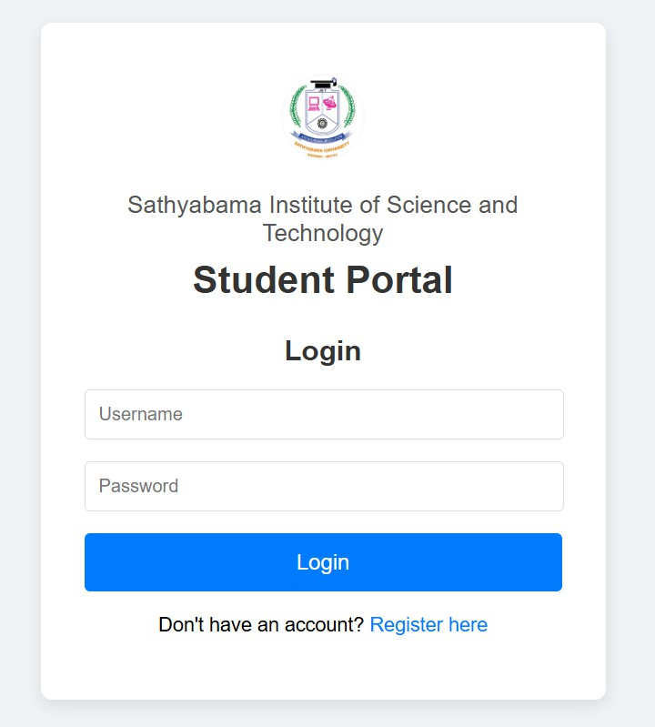
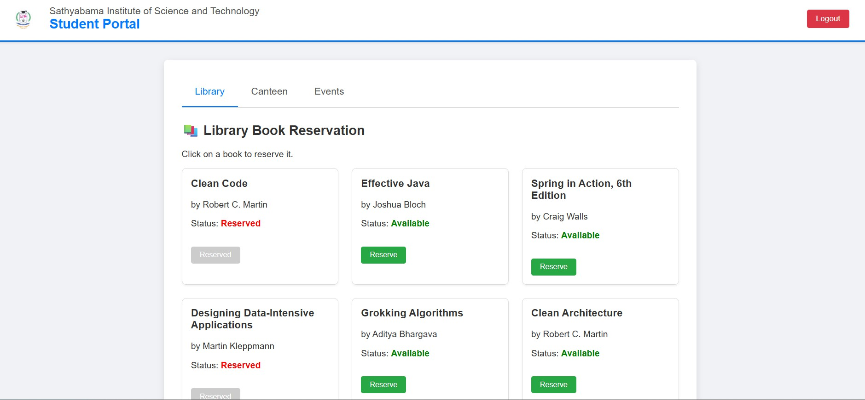
SAMPLE OUTPUT:
LIBRARY
LOG-IN PAGE

Slide 9
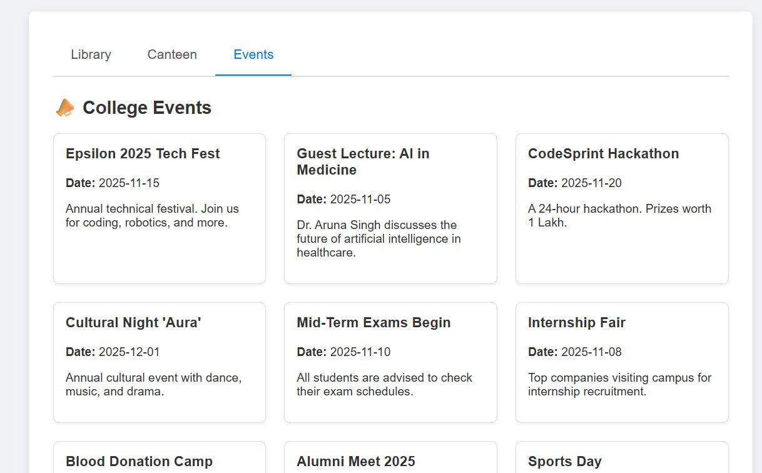
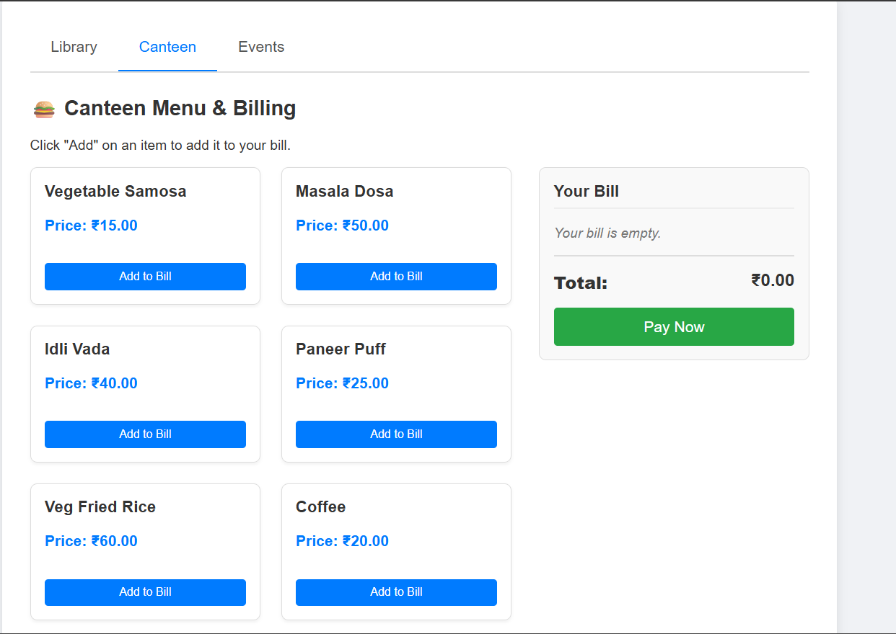
SAMPLE OUTPUT:
CANTEEN MENU AND BILLING
EVENT

Slide 10
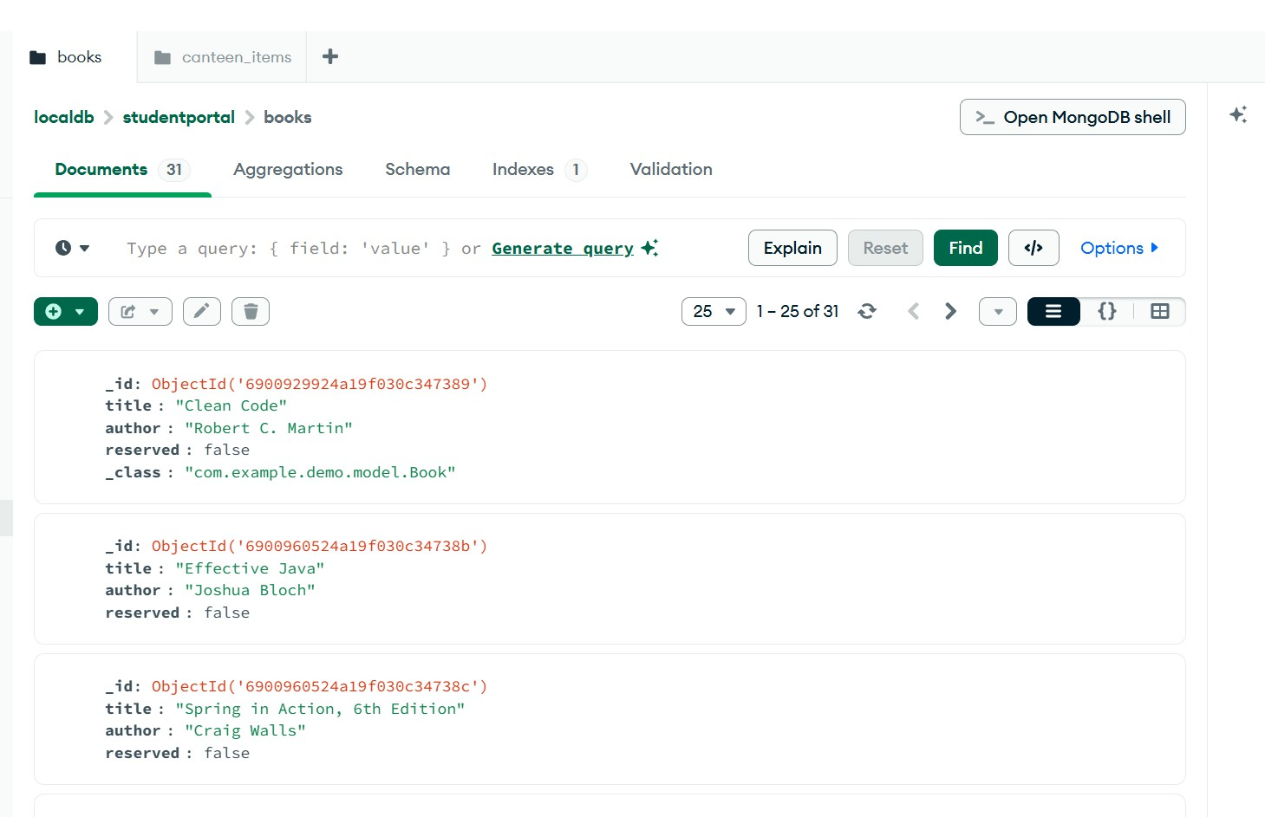
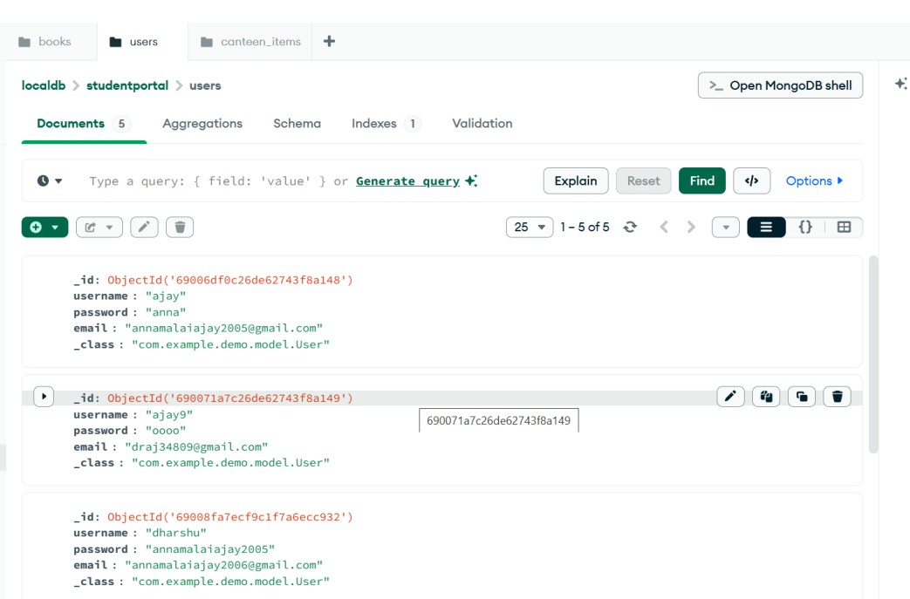
DATABASE (MONGODB):
USER DATABASE
DATABASE FOR BOOKS

Slide 11
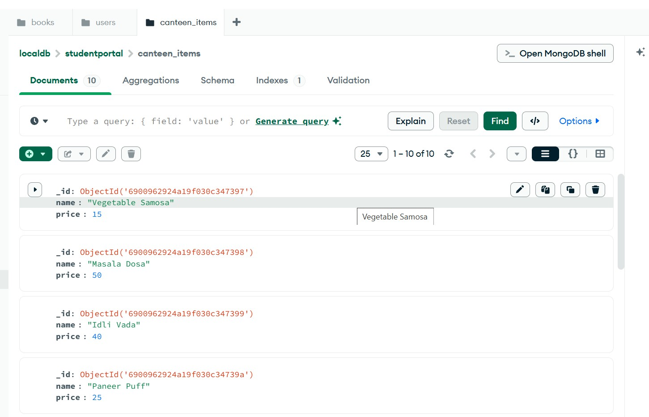
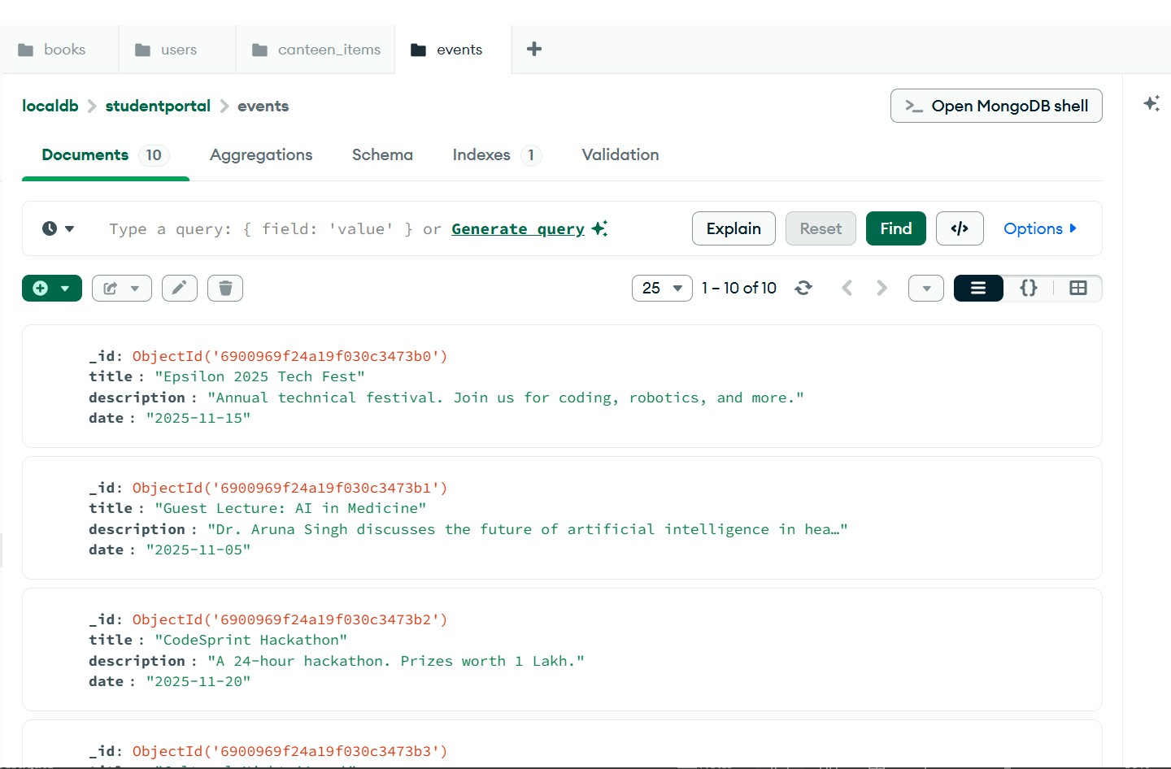
DATA BASE
EVENT DATA
CANTEEN DATA

Slide 12
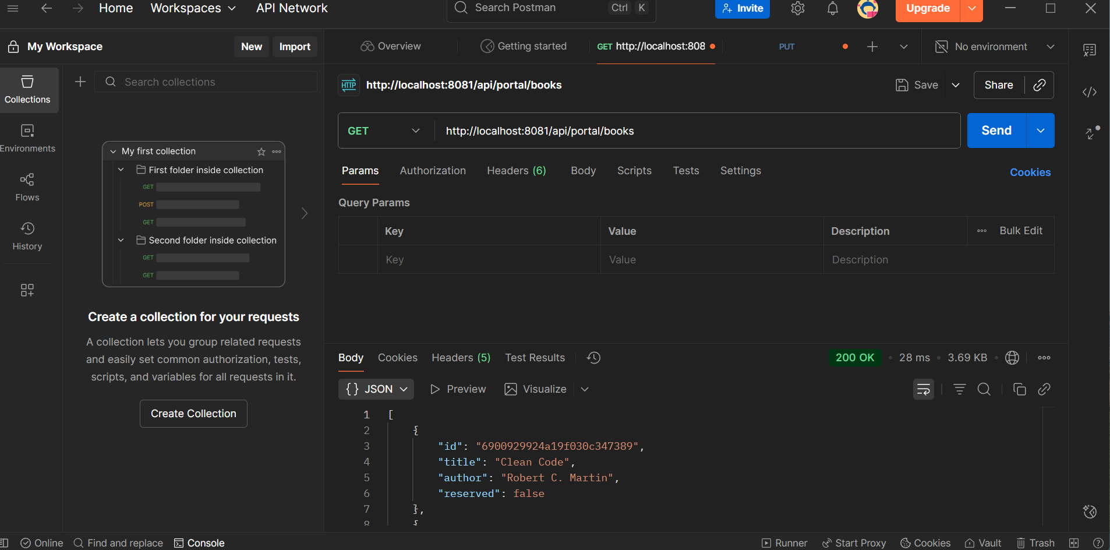
API REQUEST(POSTMAN)
CANTEEN DATA

Slide 13
CONCLUSION:
This project successfully delivers a full-stack, modular Student Portal
application.
It effectively solves the problem of scattered information and manual processes by centralizing services.
The use of Spring Boot, MongoDB, and JavaScript creates a fast, reliable, and user-friendly system.
The current build provides a strong foundation for future development, such as adding an admin panel, a real payment gateway, or a grade-tracking module

