Slide 1

WINGS FOR SUSTAINABILITY
GreenWings

Slide 2
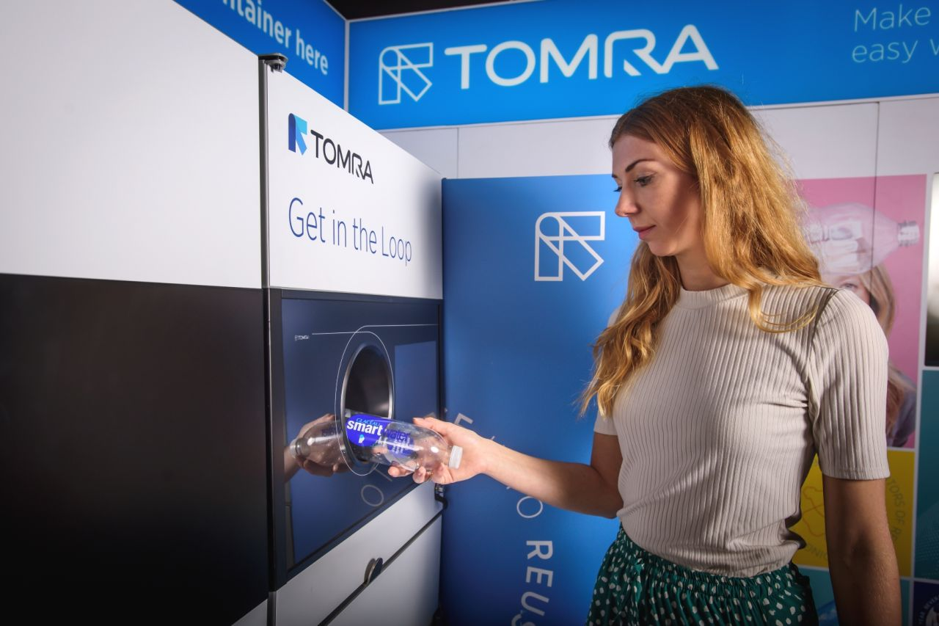
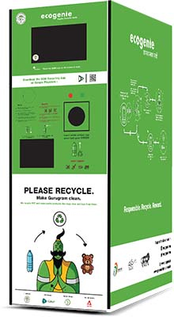
THE PROBLEM
The recycling of all types of packaging is one of the ecological proposals on which Europe focus most insistently.
The EU has proposed to member states to reach the goal of recycling 55% of urban waste by 2025. And for packaging, more concretely, it propose an average of 65%: 50% of plastic, 50% of alluminum, 70% of steel, 75% of paper and cardboard.
To reach this goal it seems that the collaboration between public and private initiative is the solution that is establishing itself in the most convincing way. Among the most satisfying projects, we can find the reverse vending machine, also known as automatic empty collector or, more briefly, intelligent bin, which is making its way more and more because it offers a highly efficient method of identifying the value of each returned container and providing a refund to the customer.
These technologies stimulate consumers versus a more widespread ecological awareness by introducing the idea of ​​restitution and reward.
These machines have spread throughout Europe, especially in the North, where for example, thanks to this, Norway has been able to achieve the highest recycling rate (97% of all plastics and general waste).
Now it seems that this system is also spreading to Southern Europe: in Spain, where the promoter of this recycling system is the Ecoembes company and in Italy where the first company that implemented these machines is RD Italia.
RedBull Italia is trying to introduce these technologies at their events to sensibilize people about waste. But now.. Let’s see our project to make this possible!

Slide 3
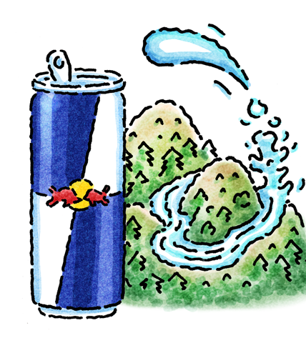
OUR PROJECT
“Redbull gives you wings”
This means it gives you the energy to tackle anything and also reach your dreams. Each one of us is dreaming about a sustainable planet, where people recycle, reduce and reuse, Redbull wants to make this dream a reality, increasing the consumer awareness on this topic and exalting the importance of the circular economy.
GreenWings takes you into an experiential trip during which the user can feel the importance of waste.
In our project we want to treat waste as it should be!
Waste is part of the everyday life of each human being and if well-treated it could become very useful. Paper, plastic, aluminium, glass, they are all reusable to generate something again and satisfy new needs.
The problem is that many people are unaware of the thousands of possible applications of these materials and do not treat waste with the respect it deserves.
GreenWings has 3 major goals:
teach
retain
push people to take good actions
How it does it?
trough an interactive experience that follows the user step by step
an app that makes everything even more interesting
rewards and possibilities to do something good

Slide 4
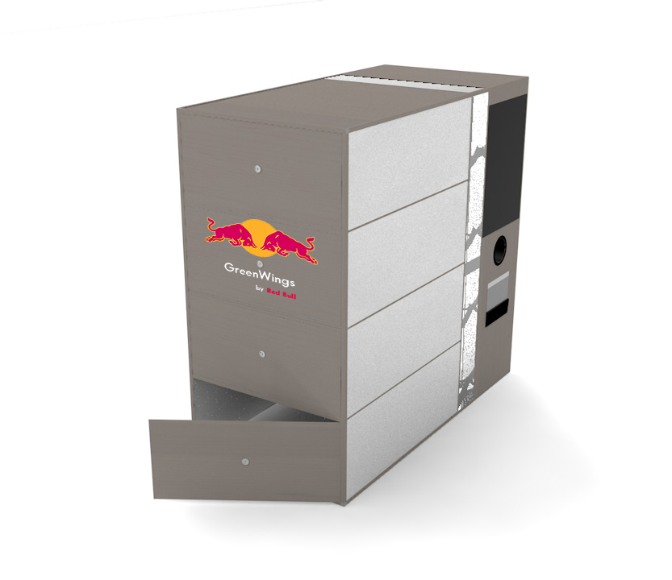
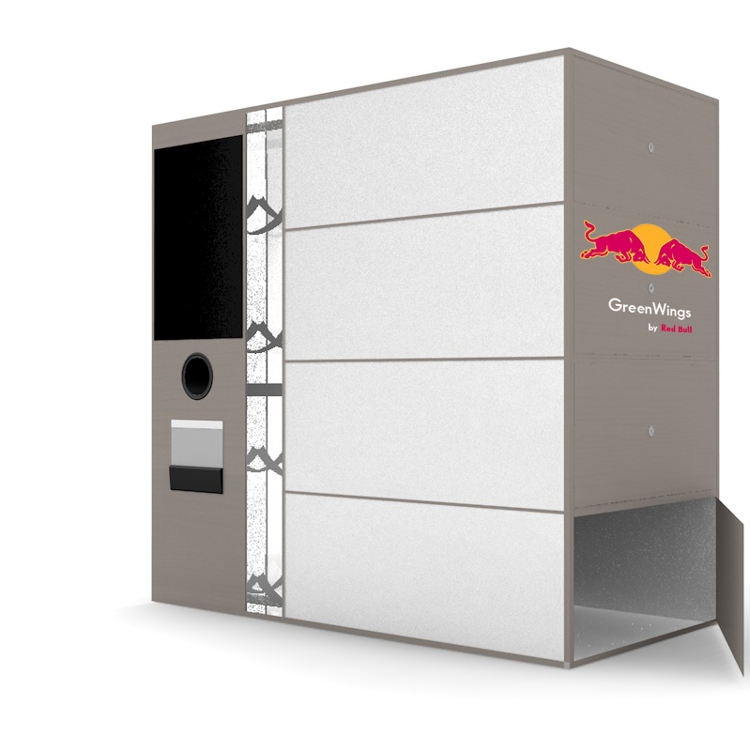
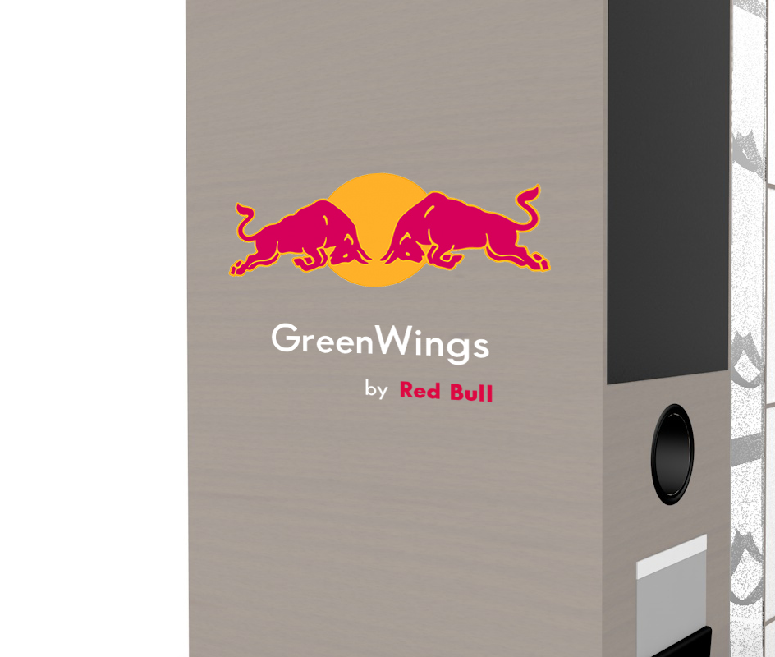
DESIGN AND TECHNICAL ASPECTS
GreenWings was conceived as a large object that is noticeable even from long distances. In fact it is quite impressive, with a height of 1.8 meters and a width of 1 meter.
It is built completely with recycled materials: resysta, aluminium, glass and ecological polystyrene. Resysta is an extremely durable material made up of 60% rice husk, 22% common salt and 18% mineral oil and maintains the visual appearance of the wood. This is the material that will give to GreenWings a premium design in the complete respect of the planet.
The machine is attractive and intuitive, by approaching it is possible to see an hole with a roller and a very large screen. The roller technology is already used in more than 40 countries, examples of it are:
Palpa company, a Finnish company that manages the return system of beverage packages;
TOMRA company in Germany and Norway;
Recycle N Save in in SIngapore.
Those technological systems are the ones we want to implement in GreenWings. In this way, the recycling tool will ensure that the waste inserted respects some standards.
Each inserted waste is read and analyzed with a sensor, if the trash is respecting the desired criterias the process continues, otherwise the rectangular hole, below the circular one, gives the trash back.

Slide 5
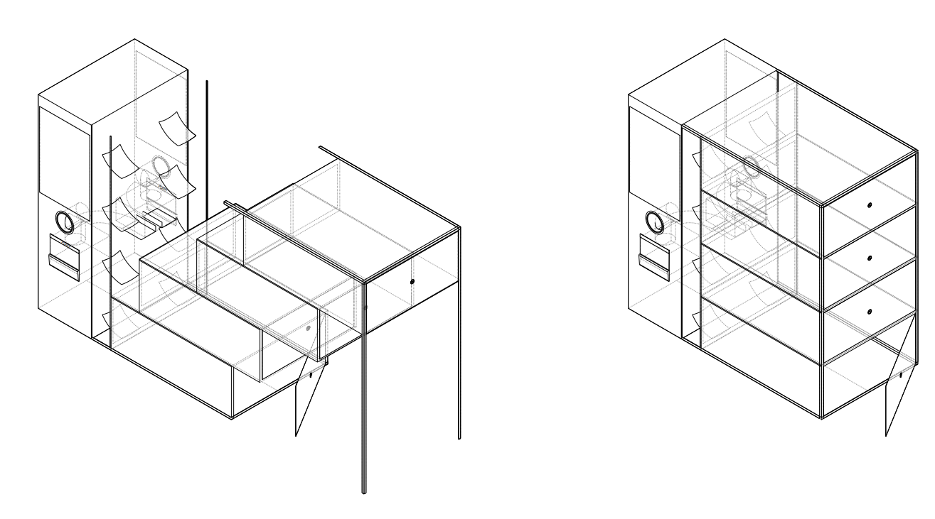
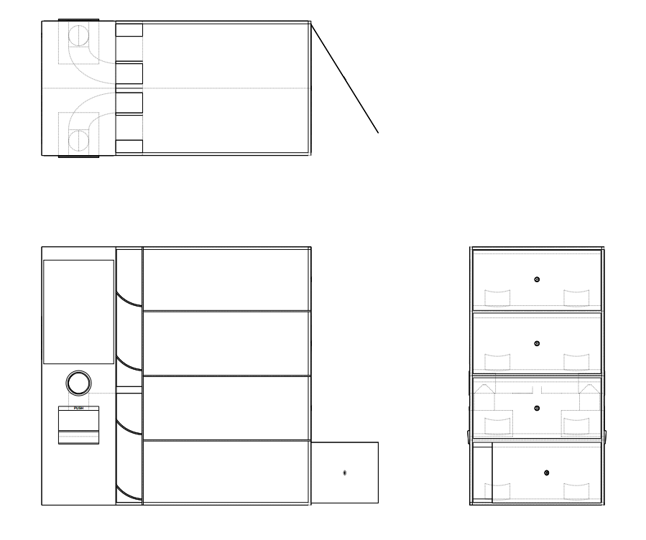
DESIGN AND TECHNICAL ASPECTS
Then there is the big screen, which plays a fundamental role in the overall experience, allowing a step by step interaction.
Initially it helps the user with the recognition of the waste characteristics and the separate collection, then it teaches him/her on how to get rewards.
GreenWings informs you, instructs you and treats the waste as something of value that slides from the roller to an illuminated lift that transports trash to the appropriate basket. This enhances the importance of waste and therefore of the contribution it is generating in the circular economy of recycling. In fact, you have a “symbolic” transport of waste, from the roller to the bin. Once in the bin, the basket emits a light signal, through LEDs embedded in the frosted glass that covers the frontal facade of the entire structure.
But it’s not all, the interaction is also doubled! GreenWings has indeed two holes and two screens, one on one side and one on the other, so that it will be possible to optimize times, and speed up the process, enhancing its importance. The more people recycle, the greater the positive impact on the environment!
To conclude, on both lateral sides there is the logo of redbull incised into the fake wood and the left side has 4 thresholds to empty the baskets once the IoT devices communicated their fullness.

Slide 6






HOW IT WORKS – THE WORKFLOW
Our item is designed for any type of user at an event, of any size. The object is immediately visible and its design encourages the user to get closer. Thanks to a very intuitive interface, the person will immediately know what he has to do: first, introduce the waste inside the hole that will be in front of him.
Then, after the machine has recognized the item, he will be asked to confirm the type of garbage, if the garbage respects the standards to be recycled, it will be transported to the appropriate bin.
While this process happens, the customer will be able to continue interacting with the interface.
Each piece of trash he introduces is associated with “wings” (our tokens), which can be redeemed immediately, by participating in charitable donations for the improvement of the environment, or collected through an app to win extraordinary experiences.
Get closer to GreenWings Introduce waste Follow the instruction Collect Wings or donate Well done!
in the interface You are a recyclist!

Slide 7
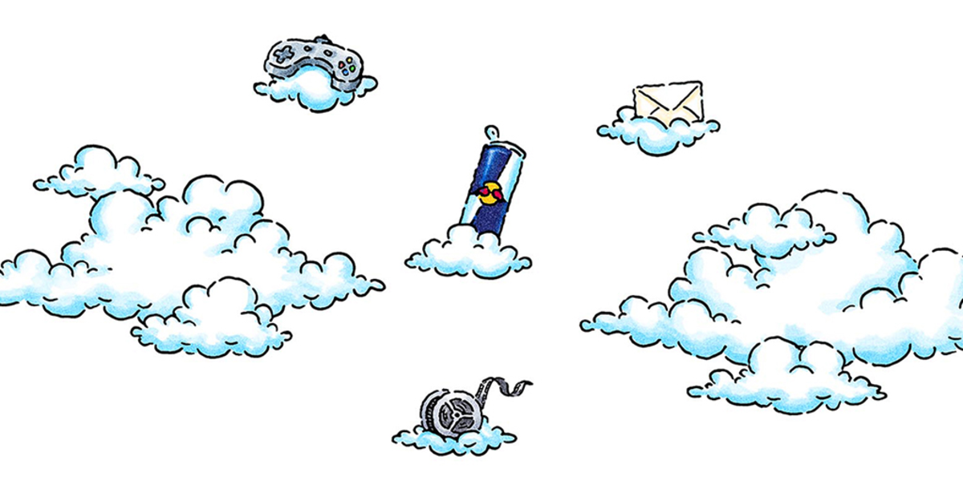
OUR APPROACH
Customer centered methodologies to push people to be actively sustainable!
We believe that every project should be born from listening to people, their needs and their requirements.
For this reason, since the first phase of ideation, we have adopted a customer-centered approach, putting ourselves in the shoes of the user and trying to simplify the flow and eliminate as many usability barriers as possible.
But in addition to ease of use, our goal is another, much higher.
The object we have designed should not only encourage people to recycle, but should establish in them a constant need to act personally to improve the situation of the planet.
And this is encouraged with our rewards, designed specifically for this purpose.

Slide 8
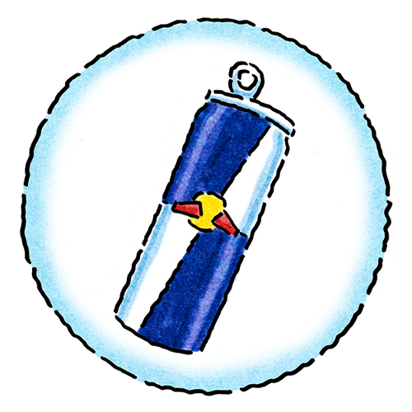
GreenWings’ REWARD SYSTEM
GreenWings’ reward system relies on tokens. We call them “wings” and they are the core of the recycle tool’s interaction. Wings work as a coin during the entire Redbull event and you get them by using the recycling tool.
The idea is that every piece of trash has a value which is given back to the user in the form of “wings”. Every time waste is inserted in the hole you get wings. “Wings” are cumulative but in order to use them in heaps it’s necessary to download an app. We’ll talk about the app later on this presentation, first just focus on how the wings work and can be used.
“Wings” are used for many purposes, but sustainability is always taken into consideration. This means that you can use tokens to:
obtain discounts for participating in subsequent Redbull events;
get a Redbull gadget made with recycled materials and phrases that motivate people to take more sustainable attitudes (bag, cloth bag, keychain), things to use every day;
obtain discounts on the purchase of cans.

Slide 9
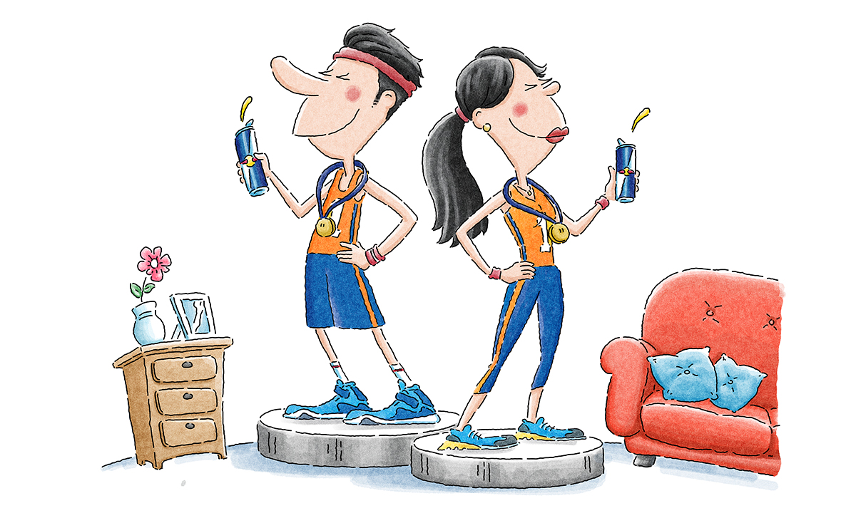
GreenWings’ REWARD SYSTEM
Each time that tokens are used for the purposes just listed, part of them are used to contribute to sustainable projects, so in order to get discounts or gadgets you must reach a certain number of tokens that allows you to donate, which is mandatory, and purchase cans or gadges or obtain discounts.
In the event that a person does not want to accumulate, because he does not want to download the app, then you have the option of giving them in sustainable projects such as:
construction of green buildings (taking the vertical forests of Milan as an example);
donation to sustainable Italian startups to help founders develop their business. In this case, each tokens is converted into real currency of value x. (eg. Cynomys, Planeta Renewables, U-Earth, O2Forest, 3Bee, Grycle, Orange Fiber, Pcup, Sfridoo, Krill Design, Bettery, Hurba, Hexagro, Sfera Agricola, Airlite);
contribution to certified local projects of sustainable nature.
Making donations to sustainable programs compulsory is part of our strategy to push people taking sustainable actions and support the planet. Our fear is that with no restrictions, people would accumulate without ever donating and the aim of the entire tool wouldn’t be understood.
Of course, there is also the option to just donate in the app!

Slide 10
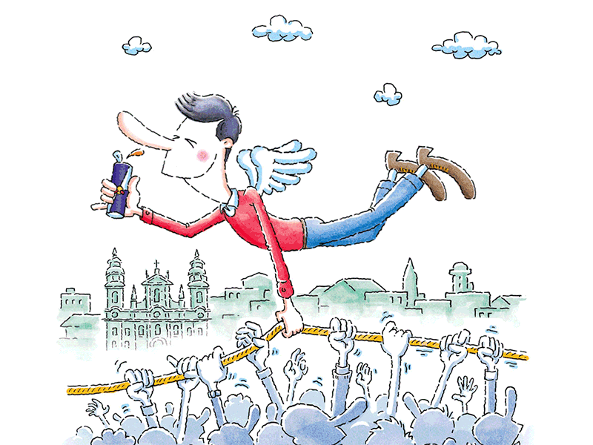
ANGELS OF SUSTAINABILITY
GreenWings gives the chance to win a lot of rewards, you just have to recycle as much as possible!
To encourage the use of GreenWings during Red Bull events, we introduced also a rank to reward the “Sustainability Angels”, who are the people that recycle more.
There are two possibility to win this “price”:
being the Sustainability Angel of the event;
electing the Sustainability Angel of the year, who is the person who donated more into sustainable projects;
To be the sustainability angel of the event, you have to recycle more than anyone else, by collecting the biggest number of wings. This method will also encourage people to collect waste from the ground, to get more wings. In the monitor of ***** there will be a screen with a countdown, and at the end of the countdown the Sustainability angel will be elected.
Examples of prices for the “Sustainability angel” are:
meet and greet with people that change as the type of the event; like influencers, or note person specialist of the sector;
the possibility of going in the backstage;
free ticket for another Redbull event;
possibility of doing free experiences within the event;
discounts.

Slide 11
COMMUNICATION STRATEGY
The communication strategy has four main bjectives:
To let people know about GreenWings
2. To let people know about Redbull commitment to sustainability
3. To show how the Greenwings works and how easy it is to use it
4. To create a community

Slide 12
OBJECTIVES 1 AND 2: IMPLEMENTATION
Pre-event sponsorship with the collaboration of an opinion leader (ex: Alex Bellini, who has already collaborated with Redbull several times).
The objective let people known about the position of Redbull on the theme of "sustainability and new habits“.
Redbull wants to promote a more sustainable lifestyle, involving everyone, sportsmen and women alike.
To raise awareness about the issue, making some videos can be a good idea, where the opinion leader will tell briefly and in an engaging way about the existence of the GreenWings app that allows you to interact with GreenWings tool. The videos can be spread through the app and/or through the Instragam page.

Slide 13
OBJECTIVE 3: IMPLEMENTATION
To demonstrate the ease of use of GreenWings, guerrilla marketing techniques are the best option.
The idea is to place the tool in a visible way, inside the structure/location hosting the Redbull event and film from a distance how people interact with it.
It would be interesting to interview some of these people on video to get immediate post-interaction feedback, as a demonstration of the simplicity and accessibility of the interactive tool.
Lastly, in the video, we would like to show the steps of the user experience from start to finish:
scanning QR code to download the app
entering trash
scanning QR for tokens and
using tokens for various projects

Slide 14
OBJECTIVE 4: IMPLEMENTATION
Redbull aims to create a digital community that has a sustainable lifestyle.
This can be accomplished through the app and known gamification techniques.
Our methods will be:
realization of an overall ranking where those who invest tokens in sustainable projects accumulate points;
possibility to propose local sustainable projects, to which users can donate tokens
tips on recycling and possibility to comment and share
Ambassadors/opinion leaders who raise awareness.

Slide 15
WHY IS THIS A WINNING SOLUTION?

Slide 16
1SUSTAINABILITY
BY DEFINITION, EVENTS HAVE ALWAYS BEEN PLACES WHERE AN IMMENSE AMOUNT OF WASTE IS CONSUMED, AND MANY TIMES IT IS NOT RECYCLED AS IT SHOULD BE.
The object we designed will make it possible to differentiate waste in a completely new way, never seen before, so that even events can be places where the environment is respected.

Slide 17
2INNOVATION
NOWADAYS EVERYONE INTERACTS WITH TECHNOLOGY. OUR GOAL IS TO USE IT FOR A GOOD CAUSE.
Thanks to the interface with which the user interacts, the object is designed to perform all functions in an automatic and innovative way. The app and the mechanisms inside the machine have been conceived to make the user participate in all phases of waste recycling.

Slide 18
3DIGITAL
DIGITAL, AS WE ARE!
The tool can claim to have one of the best technologies to cope with recycling and sustainability. The aim of this technology is to make the experience of recycling a smart and convenient one, so that the user is involved and spurred on.

Slide 19
4INTERNATIONAL
EUROPE INSPIRED US!
Our team is currently living across Europe, we are experiencing different realities and taking inspiration from them. In particular, we are based in Venice (Italy), Madrid (Spain), Barcelona (Spain), Oslo (Norway) and London (United Kingdom).
Each one of us, has analyzed the situation of the country where we are regarding the sustainability of waste recycling. Our tool and the communication strategy are the result of a good analysis of European solutions, we took inspiration from solutions that these countries already propose, trying to improve them more and more.

Slide 20
5EXPERIENCE
SEAMLESS AND ELEGANT.
The tool is intuitive and easy to use. It is visible and has an elegant design.
The app is thought to be directly connected to the tool to make the experience seamless and easy for the users. Moreover it is easily accessible through the QR code, gives a lot of advices about recycling, gives the possibility to add local projects and to to meet and hear speeches of the most important opinion leaders and so to spread the world about sustainability.

Slide 21
“We are at a tipping point, which means that we still have the opportunity to tip things back in the right direction if we act NOW”.
Join the wave
with GreenWings

Slide 22
OUR TEAM
VITTORIA LAZZER
SOFIA FAVARO
AURORA MENEGATTO
MELISSA MATTIOLI
ANNA NARDO

Slide 23
CONTACTS
In the case of doubts or questions contact:
Vittoria Lazzer: vittoria.lazzer@student.h-farm.com
Melissa Mattioli: melissa.mattioli@student.h-farm.com
Aurora Menegatto: aurora.menegatto@student.h-farm.com
Sofia Favero: sofia.favero@student.h-farm.com
Anna Nardo: anna.nardo@student.h-farm.com

