Slide 1
Blinkit Sales Data Analysis
Name: Annanya Mojumder
College Name:Guru Nanak Institute Of Technology
Department : Computer Science and Engineering
Semester : 7th
Internship Under: Classroom
📞 Phone: 8981838547
🌐 Website: https://classroomtech.in
🔗 LinkedIn: https://www.linkedin.com/company/classroom-tech/
📆 Duration: 1st April 2025 – 30th June 2025

Slide 2
Acknowledgement
I would like to express my heartfelt gratitude to Classroom for providing me with this valuable internship opportunity.
I am especially thankful to Satyaki Das for his constant support, feedback, and guidance throughout the project.
Lastly, I am grateful to my peers and teammates who contributed to discussions and enriched my understanding.

Slide 3
Table of Contents
Acknowledgement Page 2
Objective / Problem Statement Page 4
Dataset Overview Page 5
Tools Used Page 6
Methodology Page 7
Visualizations Page 8-43
Key Findings Page 44
Conclusion Page 45
References Page 46
GitHub Repository Page 47
Thank You Page 48

Slide 4
Objective / Problem Statement
• Goal: Analyze Blinkit sales to identify trends and improve strategies.
• Questions:
- What are the most sold product categories?
- When are peak order times?
- Which cities highest sales?

Slide 5
Dataset Overview
Dataset Source: Kaggle
Number of rows and columns for each dataset:
• blinkit_customer_feedback.csv → 5000 rows × 8 columns
• blinkit_customer.csv → 2500 rows × 11 columns
• blinkit_delivery_performance.csv → 5000 rows × 8 columns
• blinkit_inventory.csv → 75172 rows × 4 columns
• blinkit_inventoryNew.csv → 18105 rows × 4 columns
• blinkit_marketing_performance.csv → 5400 rows × 11 columns
• blinkit_order_items.csv → 5000 rows × 4 columns
• blinkit_order.csv → 5000 rows × 10 columns
• blinkit_products.csv → 268 rows × 10 columns

Slide 6
Tools Used
• Power BI – For data modeling and visual storytelling
• GitHub – For version control and project sharing

Slide 7
Methodology
• Data Cleaning:
Removed nulls, handled outliers
Removed zero/negative price entries.
Removed outliers in stock, price, and delivery time to ensure accurate analysis.
Merged relevant tables using relationships
• Visualization:
Created KPI Cards to highlight key metrics like Total Revenue, Average Order Value, ROAS.
Used Bar & Column Charts to compare product sales, stock trends, and order quantities.
Applied Pie Charts to display customer segments and feedback categories.
Designed Scatter Plots & Maps to analyze delivery efficiency and order locations.
Implemented Funnel Charts & Decomposition Trees for campaign and sales breakdowns.

Slide 8
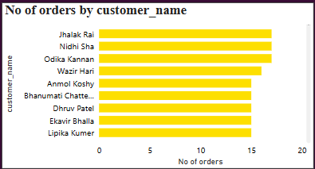
Visualization : Orders per Customer
Insights:
Jhalak Rai, Nidhi Sha, and Odika Kannan are the top three repeat customers.
Most top customers placed 15–19 orders over the period.
Indicates strong customer loyalty and potential for targeted retention programs.
Purpose:
To identify which customers placed the highest number of orders.

Slide 9
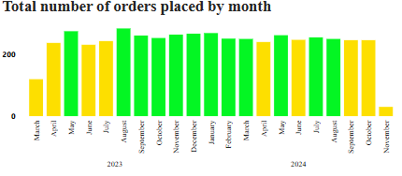
Visualization : Monthly Order Volume
Insights:
May and August 2023 had the highest order volumes (around 250+).
A consistent order rate is seen from September 2023 to April 2024.
Noticeable drop in orders in November 2024, likely due to incomplete data or seasonal decline.
Purpose:
To analyze order trends over time and identify high-performing months.

Slide 10
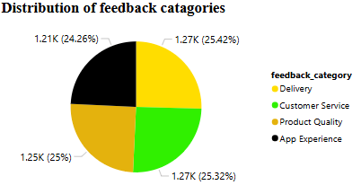
Visualization : Feedback Distribution
Insights:
Feedback is evenly distributed: Delivery, Customer Service, Product Quality, and App Experience are all around 25%.
Indicates balanced attention required in all areas of customer experience.
No major category dominates, showing diverse concerns among users.
Purpose:
To visualize how customer feedback is distributed across different categories.

Slide 11
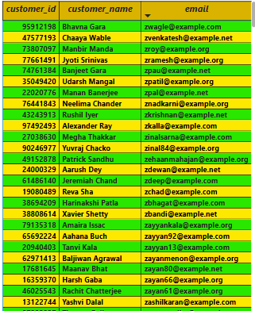
Visualization : Customer Table
Insights:
Useful for segmentation, personalized campaigns, or communication.
Data includes over 20 customers with structured contact details.
Purpose:
To display customer IDs, names, and emails for analysis or reference.

Slide 12
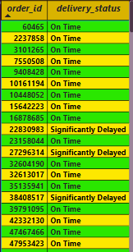
Visualization : Orders by Delivery Status
Insights:
Majority of orders are marked as On Time.
Only a small portion of orders are Significantly Delayed, indicating efficient delivery service.
Can be used to track performance of logistics over time.
Purpose:
To filter and view orders based on their delivery status (e.g., On Time, Significantly Delayed).

Slide 13
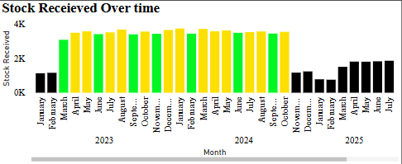
Visualization :Stock Received Over Time
Insights:
Peak stock receipts observed during mid-2023 to mid-2024.
A drop in stock is seen in late 2024, followed by a rise again in early 2025.
Helps identify inventory gaps and procurement patterns.
Purpose:
To analyze how much stock was received monthly from January 2023 to July 2025.

Slide 14
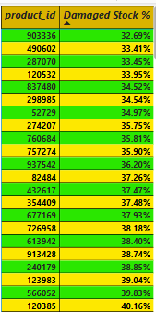
Visualization :Damaged Stock Percentage
Insights:
All products listed have damaged stock percentages above 30%, indicating a quality control issue.
Highest damaged stock % is around 41.26%, which may need urgent supplier review.
Overall damage rate is 54.41%, a significant concern for operational costs.
Purpose:
To calculate and rank products based on the percentage of damaged stock.

Slide 15
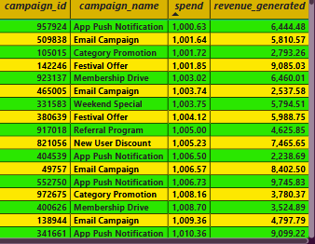
Visualization :Campaign Performance
Insights:
Campaigns like Festival Offer and Referral Program have the highest revenue returns.
Category Promotion campaigns also show efficient revenue vs spend ratios.
Useful for planning future marketing budgets.
Purpose:
To review the ROI of different marketing campaigns..

Slide 16
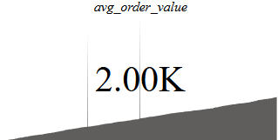
Visualization : Average Order Value (KPI Card)
Insights:
The average order value is ₹2,000, suggesting customers typically spend a moderate amount per transaction.
Can help set promotional thresholds or free delivery minimums.
Purpose:
To display the average monetary value of each order across all transactions.

Slide 17
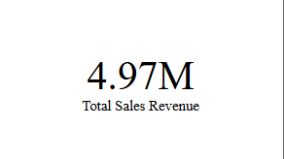
Visualization : Total Revenue from All Campaigns
Insights:
The cumulative revenue is ₹4.97 million, showcasing a successful overall campaign performance.
Can be used as a benchmark for future targets.
Purpose:
To display the total revenue generated from all sales or marketing campaigns.

Slide 18
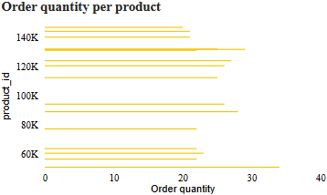
Visualization : Product-wise Order Quantity
Insights:
Products like 992178 and 991443 have the highest order quantities.
A few products show relatively low order numbers, indicating low demand or visibility.
Purpose:
To compare how many times each product was ordered.

Slide 19
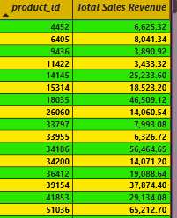
Visualization :Sales Revenue by Product
Insights:
Product 51036 alone generated over ₹65K in revenue.
Top 5 products contribute a significant portion of overall revenue, indicating their importance in inventory decisions.
Purpose:
To calculate and display revenue generated by individual products.

Slide 20
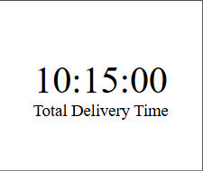
Visualization : Total Delivery Time(Card)
Insights:
Total delivery time logged is 10 hours and 15 minutes.
Useful in analyzing efficiency and identifying time delays in logistics.
Purpose:
To calculate the cumulative delivery time using actual_time - promised_time.

Slide 21
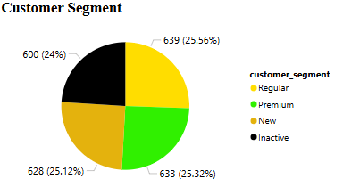
Visualization : Customer Segment Distribution
Insights:
Segments are fairly balanced: Regular (25.56%), Inactive (24%),Premium(25.32%),
New(25.12%).
The Premium segment is almost equal in size to Regular and New.
Helps in tailoring marketing strategies for each group.
Purpose:
To visualize how customers are segmented based on behavior or purchase history.

Slide 22
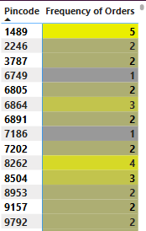
Visualization : Pincode Heatmap
Insights:
Pincode 1489 has the highest number of orders (5).
Most pincodes have 2–3 orders, indicating distributed demand.
Helps target areas with higher engagement for local promotions.
Purpose:
To analyze which locations (pincodes) have the most customer orders.

Slide 23
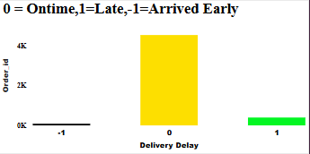
Visualization : Delivery Delay Analysis
Insights:
Majority of deliveries are on time.
A small fraction arrived early, while late deliveries are rare.
Demonstrates strong operational efficiency.
Purpose:
To visualize and categorize orders based on their delivery status: 0 = On Time, 1 = Late, -1 = Arrived Early.

Slide 24
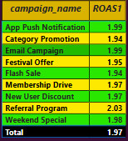
Visualization : Campaign ROAS Comparison
Insights:
Referral Program has the highest ROAS (2.03), indicating great efficiency.
Most campaigns have ROAS around 1.95–2.00, reflecting consistent performance.
Can be used to optimize budget allocation in future campaigns.
Purpose:
To measure and compare the Return on Ad Spend across multiple marketing campaigns.

Slide 25
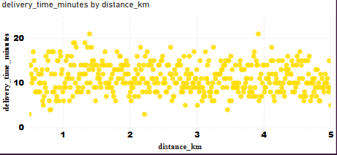
Visualization : Delivery Efficiency Analysis (Scatter Plot)
Insights:
No strong correlation: delivery time fluctuates regardless of distance.
Indicates other factors (traffic, time of day, logistics) may influence delivery time more than distance.
Useful for performance optimization.
Purpose:
To analyze the relationship between delivery distance and delivery time.

Slide 26
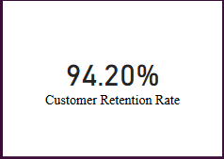
Visualization : Customer Retention Rate
Insights:
Retention rate is 94.20%, indicating excellent customer loyalty.
Suggests successful user experience and repeat engagement.
Useful for projecting future revenue and customer lifetime value.
Purpose:
To measure how many customers return to place another order.

Slide 27
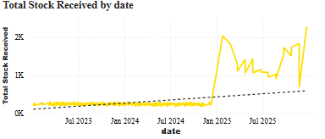
Visualization : Total Stock Received Over Time with Forecast
Insights:
Stock received increases sharply from early 2025.
The dotted trendline suggests a continued upward movement in demand.
Important for procurement and warehouse planning.
Purpose:
To forecast future stock needs using trends from past received stock data.

Slide 28
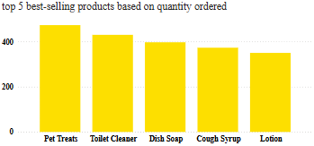
Visualization : Top 5 Best-Selling Products
Insights:
Pet Treats and Toilet Cleaner are top sellers.
All top 5 products have over 350 units sold.
Indicates where inventory priority and promotions should focus.
Purpose:
To identify the most frequently ordered products.

Slide 29
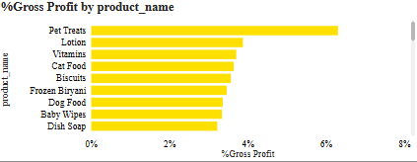
Visualization : Gross Profit by Product
Insights:
Pet Treats has the highest gross profit (~8%).
Dish Soap and Baby Wipes have the lowest margins (~2%).
Helps optimize pricing and marketing around high-margin items.
Purpose:
To calculate and compare gross profit margins for individual products

Slide 30
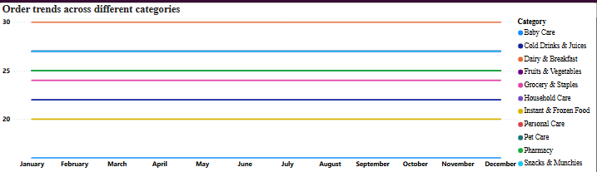
Visualization : Order Trends Across Different Categories
Insights:
Baby Care consistently has the highest order volume (~30 orders monthly).
Pharmacy and Instant & Frozen Food see relatively lower order volumes.
Trends remain stable over the year—suggesting consistent customer preference.
Purpose:
To analyze how different product categories perform over the months.

Slide 31
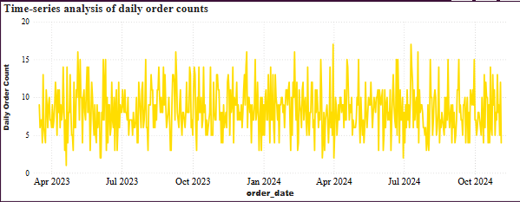
Visualization : Time-Series Order Analysis
Insights:
Orders remain steady, with minor peaks and troughs.
Some short-term spikes might align with campaigns or holidays.
No major long-term increase/decrease—indicates market stability.
Purpose:
To observe daily order volume fluctuations and trends over 2023–2024.

Slide 32
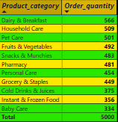
Visualization : Product Category vs Order Quantity
Insights:
Dairy & Breakfast leads with 566 units, followed by Household Care and Pet Care.
Lower quantities in Baby Care and Cold Drinks indicate seasonal or niche demand.
Ideal for inventory planning and category-specific promotions.
Purpose:
To display which categories have the highest cumulative product orders.

Slide 33
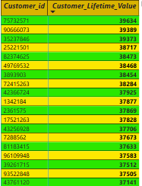
Visualization : Customer Lifetime Value
Insights:
Top customers show lifetime values over ₹39,000, with a long-term revenue potential.
LTV distribution helps segment premium vs casual buyers.
Crucial for targeted loyalty campaigns.
Purpose:
To calculate lifetime value based on avg_order_value × total_orders.

Slide 34
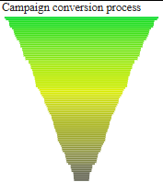
Visualization : Campaign Conversion Funnel
Insights:
Sharp drop at each stage shows potential leaks in the funnel.
Indicates high drop-off before final conversion.
Helps refine campaign messaging and targeting at each level.
Purpose:
To visualize how users progress through stages of a marketing campaign.

Slide 35
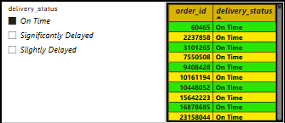
Visualization : Filter Orders by Delivery Status(Using Slicer)
Insights:
Interactive slicer allows quick filtering by delivery status.
Current view shows all selected orders as On Time.
Great tool for real-time logistics performance tracking.
Purpose:
To dynamically filter and display orders based on delivery performance (On Time, Slightly Delayed, Significantly Delayed).

Slide 36
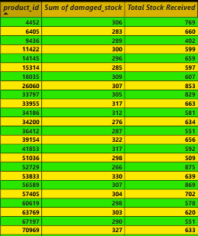
Visualization : Merged Stock Report
Insights:
Products like 6405 and 9436 have damage counts over 280 units.
Total Stock Received ranges between 400 and 900 per product.
Useful for identifying suppliers or SKUs with consistent quality issues.
Purpose:
To analyze and compare total received stock and damaged stock per product.

Slide 37
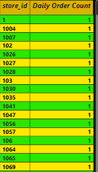
Visualization : Daily Order Count by Store
Insights:
All listed stores have exactly 1 order in the dataset (current filtered view).
Total of 3,470 orders processed—shows high store engagement.
Ideal for evaluating store-wise order fulfillment performance.
Purpose:
To track the number of orders processed per store location.

Slide 38
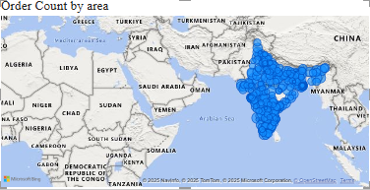
Visualization : Geographic Order Distribution
Insights:
High order density in metro cities and Tier-1 zones.
North and South India show more coverage than the Northeast.
Supports regional expansion and logistics resource allocation.
Purpose:
To visualize which regions place the most orders.

Slide 39
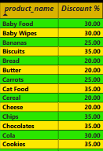
Visualization : Product-wise Discount Percentage
Insights:
.Products like Chocolates, Cookies, and Chips offer up to 35% discount.
Majority of items fall in the 20%–30% discount range.
Useful for identifying top-discounted products to promote.
Purpose:
To show the calculated discount percentages by comparing Price and MRP.

Slide 40
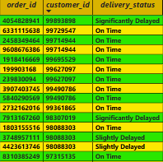
Visualization : Live Order Delivery Status
Insights:
Most deliveries are On Time, with a few marked as Slightly Delayed.
Helps customer service teams monitor exceptions in real time.
Useful for immediate operational decision-making.
Purpose:
To track the live status of orders and delivery outcomes.

Slide 41
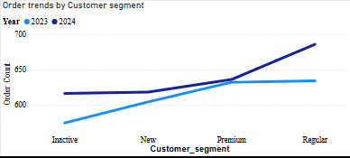
Visualization : Order Trends by Customer Segment (Drill-down)
Insights:
Regular and Premium customers show an upward order trend into 2024.
Inactive segment shows a flat trend, indicating limited re-engagement.
Drill-down can further reveal trends by region, campaign, or product.
Purpose:
To analyze how order volume trends across segments (Inactive, New, Premium, Regular) over time.

Slide 42
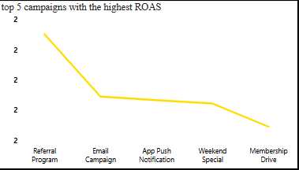
Visualization : Top 5 ROAS-Performing Campaigns
Insights:
Referral Program delivers the best return.
Campaigns like Member Drive underperform in comparison.
Can inform future ad budget prioritization.
Purpose:
To identify the most efficient marketing campaigns using ROAS metric.

Slide 43
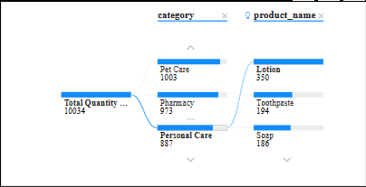
Visualization : Decomposition of Product Sales by Category
Insights:
Pharmacy and Pet Care are top categories based on quantity sold.
Within Personal Care, items like Toothpaste and Soap perform well.
Great for multi-level drill-down analysis and exploring sales hierarchies.
Purpose:
To visually break down total sales into category-wise and product-wise contributions.

Slide 44
Key Findings
Customer retention is high at 94.20%, with Regular and Premium segments placing the most orders.
Pet Treats is both the best-selling and highest-margin product.
The Referral Program delivers the highest ROAS among all campaigns.
Most deliveries are on time, but some products show recurring damaged stock.
Sales trends, order heatmaps, and store-level data support smarter regional planning.

Slide 45
Conclusion
Through this analysis, I learned how to use Power BI to clean data, build interactive dashboards, and extract meaningful business insights. It helped me understand customer behavior, sales trends, and campaign performance using real-world datasets. This project also strengthened my skills in data visualization, DAX, and report storytelling. The insights generated can guide decision-makers in optimizing product offerings, improving delivery efficiency, and allocating marketing budgets more effectively. Overall, this analysis supports data-driven strategies to enhance customer satisfaction and business growth.

Slide 46
References
Dataset Source: [Kaggle – Blinkit Sales Dataset]
Visualization Tool: Microsoft Power BI
Report Hosting: GitHub (Your project repository link)
Internship Platform: Classroom Tech
Official LinkedIn: Classroom Tech – https://www.linkedin.com/company/classroom-tech/

Slide 47
Thank You
Name : Annanya Mojumder
Email : annanyamajumder22@gmail.com
LinkedIn : https://www.linkedin.com/in/annanya- mojumder-3734a81a4/

