Slide 1



Movies and Shows Dashboard
View in Power BI
Last data refresh:
4/13/2024 10:17:33 PM UTC
Downloaded at:
4/13/2024 10:19:15 PM UTC

Slide 2
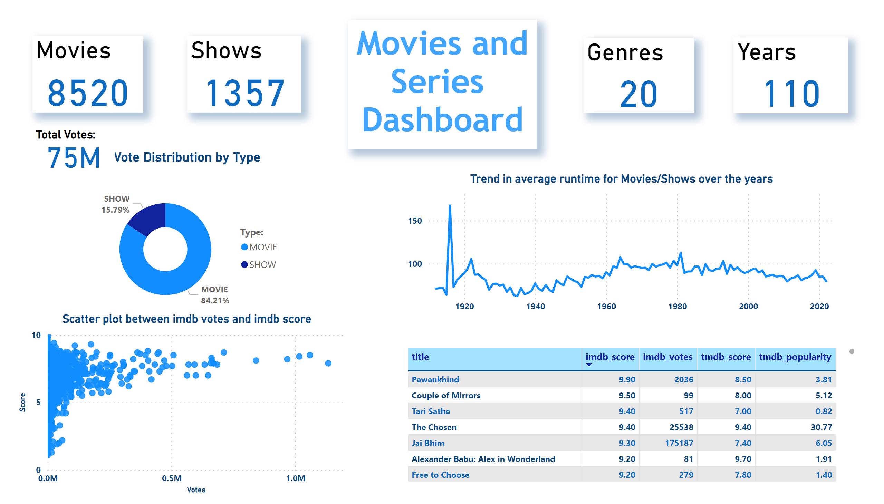
Main
Notes:
textbox
No alt text provided
Movies
No alt text provided
Shows
No alt text provided
Genres
No alt text provided
Years
No alt text provided
Vote Distribution by Type
No alt text provided
Total Votes:
No alt text provided
tableEx
No alt text provided
Scatter plot between imdb votes and imdb score
No alt text provided
Trend in average runtime for Movies/Shows over the years
No alt text provided

Slide 3
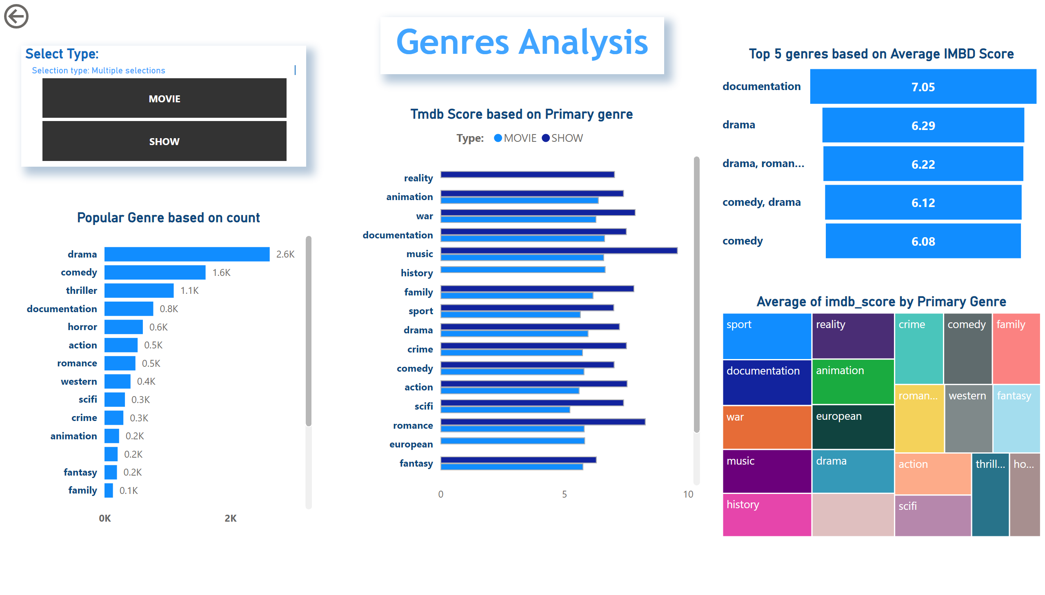
Genres
Notes:
Top 5 genres based on Average IMBD Score
No alt text provided
actionButton
No alt text provided
textbox
No alt text provided
Select Type:
No alt text provided
Tmdb Score based on Primary genre
No alt text provided
Popular Genre based on count
No alt text provided
Average of imdb_score by Primary Genre
No alt text provided

Slide 4
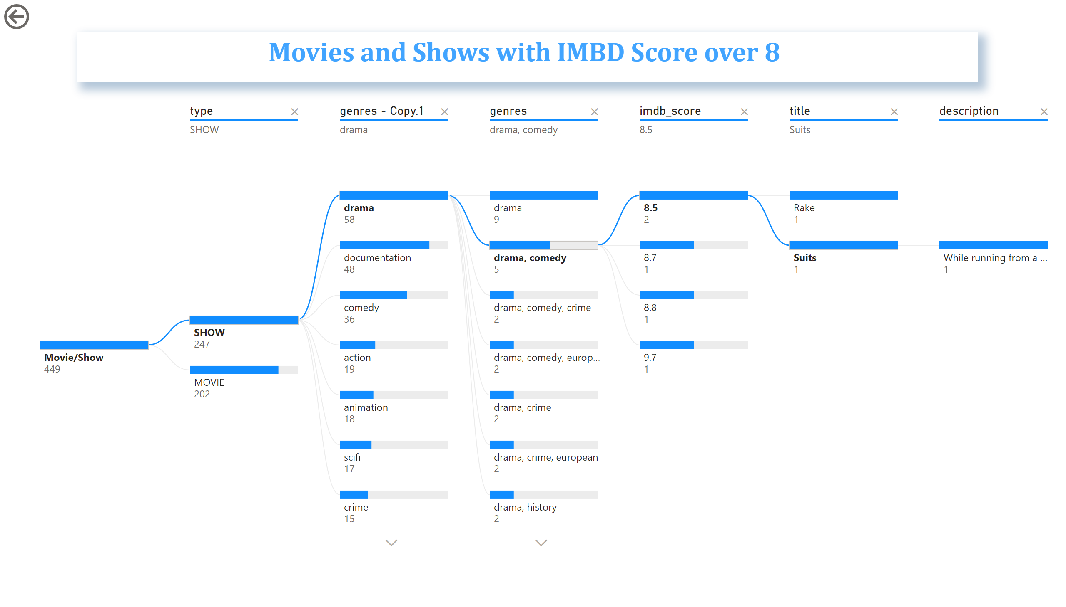
Popular
Notes:
decompositionTreeVisual
No alt text provided
textbox
No alt text provided
actionButton
No alt text provided

Slide 5
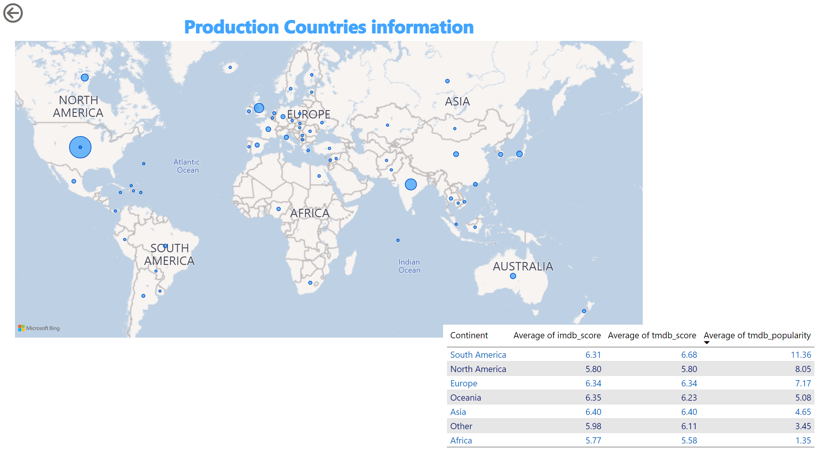
Map
Notes:
Production Countries information
No alt text provided
tableEx
No alt text provided
actionButton
No alt text provided

