Slide 1
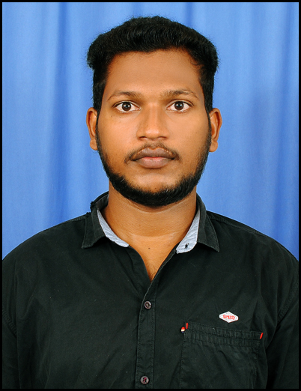


RAJESH ANNARAPU
Analyst/Software Engineer
Bachelor of Technlogy, Computer Science and Engineering:2016 - 20
Skills
Bengaluru
Java | Java Basics, OOPS, Generics, Collections, Arrays, Loops.
C# | C#Basics,OOPS,Generics,Collections, Array,Loops,LINQ
.NET Framework & core | ADO.NET,ASP.NET with MVC5 and WEB API,Entity Framework
Database | MySQL
Tools | Git, Postman, Swagger, Visual Studio, Visual Studio Code
Add On skills | Peer learning
FrontEnd | Angular, html, javascript, typescript , css Bootstrap.
RAJESH.ANNARAPU@CAPGEMINI.COM
+91 7729057517
A4
Full Stack Developer trained on .Net
Hands on experience on
. Git and GitHub
SQL and RDBMS
C# Intermediate
ADO.net, Entity framework, LINQ, ASP.Net Framework (MVC) and Web API
ASP dotNet Core Web App(MVC)
ASP dotNet Core Web API
HTML, CSS , JavaScript , Typescript
Angular
Good Knowledge of java programming.
Ongoing training on Azure
FINAL CASE STUDY:
Created an Online Shopping Cart Application With MySQL
Backend and .Net Core Web API and EF as middleware and Angular as frontend Used HTML, CSS ,Bootstrap and TypeScript for the UI designing.
Three layered architecture which includes a Data Access Layer, Business Logic Layer using C#, ASP.NET CORE WEB API. , SQL Server . Exception.​
Check Out the Project Vedio.LInk
https://drive.google.com/drive/folders/1rwurN04gVuvC4v1AZisl4soCX_-uQVLy?usp=sharing
Check out my work on GitHub
https://github.com/AnnarapuRajesh/.NETCORE.FINALPROJECT-CASE-STUDY.git

