Slide 1
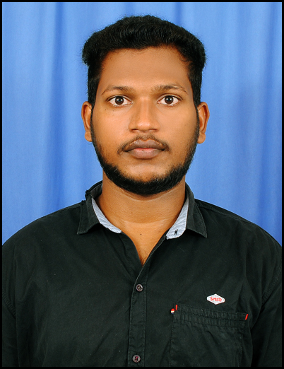


RAJESH ANNARAPU
Bachelor of Technlogy, Computer Science and Engineering:2016 - 20
Analyst/Software Engineer
Skills
HYDERADAB
C# | C# Basics, OOPS, Generics, Collections, Array, Loops, LINQ
.NET Framework & core | ADO.NET,ASP.NET with MVC5 and WEB API, Entity Framework
Database | MySQL
Tools | Git, Postman, Swagger, Visual Studio, Visual Studio Code
Add On skills | Peer learning
FrontEnd | Angular, html, javascript, typescript , css Bootstrap.
RAJESH.ANNARAPU@CAPGEMINI.COM
+91 7729057517
A4
Full Stack Developer trained on .Net
Hands on experience on
. Git and GitHub
SQL and RDBMS
C# Intermediate
ADO.net, Entity framework, LINQ, ASP.Net Framework (MVC) and Web API
ASP dotNet Core Web App(MVC)
ASP dotNet Core Web API
HTML, CSS , JavaScript , Typescript
Angular
Good Knowledge of java programming.
Azure Certification on AZ-900, AZ-104, AZ-204
FINAL CASE STUDY:
Created an Online Shopping Cart Application With MySQL
Backend and .Net Core Web API and EF as middleware and Angular as frontend Used HTML, CSS ,Bootstrap and TypeScript for the UI designing.
Three layered architecture which includes a Data Access Layer, Business Logic Layer using C#, ASP.NET CORE WEB API. , SQL Server . Exception.​
Working Project :
MPP project under ETAP
Role UI (angular) developer
Developed UI for new Timeseries data model
Check Out the case study Project Video. Click Here
Check out my work on GitHub

