Slide 1
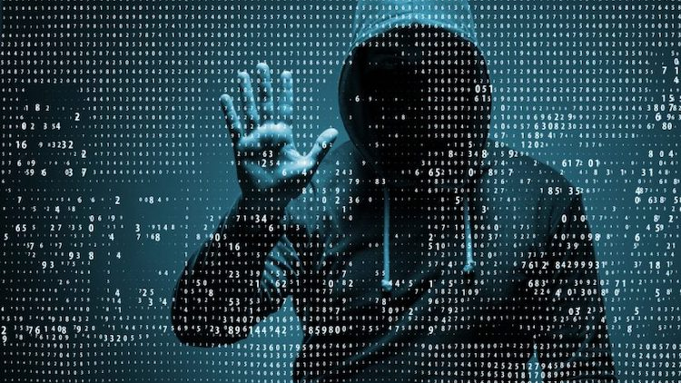
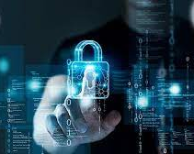
CYBER SECURITY
By:
Annas Furquan Pasha
20011A0503
B.Tech 3rd Year
JNTUH College Of Engineering
This Photo by Unknown author is licensed under CC BY.

Slide 2
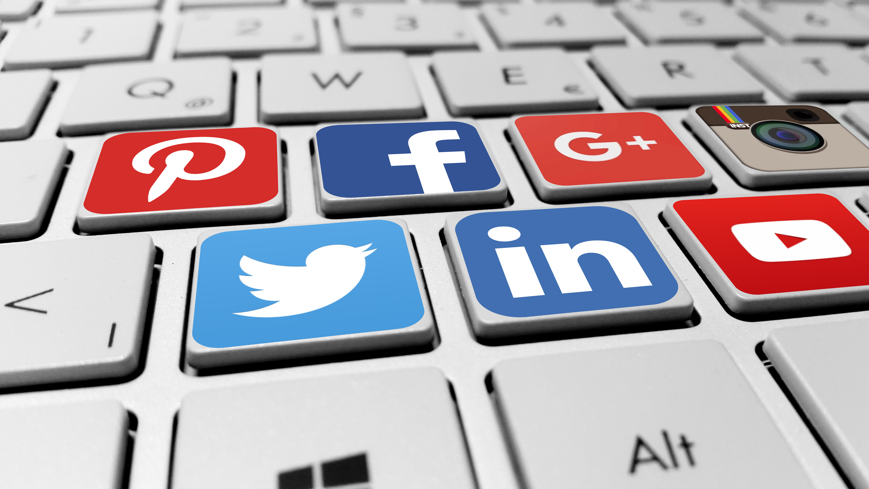
What is Cyber Security?
Cyber security is the practice of defending computers, servers, mobile devices, electronic systems, networks, and data from malicious attacks.
It's also known as information technology security or electronic information security.
This Photo by Unknown author is licensed under CC BY-NC.

Slide 3
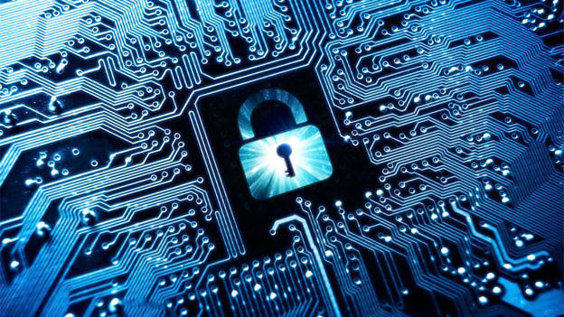
THE SCALE OF THE CYBER THREAT !
This Photo by Unknown author is licensed under CC BY-SA-NC.

Slide 4
The global cyber threat continues to evolve at a rapid pace, with a rising number of data breaches each year. A report by RiskBased Security revealed that a shocking 7.9 billion records have been exposed by data breaches in the first nine months of 2019 alone. This figure is more than double (112%) the number of records exposed in the same period in 2018.
With the scale of the cyber threat set to continue to rise, the International Data Corporation predicts that worldwide spending on cyber-security solutions will reach a massive $133.7 billion by 2022.

Slide 5
In the U.S., the National Institute of Standards and Technology (NIST) has created a cyber-security framework. To combat the proliferation of malicious code and aid in early detection, the framework recommends continuous, real-time monitoring of all electronic resources.
The Australian Cyber Security Centre(ACSC) regularly publishes guidance on how organizations can counter the latest cyber-security threats.

Slide 6
Cyber security Strategy - India
Security policy, Legal Framework
- IT Act 2000
- IT(Amendment ) Bill 2006 – Data Protection and Computer Crimes
Research and Development
- Cyber Monitoring
- Network Security
International Collaboration

Slide 7
TYPES OF CYBER THREATS The threats countered by cyber-security are three-fold:
1. Cybercrime includes single actors or groups targeting systems for financial gain or to cause disruption.
2. Cyber-attack often involves politically motivated information gathering.
3. Cyberterrorism is intended to undermine electronic systems to cause panic or fear.

Slide 8
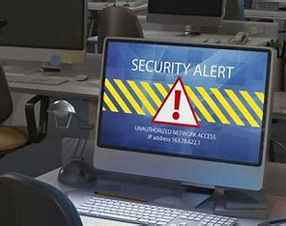
So, how do malicious actors gain control of computer systems?

Slide 9
Malware
Malware means malicious software. One of the most common cyber threats, malware is software that a cybercriminal or hacker has created to disrupt or damage a legitimate user’s computer.
Often spread via an unsolicited email attachment or legitimate-looking download, malware may be used by cybercriminals to make money or in politically motivated cyber-attacks.

Slide 10
There are a number of different types of malware, including:
Virus: A self-replicating program that attaches itself to clean file and spreads throughout a computer system, infecting files with malicious code.
Trojans: A type of malware that is disguised as legitimate software. Cybercriminals trick users into uploading Trojans onto their computer where they cause damage or collect data.
Spyware: A program that secretly records what a user does, so that cybercriminals can make use of this information. For example, spyware could capture credit card details.
Ransomware: Malware which locks down a user’s files and data, with the threat of erasing it unless a ransom is paid.
Adware: Advertising software which can be used to spread malware.
Botnets: Networks of malware infected computers which cybercriminals use to perform tasks online without the user’s permission.

Slide 11
Other methods:
SQL injection
An SQL (structured language query) injection is a type of cyber-attack used to take control of and steal data from a database. Cybercriminals exploit vulnerabilities in data-driven applications to insert malicious code into a databased via a malicious SQL statement. This gives them access to the sensitive information contained in the database.
Phishing
Phishing is when cybercriminals target victims with emails that appear to be from a legitimate company asking for sensitive information. Phishing attacks are often used to dupe people into handing over credit card data and other personal information.
Man-in-the-middle attack
A man-in-the-middle attack is a type of cyber threat where a cybercriminal intercepts communication between two individuals in order to steal data. For example, on an unsecure WiFi network, an attacker could intercept data being passed from the victim’s device and the network.

Slide 12
Latest cyber threats

Slide 13

Romance scams
In February 2020, the FBI warned U.S. citizens to be aware of confidence fraud that cybercriminals commit using dating sites, chat rooms and apps. Perpetrators take advantage of people seeking new partners, duping victims into giving away personal data.
The FBI reports that romance cyber threats affected 114 victims in New Mexico in 2019, with financial losses amounting to $1.6 million.

Slide 14
Cyber safety tips - protect yourself against cyberattacks
Update
Update your software and operating system: This means you benefit from the latest security patches.
Use
Use anti-virus software and strong passwords
Do not open
Do not open email attachments from unknown senders: These could be infected with malware.
Do not click on
Do not click on links in emails from unknown senders or unfamiliar websites: This is a common way that malware is spread.
Avoid
Avoid using unsecure WiFi networks in public places: Unsecure networks leave you vulnerable to man-in-the-middle attacks.

Slide 15
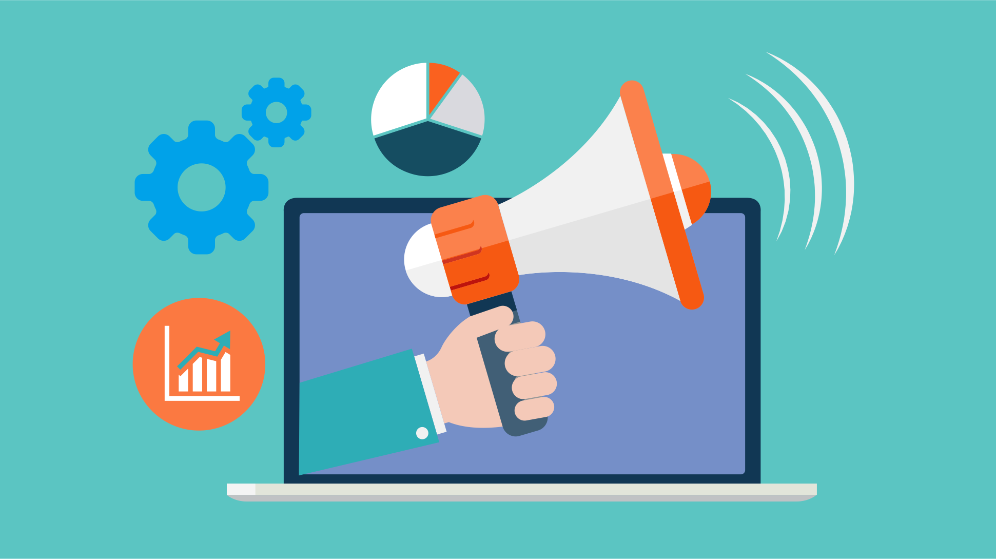
Conclusion
I hope that my information will be helpful for you to improve your knowledge about cyber security and to overcome several security loopholes in your computer operations.
Also it helps to spread awareness among normal people about emerging security threats .

Slide 16

Queries
www.kaspersky.co.in/resource-center/definitions/what-is-cyber-security.

Slide 17

THANK YOU

