Slide 1
FULL STACK WEB DEVELOPMENT UNIT - 5

Slide 2
GIT And Version Control
What is Git?
Git is an open-source distributed version control system. It is designed to handle minor to major projects with high speed and efficiency. It is developed to co-ordinate the work among the developers. The version control allows us to track and work together with our team members at the same workspace.
Git is foundation of many services like GitHub and GitLab, but we can use Git without using any other Git services. Git can be used privately and publicly.
Git was created by Linus Torvalds in 2005 to develop Linux Kernel. It is also used as an important distributed version-control tool for the DevOps.
It is used for:
Tracking code changes
Tracking who made changes
Coding collaboration

Slide 3
What does Git do?
Manage projects with Repositories
Clone a project to work on a local copy
Control and track changes with Staging and Committing
Branch and Merge to allow for work on different parts and versions of a project
Pull the latest version of the project to a local copy
Push local updates to the main project.
Working with Git:
Initialize Git on a folder, making it a Repository
Git now creates a hidden folder to keep track of changes in that folder
When a file is changed, added or deleted, it is considered modified
You select the modified files you want to Stage
The Staged files are Committed, which prompts Git to store a permanent snapshot of the files
Git allows you to see the full history of every commit.
You can revert back to any previous commit.
Git does not store a separate copy of every file in every commit, but keeps track of changes made in each commit!

Slide 4
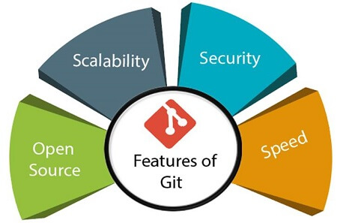
Features of Git

Slide 5
Open Source Git is an open-source tool. It is released under the GPL (General Public License) license.
Scalable Git is scalable, which means when the number of users increases, the Git can easily handle such situations.
Distributed One of Git's great features is that it is distributed. Distributed means that instead of switching the project to another machine, we can create a "clone" of the entire repository. Also, instead of just having one central repository that you send changes to, every user has their own repository that contains the entire commit history of the project. We do not need to connect to the remote repository; the change is just stored on our local repository. If necessary, we can push these changes to a remote repository.

Slide 6
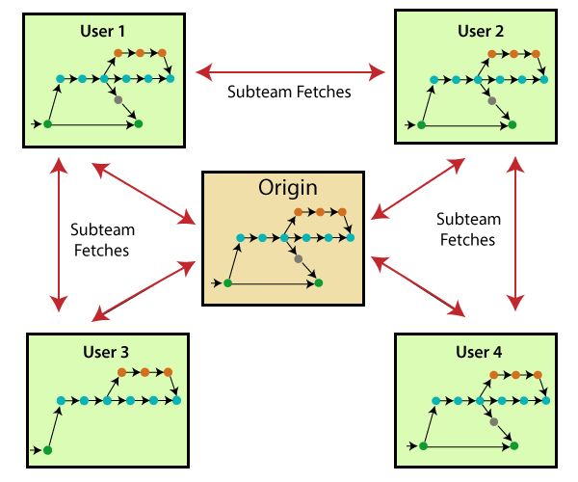

Slide 7
Security Git is secure. It uses the SHA1 (Secure Hash Function) to name and identify objects within its repository. Files and commits are checked and retrieved by its checksum at the time of checkout.
Speed Git is very fast, so it can complete all the tasks in a while. Most of the git operations are done on the local repository, so it provides a huge speed. Also, a centralized version control system continually communicates with a server somewhere. Performance tests conducted by Mozilla showed that it was extremely fast compared to other VCSs.
Supports non-linear development Git supports seamless branching and merging, which helps in visualizing and navigating a non-linear development. A branch in Git represents a single commit. We can construct the full branch structure with the help of its parental commit.
Branching and Merging Branching and merging are the great features of Git, which makes it different from the other SCM tools. Git allows the creation of multiple branches without affecting each other. We can perform tasks like creation, deletion, and merging on branches, and these tasks take a few seconds

Slide 8
some features that can be achieved by branching:We can create a separate branch for a new module of the project, commit and delete it whenever we want.
We can have a production branch, which always has what goes into production and can be merged for testing in the test branch.
We can create a demo branch for the experiment and check if it is working. We can also remove it if needed.
The core benefit of branching is if we want to push something to a remote repository, we do not have to push all of our branches. We can select a few of our branches, or all of them together.

Slide 9
Data Assurance The Git data model ensures the cryptographic integrity of every unit of our project. It provides a unique commit ID to every commit through a SHA algorithm. We can retrieve and update the commit by commit ID. Most of the centralized version control systems do not provide such integrity by default.
Staging Area The Staging area is also a unique functionality of Git. It can be considered as a preview of our next commit, moreover, an intermediate area where commits can be formatted and reviewed before completion.
When you make a commit, Git takes changes that are in the staging area and make them as a new commit. We are allowed to add and remove changes from the staging area. The staging area can be considered as a place where Git stores the changes. Although, Git doesn't have a dedicated staging directory where it can store some objects representing file changes (blobs). Instead of this, it uses a file called index.
Maintain the clean history Git facilitates with Git Rebase; It is one of the most helpful features of Git. It fetches the latest commits from the master branch and puts our code on top of that. Thus, it maintains a clean history of the project.

Slide 10
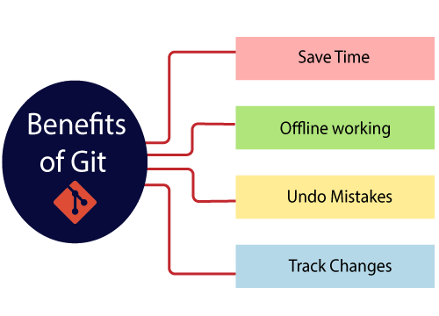
Benefits of Git

Slide 11
Saves Time Git is lightning fast technology. Each command takes only a few seconds to execute so we can save a lot of time as compared to login to a GitHub account and find out its features.
Offline Working One of the most important benefits of Git is that it supports offline working. If we are facing internet connectivity issues, it will not affect our work. In Git, we can do almost everything locally. Comparatively, other CVS like SVN is limited and prefer the connection with the central repository.
Undo Mistakes One additional benefit of Git is we can Undo mistakes. Sometimes the undo can be a savior option for us. Git provides the undo option for almost everything.
Track the Changes Git facilitates with some exciting features such as Diff, Log, and Status, which allows us to track changes so we can check the status, compare our files or branches.

Slide 12
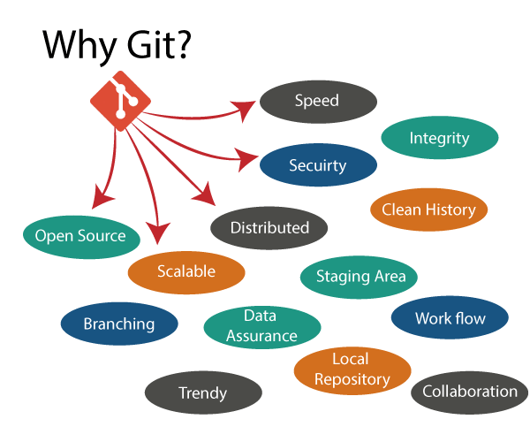
Why Git?

Slide 13
Over 70% of developers use Git!
Developers can work together from anywhere in the world.
Developers can see the full history of the project.
Developers can revert to earlier versions of a project.
Git Integrity Git is developed to ensure the security and integrity of content being version controlled. It uses checksum during transit or tampering with the file system to confirm that information is not lost. Internally it creates a checksum value from the contents of the file and then verifies it when transmitting or storing data.
Trendy Version Control System Git is the most widely used version control system. It has maximum projects among all the version control systems. Due to its amazing workflow and features, it is a preferred choice of developers.
Everything is Local Almost All operations of Git can be performed locally; this is a significant reason for the use of Git. We will not have to ensure internet connectivity.
Collaborate to Public Projects There are many public projects available on the GitHub. We can collaborate on those projects and show our creativity to the world. Many developers are collaborating on public projects. The collaboration allows us to stand with experienced developers and learn a lot from them; thus, it takes our programming skills to the next level.
Impress Recruiters We can impress recruiters by mentioning the Git and GitHub on our resume. Send your GitHub profile link to the HR of the organization you want to join. Show your skills and influence them through your work. It increases the chances of getting hired.

Slide 14
GitHub
What is GitHub?
GitHub is a Git repository hosting service. GitHub also facilitates with many of its features, such as access control and collaboration. It provides a Web-based graphical interface.
GitHub is an American company. It hosts source code of your project in the form of different programming languages and keeps track of the various changes made by programmers.
It offers both distributed version control and source code management (SCM) functionality of Git. It also facilitates with some collaboration features such as bug tracking, feature requests, task management for every project.
Git is not the same as GitHub.
GitHub makes tools that use Git.
GitHub is the largest host of source code in the world, and has been owned by Microsoft since 2018.
In this tutorial, we will focus on using Git with GitHub.

Slide 15
Features of GitHub
GitHub is a place where programmers and designers work together. They collaborate, contribute, and fix bugs together. It hosts plenty of open source projects and codes of various programming languages.
Some of its significant features are as follows.
Collaboration
Integrated issue and bug tracking
Graphical representation of branches
Git repositories hosting
Project management
Team management
Code hosting
Track and assign tasks
Conversations
Wikisc

Slide 16
Benefits of GitHub
It is easy to contribute to open source projects via GitHub.
It helps to create an excellent document.
We can attract recruiter by showing off your work. If you have a profile on GitHub, you will have a higher chance of being recruited.
It allows your work to get out there in front of the public.
We can track changes in your code across versions.

Slide 17
Git Getting Started
Git Install
We can download Git for free from the following website: https://www.git-scm.com/
Using Git with Command Line
To start using Git, we are first going to open up our Command shell.
For Windows, you can use Git bash, which comes included in Git for Windows. For Mac and Linux you can use the built-in terminal.
How to download Git?
Step1:
To download the Git installer, visit the Git's official site and go to download page. The link for the download page is https://git-scm.com/downloads. The page looks like as

Slide 18
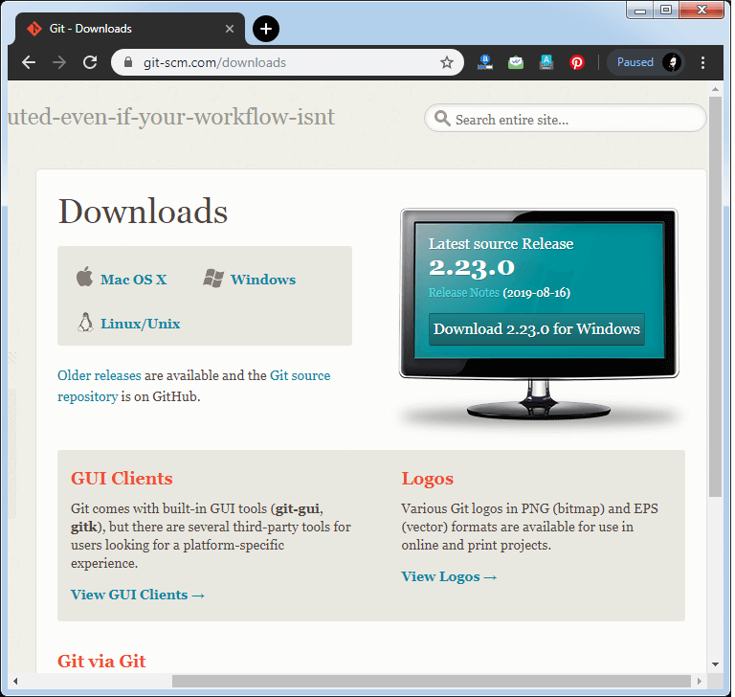
How to download Git?

Slide 19
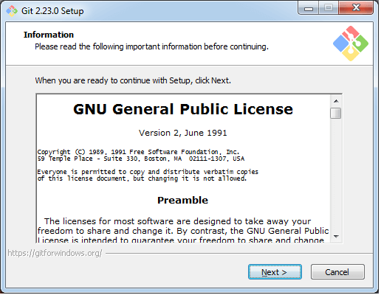
Step2 Click on the downloaded installer file and select yes to continue. After the selecting yes the installation begins, and the screen will look like as

Slide 20
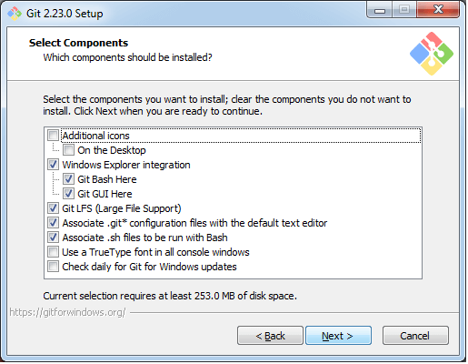
Click on next to continue. Step3 Default components are automatically selected in this step. You can also choose your required part.

Slide 21
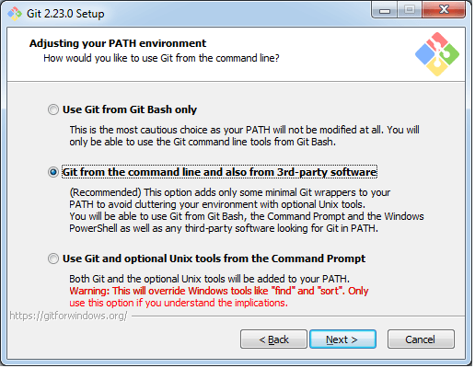
Step4: The default Git command-line options are selected automatically. You can choose your preferred choice. Click next to continue.

Slide 22
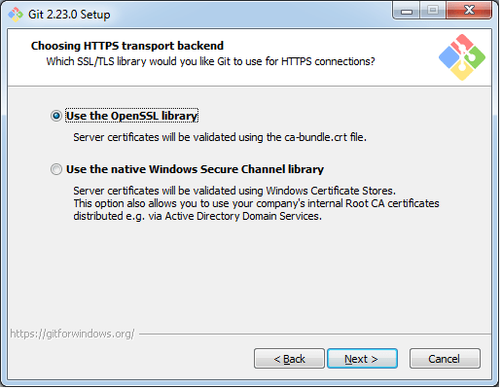
Step5 The default transport backend options are selected in this step. Click next to continue.

Slide 23
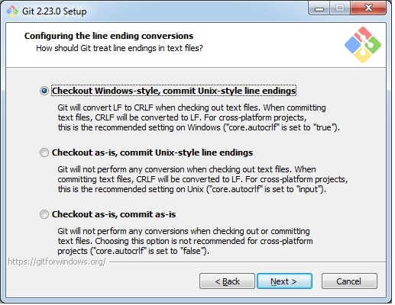
Step6: Select your required line ending option and click next to continue.

Slide 24
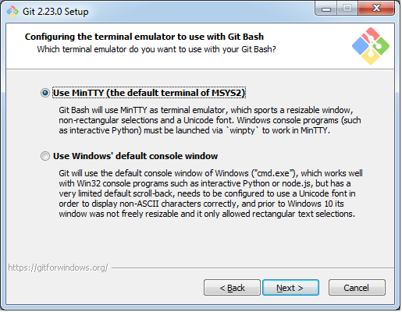
Step7 Select preferred terminal emulator clicks on the next to continue.

Slide 25
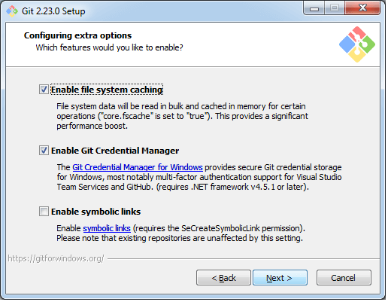
Step8 This is the last step that provides some extra features like system caching, credential management and symbolic link. Select the required features and click on the next option.

Slide 26
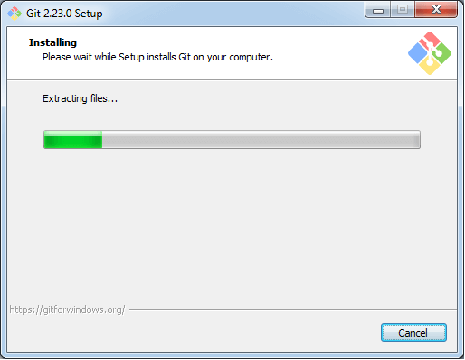
Step9 The files are being extracted in this step.

Slide 27
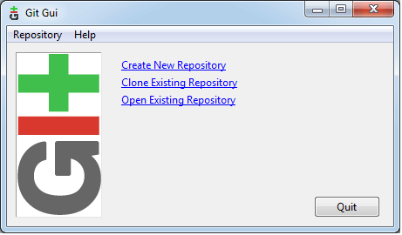
Therefore, The Git installation is completed. Now you can access the Git Gui and Git Bash. The Git Gui looks like this

Slide 28
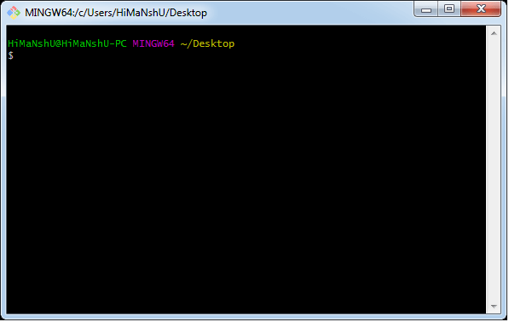
I It facilitates with three features. Create New Repository Clone Existing Repository Open Existing Repository

Slide 29
The first thing we need to do, is to check if Git is properly installed:
Example:
git --version
git version 2.30.2.windows.1
Configure Git
Example:
git config --global user.name “cmrit"
git config --global user.email “cmrit@gmail.com"

Slide 30
Git Commands
Create a folder on desktop and create a simple text file type some text and save it
Open that folder in command prompt
Init Commnd - To initialize git
This command is used to create a local repository.
Syntax:
git init repo_name
Config command - To configure Git
This command configures the user. The Git config command is the first and necessary command used on the Git command line. This command sets the author name and email address to be used with your commits. Git config is also used in other scenarios.
git config --global user.email “student@gmail.com”
git config --global user.name “UserName” (CaseSensitive)
Note: User email and User Name should be same as GitHub account
Git add Command
This command is used to add one or more files to staging (Index) area.
Syntax: git add filename
To add all files
Git add .

Slide 31
Git Commands
To commit changes
This command changes the head. It records or snapshots the file permanently in the version history with a message.
Syntax: git commit –m “commit message”
Status command
The status command is used to display the state of the working directory and the staging area. It allows you to see which changes have been staged, which haven't, and which files aren't being tracked by Git. It does not show you any information about the committed project history. For this, you need to use the git log. It also lists the files that you've changed and those you still need to add or commit.
Syntax: git status
To check log
Syntax: git log
To Create new branch
Git checkout –b main
To current check branch
git branch
To change branch
git checkout branch name
To add remote origin
Git remote add origin https://github.com/bharadwajVY/CSE.git (Provide your URL)
Check → git remote –v

Slide 32
Git Commands
Push Command
It is used to upload local repository content to a remote repository. Pushing is an act of transfer commits from your local repository to a remote repo. It's the complement to git fetch, but whereas fetching imports commits to local branches on comparatively pushing exports commits to remote branches. Remote branches are configured by using the git remote command. Pushing is capable of overwriting changes, and caution should be taken when pushing.
Syntax: git push –f origin main
Provide Username and Password
Open your GitHub and check the repository
clone command
This command is used to make a copy of a repository from an existing URL. If I want a local copy of my repository from GitHub, this command allows creating a local copy of that repository on your local directory from the repository URL.
Syntax: git clone URL
To Remove remote origin
git remote rm origin

Slide 33
Git Commands
Pull command
Pull command is used to receive data from GitHub. It fetches and merges changes on the remote server to your working directory.
Syntax: git pull URL
Git Merge Command
This command is used to merge the specified branch?s history into the current branch.
Syntax
git merge BranchName
Note: Create GitHub account login into it and work with git and github by configuring both with same email and username.

Slide 34
Dear Students,
Take this ppt as reference, go through syllabus copy and prepare accordingly. Code of remaining concepts are shared in our group as zip file with the name FSWD_Example_Programs Practice codes and Lab experiments.
All the best

