Slide 1

Portfolio
A.Ананд

Slide 2

Үндсэн 4н цэс
Home,About,
Resume,Creations

Slide 3
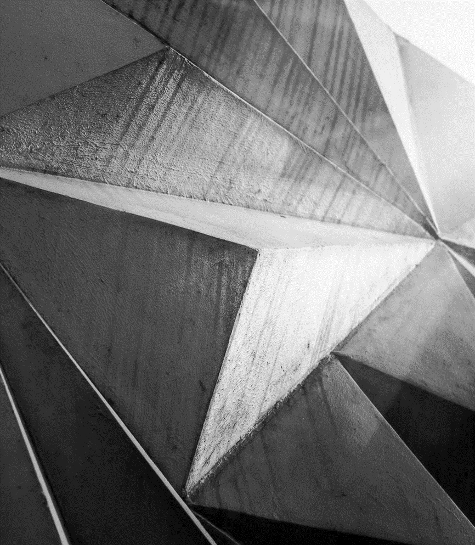
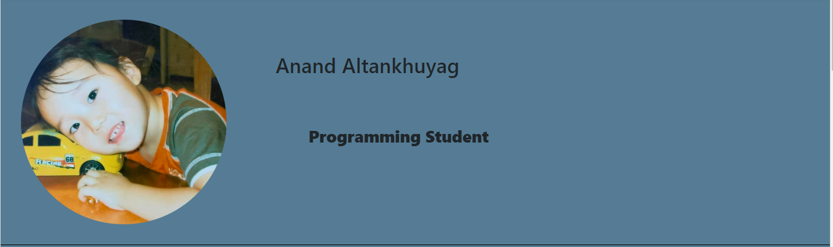
HOME

Slide 4
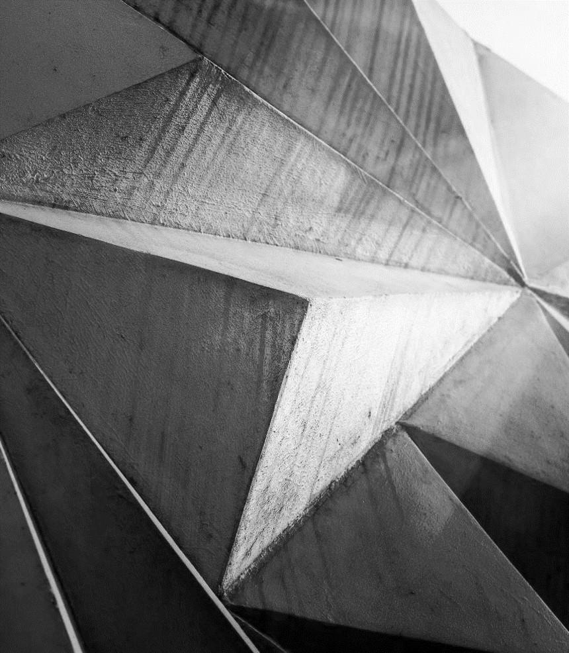
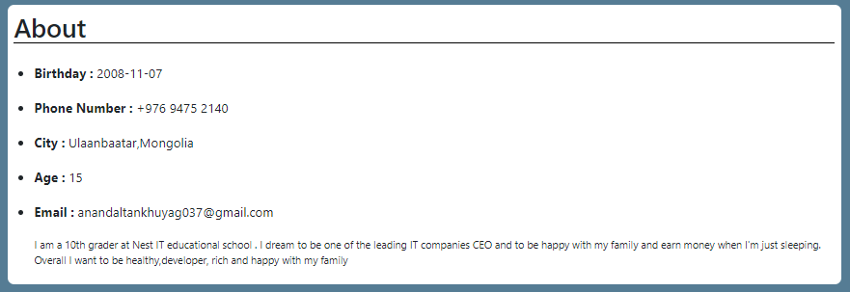
ABOUT

Slide 5
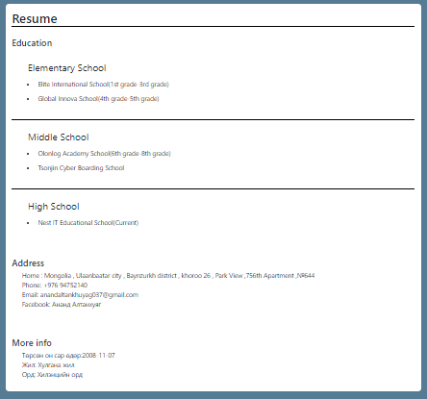
RESUME

Slide 6

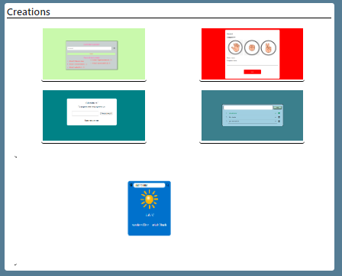
CREATIONS

Slide 7
HTML(ACTIVE)
<div class="col-md-3" id="menu">
<i class="bi bi-file-earmark-person" id="resume"></i>
<h6 id="resume"><a href="#res" class="btn">RESUME</a></h6>
</div>
<div class="col-md-3" id="menu">
<i class="bi bi-brightness-high" id="creations"></i>
<h6 id="creations"><a href="#cret" class="btn">CREATIONS</a></h6>
</div>
</div>
</div>
</div>
<div class="menu">
<div class="container one">
<div class="row" id="myDiv">
<div class="col-md-3" id="menu">
<i class="bi bi-house-door" id="home"></i>
<h6 id="home"><a href="#hm" class="btn">HOME</a></h6>
</div>
<div class="col-md-3" id="menu">
<i class="bi bi-person" id="about"></i>
<h6 id="about"><a href="#ab" class="btn">ABOUT</a></h6>
</div>

Slide 8
JS(ACTIVE)
let btnContainer = document.getElementById("myDiv");
let btns = btnContainer.getElementsByClassName("btn");
for (let i = 0; i < btns.length; i++) {
btns[i].addEventListener("click", function() {
let current = document.getElementsByClassName("active");
if (current.length > 0) {
current[0].className = current[0].className.replace(" active","");
}
this.className += " active";
});
}

Slide 9
CSS(ACTIVE)
h6 a:hover{
color: black !important;
font: bold;
border: none;
font-size: 19px;
}
.menu .active{
color: black !important;
border: none;
font-size: 19px;
font-weight: bold ;
}
h6 a{
color: rgb(136, 136, 136) !important;
}

Slide 10
HTML(ANIMATION)
<h5 class="ml4">
<span class="letters letters-1">High School Student</span>
<span class="letters letters-2">Programming Student</span>
</h5>

Slide 11
CSS(ANIMATION)
.ml4 {
position: relative;
font-weight: 900;
font-size: 2.5em;
margin-left:4.5em;
}
.ml4 .letters {
position: absolute;
margin: auto;
left: 0;
top: 0.3em;
right: 0;
opacity: 0;
}

Slide 12
JS(ANIMATION)
anime.timeline({loop: true})
.add({
targets: '.ml4 .letters-1',
opacity: ml4.opacityIn,
scale: ml4.scaleIn,
duration: ml4.durationIn
}).add({
targets: '.ml4 .letters-1',
opacity: 0,
scale: ml4.scaleOut,
duration: ml4.durationOut
,
easing: "easeInExpo",
delay: ml4.delay
})
.add({
targets: '.ml4 .letters-2',
opacity: ml4.opacityIn,
scale: ml4.scaleIn,
duration: ml4.durationIn
}).add({
targets: '.ml4 .letters-2',
opacity: 0,
scale: ml4.scaleOut,
duration: ml4.durationOut,
easing: "easeInExpo",
delay: ml4.delay
}).add({
targets: '.ml4',
opacity: 0,
duration: 500,
delay: 500
});
let ml4 = {};
ml4.opacityIn = [0,1];
ml4.scaleIn = [0.2, 1];
ml4.scaleOut = 3;
ml4.durationIn = 800;
ml4.durationOut = 600;
ml4.delay = 500;

Slide 13
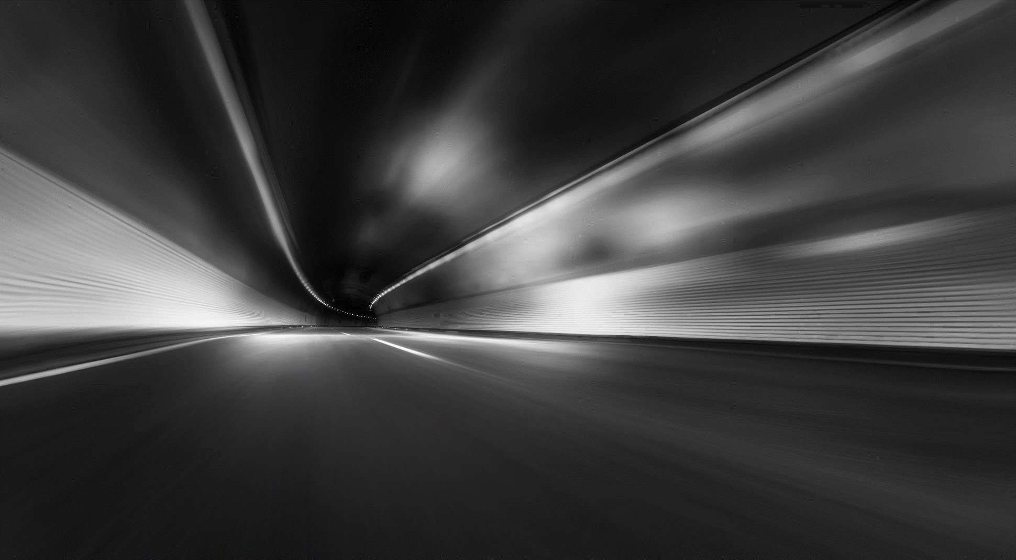
АНХААРАЛ ХАНДУУЛСАНД БАЯРЛАЛАА …

