Slide 1
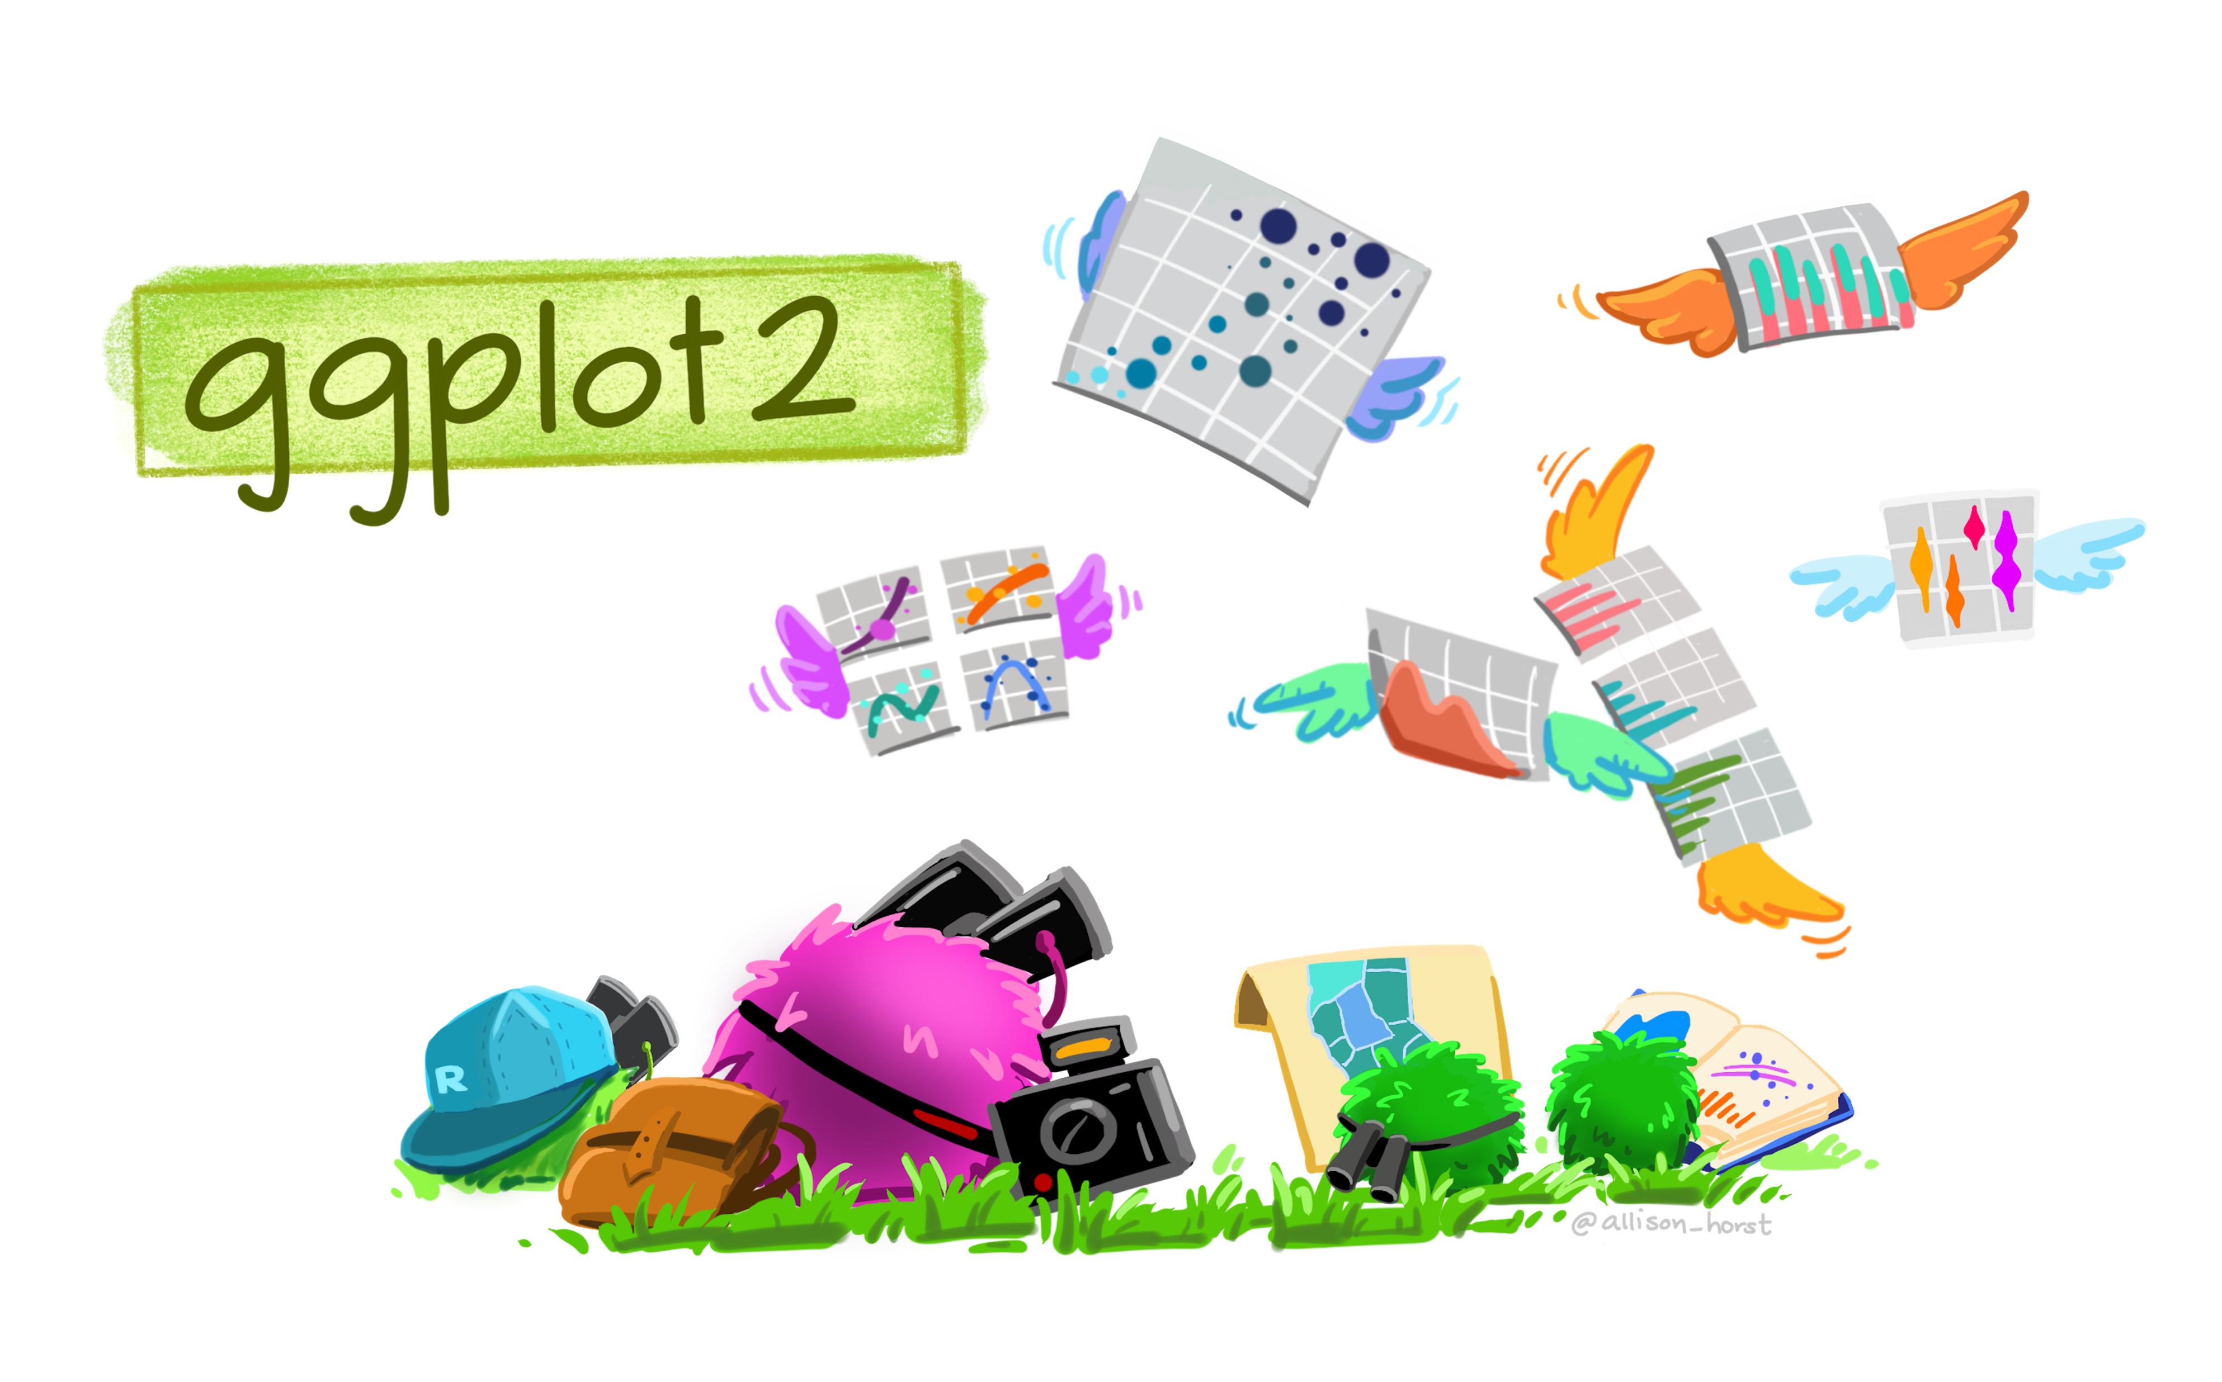

Pretty_plots()
with
BioEdu workshop
June 23rd, 2026
Navya Shukla, PhD
Anne-Lise Gérard, PhD

Slide 2
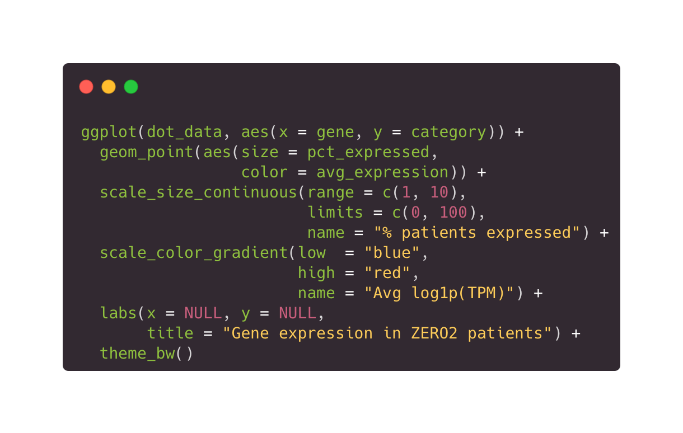
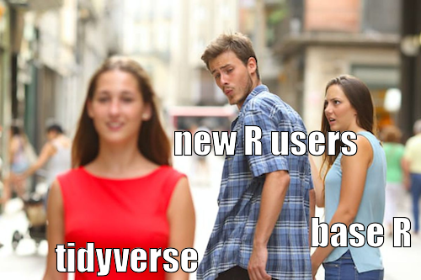
1| Why ggplot?
<iframe src="https://carbon.now.sh/embed?bg=rgba%28171%2C+184%2C+195%2C+1%29&t=hopscotch&wt=none&l=r&width=680&ds=true&dsyoff=20px&dsblur=68px&wc=true&wa=true&pv=56px&ph=56px&ln=false&fl=1&fm=Hack&fs=14px&lh=133%25&si=false&es=2x&wm=false&code=ggplot%28dot_data%252C%2520aes%28x%2520%253D%2520gene%252C%2520y%2520%253D%2520category%29%29%2520%252B%250A%2520%2520geom_point%28aes%28size%2520%253D%2520pct_expressed%252C%2520color%2520%253D%2520avg_expression%29%29%2520%252B%250A%2520%2520scale_size_continuous%28range%2520%253D%2520c%281%252C%252010%29%252C%2520limits%2520%253D%2520c%280%252C%2520100%29%252C%2520name%2520%253D%2520%2522%2525%2520patients%2520expressed%2522%29%2520%252B%250A%2520%2520scale_color_gradient%28low%2520%2520%253D%2520%2522blue%2522%252C%2520high%2520%253D%2520%2522red%2522%252C%2520name%2520%253D%2520%2522Avg%2520log1p%28TPM%29%2522%29%2520%252B%250A%2520%2520labs%28x%2520%253D%2520NULL%252C%2520y%2520%253D%2520NULL%252C%2520title%2520%253D%2520%2522Gene%2520expression%2520in%2520ZERO2%2520patients%2522%29%2520%252B%250A%2520%2520theme_bw%28%29" style="width: 927px; height: 279px; border:0; transform: scale(1); overflow:hidden;" sandbox="allow-scripts allow-same-origin"> </iframe>
simple
Notes:
Why bother learning coding let alone ggplot? Let me convince you
Simple code -> complex plots
Will dive deeper into what this code snippet means and how to construct a plot from scratch later. But the idea is you don’t need much to make something relatively complex. Example here with a dotplot of ALK & MYCN expression in ZERO2 patients by disease. There is quite a bit of information on this plot yet only takes a few lines of code to construct.
Why not baseR?
Base graphics functions are generally fast, but have limited scope -> good for data exploration.
As we’ll see later, ggplot is based on a “grammar of graphics” meaning every plot type you’ll make is composed of the same components, it’s more intuitive, simple to learn, and allows you to create plots that are tailored to your specific problem

Slide 3
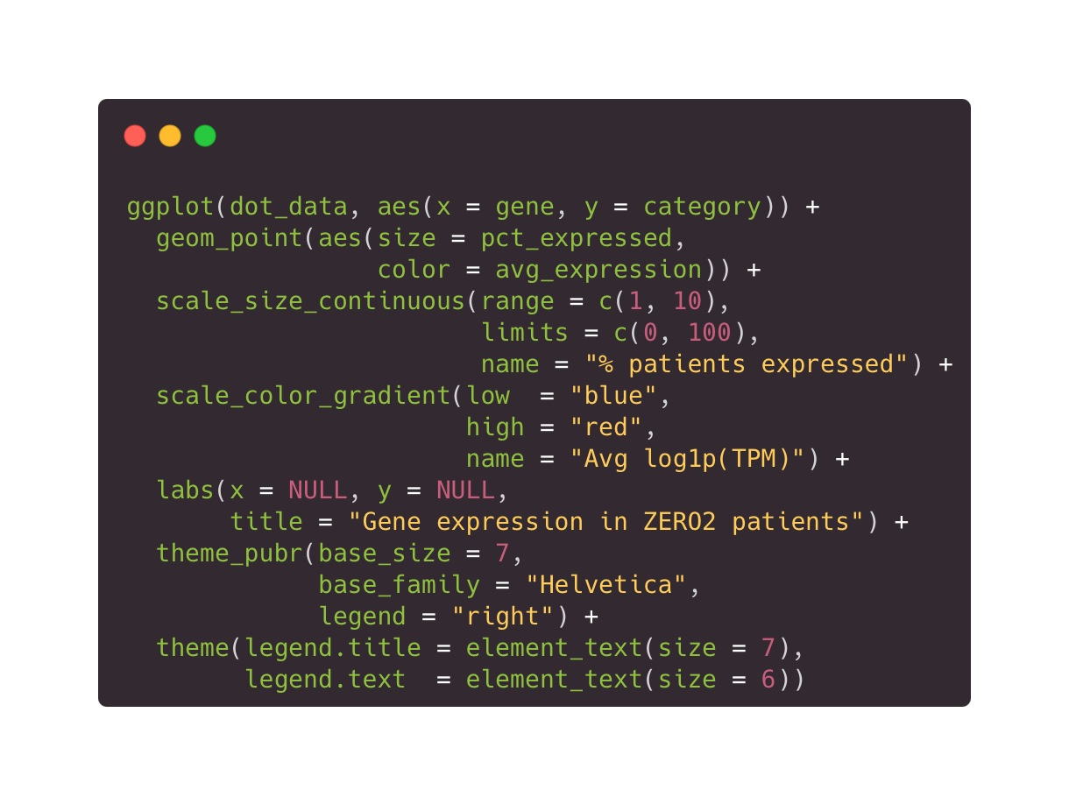
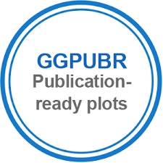

1| Why ggplot?
flexible
Notes:
Flexible
No more spending hours to reformat plots when resubmitting a manuscript.
Packages such as ggpubr and ggsci -> create publication ready plots in seconds, ticking every box in those pesky author guidelines. For this example, I applied the Nature Publishing Group colour palette and font requirements.
ggplot’s comprehensive theming system makes it easy to do change the look of your plot how you want it.

Slide 4
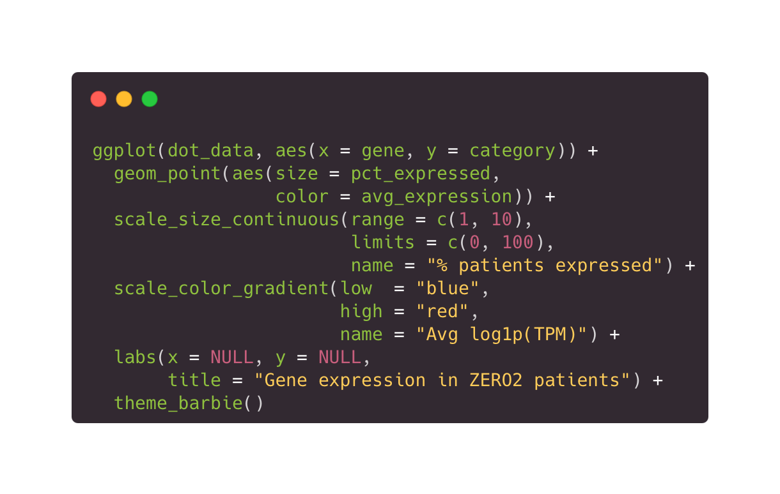
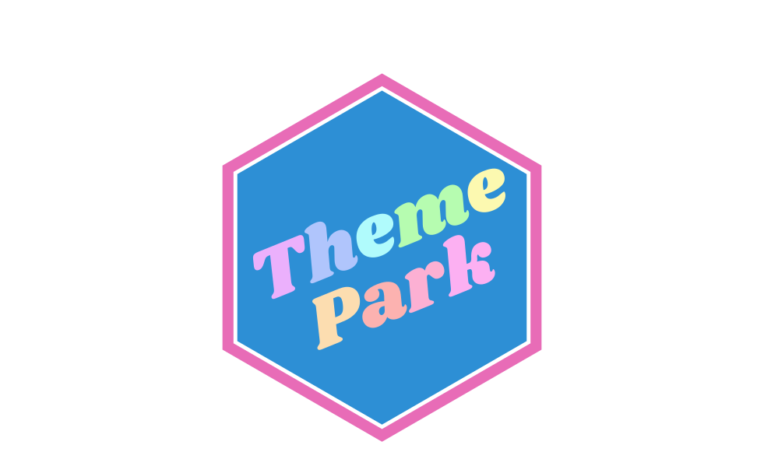
1| Why ggplot?
flexible
Notes:
And I meant that literally. If you’re feeling like spicying up your lab presentation with Barbie themed plots, there is a package for that!

Slide 5
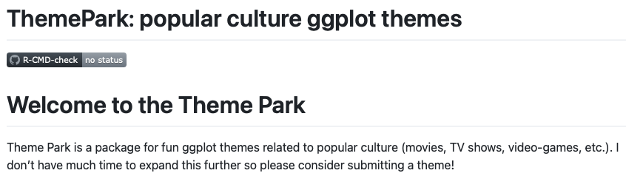
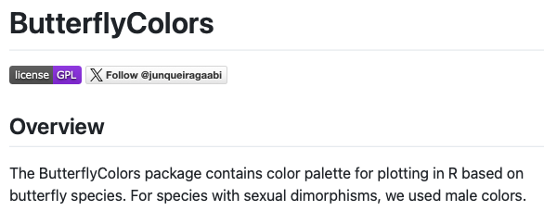
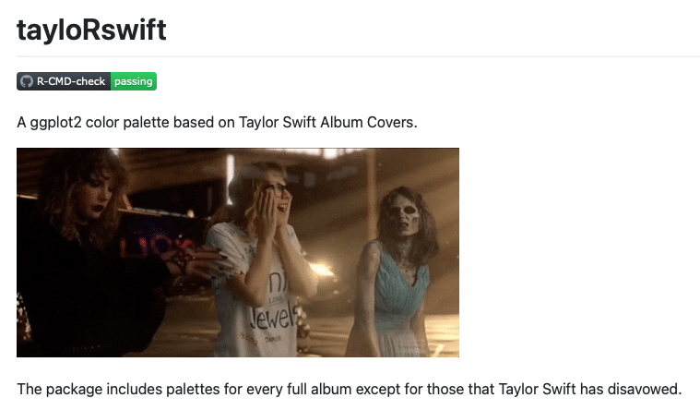
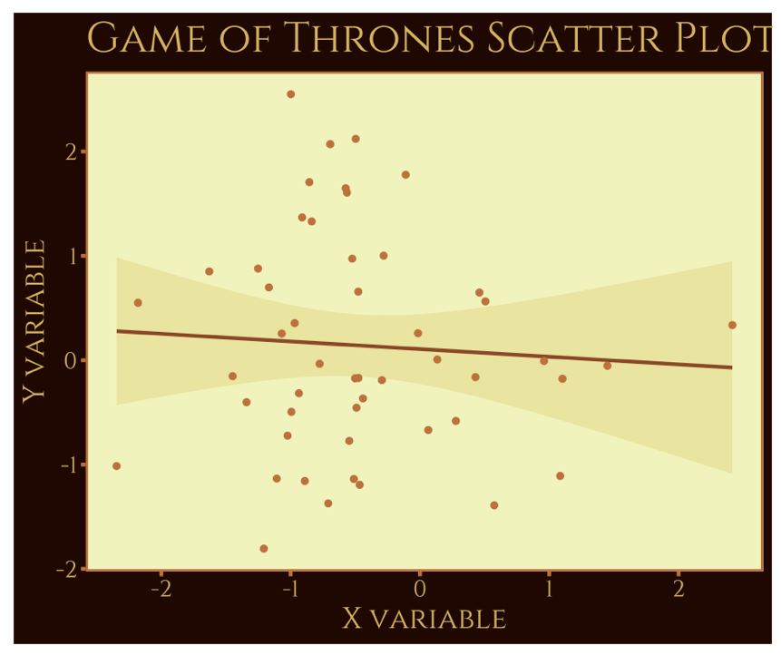
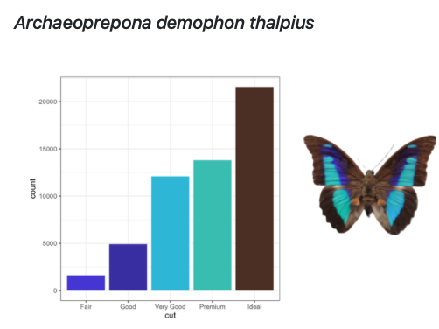
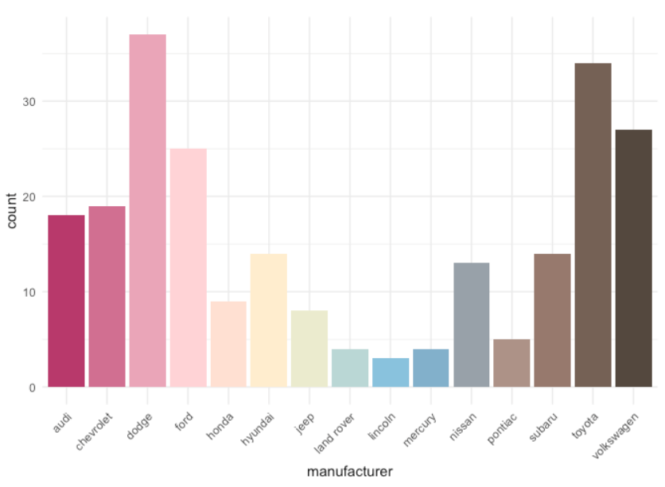

1| Why ggplot?
flexible
Notes:
In fact, people have made entire packages including themes based on movies & TV series, butterfly colors, and even Taylor Swift album covers.

Slide 6
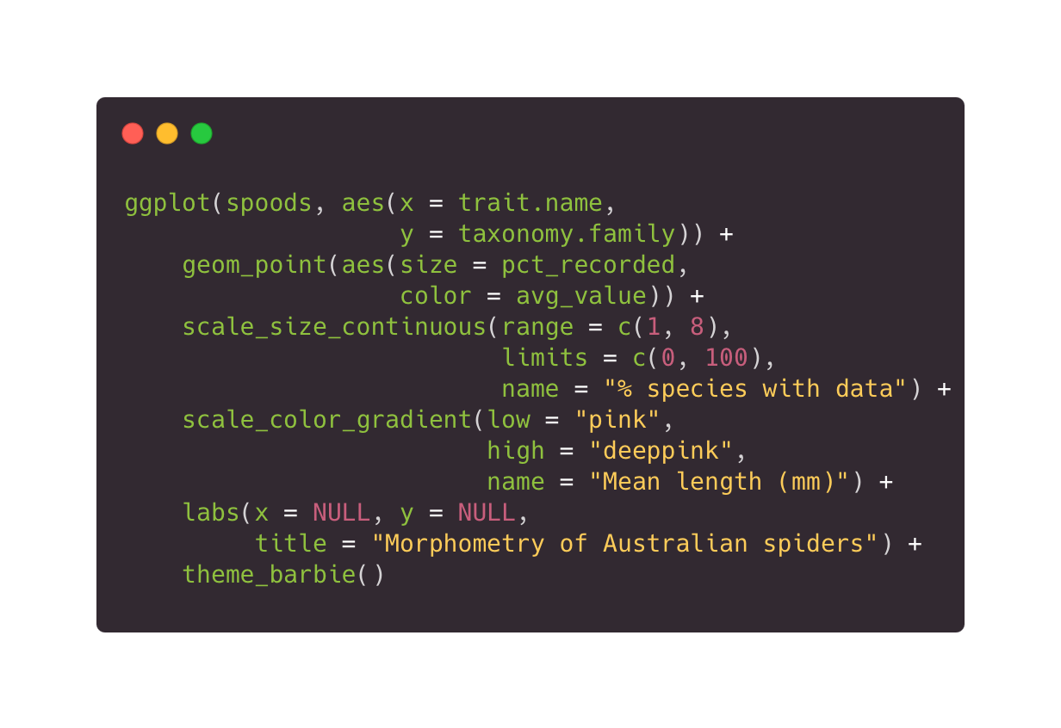
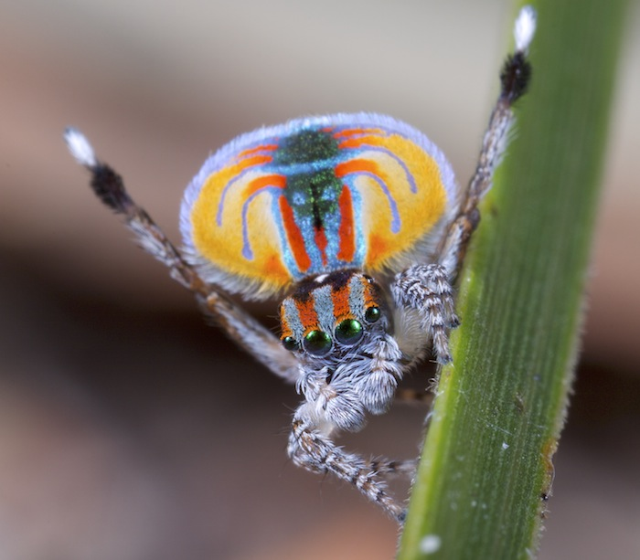
1| Why ggplot?
reproducible
Notes:
Ggplot is reproducible.
It is easy for someone to look at your code, understand what transformations have been applied to the data and what exactly has been represented.
It is also easy for you and others to re-use code. Say you find a really cool Barbie-themed plot showing gene expression of different pediatric cancers but you want to apply it to a different question.
Completely unbiased example but say you want to figure out if what makes spiders so big and scary are really their abdomen size or leg length?
You could fetch that data online, - and yes I have done that for fun, and plot abdomen length vs leg length with minimal changes to the code. And if you wonder, yes spiders appear big because of their long legs.

Slide 7
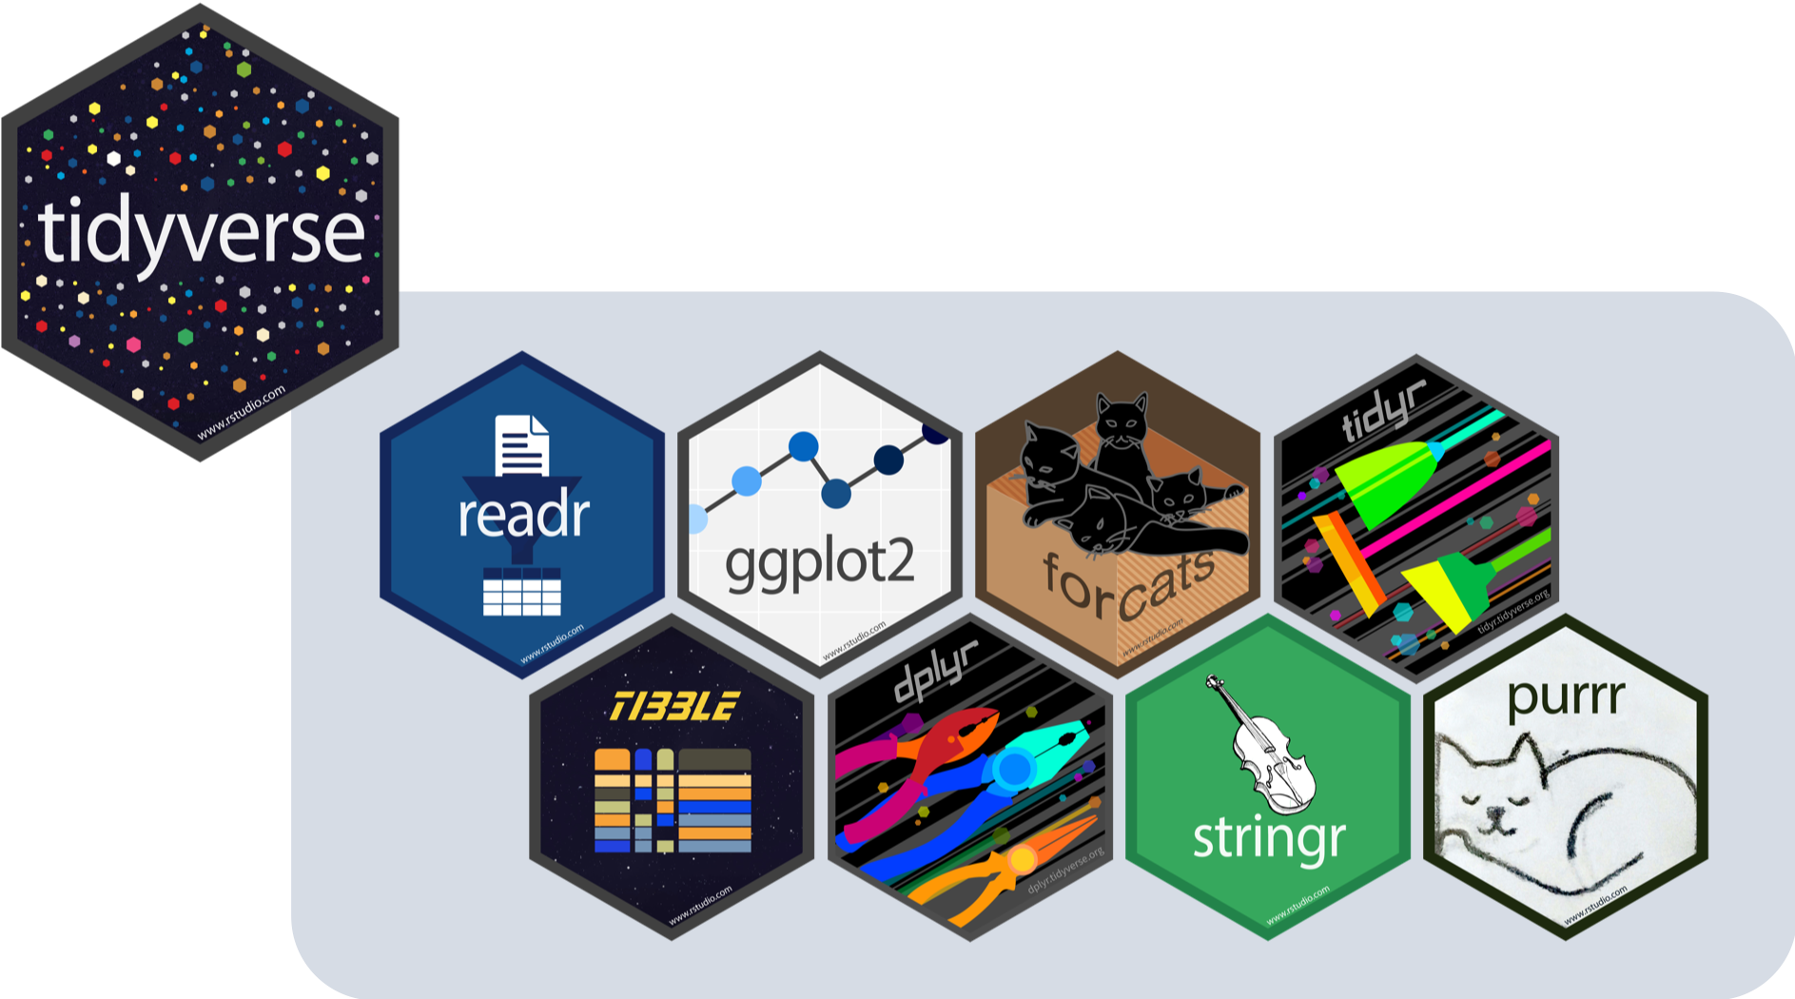
1| Why ggplot?
gguniverse
Notes:
gguniverse
You might have noticed by now that I introduced a few other packages that work well with ggplot. There is a true universe around ggplot – not kidding it’s called the tidyverse.
The core packages cover the main steps of a data analysis workflow: readr for importing data, tidyr for reshaping it, dplyr for manipulating it, ggplot2 for visualising it, and purrr for functional programming.

Slide 8
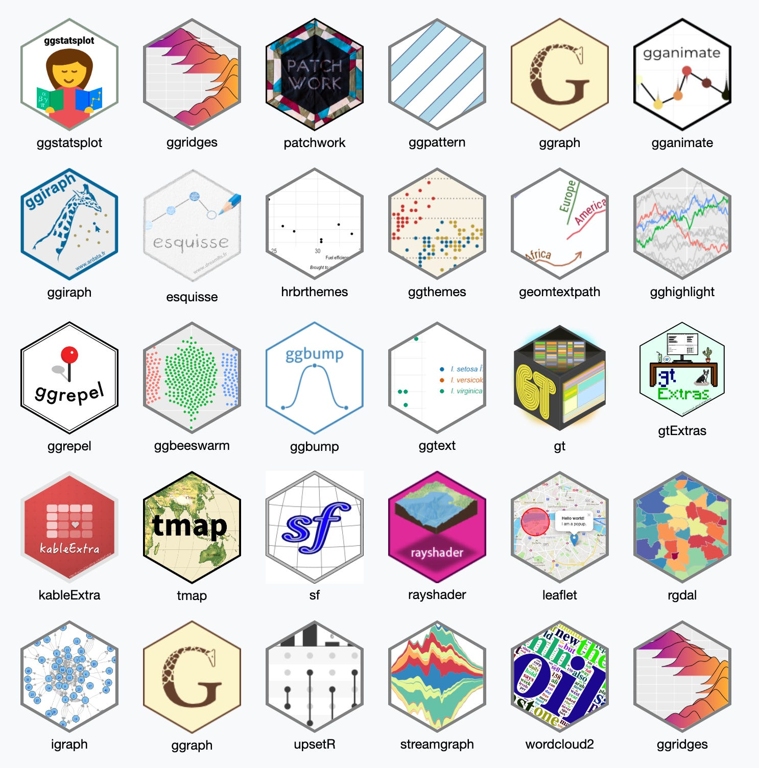
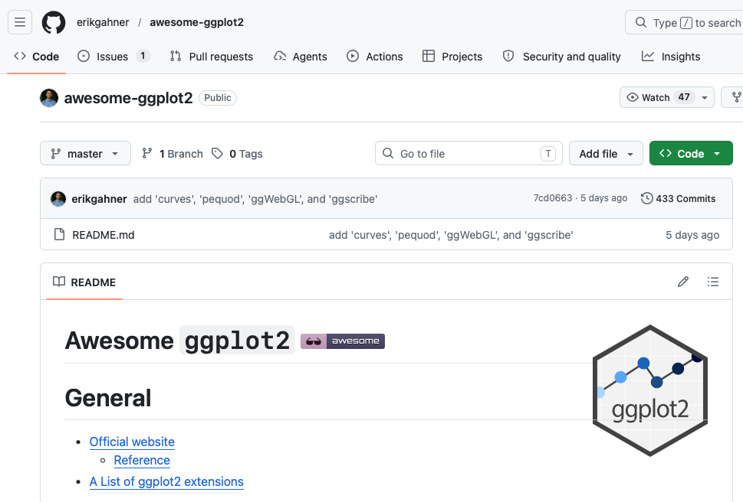
1| Why ggplot?
gguniverse
https://github.com/erikgahner/awesome-ggplot2
Notes:
But so many more packages have been developed to expand on ggplot2! Recommend checking out this GitHub repo.

Slide 9
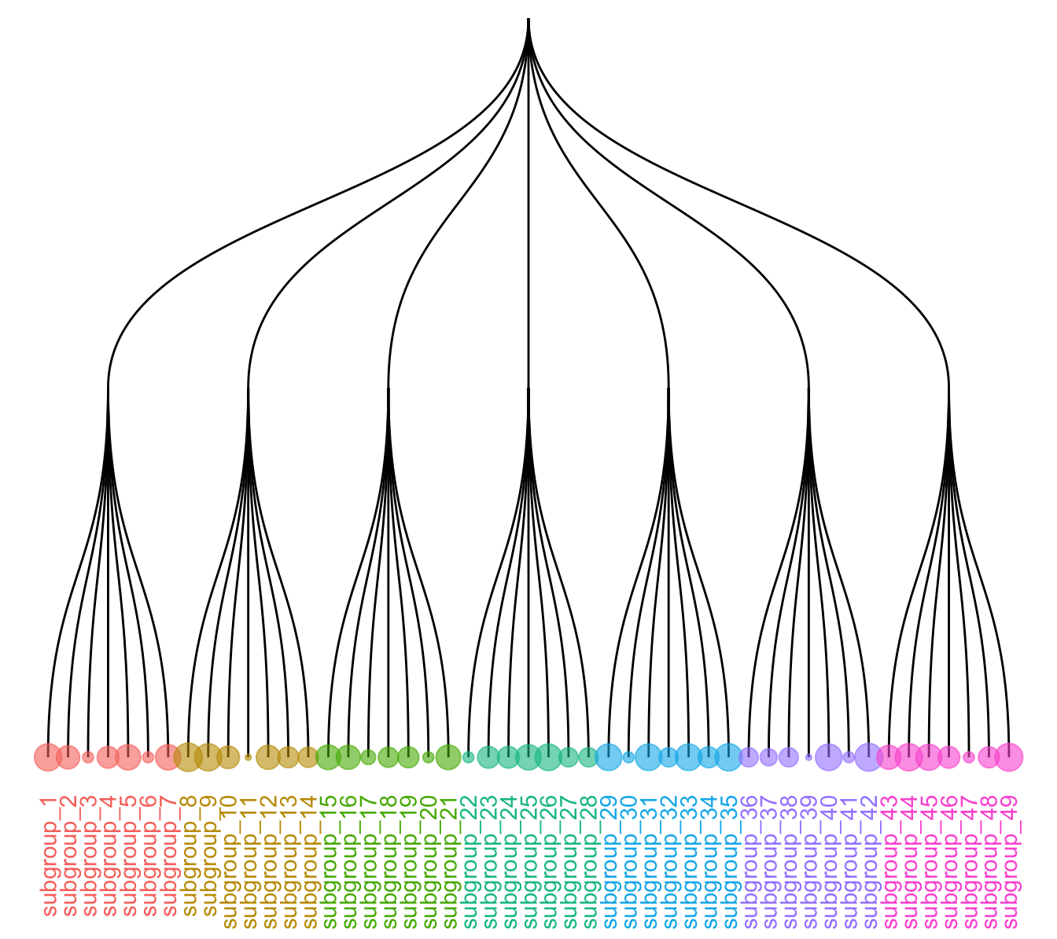
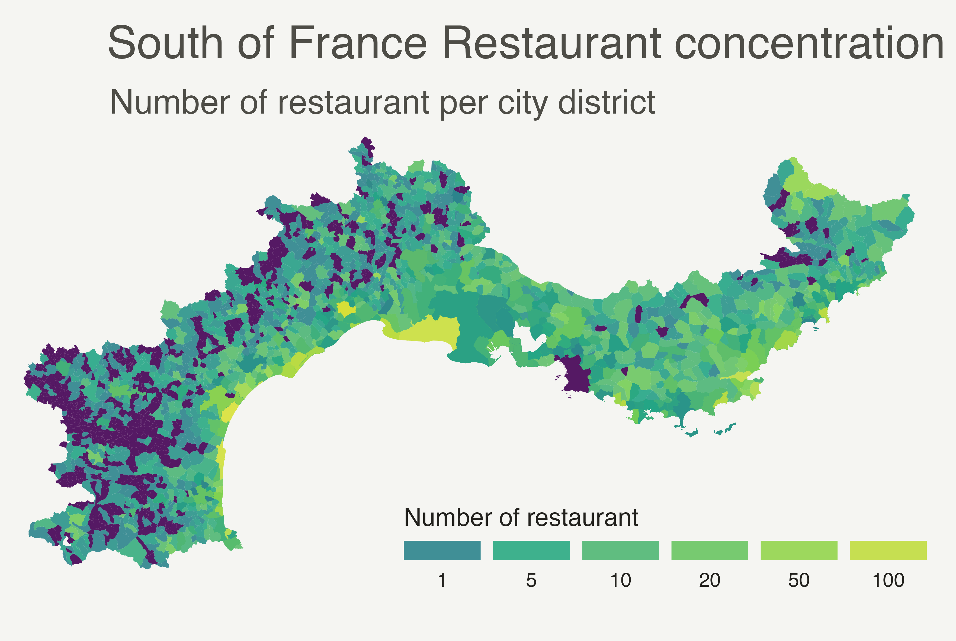
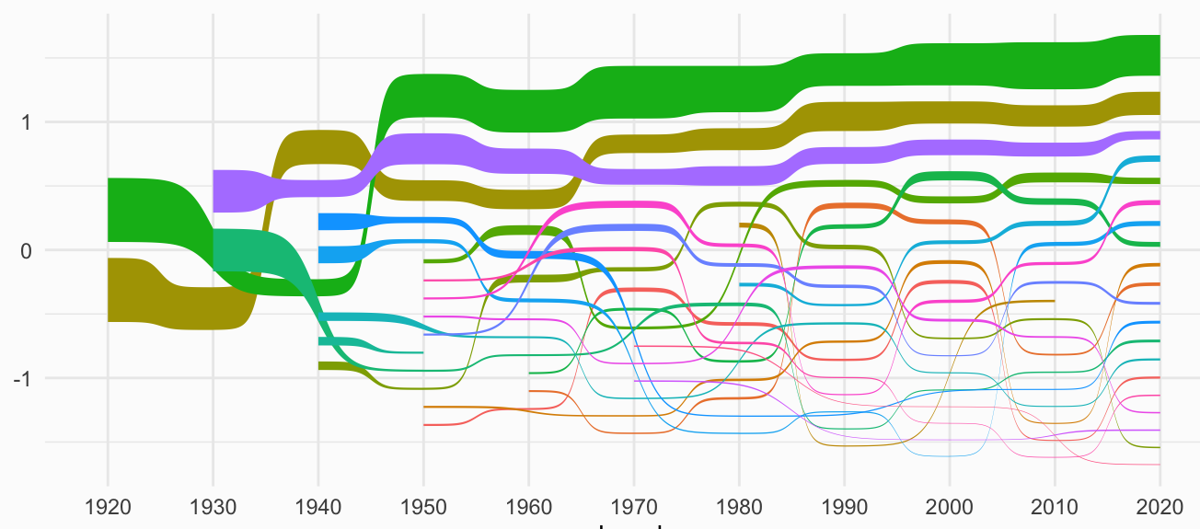
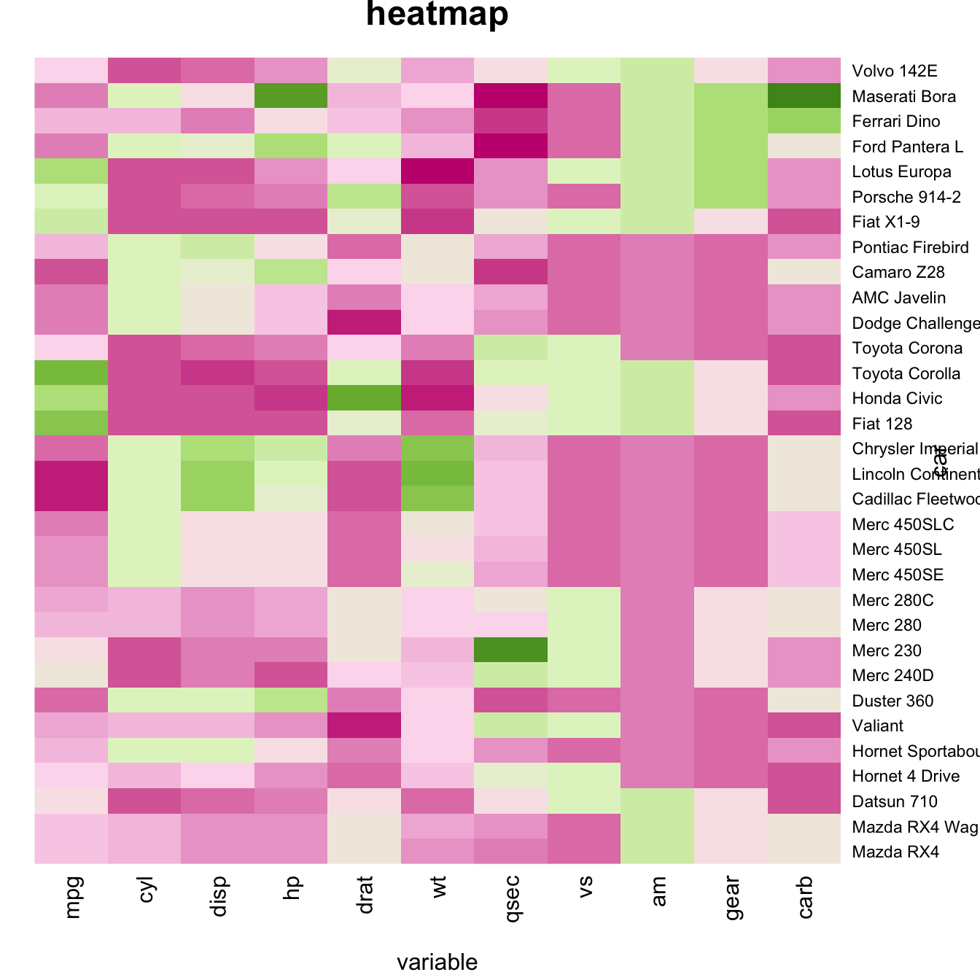
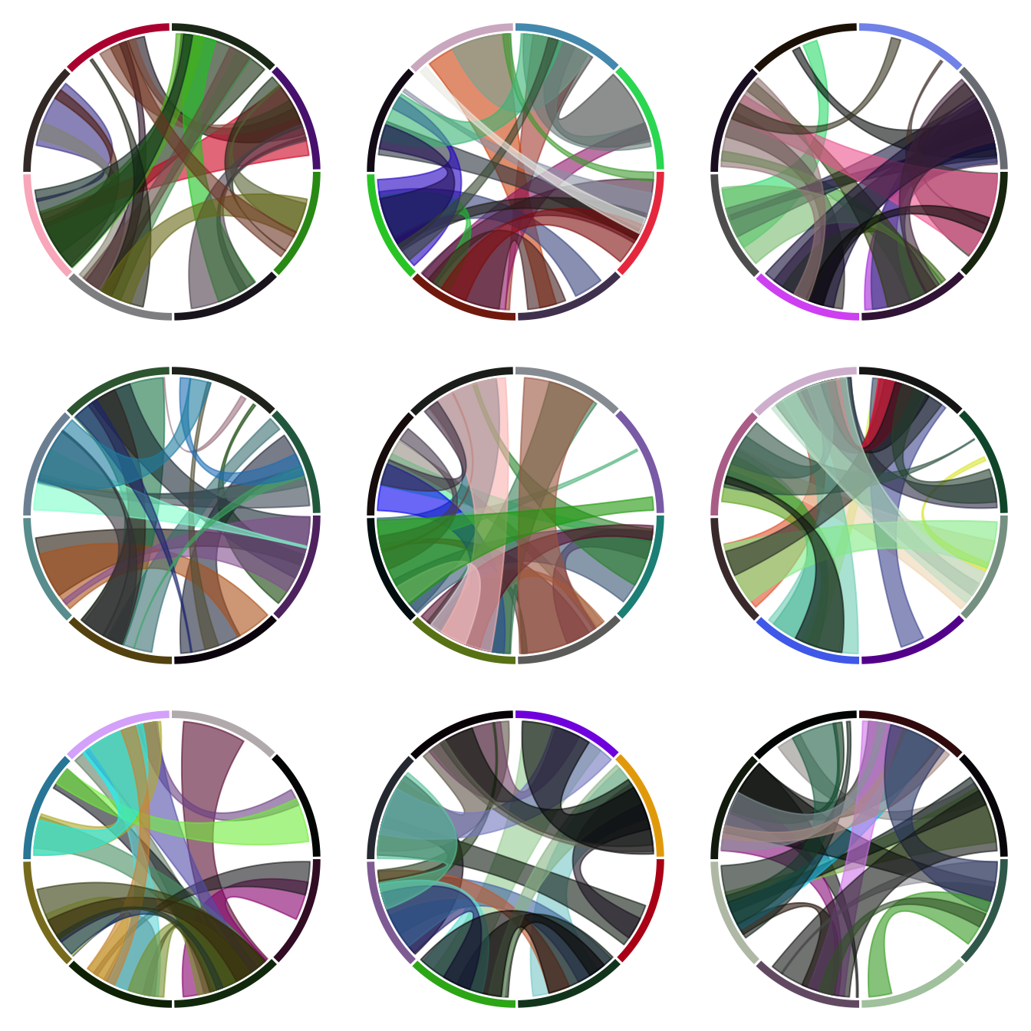
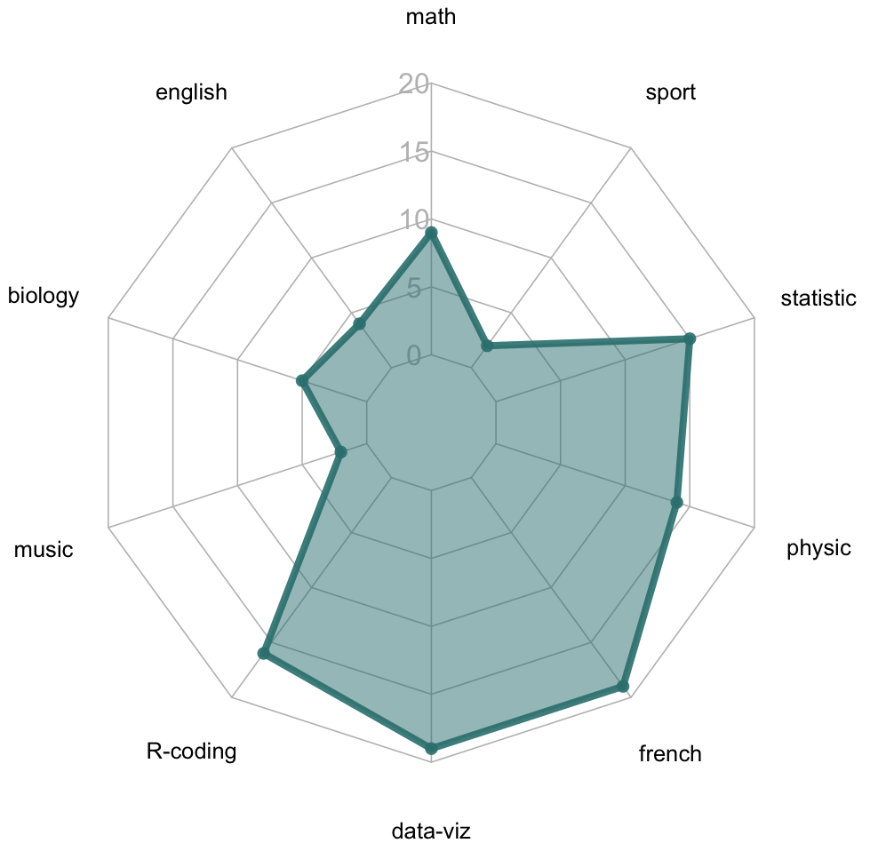
1| Why ggplot?
<iframe src="https://carbon.now.sh/embed?bg=rgba%28171%2C+184%2C+195%2C+1%29&t=hopscotch&wt=none&l=r&width=680&ds=true&dsyoff=20px&dsblur=68px&wc=true&wa=true&pv=56px&ph=56px&ln=false&fl=1&fm=Hack&fs=14px&lh=133%25&si=false&es=2x&wm=false&code=ggplot%28dot_data%252C%2520aes%28x%2520%253D%2520gene%252C%2520y%2520%253D%2520category%29%29%2520%252B%250A%2520%2520geom_point%28aes%28size%2520%253D%2520pct_expressed%252C%2520color%2520%253D%2520avg_expression%29%29%2520%252B%250A%2520%2520scale_size_continuous%28range%2520%253D%2520c%281%252C%252010%29%252C%2520limits%2520%253D%2520c%280%252C%2520100%29%252C%2520name%2520%253D%2520%2522%2525%2520patients%2520expressed%2522%29%2520%252B%250A%2520%2520scale_color_gradient%28low%2520%2520%253D%2520%2522blue%2522%252C%2520high%2520%253D%2520%2522red%2522%252C%2520name%2520%253D%2520%2522Avg%2520log1p%28TPM%29%2522%29%2520%252B%250A%2520%2520labs%28x%2520%253D%2520NULL%252C%2520y%2520%253D%2520NULL%252C%2520title%2520%253D%2520%2522Gene%2520expression%2520in%2520ZERO2%2520patients%2522%29%2520%252B%250A%2520%2520theme_bw%28%29" style="width: 927px; height: 279px; border:0; transform: scale(1); overflow:hidden;" sandbox="allow-scripts allow-same-origin"> </iframe>
gguniverse
Notes:
ggplot’s unified syntax ->it easy to make simple & complex plots. And if there is interest, we might dive into some of these in a future BioEdu Workshop.

Slide 10

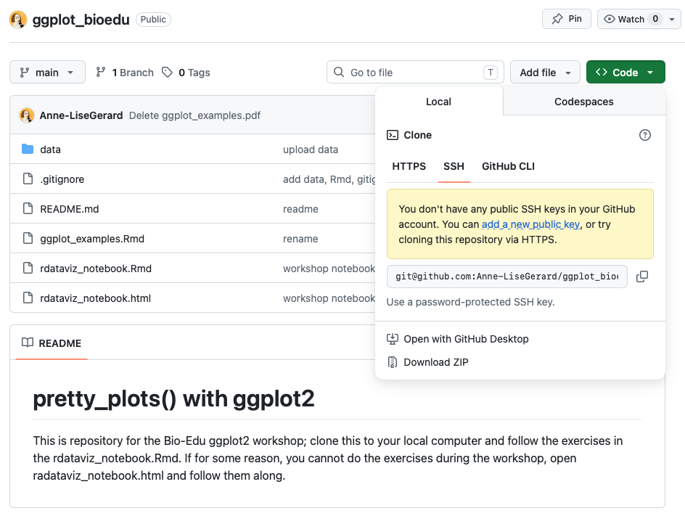


2| How to ggplot?
https://github.com/Anne-LiseGerard/ggplot_bioedu
Notes:
Let’s get ready to code! We’ll first ask you to download the GitHub repo at the following address. And open the notebook called rdataviz_notebook.Rmd

Slide 11
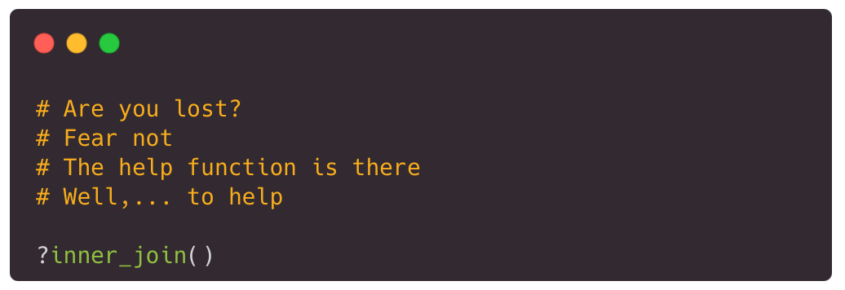
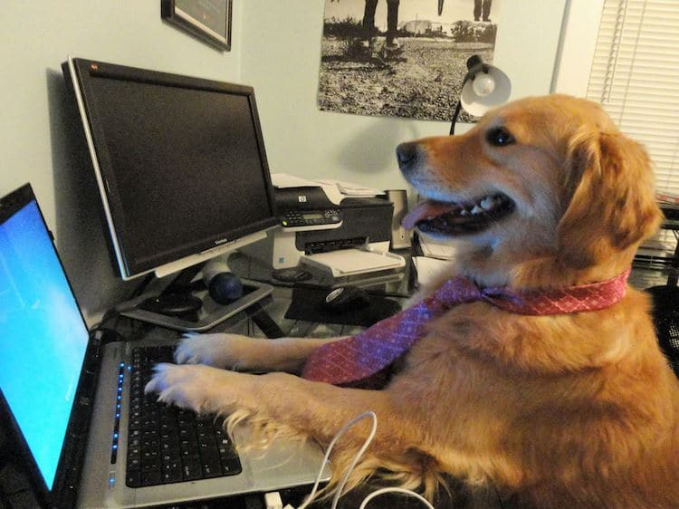
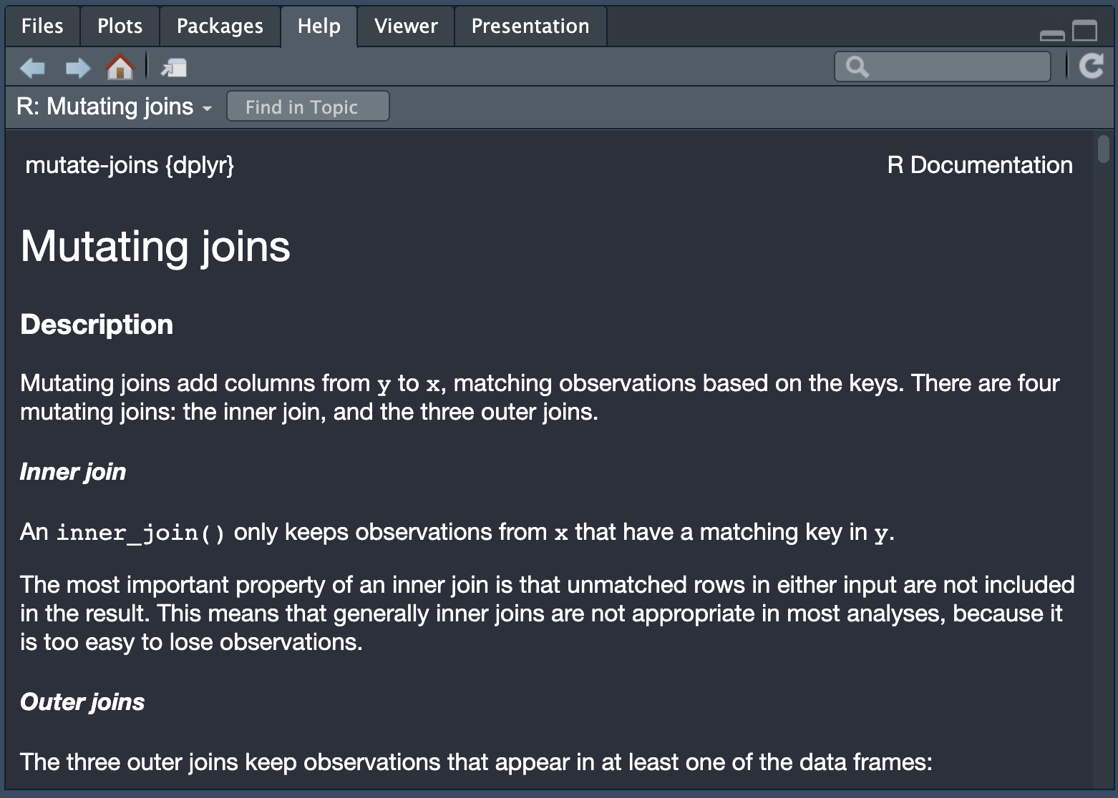
2| How to ggplot?
Notes:
XXXXXXXXXX reminder help?

Slide 12
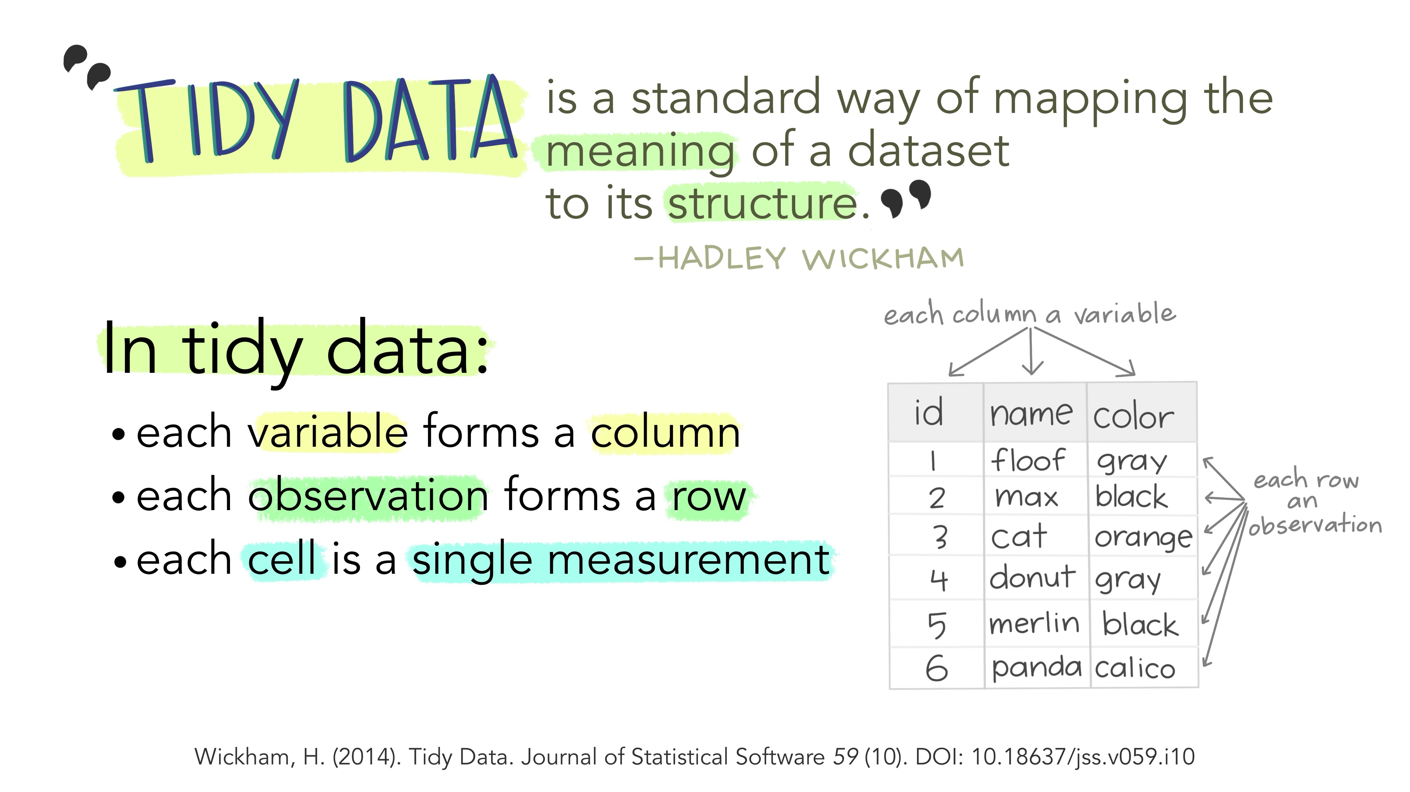
2| How to ggplot?
Read and format sample data
Notes:
Let’s start by introducing -- or reminding you if you attended Sam’s ggoncoplot workshop -- what a tidy dataset is.
1 variable = 1 column
1 observation = 1 row
1 cell = 1 measurement

Slide 13
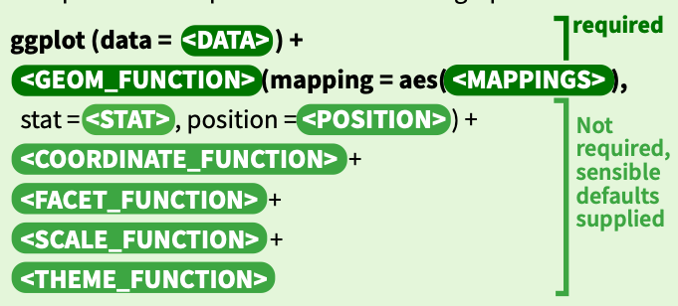
3| What’s a ggplot?
➪ Grammar of graphics
Notes:
ggplot2 is based on the grammar of graphics
the idea is that you can build every graph from the same components. Of all these, only three are strictly necessary: data + mapping and layers.
The mapping of a plot is a set of instructions on how parts of the data are mapped onto the graphics elements of your plot. For example, the variable that you will represent on the x & y axis.
A mapping can be made by using the aes()
The heart of any graphic is the layers. They take the mapped data and display it in something humans can understand as a representation of the data.
The geometry that determines how data are displayed, such as points, lines, or rectangles.
The statistical transformation that may compute new variables from the data and affect what of the data is displayed.
The position adjustment that primarily determines where a piece of data is being displayed.
Now we’ll dive into the exercices where you’ll build your first ggplot component by component!

Slide 14
4| Your first ggplot
Step 1: Passing your data to ggplot() and mapping variables with aes()

Slide 15
4| Your first ggplot
Step 1: Passing your data to ggplot() and mapping variables with aes()

Slide 16
4| Your first ggplot
Step 2: Choosing a geom function - what kind of plot do you want to make?

Slide 17
4| Your first ggplot
Step 3: The scale functions
Notes:
Scales are important for translating what is shown on the graph back to an understanding of the data. Scales are responsible for updating the limits of a plot, setting the breaks, formatting the labels, and possibly applying a transformation.

Slide 18
4| Your first ggplot
Step 4: Themes! (and labels and coord())
Extra 1
Notes:
Facets can be used to separate small multiples, or different subsets of the data. It is a powerful tool to quickly split up the data into smaller panels, based on one or more variables, to display patterns or trends (or the lack thereof) within the subsets.

Slide 19
4| Your first ggplot
Step 4: Themes! (and labels and coord())
Notes:
You can view the coordinates part of the plot as an interpreter of position aesthetics. While typically Cartesian coordinates are used, the coordinate system powers the display of map projections and polar plots.

Slide 20
4| Your first ggplot
Step 4: Themes! (and labels and coord())
Notes:
The theme system controls almost any visuals of the plot that are not controlled by the data and is therefore important for the look and feel of the plot. You can use the theme for customizations ranging from changing the location of the legends to setting the background color of the plot. Many elements in the theme are hierarchical in that setting the look of the general axis line affects those of the x and y axes simultaneously.

Slide 21
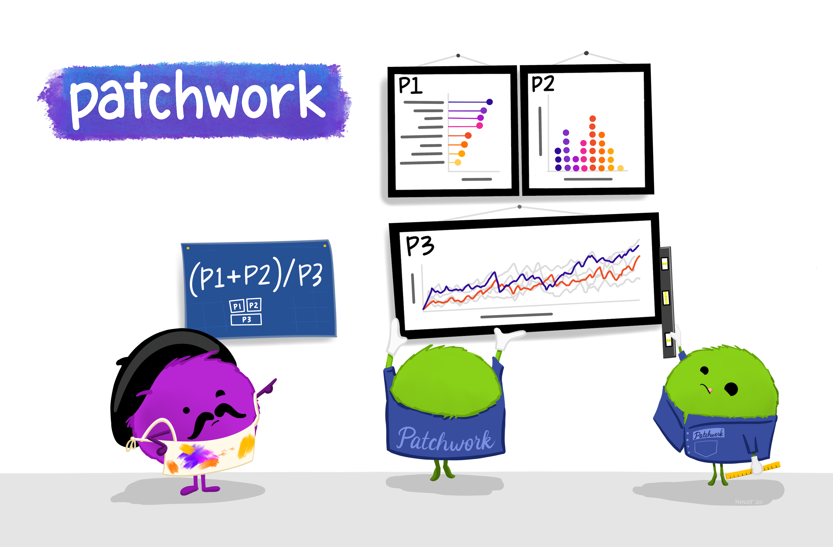
5| What do I do with these plots?
More extras!

Slide 22
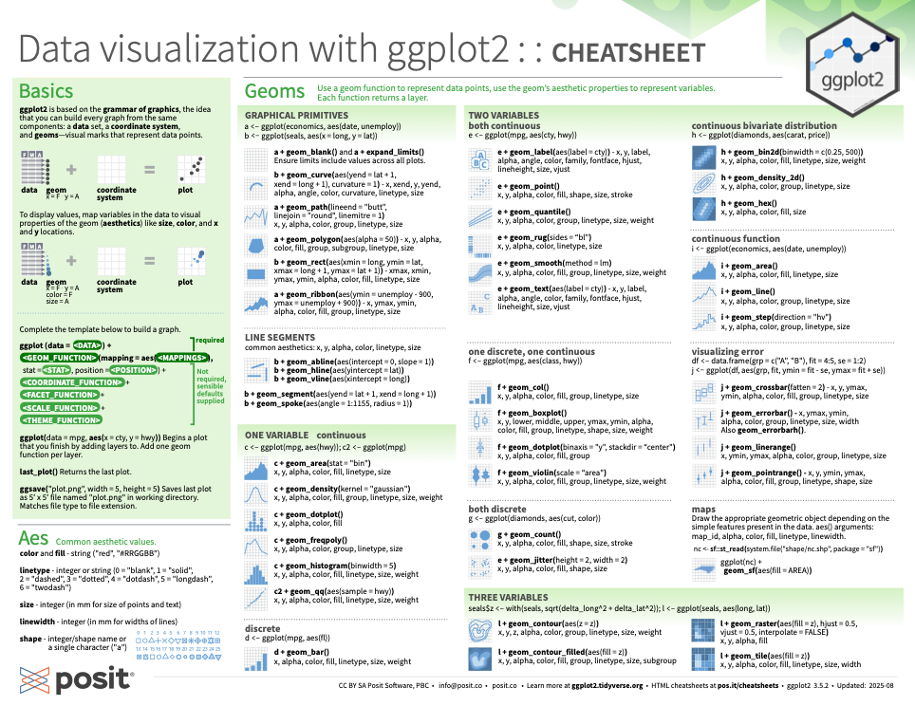
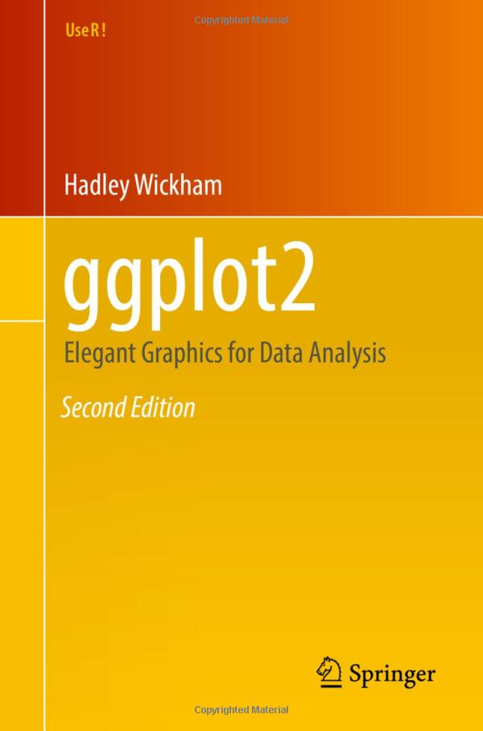
6| What’s next?
➪ Useful resources
https://ggplot2-book.org
https://rstudio.github.io/cheatsheets/data-visualization.pdf
Notes:
We’re now reaching the edn of this workshop, we’d like to leave you with some useful resources: the ggplot2 cheatsheet – if you’re familiar with R packages, posit has made these cheatsheets for all tidyverse packages and they’re extremely helpful if you’ve ran out of credits when asking your favorite LLM. Otehrwise you can always look into this old technology called a book – I know gross -- and find even more info there.

Slide 23
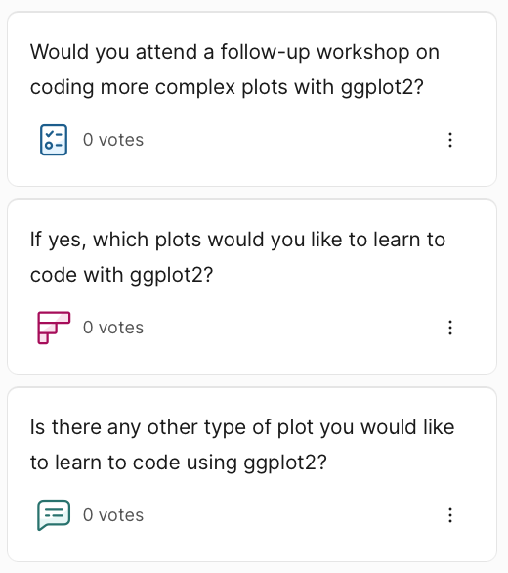

6| What’s next?
➪ Do you want more?
https://app.sli.do/event/kog6kSc2j2VZa9MS6KQZLZ
Slido code: 3258650
Notes:
Before you leave, I’ll ask one last thing of you, if you could take 2 min to complete this very short survey – only three questions, so we can sus out if you’d be keen to learn more.

Slide 24
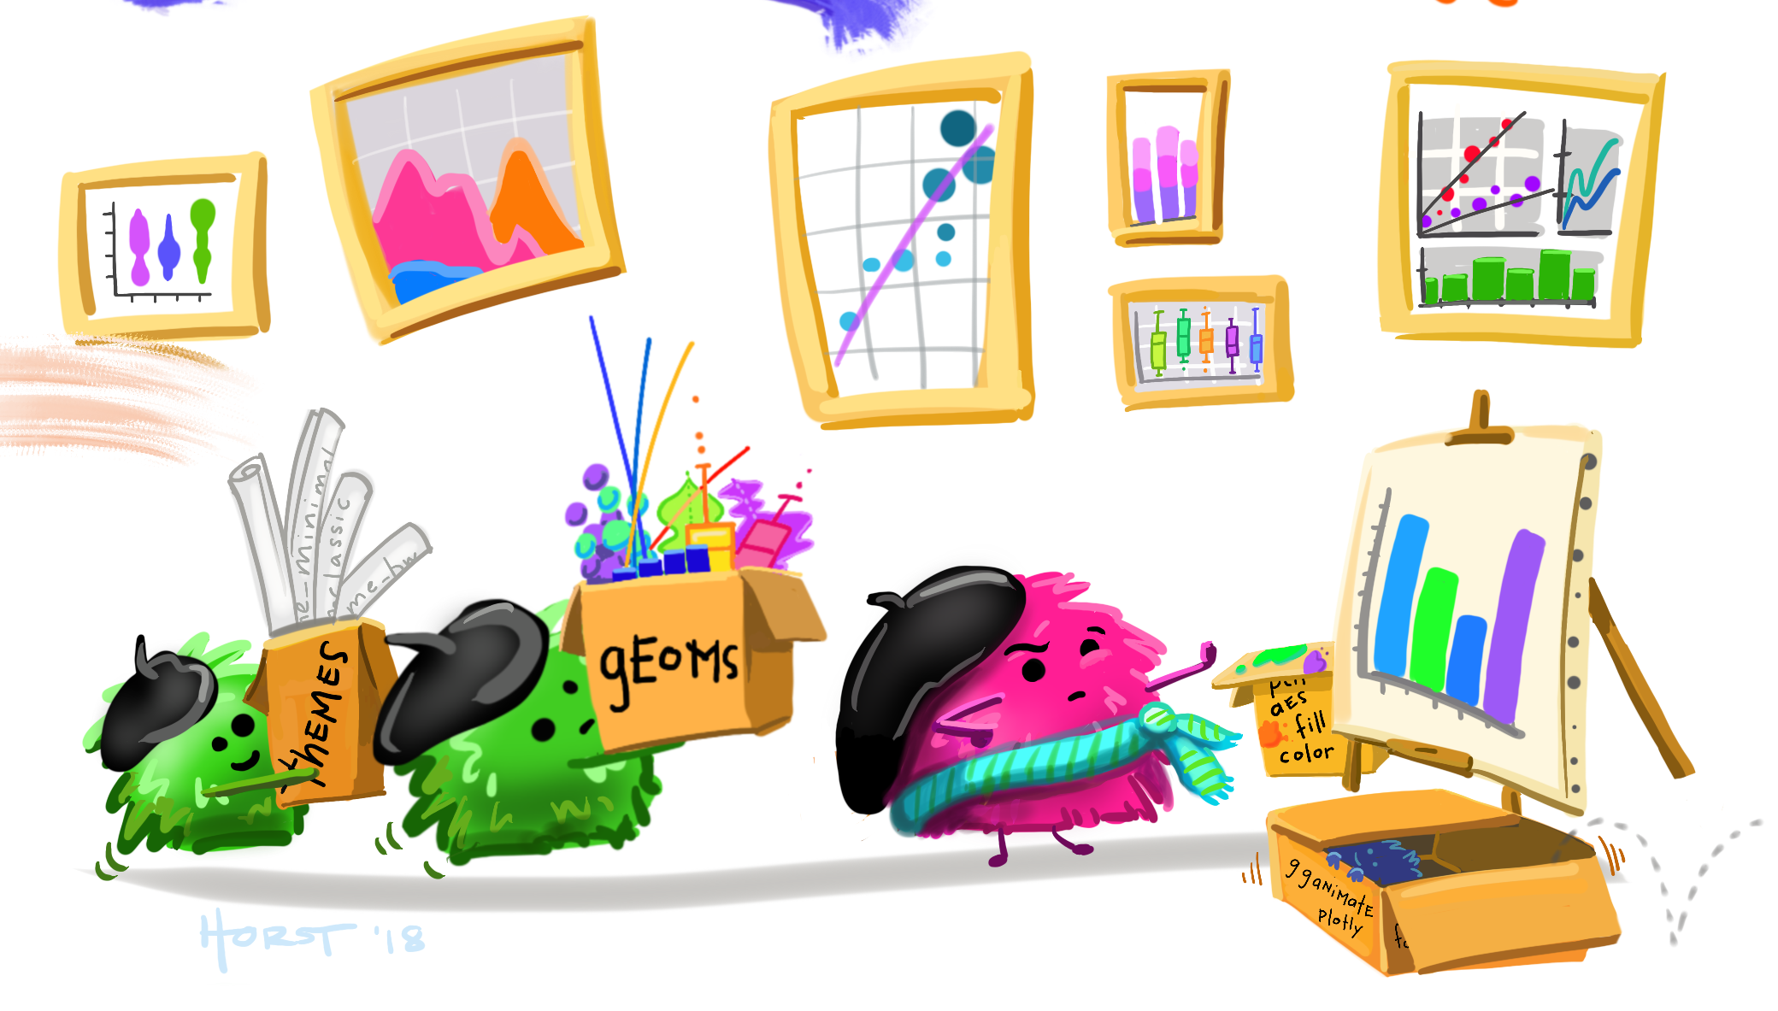
Thank you!
Notes:
Thanks a lot!

Slide 25
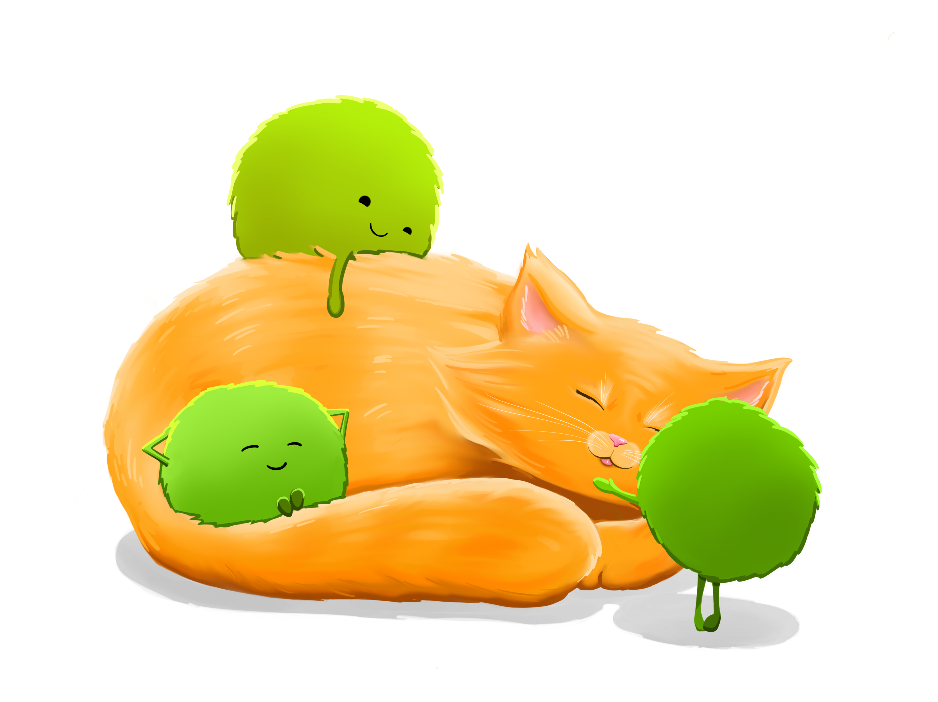
7| Resources
Main references
https://ggplot2-book.org
https://ggplot2.tidyverse.org/articles/ggplot2.html
https://github.com/Anne-LiseGerard/ggplot_bioedu
Packages
https://github.com/erikgahner/awesome-ggplot2
https://tidyverse.org
https://ggplot2.tidyverse.org
https://github.com/themepark-dev/theme.park
https://github.com/junqueiragaabi/ButterflyColors
https://github.com/cran/tayloRswift
Illustrations
https://github.com/allisonhorst/stats-illustrations
https://carbon.now.sh
Claude AI
Somewhere on the internet for the ones I forgot to write down…
Notes:
REF SLIDE

