Slide 1

Effective Cybersecurity in Modern Vehicles
Anne Aeschliman

Slide 2

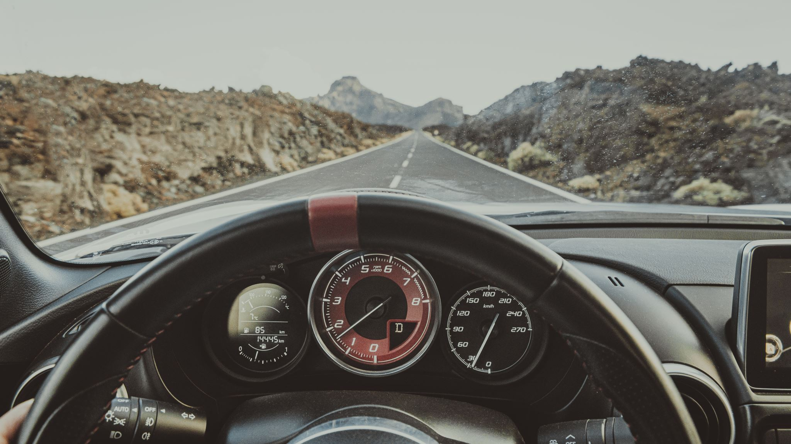
Why Does it Matter?
Driving a modern car produces terabytes of data
How is it stored?
Where is it sent?
What data is produced?
Who wants that data, and why?
Who is willing to protect that data?
How do they protect that data?

Slide 3
Types of Information Produced
Data types:
In-vehicle
Different nodes for different systems (i.e. suspension, exhaust, interior, fuel, etc.)
Cloud
Music streaming, navigation, software updates
Data transfers:
In-vehicle transfers (fuel system to dashboard)
Vehicle-to-X
Vehicle-to-Cloud
Vehicle-to-X-to-vehicle
X-to-vehicle-to-X

Slide 4
Data Abuses
Vehicle Manufacturers
Class-action lawsuit on General Motors and OnStar for sending driving habits to insurance companies, driving up insurance rates
Gathering biometric data
Companies get hacked and compromise gathered data
Law Enforcement
No requirement for a warrant, simply "probable cause."
Automakers easily hand over user data
Abusers, stalkers
Can track navigation data and manipulate vehicle functions from manufacturer's phone applications

Slide 5
Who Wants to Protect this Data?
NHTSA
Organized multiple panels with automotive manufacturers, experts, and computer developers
Put in place Information Sharing and Analysis Centers (ISAC) between automakers to ward off cyberattacks
Senators
Senator Edward J. Markey petitioned automakers to become more ethical with data practices.
Private entities
Cybersecurity models

Slide 6
Data Protection
Limit the types of information sent to different entities.
Music streaming services do not require navigational data, key fobs do not need fuel system error codes, other road users should not see TPMS information, etc.
Encrypt sent data.
Send information outside the vehicle encrypted, in raw data format, or a combination of both

Slide 7
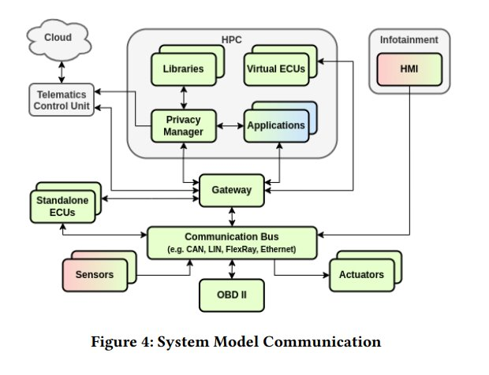
Data Protection Model

Slide 8
Research Timeline
Aug.–Dec.
Planning
Requirements
January
Data systems within vehicle
February
Vulnerable data
March
Data currently abused
April
Organizations formed to secure information
Cybersecurity models
May
Publish

Slide 9
References
NHTSA. (2016). NHTSA and Vehicle Cybersecurity.
Hill, K. (2024, October). The spy in your car. Reader’s Digest, 68–75.
Pape, S., Syed-Winkler, S., Garcia, A. M., Chah, B., Bkakria, A., Hiller, M., Walcher, T., Lombard, A., Abbas-Turki, A., & Yaich, R. (2023a). A systematic approach for Automotive Privacy Management. Proceedings of the 7th ACM Computer Science in Cars Symposium, 1–12. https://doi.org/10.1145/3631204.3631863
Bronstad, A. (2024, May 28). “a lot of outrage”: Privacy suits allege GM Steers driver data to insurers. Law.com. https://www.law.com/2024/05/28/a-lot-of-outrage-privacy-suits-allege-gm-steers-driver-data-to-insurers/
Caltrider, J., Rykov, M., & MacDonald, Z. (2023, September 26). After Researching Cars and Privacy, Here’s What Keeps Us up at Night. Mozilla Foundation. https://foundation.mozilla.org/en/privacynotincluded/articles/after-researching-cars-and-privacy-heres-what-keeps-us-up-at-night/
Beggin, R. (2022, January 4). Police Don’t Need a Warrant to Pull Personal Data from Cars. Governing. https://www.governing.com/security/police-dont-need-a-warrant-to-pull-personal-data-from-cars
Markey, E. J. (2023, December 1). Senator Markey Letter to Automakers on Privacy. Senator Edward Markey of Massachusetts. Retrieved November 25, 2024, from https://www.markey.senate.gov/imo/media/doc/senator_markey_letter_to_automakers_on_privacy.pdf.

