Slide 1
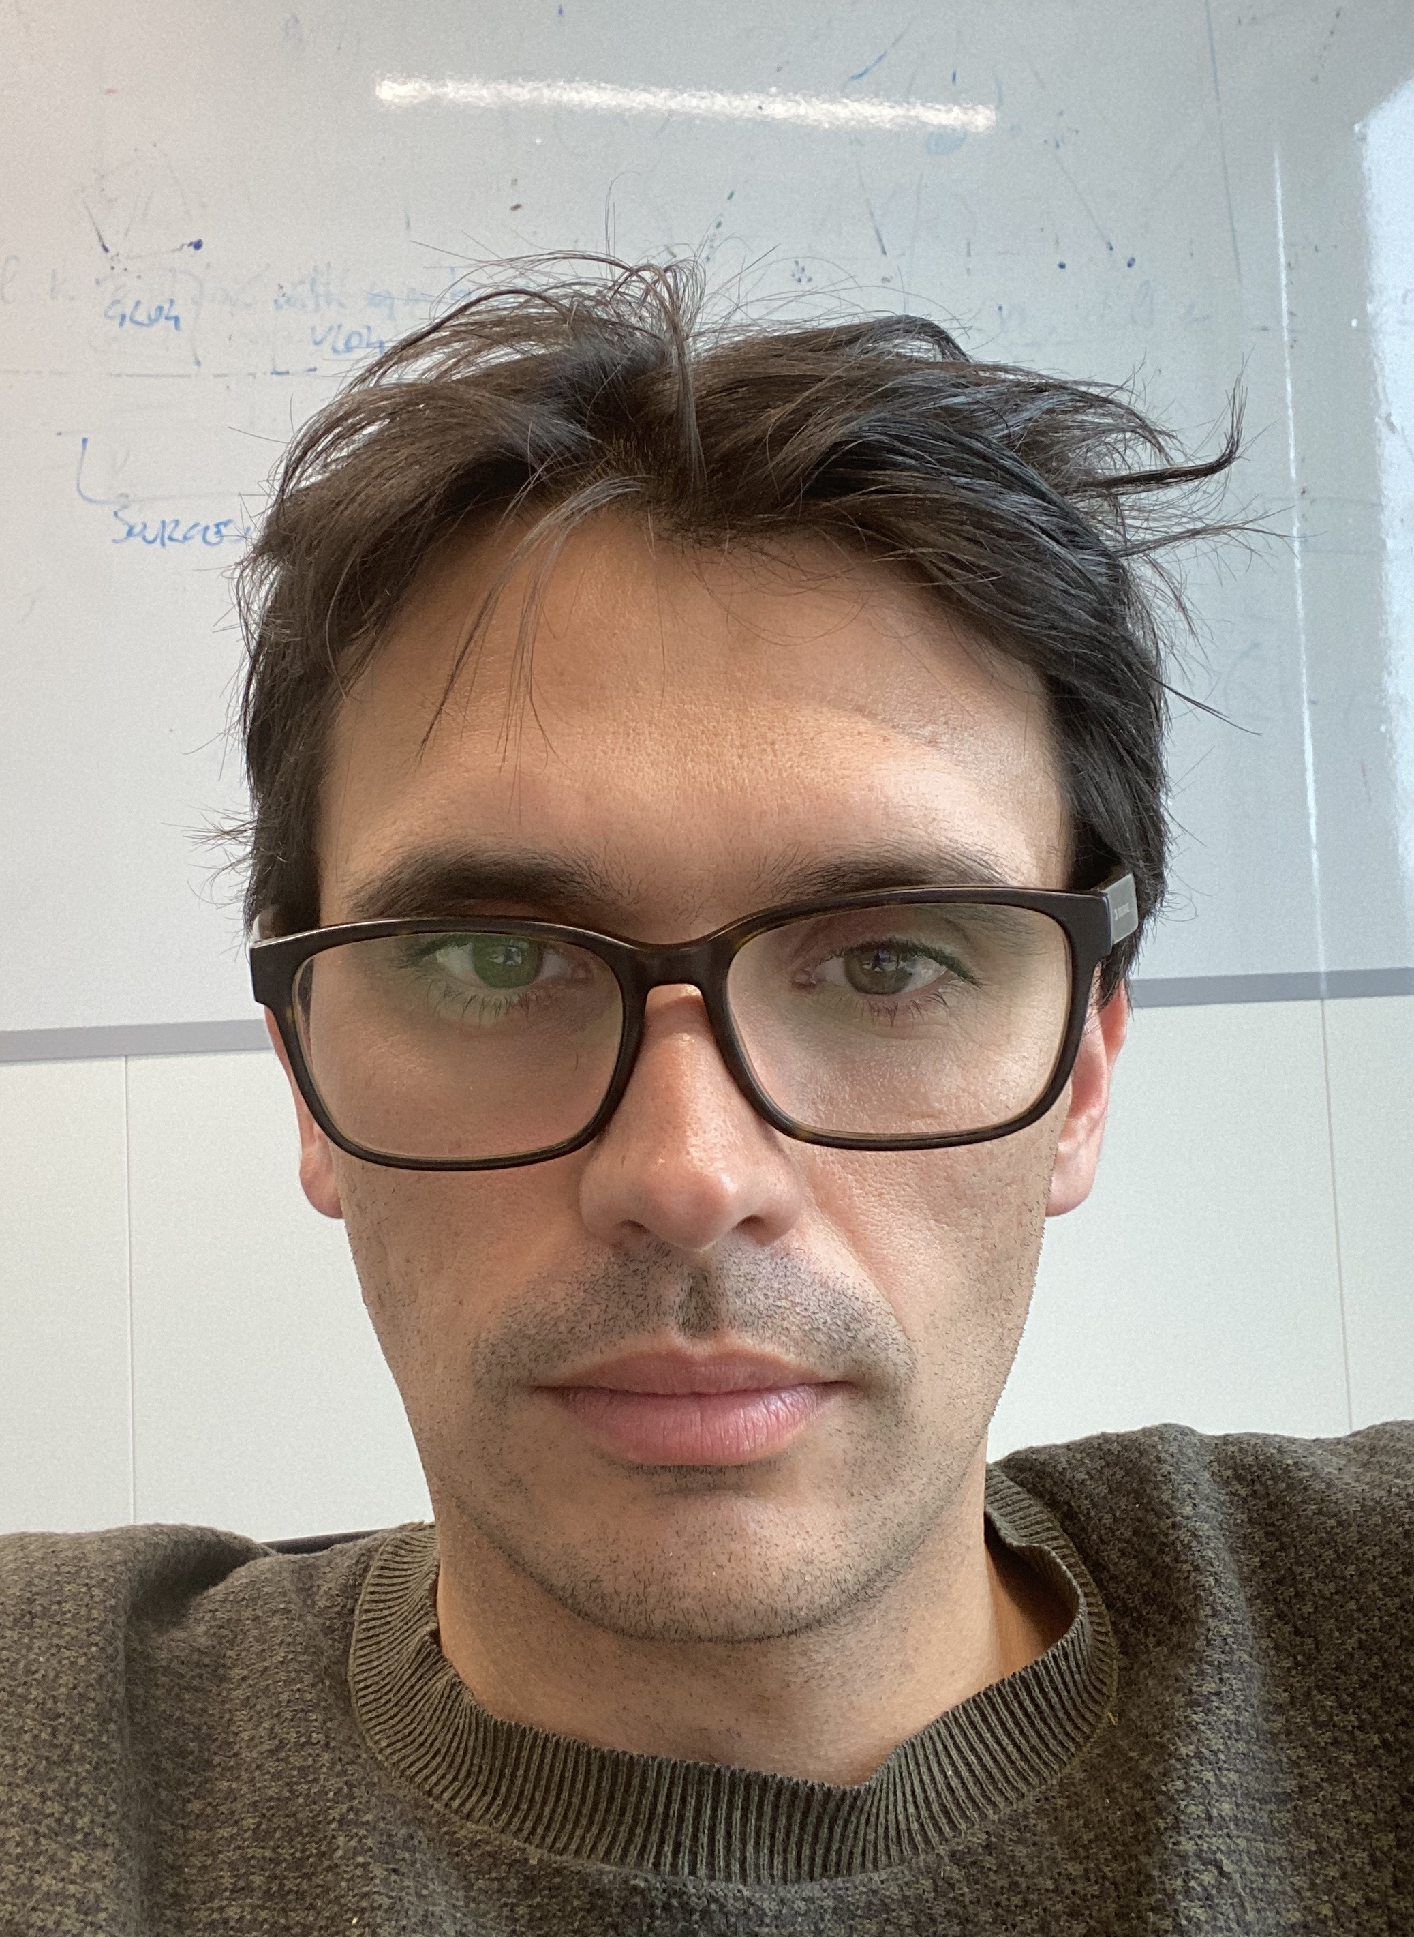




Jacopo Urbani
Title: Assistant Professor e-mail: jacopo@cs.vu.nl
Website: jacopourbani.it
Who: Group in AI data-intensive systems in Amsterdam
Goal: discover and retrieve knowledge by integrating symbolic and numerical inference techniques that are learned from the data (neuro-symbolic AI)
Funding:
Team:
Unmesh Joshi (PhD student)
Benno Kruit (PhD student)
You? (PhD opening in security and AI)

Slide 2






Trident: Graph database for storing very large graphs (TheWebConf’20) – see talk later
https://www.github.com/karmaresearch/trident
Projects
VLog: The fastest rule-based reasoner (Datalog, TGDs, EGDs) (AAAI’16, IJCAR’19, ISWC’20) https://www.github.com/karmaresearch/vlog
Best resource paper award ISWC 21
GLog: New reasoner to materialize Knowledge Bases with Trigger Graphs (VLDB’21) https://www.github.com/karmaresearch/glog
TAKCO: Web Tables Integration (ISWC’20, CIKM’21, TheWebConf’21) https://www.github.com/karmaresearch/takco

