Slide 1
Investigating the effects of Air Pollution in London on Respiratory illnesses
Group 3
Adheesha Kumarasinghe, Elise Vong, Anne Bai, Jeremy O’Connor

Slide 2
Introduction
We are looking at NOx, CO2, PMI2.5, PMI10 concentrations in each borough and comparing them to the proportion in each borough that contracted covid-19 and the proportion in each borough that died from covid-19.
Preliminary results show a very weak correlation.
We are currently trying to consider extra factors we need to consider and implement into our correlations.
We need to make quantitative estimations on the errors of each of the points – both systematically and quantitively.

Slide 3
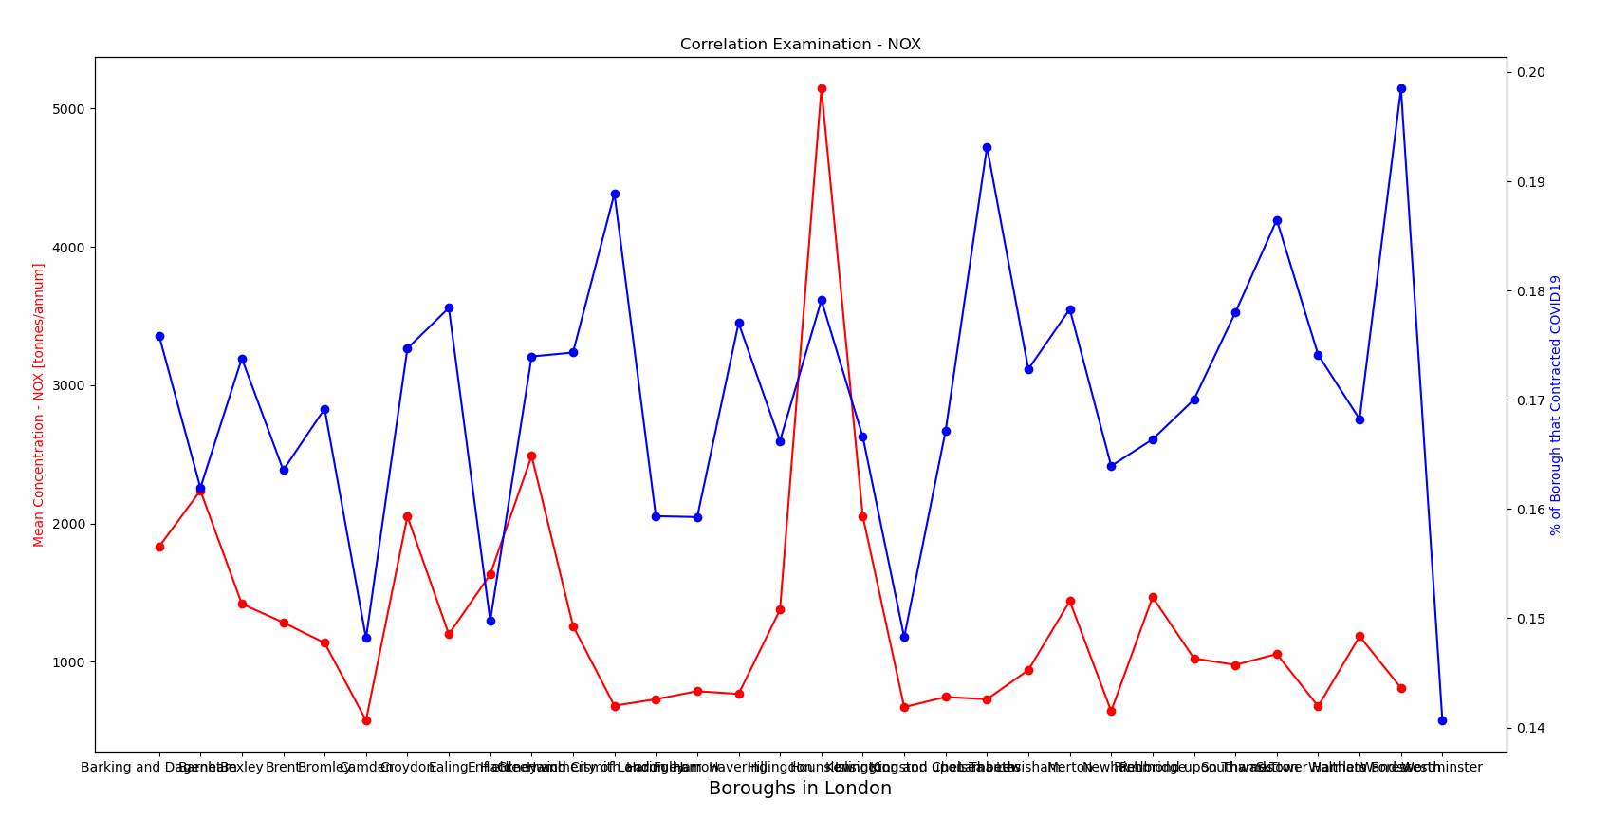
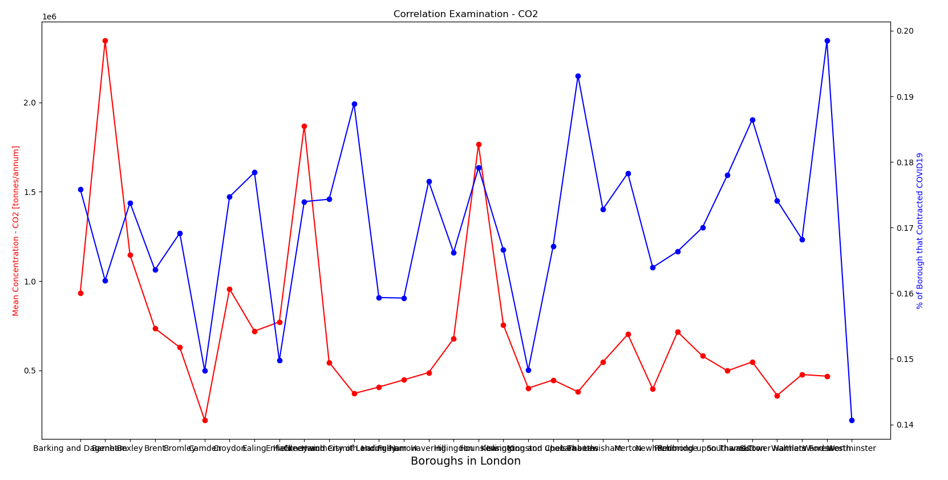
Current investigation – COVID19
This is data from LEAI 2013/2016/2019 on air pollution correlated with from Covid-19 case rates per Borough.

Slide 4
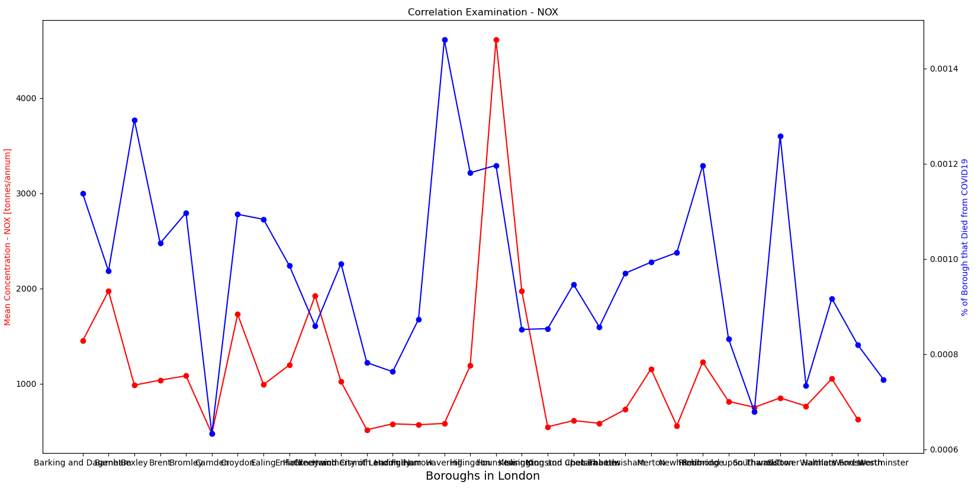
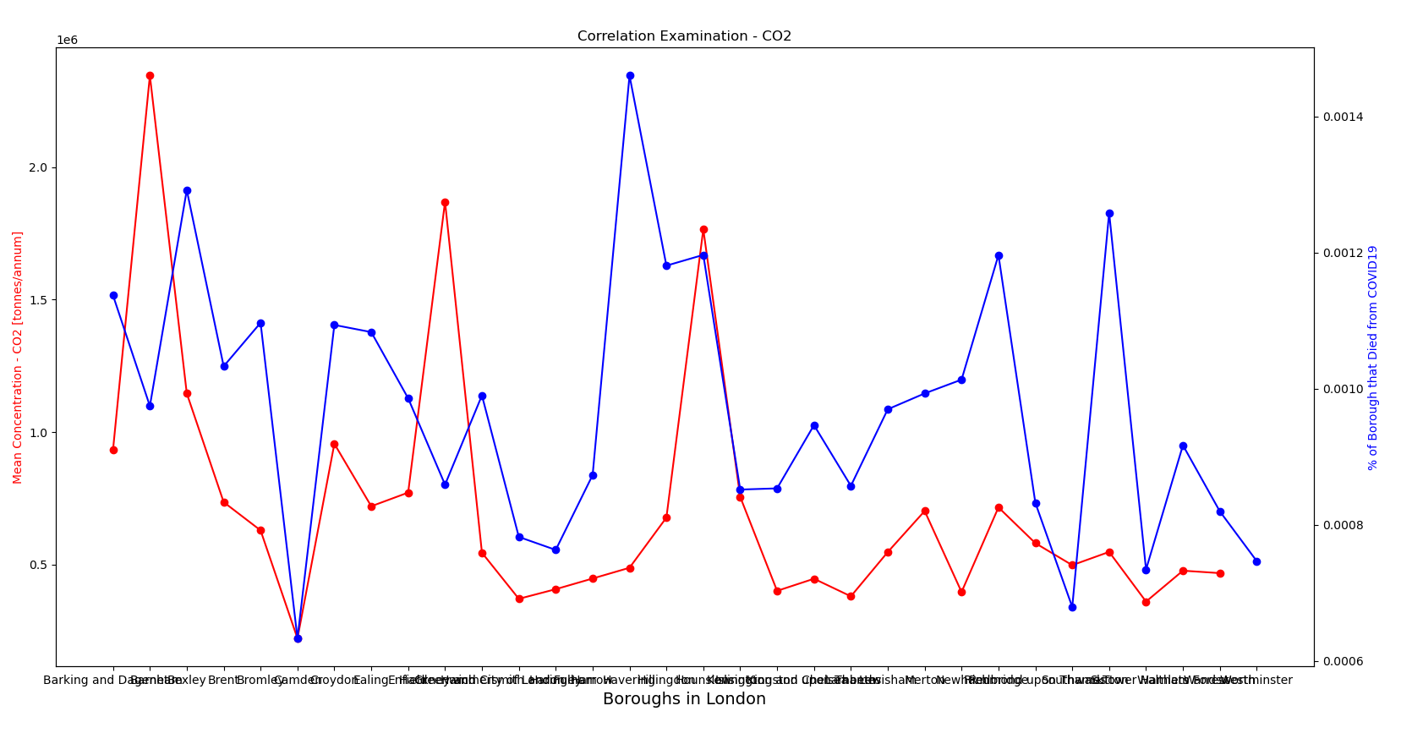
Current investigation – COVID19
This is data from LEAI 2013/2016/2019 on air pollution correlated with from Covid-19 death rates per Borough.

Slide 5
What we are hoping to further investigate?
Investigating air pollution concentrations relationships for other respiratory illnesses such as Asthma
Cleaning Data sets for years before 2008 for Air Pollution concentrations from LEAI
Investigating effects on life expectancy with our new quantitative data
Attempt to estimate the likelihood of death from certain respiratory diseases based on the concentration of air pollution substances.
Attempt to implement a more efficient sorting technique so our model could be used for different cities via machine learning?

Slide 6
Correlation Matrix
Regression

