Slide 2
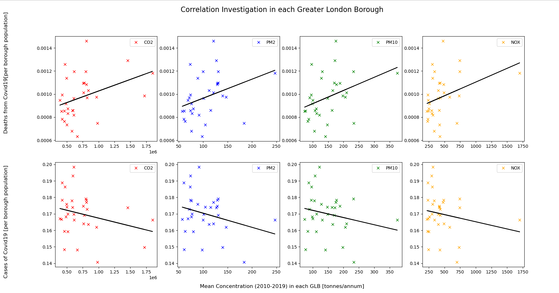
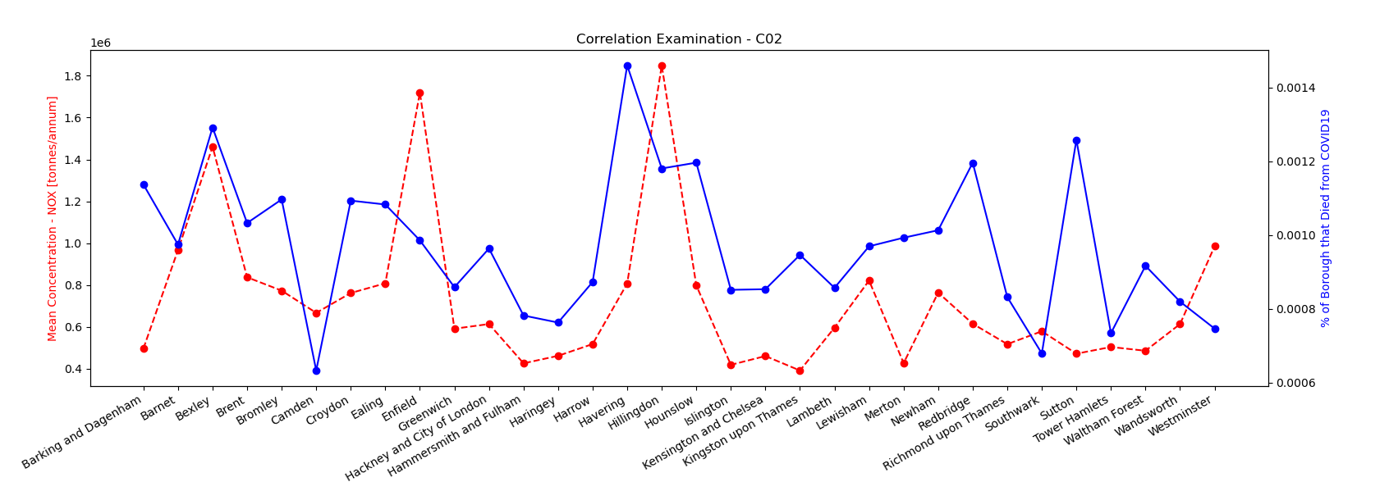
The correlation between long-term overexposure to air pollution and deaths from COVID-19 across all Greater London Boroughs
Introduction
SARS-CoV-2 2 is a virus affecting primarily the respiratory system that resulted in a global pandemic starting in December 2022. There have been upwards of 6.8 million deaths recorded as being due to the infection as of March 2022.
In terms of pathophysiology, the virus binds to ACE2 on respiratory epithelial cells using its spike protein, entering the cell and using its genetic machinery to proliferate.
Presentation can range from asymptomatic to severe pneumonia and lung failure. Most symptoms are respiratory in nature, such as coughing, and fever is also common. However, the virus also affects processes in other components of the body, such as blood clotting times.
The pandemic had a massive impact not only in terms of deaths caused directly on the virus, but also by delaying routine procedures for other illnesses. It also compromised key determinants of health, such as exercise and socialising, by limiting peoples' ability to leave their homes.
Mortality from COVID varies based on multiple risk factors. Established ones include advanced age, higher BMI and existing respiratory illnesses.
Given that existing respiratory dysfunction predisposes mortality from COVID, and pollutants such as nitrogen dioxide have been suspected of causing respiratory damage, we were interested in seeing the correlation between nitrous oxide levels and COVID mortality in different London boroughs.
We predicted there would be a positive correlation, but also noted that there could be multiple confounding factors affecting the relationship.
Main Quantitative Results
Null Hypothesis:
There is no correlation between the concentration of pollutants in each of the GLB and the likeliness of contracting Covid-19/death from Covid-19.
Alternate Hypothesis:
There is a correlation between the concentration of pollutants in each of the GLB and the likeliness of contracting Covid-19/death from Covid-19.
In the case of the correlation of Cases of Covid-19 and Air pollution concentration in each of GLB, with a p-value of >0.05, there is insufficient evidence to whether we can accept or reject the null hypothesis.
However, In the case of the correlation of Deaths from Covid-19 and Air pollution in each of the GLB, with a p-value of <0.05 (or = 0.05), there is sufficient evidence to rejected the null hypothesis on the 95% confidence interval. This significant result proposes it is extremely likely that there is a correlation between Air Pollution and Death from Covid-19 in each of the Greater London Boroughs.
 | CO2 | PMI2.5 | PMI10 | NOX
Cases
R Value | -0.26549 | -0.26942 | -0.21258 | -0.18924
P Value | 0.141937 | 0.135921 | 0.242762 | 0.299589
Deaths
R Value | 0.371579 | 0.344748 | 0.370651 | 0.344799
P Value | 0.036262 | 0.053322 | 0.036768 | 0.053284
Data Sorting and Analysis
-write about how you decided to produce your code i.e. what outcome did you want and what code did you write for this (describe step by step)
-can include a picture of your code (doesn’t have to include the entire code), e.g. can include the code for cleaning the data, why did you want to cleaning the data before plotting the data
-can include the code for sorting
1. COVID and NO2 Correlation for each borough
Selection of data
Three sets of data are applied to produce the graph:
COVID cases in each London borough every day from 2020/02/03 to 2023/02/08, each record contains area name, area code, date, new cases [1].
COVID deaths in each London borough every day from 2020/03/09 to 2023/02/09, each record contains area name, area code, date, new death [2].
NO2 emission in each site in London from 2015 to 2023, each record contains data, NO2 level, site and site code[3].
COVID data cleaning
Aim: return a list of percentage death of each borough in 2021 with a list of corresponding borough name.
  select row numbers to which date is in the year of 2021
  Divide into boroughs by area code, add together to obtain total COVID cases and deaths over the year
  Divide total number of deaths by total number of cases to obtain the percentage death of each borough.
NO2 data cleaning
Aim: return a list of average NO2 level of each borough in 2021 with a list of corresponding borough name.
Divide the sites to boroughs in terms of the name of the sites. Return a list of site code of different boroughs.
According to site code belonging to each borough, search through the file to get corresponding NO2 levels.
Obtain average NO2 level over the period for each borough.
Correlation Plot
  For the average NO2 level for each borough, if outcome is 0, delete the point from the plot.
  For each point, find the corresponding NO2 level and percentage death in terms of borough name, then plot using matplotlib.pyplot.
  Using curve_fit from scipy.optimize, fit a linear line to the data points and study its trend.
Interpretation of Quantitative Analysis
-create 3 graphs which will be used in the analysis (before this Wednesday)
+e.g. NO2 vs covid deaths , another pollutant vs covid deaths
1. COVID and NO2 Correlation for each borough
As shown in the figure above, a negative correlation is observed for the percentage death of COVID-19 and the Average NO2 pollution level. This may or may not indicate that the two are independent of each other, since the correlation is not clear and obvious enough. This result does not agree with the study conducted by Wu[1] in USA. This may be due to three reasons.
Firstly, the boroughs are very close to each other, so residents travel between each area, so the exposure to air pollution cannot be solely determined by the NO2 in each borough. Secondly, new residents that have just moved to the borough possibly exist, who are not exposed to the air pollution in that borough for a long time. Thirdly, young people are more resistant towards COVID-19, and the proportion of young people differ for different boroughs, which may affect the outcome of mortality rate.
Reference: [1] Wu, X. et al. (2020) “Air pollution and covid-19 mortality in the United States: Strengths and limitations of an ecological regression analysis,” Science Advances, 6(45). Available at: https://doi.org/10.1126/sciadv.abd4049.
Discussion
Adheesha: We did not get a positive correlation as expected, instead getting a negative one (albeit with a small correlation coefficient). Disregarding the possibility of an error in data analysis, there could be two possibilities for this. Either higher nitrogen dioxide levels are genuinely associated with lower COVID morality, or there are confounding factors at play. Given that COVID-19 mortality has been established to be multifactorial, the second option is certainly most likely. For instance, higher nitrogen dioxide levels may be found in more urbanised London boroughs, which also generally have better access to healthcare. Also, more urbanised boroughs have younger populations in general, and young people are less likely to die from COVID. The effect of these confounding factors seems to be more significant than that of nitrogen dioxide. The next logical step would be to perform a multivariate analysis, looking at the correlation coefficient between nitrogen dioxide and COVID mortality having accounted for factors such as age. If the correlation is different to that in the univariate analysis that we have conducted, confounding is indicated.
Anne: From the results, I found that clearly more variables are needed for considering mortality rate from COVID-19 for each borough. For example, the average age of residents in each borough, the proportion that have just moved to each borough, and proportion of people who travel between the boroughs. It is too arbitrary to solely consider the air pollution level. For further studies, larger areas should be considered to calculate pollution and mortality rate, to decrease the degree to which people travelling between areas affect the mortality rate. In addition, variables such as age should be included and a multivariable correlation studied.
  References
  [1]: GLA, C.I. (2020) Coronavirus (COVID-19) weekly update, London Datastore News. Greater London Authority. Available at: https://data.london.gov.uk/dataset/coronavirus--covid-19--cases
  (Accessed: March 15, 2023).
  [2]: GLA, C.I. (2020) Coronavirus (COVID-19) Deaths, London Datastore News. Greater London Authority. Available at: https://data.london.gov.uk/dataset/coronavirus--covid-19--deaths (Accessed: March 15, 2023).
  [3]: London Air, I.C. (2015) London Air Nitrogren Dioxide. Available at: https://www.londonair.org.uk/london/asp/dataspecies.asp?species=NO2m (Accessed: March 15, 2023).

