Slide 1

Covid-19
Health Data
Data Analytics Bootcamp
Tarak Patel, Nicole Lund & Anne Niemiec

Slide 2



Hypotheses
We expect to see larger quantities of Pfizer
vaccines being allocated to states with the
greatest population density due to storage
requirements and larger quantities of
Johnson and Johnson vaccines being
allocated to states with lower population densities.
We expect to see a significant ramp-up
in vaccine allocation with time. Aside from
known anomalies like the Texas storm in March.
We believe the distribution ratios between
the first and second dose will invert
over time with early dates showing a
higher level of 1st dose allocations and
later dates showing a higher level
of 2nd dose allocations.
We believe that states will administer vaccines at the rate in which they are allocated.
We expect to see a correlation between the number of deaths and poverty rate within the state.

Slide 3
Data Sources
Pfizer Vaccine Allocation:
Covid Cases and Deaths
https://data.cdc.gov/Vaccinations/COVID-19-Vaccine-Distribution-Allocations-by-Juris/saz5-9hgg
Dataset: X rows and x columns; weekly or daily data
https://data.cdc.gov/Case-Surveillance/United-States-COVID-19-Cases-and-Deaths-by-State-o/9mfq-cb36
Dataset: X rows and x columns; weekly or daily data
Moderna Vaccine Allocation:
Census
https://data.cdc.gov/Vaccinations/COVID-19-Vaccine-Distribution-Allocations-by-Juris/b7pe-5nws
Dataset: X rows and x columns; weekly or daily data
URL:
Dataset: X rows and x columns; weekly or daily data
J & J Vaccine Allocation:
Vaccines Administered
https://data.cdc.gov/Vaccinations/COVID-19-Vaccine-Distribution-Allocations-by-Juris/w9zu-fywh
Dataset: X rows and x columns; weekly or daily data
https://ourworldindata.org/us-states-vaccinations
Dataset: X rows and x columns; weekly or daily data
*State Abbreviations List: https://www.infoplease.com/us/postal-information/state-abbreviations-and-state-postal-codes

Slide 4
Datasets
Timeframe
Vaccines
Demographics
12/14/20-4/19/21
Pfizer, Moderna, and J&J
Population, median age, household income, poverty rate and unemployment rate
#
!
USA
Allocations
Infections
States and territories
When the vaccines are established by the US Government
Date in which the state or territory records transmission and deaths

Slide 5

Exploration & Cleanup
Normalized Data
Measured the number of days from the original start date (12/14/20) and removed all case and death data prior to this date.
Vaccine Allocation
Set zero value for null values
State Naming Conventions
Utilized state codes as common index
Summarized data restrictions
With select plots, it was necessary to omit territories (e.g. Puerto Rico) and government affiliations

Slide 6
Implementation & Execution
Team Project
J&J
Pfizer
Moderna
How we tackled our dataset:
Created a data manipulation folder and two subfolders within GitHub for clean data and source data, along with original readme file.
Datasets were scrubbed multiple times to ensure accuracy, including combining territories (e.g. Guam, Puerto Rico into separate state) for plotting purposes.
Assigned the plotting tasks (11) into individual folders with a respective read me file script for each person to follow.
Once team member completed their work, it was committed and pushed to our respective individual branches and later merged/squashed into the main branch.
All remaining updates were conducted through the main branch, requiring coordination among the team to avoid merge conflicts and overwriting our work.

Slide 7

Analysis
We will present visualizations that help illustrate the current situation related to the Covid-19 pandemic and where we stand relative to vaccinations at a state level within the United States.

Slide 8
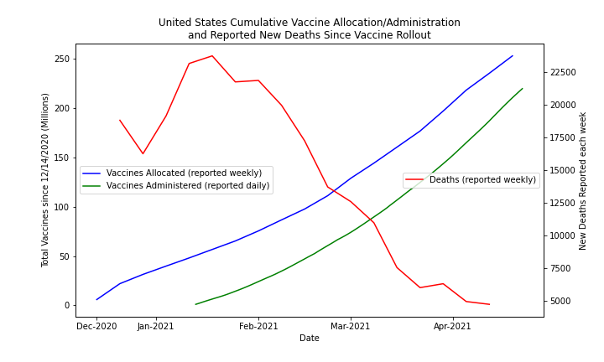
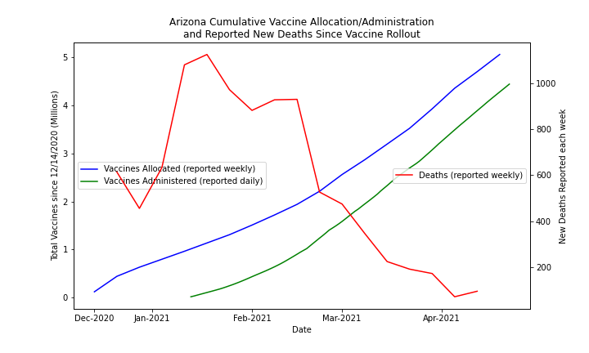
Are vaccinations decreasing death rates?
There is good evidence that the administration is reflective is
reflective of the lower number of deaths.

Slide 9
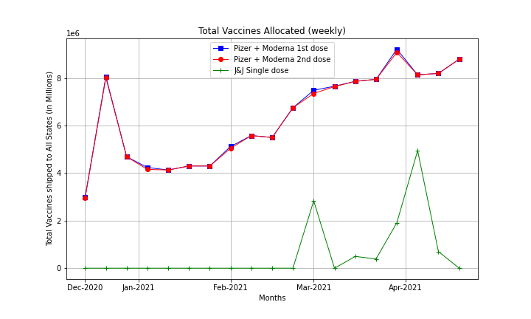
How does the CDC handle the multi dose allocation in their distribution values?
The CDC has allocated both doses for Pfizer and Moderna at the time of allocation.

Slide 10
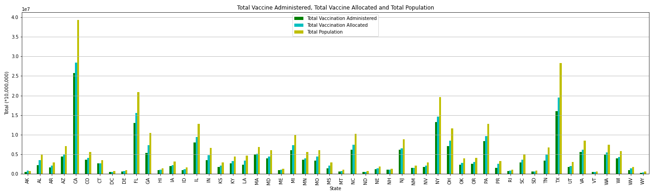
How many doses were administered by state?
This figure displays the relationship between the population and the number of vaccines allocated and administrated. As you can see, California and Texas have a large task ahead.

Slide 11
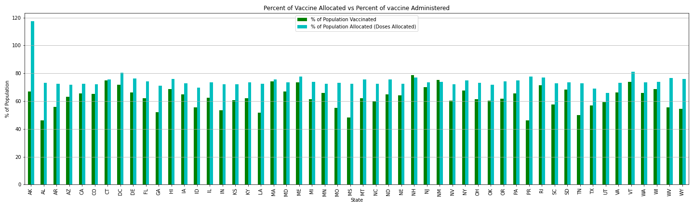
How well are states distributing the vaccines received from the CDC?
This figure represents the percent of vaccines allocated versus the percent of vaccines administered. This is a calculation based on the number of doses. Keep in mind that two of the three vaccines in our dataset require two doses (Pfizer & Moderna). The majority of states are adequately administering the vaccines upon receipt from the CDC. New Hampshire and New Mexico reflect a higher number of vaccines received versus administered and we suspect it is related to the indigenous population and their diligence within the tribal community to administer them quickly; while we suspect Alaska has experienced challenges with administering the vaccination based on population density.

Slide 12
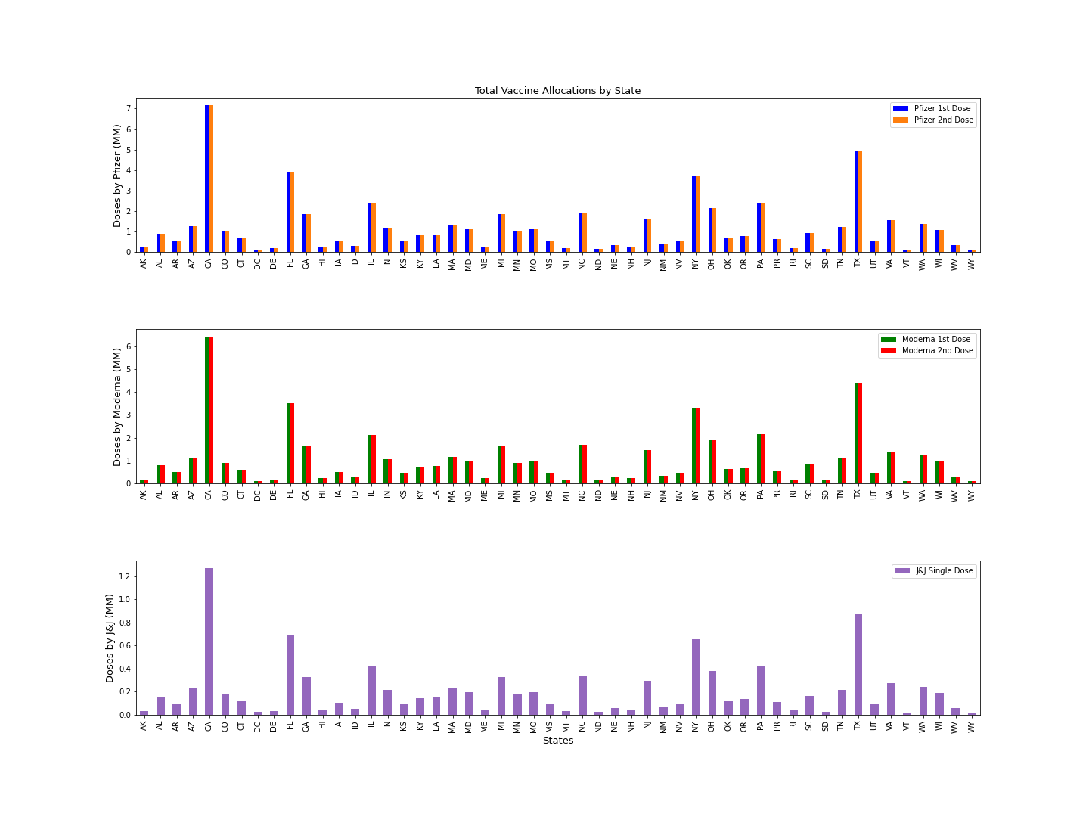
How many vaccines dosages were allocated by state ?
It appears that California received a higher number of doses of Moderna versus Pfizer and J&J.

Slide 13
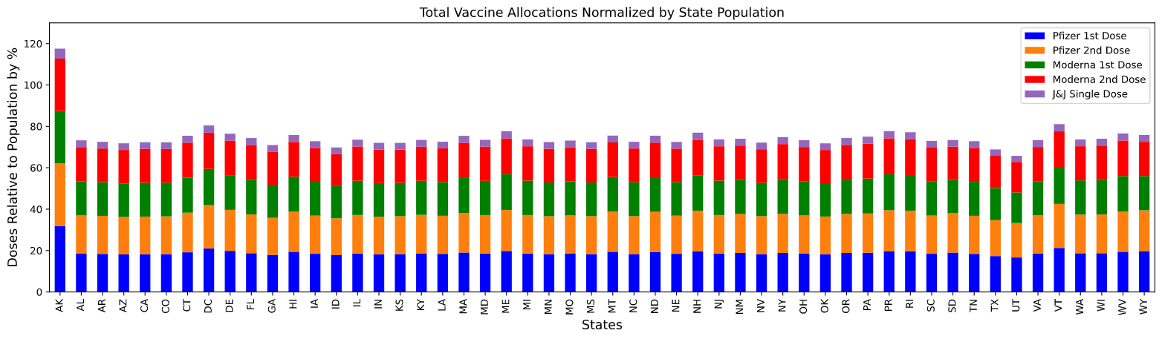
If the population is normalized across the states, how does the vaccine allocation compare respectively?
We believe Alaska has a higher percent of allocation based on the lower density of population compared to the other states. Additionally, they reported their distribution values on a monthly basis versus weekly, as all other states.

Slide 14
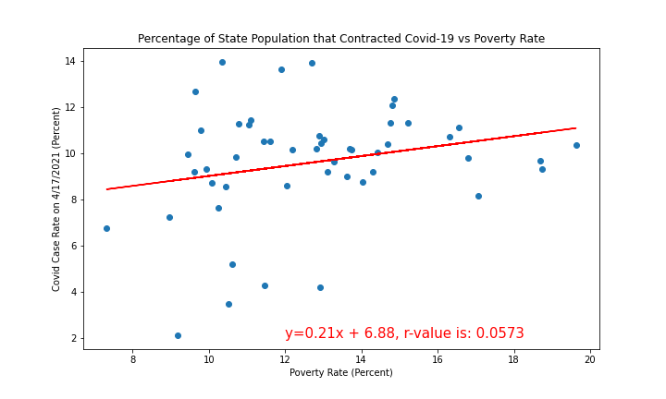
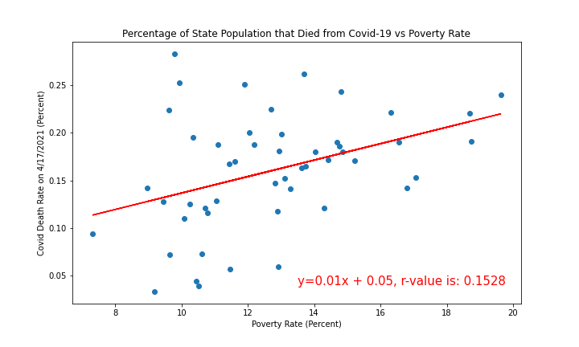
Does impoverished areas have a pattern of increased transmission and death?
On the state level of poverty does not have a strong correlation with the
prevalence of Covid-19 in the state. The correlation values are too small
to draw a conclusion on this data.

Slide 15

Conclusions
It is apparent the CDC allocated the same number of doses for first and second shots for Pfizer and Moderna on a weekly basis to each state.
We’ve shown that states have kept pace with vaccine administration relative to the allocations provided by the CDC. Additionally, the allocations increased each month respectively.
Our data confirms that the number of vaccines allocated is representative to the population.
Deaths are decreasing in the time period that vaccines were administered.
There is not enough evidence at the state level to indicate a correlation between poverty rate and Covid-19 deaths; it would require a deeper dive at the zip code or county level.
As of 4/19/21, 62.1% of vaccines have been administered nationwide.

