Slide 1

Covid-19
Health Data
Data Analytics Bootcamp
Tarak Patel, Nicole Lund & Anne Niemiec

Slide 2



Hypotheses
We expect to see larger quantities of Pfizer
vaccines being allocated to states with the
greatest population density due to storage
requirements and larger quantities of
Johnson and Johnson vaccines being
allocated to states with lower population densities.
We expect to see a significant ramp-up
in vaccine allocation with time. Aside from
known anomalies like the Texas storm in March.
We believe the distribution ratios between
the first and second dose will invert
over time with early dates showing a
higher level of 1st dose allocations and
later dates showing a higher level
of 2nd dose allocations.
We believe that states will administer vaccines at the rate in which they are allocated.
We expect to see a correlation between the number of deaths and poverty rate within the state.

Slide 3
Data Sources
Pfizer Vaccine Allocation:
Covid Cases and Deaths
https://data.cdc.gov/Vaccinations/COVID-19-Vaccine-Distribution-Allocations-by-Juris/saz5-9hgg
1198 rows, 4 columns
Reported weekly by state, territories, government and select cities
https://data.cdc.gov/Case-Surveillance/United-States-COVID-19-Cases-and-Deaths-by-State-o/9mfq-cb36
27120 rows, 15 columns
Reported weekly by state, territories, and New York City
Moderna Vaccine Allocation:
Vaccines Administered
https://data.cdc.gov/Vaccinations/COVID-19-Vaccine-Distribution-Allocations-by-Juris/b7pe-5nws
1134 rows, 4 columns
Reported weekly by state, territories, government and select cities
https://ourworldindata.org/us-states-vaccinations
6400 rows and 4 columns;
Reported weekly by state, territories and government
J & J Vaccine Allocation:
Census
https://data.cdc.gov/Vaccinations/COVID-19-Vaccine-Distribution-Allocations-by-Juris/w9zu-fywh
379 rows, 4 columns
Reported weekly by state, territories, government and select cities
https://github.com/datamade/census
Wrapper for United States Census Bureau’s API
Used 2013 ACS5 Census Data
52 rows and 8 columns
Reported 50 States, the District of Columbia and Puerto Rico
*State Abbreviations List: https://www.infoplease.com/us/postal-information/state-abbreviations-and-state-postal-codes

Slide 4
Datasets
Timeframe
Vaccines
Demographics
12/14/20-4/22/21
Pfizer, Moderna, and J&J
Population, median age, household income, poverty rate and unemployment rate
#
!
USA
Distribution
Infections
States, territories and government
How the vaccines are allocated by the US Government
Recorded transmission and death totals by state/territory

Slide 5
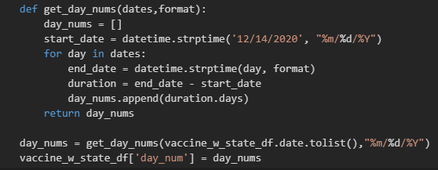
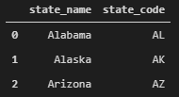
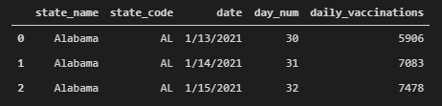
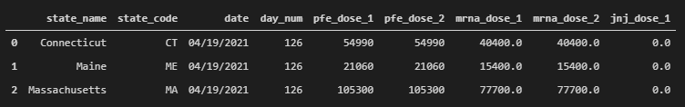

Exploration & Cleanup
Collected .csv files and loaded into Pandas DataFrames
Utilized common column naming convention across files
Created common state name and state code columns in all files by
Merge with state abbreviation list DataFrame
Accounted for unique inconsistencies for each file type
Created day_num column in all files with periodic reporting structure
Vaccine Allocation
Merged all suppliers into single DataFrame
Set zero value for null values
Covid Cases and Deaths
Removed data prior to 12/14/2020
Census Data
Calculated Poverty and Unemployment Rates
Additional DataFrame merges, filtering and summary statistics were calculated as part of data analysis

Slide 6
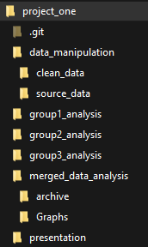
Implementation & Execution
Team Project
Selected dataset
Created project README containing
Initial hypothesis
Data Sources
Brainstormed list of figures to begin analysis
Formulated plan for organizing
Repository file structure
Git branch structure
One person working on one branch in one subfolder at any one time
Analysis work distribution
Data analysis and original figure list split into three groups
Analysis worked independently
Created brainstormed figures
Created additional figures that furthered the data story
Issues Resolved
State naming convention issues => Data cleaning revisited
Work was committed to unintended branches causing merge conflicts => Reverted commits, removed/re-cloned local repositories, revisited Git branch plans
Protected main branch by requiring Administrator or at least 1 review before Pull Requests could be resolved
Selected best figures for final presentation
Updated project README

Slide 7

Analysis
We will present visualizations that help illustrate the current situation related to the Covid-19 pandemic and where we stand relative to vaccinations at a state level within the United States.

Slide 8
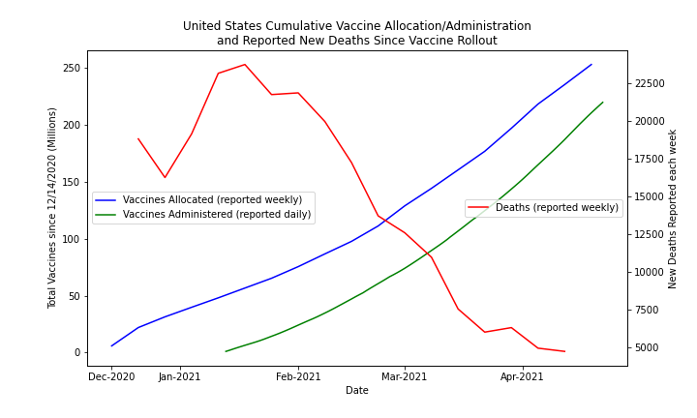
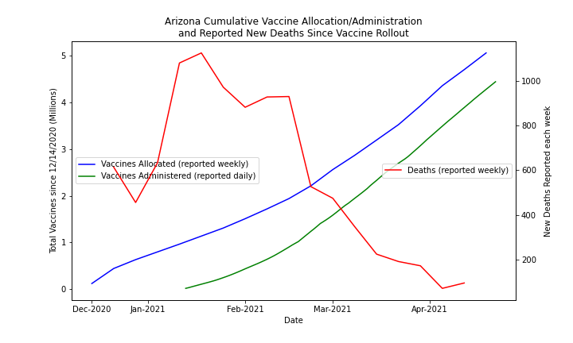
Are vaccinations decreasing death rates?
Death rates decreased after vaccine rollout began. It is possible that vaccination contributed to this result.

Slide 9
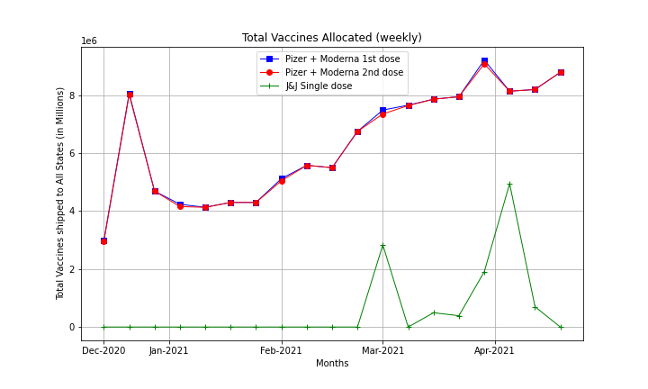
How does the CDC handle the multi dose allocation in their distribution values?
The CDC allocated both doses of the Pfizer and Moderna regimens at the same time.
Vaccine allocations are increasing with time.

Slide 10
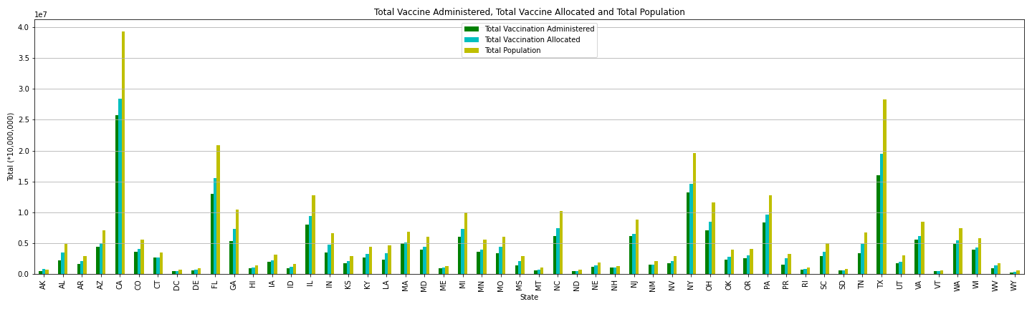
How many doses were allocated to and administered by state?
Vaccine allocations appear to be related to state population.

Slide 11
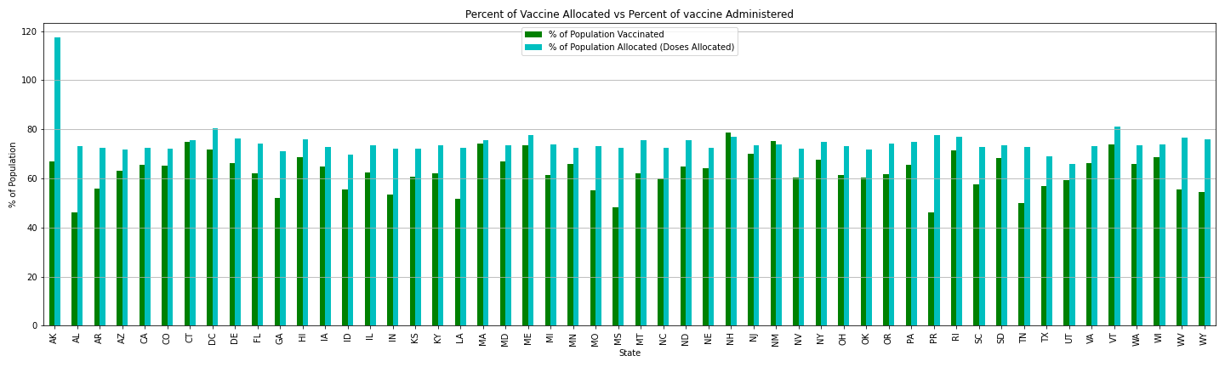
How well are states distributing the vaccines received from the CDC relative to other states?
New Hampshire and New Mexico reflect a higher number of vaccines administered than received. This may be due to categorization of data between datasets being different. Additional data cleansing is needed to identify the source of the discrepancy.
States are receiving proportional shares of vaccines relative to their population with the exception of Alaska.
Notes:
This figure represents the percent of vaccines allocated versus the percent of vaccines administered. This is a calculation based on the number of doses. Keep in mind that two of the three vaccines in our dataset require two doses (Pfizer & Moderna). The majority of states are adequately administering the vaccines upon receipt from the CDC. New Hampshire and New Mexico reflect a higher number of vaccines received versus administered and we suspect it is related to the indigenous population and their diligence within the tribal community to administer them quickly; while we suspect Alaska has experienced challenges with administering the vaccination based on population density.

Slide 12
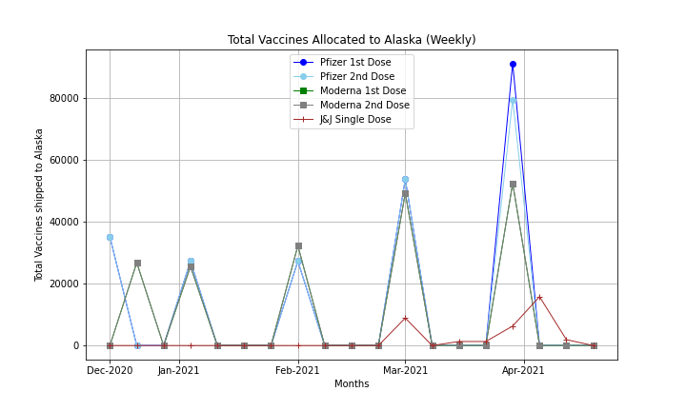
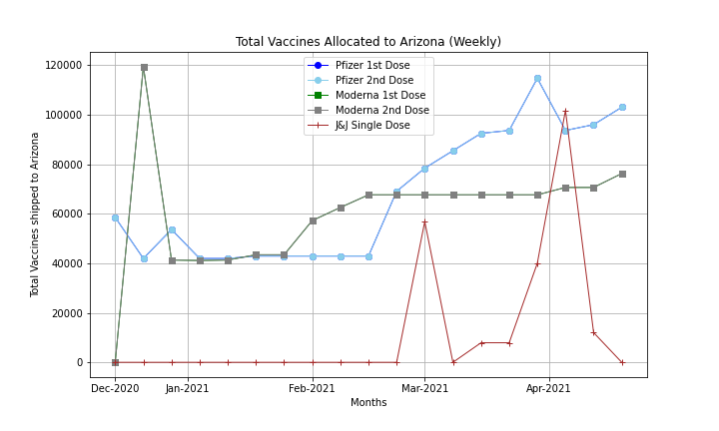
What is happening with the Alaska allocations?
Alaska is receiving vaccines monthly vs weekly like other states.

Slide 13
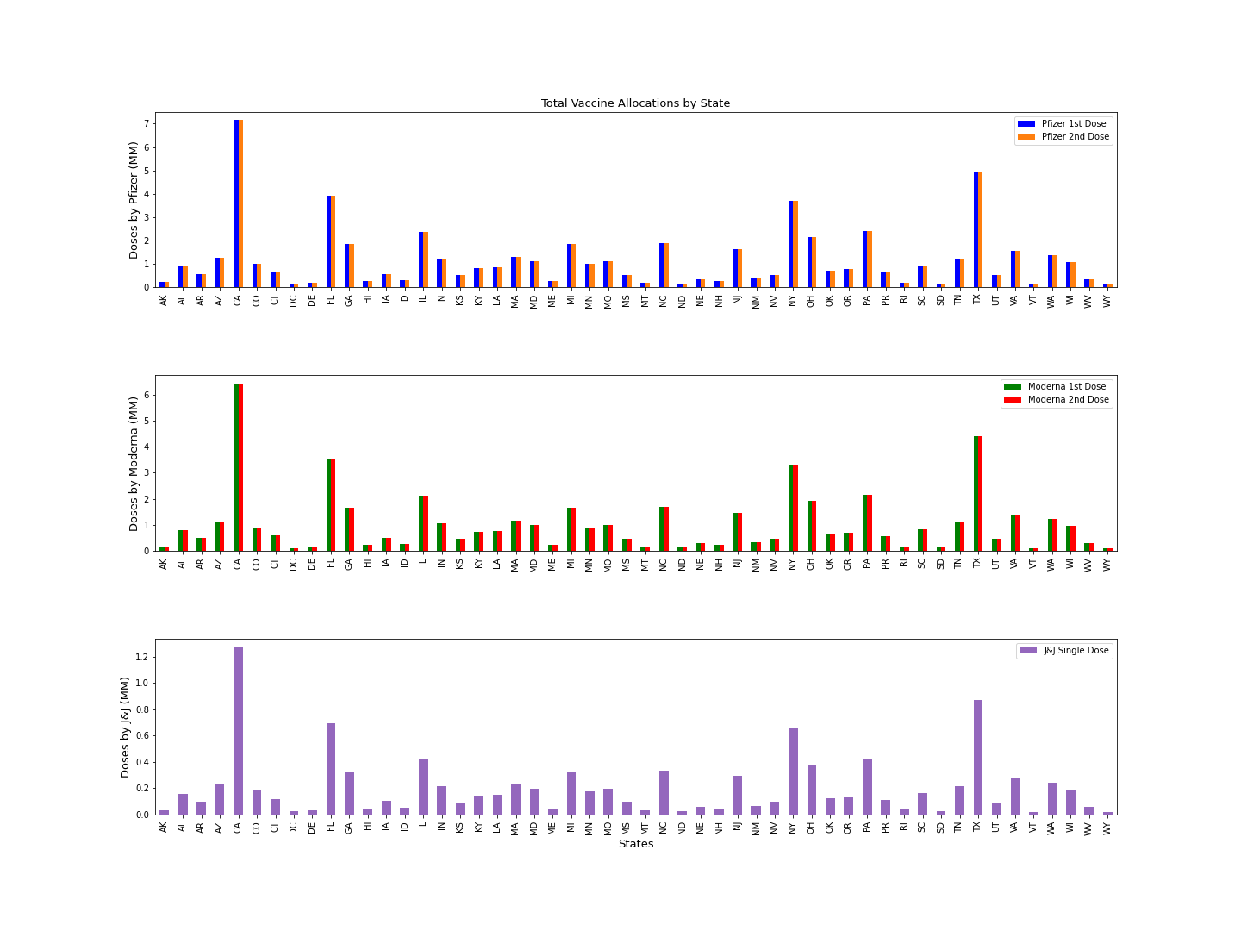
How many vaccine regimens were allocated by state?
Larger states receive more complete vaccine regimens.
The phased rollout of each supplier’s vaccine is evidenced by the total numbers of allocated vaccines being different.

Slide 14
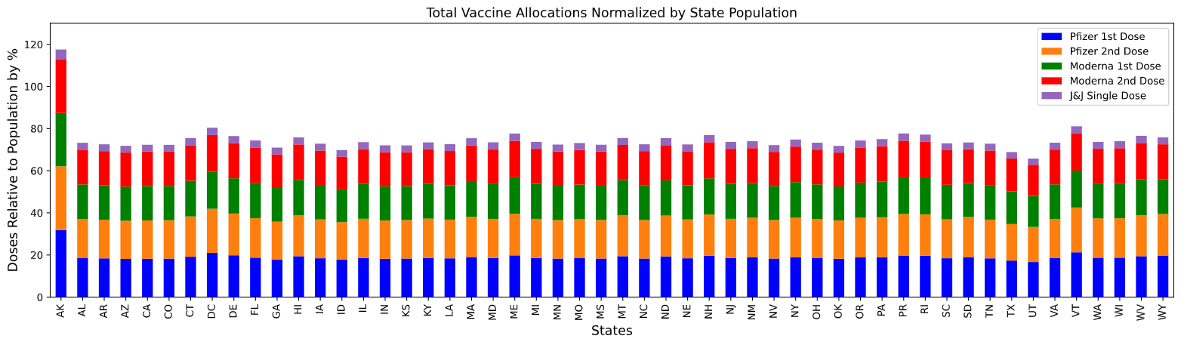
How do vaccine allocations by supplier compare when normalized by state population?
Alaska receives monthly allocations causing their results to appear higher based on the timing of the data analyzed relative to shipment dates.
States are receiving proportional shares of each supplier’s vaccines relative to their population.

Slide 15
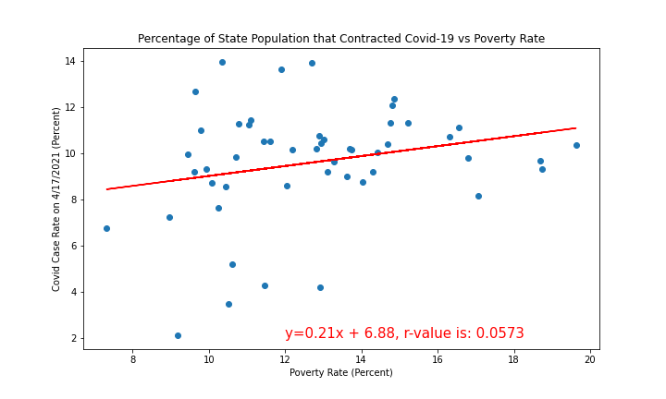
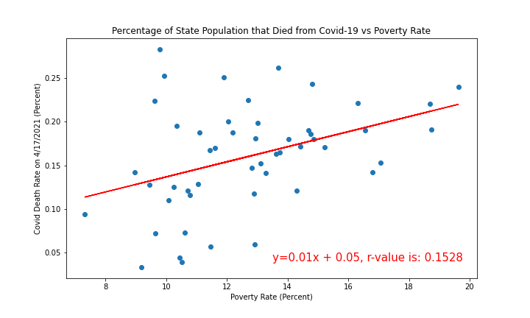
Do impoverished states show a pattern of increased transmission and/or death?
State levels of poverty do not show correlation (small r-values) with the prevalence of Covid-19 in the state.
This data cannot be used to analyze the initial hypothesis.

Slide 16

Conclusions
The CDC allocated the same number of first and second doses for the Pfizer and Moderna vaccines on a weekly basis to each state (except for Alaska).
States have kept pace with vaccine administration relative to the allocations provided by the CDC.
Weekly vaccine allocations are increasing with time.
The number of vaccines allocated is proportional to the state’s population.
Deaths are decreasing in the time period that vaccines were administered.
There is not enough evidence at the state level to indicate a correlation between poverty rate and Covid-19 transmissions or deaths.
As of 4/19/21, 62.1% of allocated vaccines were administered nationwide.

Slide 17
J&J
Pfizer
Moderna

