Slide 1
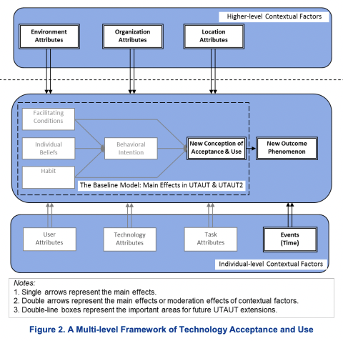


Slide 2
Stable higher-level contextual factors:
Environment
Location
Facilitating conditions
Individual beliefs
performance expectancy*
effort expectancy*
social influence
hedonic motivation*
price value
Acceptance/ attitude
SEE NEXT SLIDE
Intention to use
Habit
User attributes
Demographics (age, gender)
Experience
Voluntariness
Occupation
user type (e.g., employees, consumers, and citizens)
Personality
GAAIS*
Technology attributes
Features of the target technology
Usability
Privacy
Trust in technology
Technology risks
Task attributes
diagnostics vs treatment vs training
Info:
Black: part of the original model
Grey: not relevant for study context
Green: additions
Notes:
Facilitating conditions:
Hong et al. (2009): defined as the degree to which individuals believe that an organizational and technical infrastructure exists to support use of the past upgrades of agile IS
Lancelot et al. (2015): whether an individual believes that some enabling factors exist to support acceptance of the system
Venkatesh et al. (2011): Facilitating conditions is defined as the degree to which an individual believes that organisational and technical infrastructure exist to support use of the IS (Venkatesh et al., 2003)
Performance expectancy:
Hong et al. (2011): Here, perceived usefulness (PU) is defined as the extent to which users believe using the past upgrades of agile IS enhances their job performance
Effort expectancy:
Hong et al. (2011): Here, perceived ease of use (PEOU) is defined as the extent to which users believe using the past upgrades of agile IS is free of effort
Hedonic motivation:
Venkatesh et al. (2012): Hedonic motivation is defined as the fun or pleasure derived from using a technology
GAAIS:
Schepman & Rodway (2021): The General Attitudes towards Artificial Intelligence Scale (GAAIS)
Positive and negative GAAIS

Slide 3
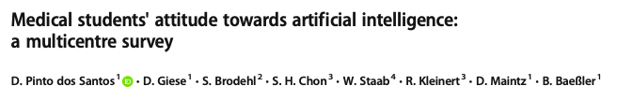
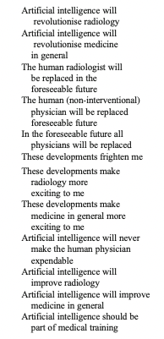
AI Attitudes Measurements (Medicine)
See also: https://www.birpublications.org/doi/pdf/10.1259/dmfr.20200461

Slide 4
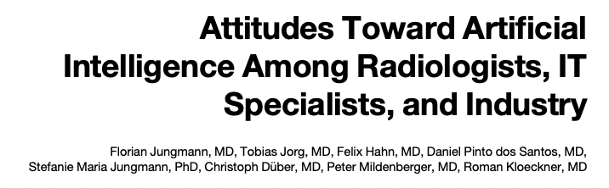
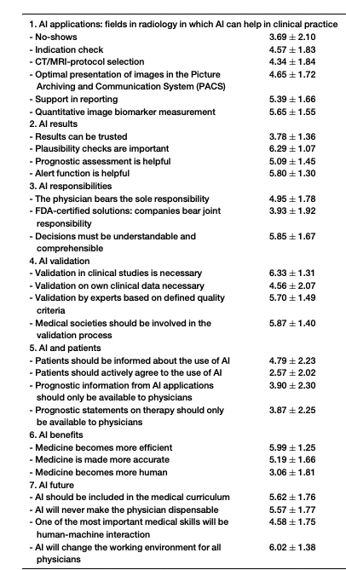
AI Attitudes Measurements (Medicine)

Slide 5
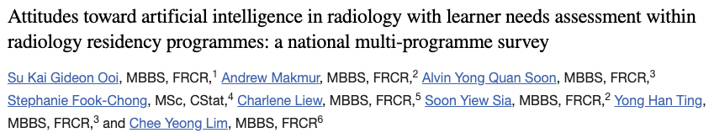
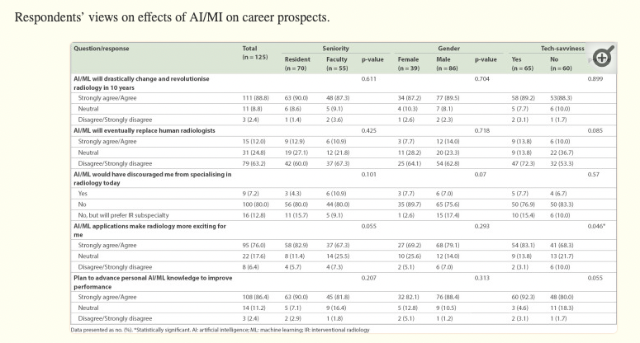
AI Attitudes Measurements (Medicine)

Slide 6
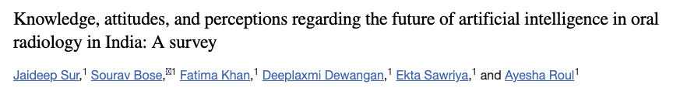
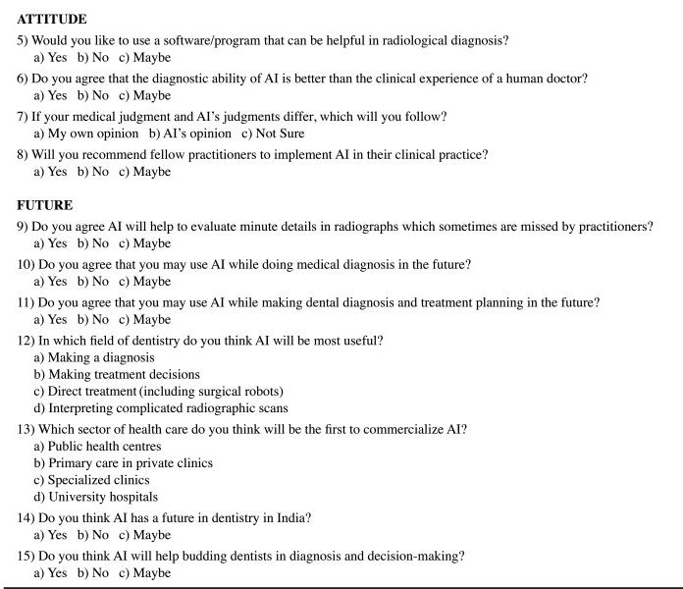
AI Attitudes Measurements (Medicine)

Slide 7
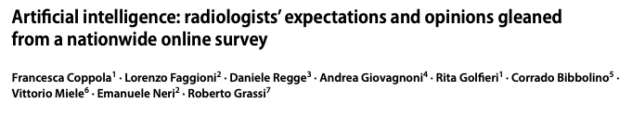
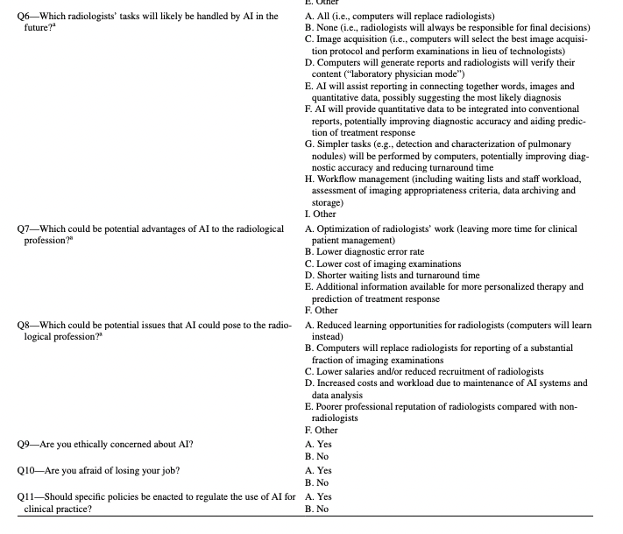
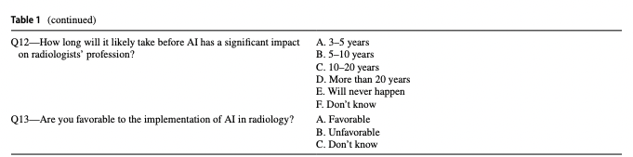
AI Attitudes Measurements (Medicine)

Slide 8
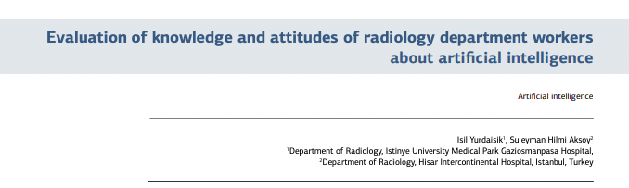
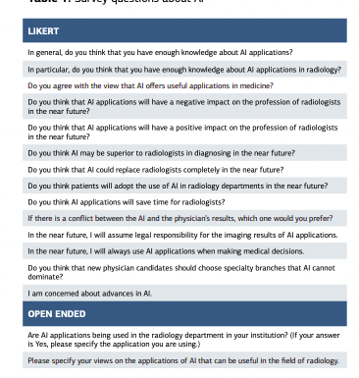
AI Attitudes Measurements (Medicine)

Slide 9
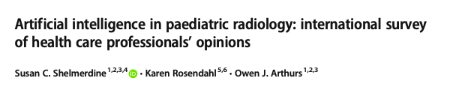
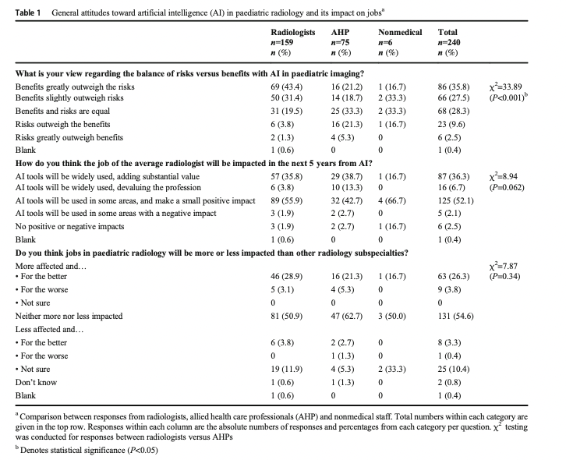
AI Attitudes Measurements (Medicine)

Slide 10
AI Attitudes Measurements (Medicine)
Possible categories (Jungmann et al., 2020):
Trust: “Recommendations of an AI system can be trusted”
Efficiency benefits: “Mental health care becomes more efficient”
Education: “AI should be included in the [psychology/ medical] curriculum”

