Slide 1
blogdown

Slide 2
Workflow
Choose a theme
Create a new Rstudio project
Add basic site with desired theme
Push to GitHub
Edit the website
Publish the website

Slide 3
1) Choose a theme
See available themes: https://themes.gohugo.io
We use hugo-lithium for today, see: https://github.com/yihui/hugo-lithium

Slide 4
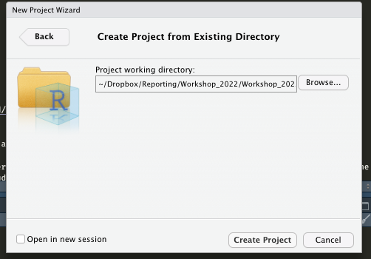
2) Create an R Project
In Rstudio:
Click “File”
“New project…”
choose “Existing Directory”
Browse to your project folder and create project here

Slide 5
3) Create a basic website
Go to console in your newly created project and install blogdown (if not done already):
devtools::install_github('rstudio/blogdown') # install blogdown
Initiate site:
blogdown::new_site(theme = 'yihui/hugo-lithium')
Serve and preview site

Slide 6
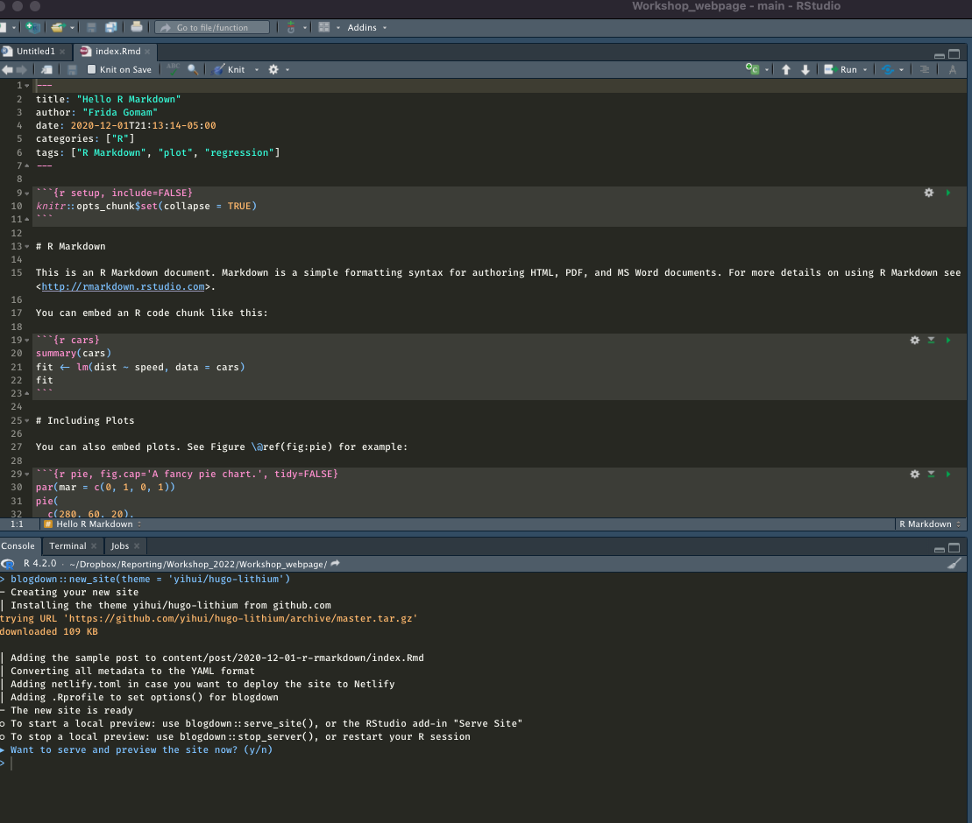
You should see sth like this happening after ”serving the site”

Slide 7
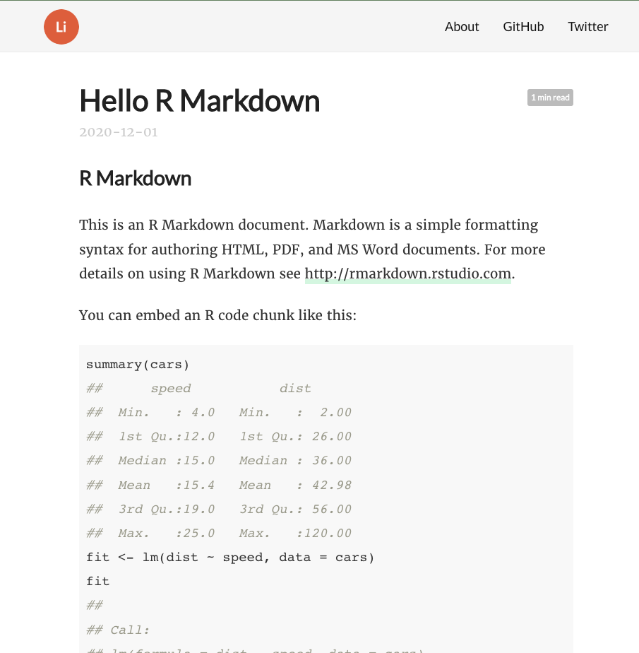
You should see sth like this happening after ”serving the site”

Slide 8
Templates
It is often helpful to use a template for a start or to get inspired by other people’s blog creations
Recommended way: via GitHub
For example: https://github.com/yihui/hugo-xmin/tree/4bb305

Slide 9
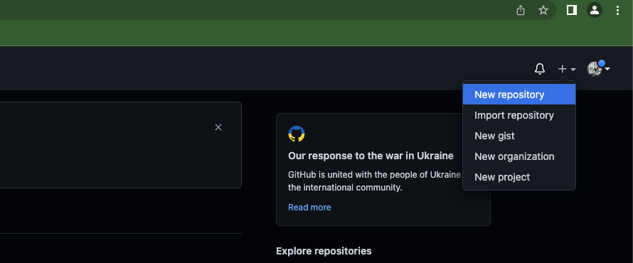
4) Push to GitHub Create GitHub repository

Slide 10
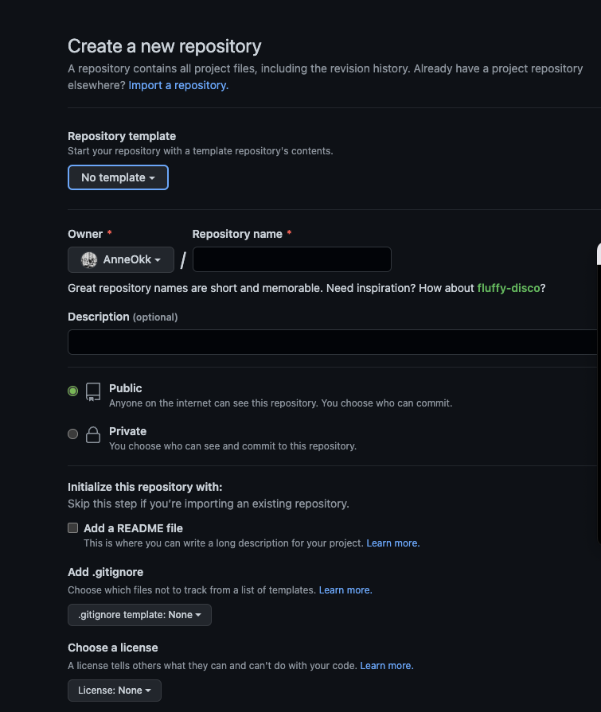
Add repository details

Slide 11
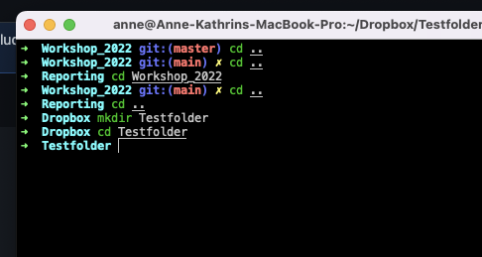
Navigate to folder in terminal

Slide 12
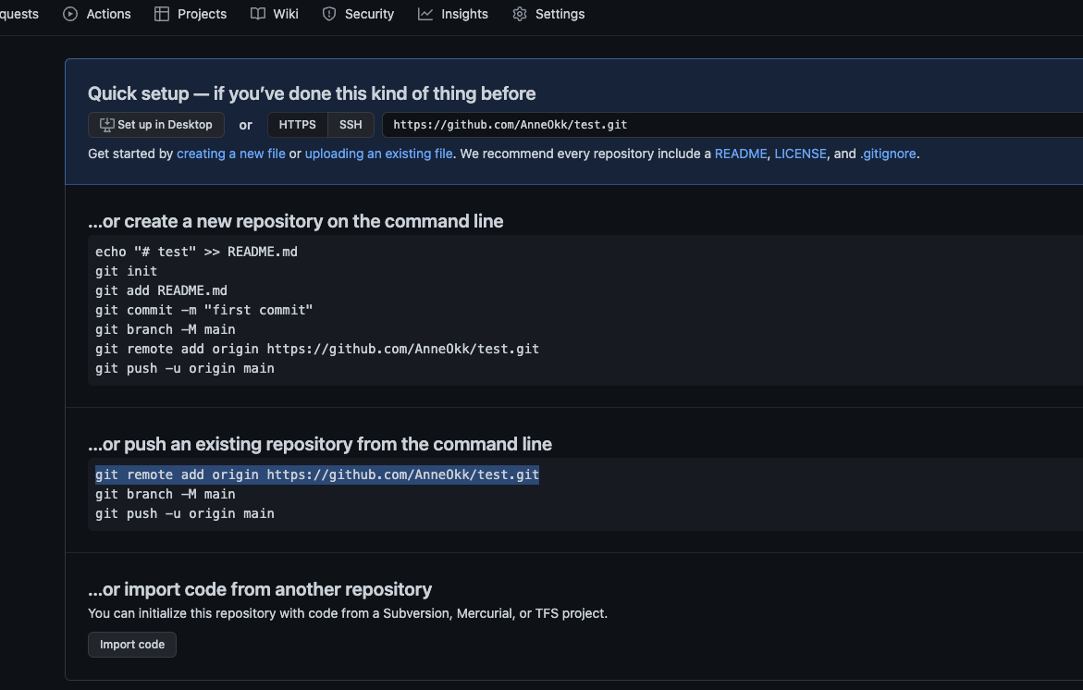

Slide 13
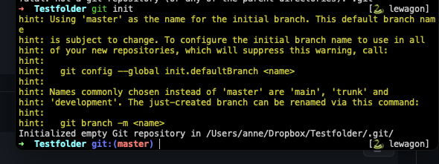
Execute the following commands
git init

Slide 14
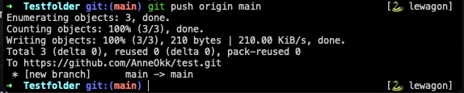
git remote add origin [link to remote repository]
git branch -M main (here you’re setting your current branch to “main” – remember this! You will have to push changes to main!)
git add . (with this command, you’re staging all new files in this repo to be committed)
git commit –m“just a test” (add a more informative commit message)
git push origin main

Slide 15
5) Edit the website according to your wishes
Play around with different folders! (Group task)
Serve site to preview
New post for new entries
Update metadata to edit metadata of posts

Slide 16
6) Deloyment
Different options, see https://bookdown.org/yihui/blogdown/deployment.html:
Netlify
GitHub Pages
Travis + GitHub
GitLab Pages

Slide 17
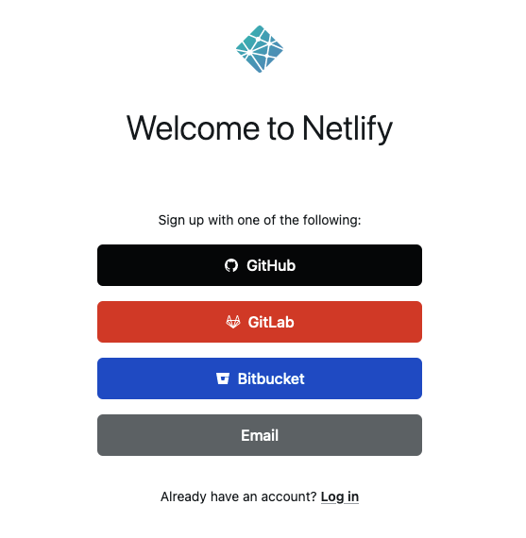
Netlify
Sign up on netlify.com with your GitHub Account

Slide 18
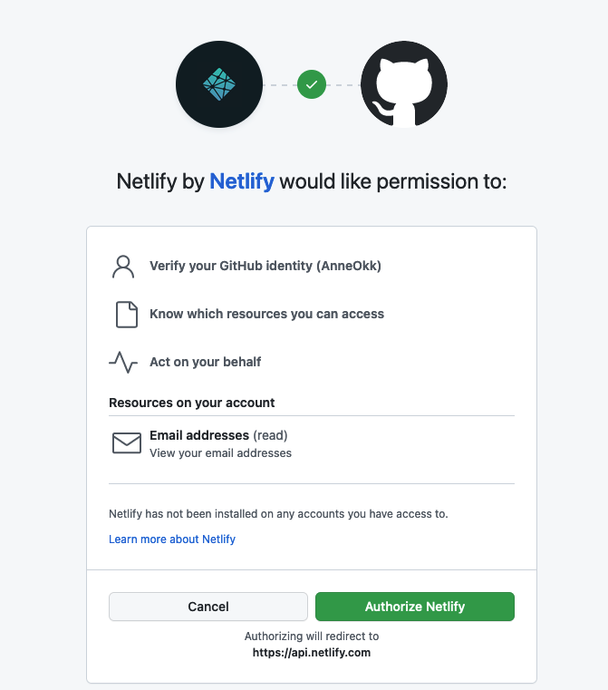
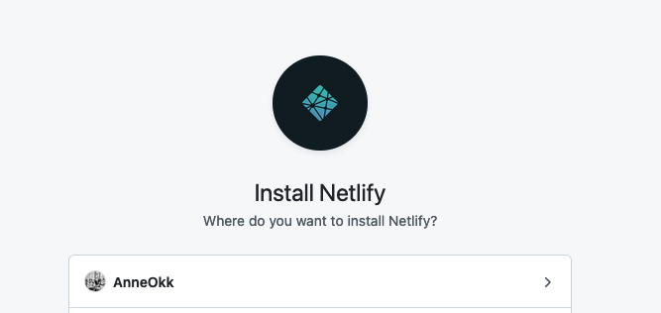
Connect with GitHub and install Netlify

Slide 19
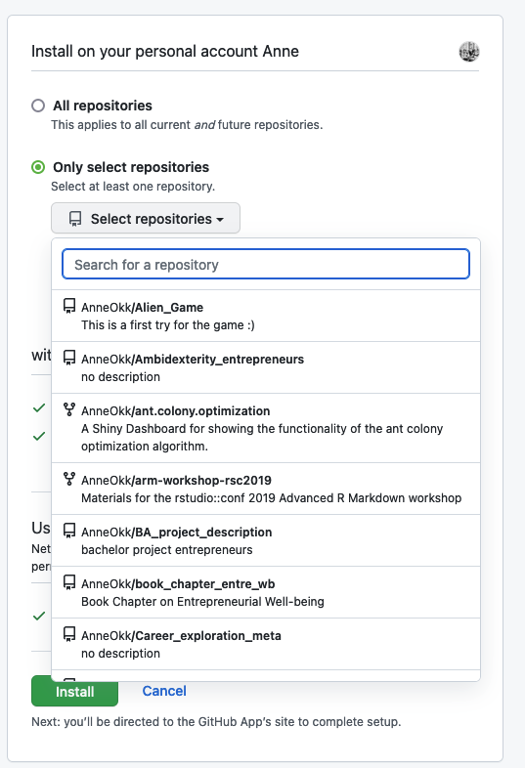
Select repository with project

Slide 20
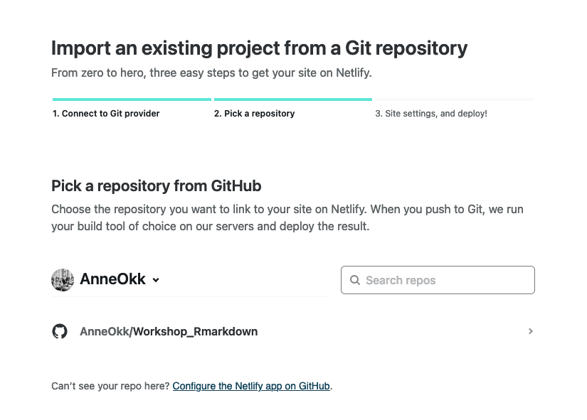
Set site settings for the selected repository

Slide 21
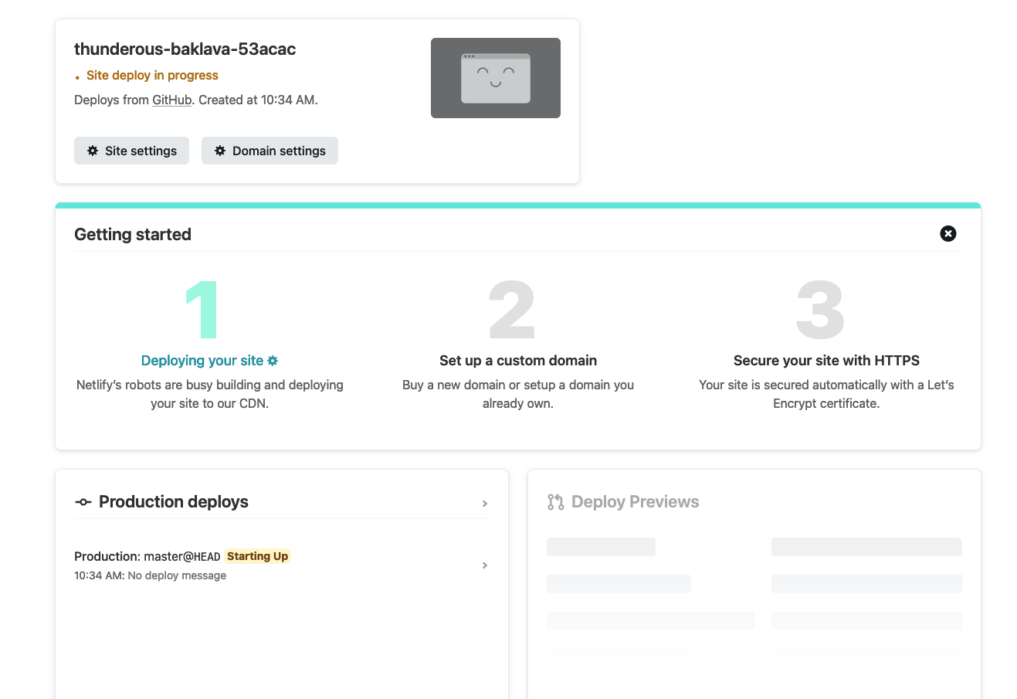
Deploy!

Slide 22
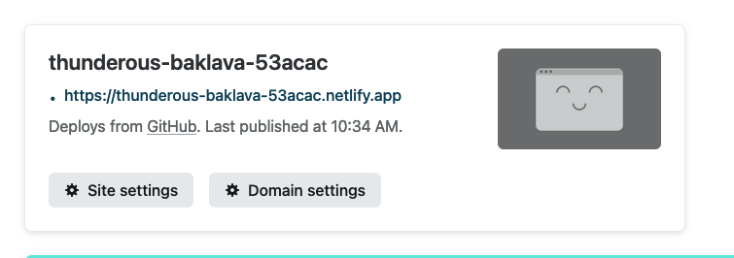
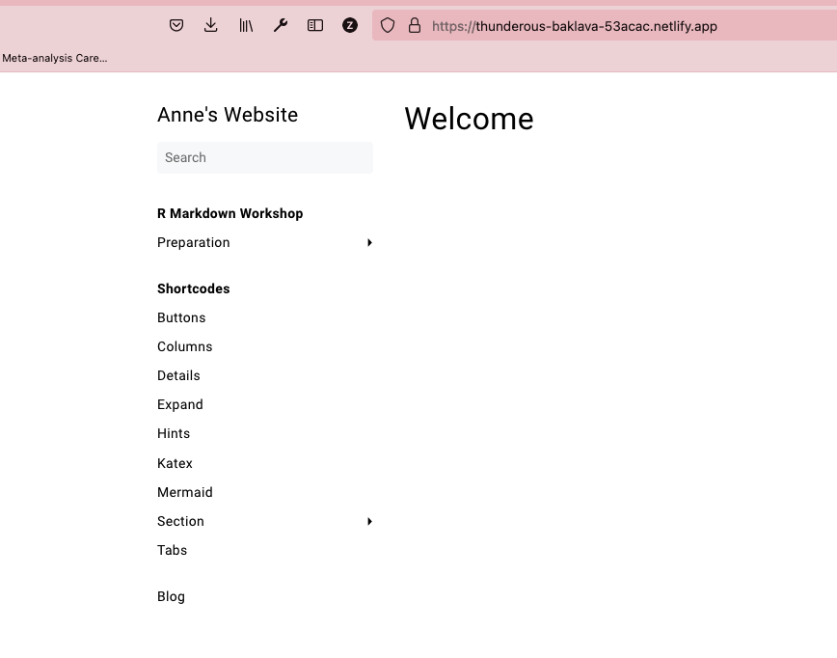
Once your site is deployed, you may open the generated URL and check whether everything worked. You should see your website.

Slide 23
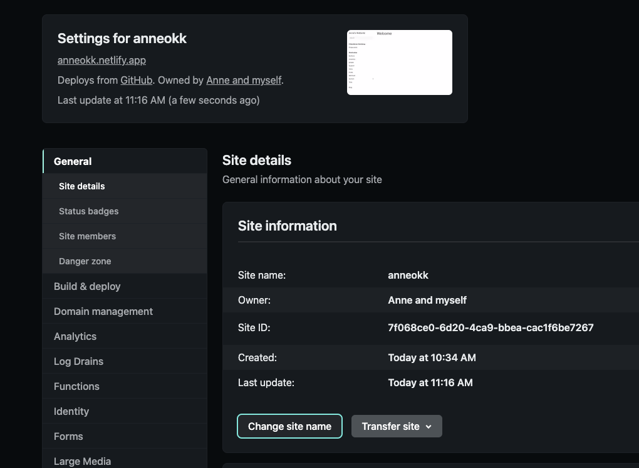
Change site name

Slide 24
You may now update the content of your website as you wish
Simply use the usual Git commands to push the changes to GitHub
git add .
git commit –m “commit message”
git push origin main
Your site will automatically update after a while

