Slide 1
Data analysis with R and Quarto + Collaboration using GitHub
Introductory workshop for the Human AI Team, Sep 2022

Slide 2
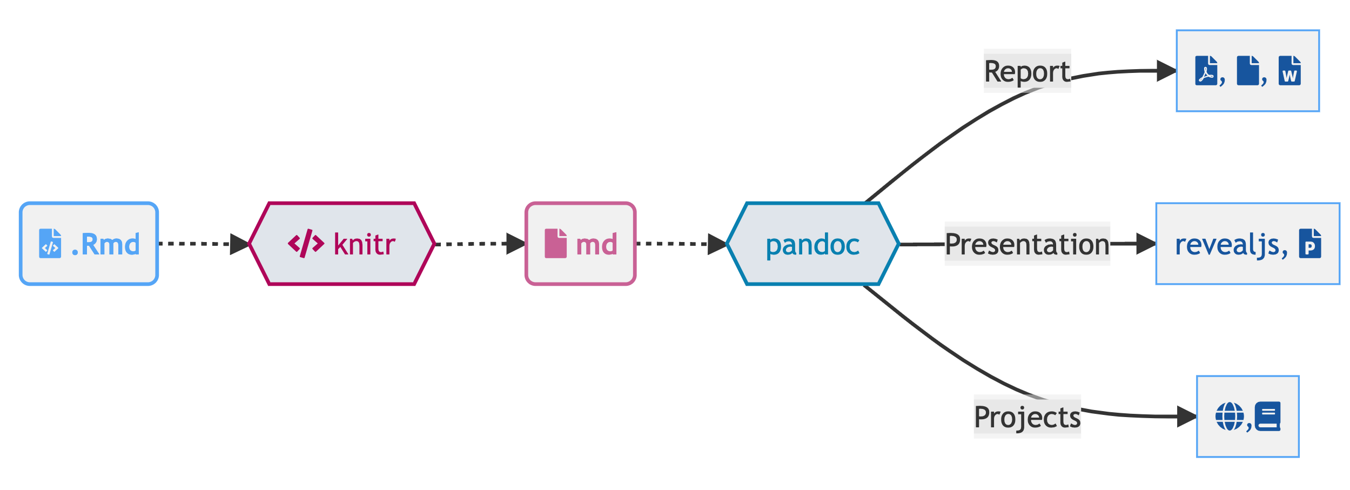
Overview
What I will present today:
How to write, share, and present code and text using R and Quarto
How to render code and text into different output formats (including presentations and APA style articles in word)
How to use Zotero with R
How to collaborate using Git and GitHub (only introduction)
…and some other stuff
Resources
many of the Quarto-specific slides adapted from Thomas Mock’s presentation
many helpful resources may be found in this GitHub repository
Workshop Prep (do it now!)
Are you on the latest version of RStudio i.e. v2022.07.1 or later?
pkg_list <- c( "tidyverse", "gt", "gtExtras", "reactable", "ggiraph", "here", "quarto", "rmarkdown", "gtsummary", "palmerpenguins", "fs", "skimr" ) install.packages(pkg_list)
How does RMarkdown work?

Slide 3
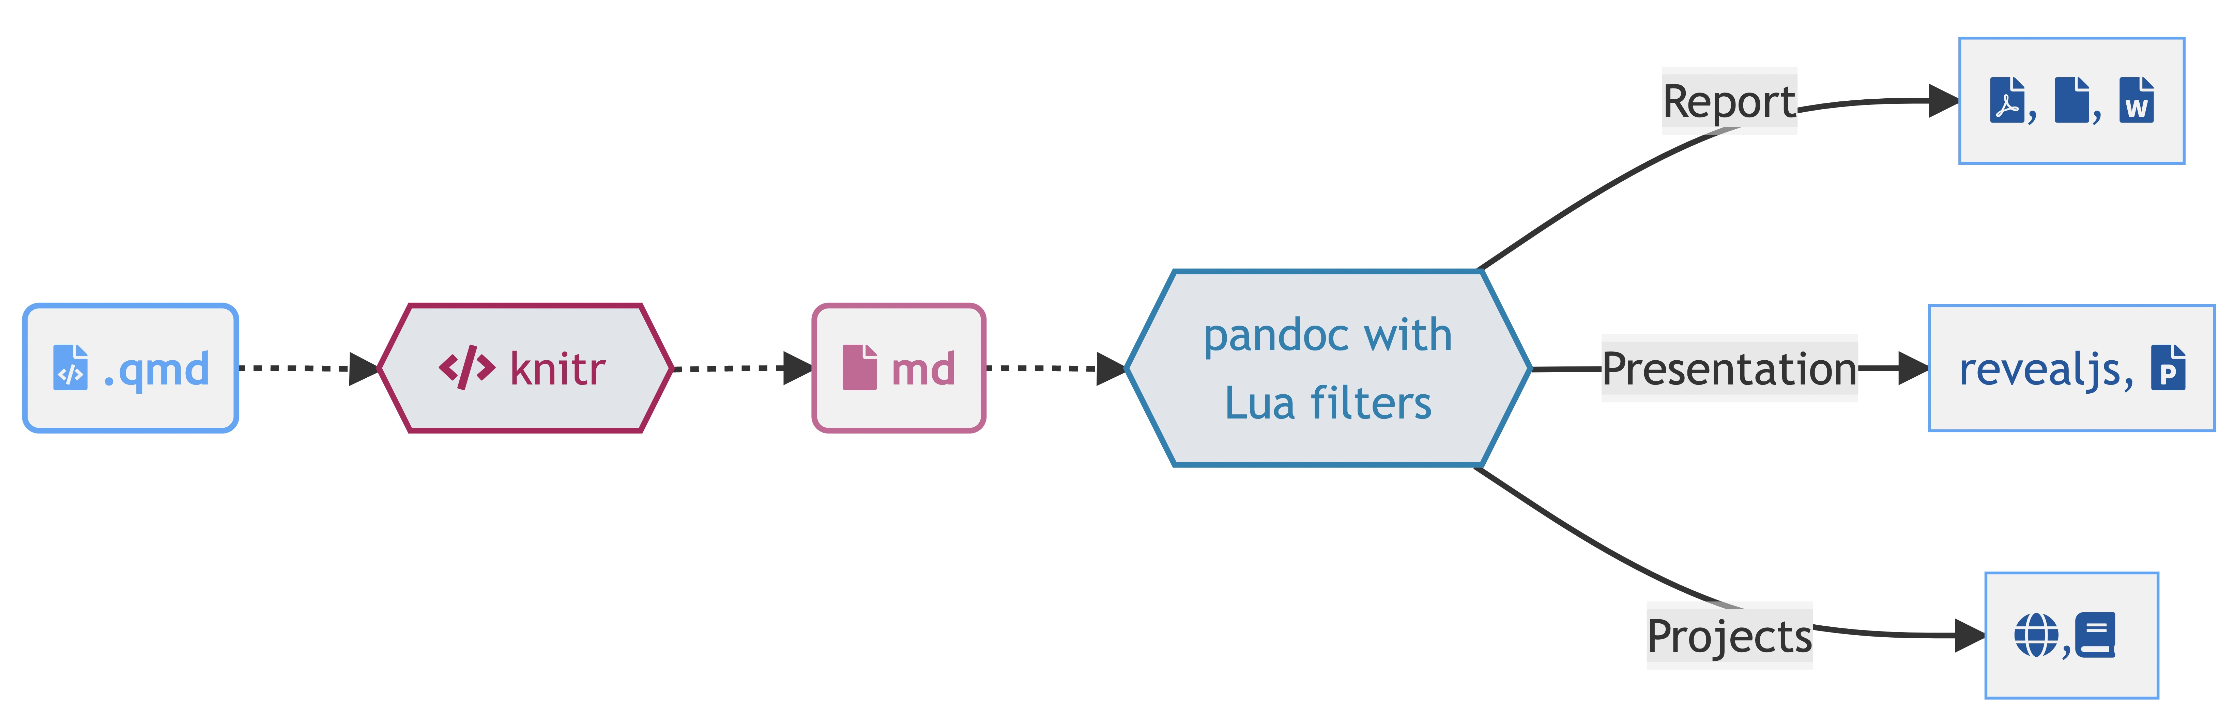
Quarto, more than just knitr
. . .

Slide 4
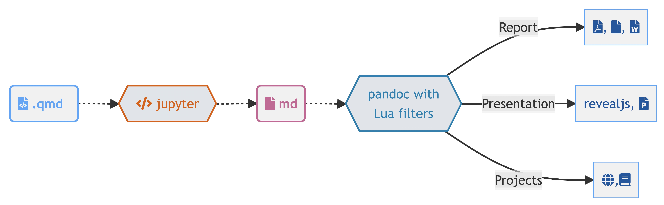
Quarto, more than just knitr

Slide 5
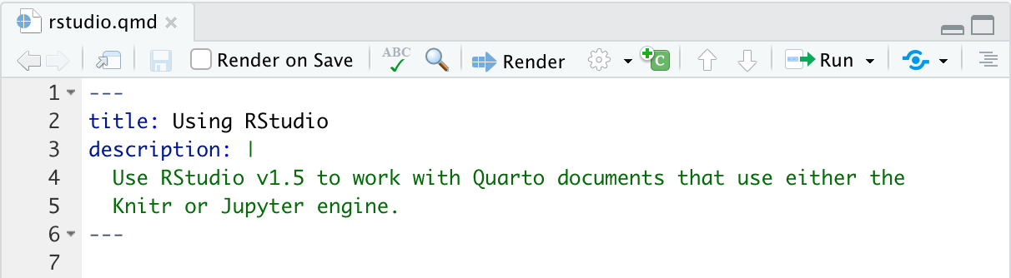
So what is Quarto?
Quarto is a command line interface (CLI) that renders plain text formats (.qmd, .rmd, .md) OR mixed formats (.ipynb/Jupyter notebook) into static PDF/Word/HTML reports, books, websites, presentations and more
One install, “Batteries included”
Quarto is bundled and comes pre-installed with RStudio v2022.07.1 and beyond!
more infos
Rendering
Render button
. . .

Slide 6
Rendering
System shell via quarto render
terminal
quarto render document.qmd # defaults to html quarto render document.qmd --to pdf quarto render document.qmd --to docx

Slide 7
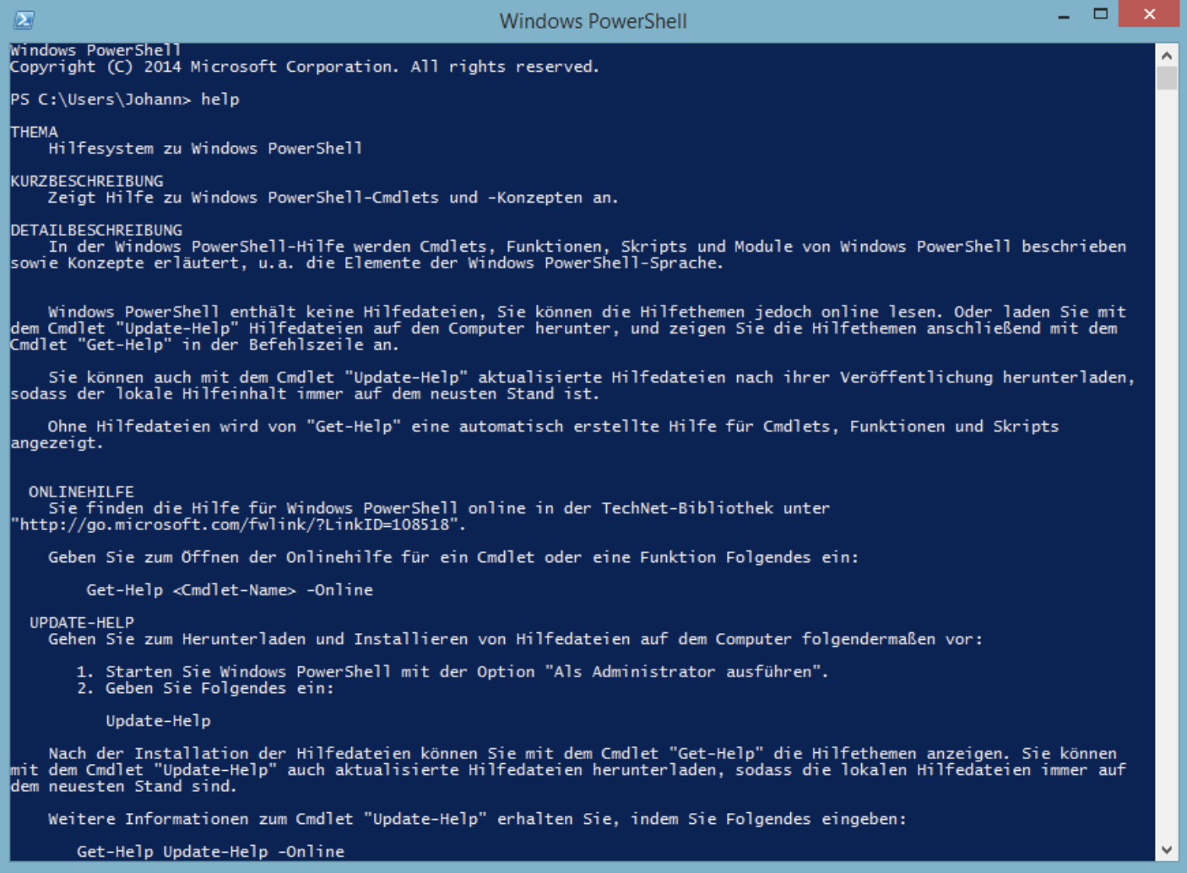
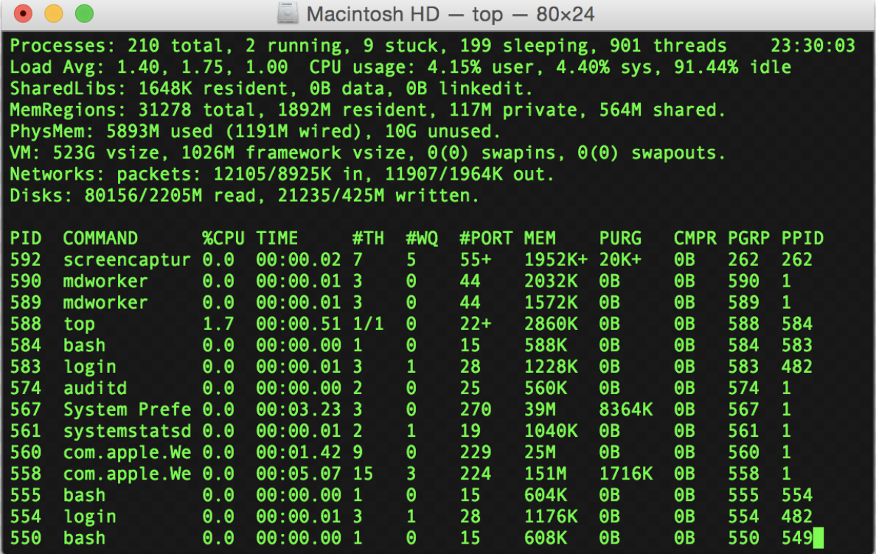
Quick excourse: Power Shell and Terminal
Windows Power Shell
Click Start, type PowerShell, right-click Windows PowerShell, and then click Run as administrator
Mac Terminal
Click the Launchpad icon in the Dock, type Terminal in the search field, then click Terminal
Image source: Wikipedia
Image source: Wikipedia

Slide 8
Rendering
R console via quarto R package
library(quarto) quarto_render("document.qmd") # defaults to html quarto_render("document.qmd", output_format = "pdf")

Slide 9
Change Your Mental Model

Slide 10

Source
Output

Slide 12
Source
--- title: "ggplot2 demo" author: "Norah Jones" date: "5/22/2021" format: html: fig-width: 8 fig-height: 4 code-fold: true --- ## Air Quality @fig-airquality further explores the impact of temperature on ozone level. ```{r} #| label: fig-airquality #| fig-cap: Temperature and ozone level. #| warning: false library(ggplot2) ggplot(airquality, aes(Temp, Ozone)) + geom_point() + geom_smooth(method = "loess" ) ```
Output

Slide 13
Working with a .qmd
A .qmd is a plain text file
. . .
Metadata (YAML)
format: html engine: knitr
. . .
Code
```{r} library(dplyr) mtcars |> group_by(cyl) |> summarize(mean = mean(mpg)) ```
. . .
Text
# Heading 1 This is a sentence with some **bold text**, *italic text* and an ![image](image.png){fig-alt="Alt text for this image"}.
Metadata: YAML
The YAML metadata or header is:
processed in many stages of the rendering process and can influence the final document in many different ways. It is placed at the very beginning of the document and is read by each of Pandoc, Quarto and knitr. Along the way, the information that it contains can affect the code, content, and the rendering process.
YAML
--- title: "My Document" format: html: toc: true code-fold: true ---
Output Options

Slide 14
--- format: something ---
--- format: html ---
--- format: pdf ---
--- format: revealjs ---

Slide 15
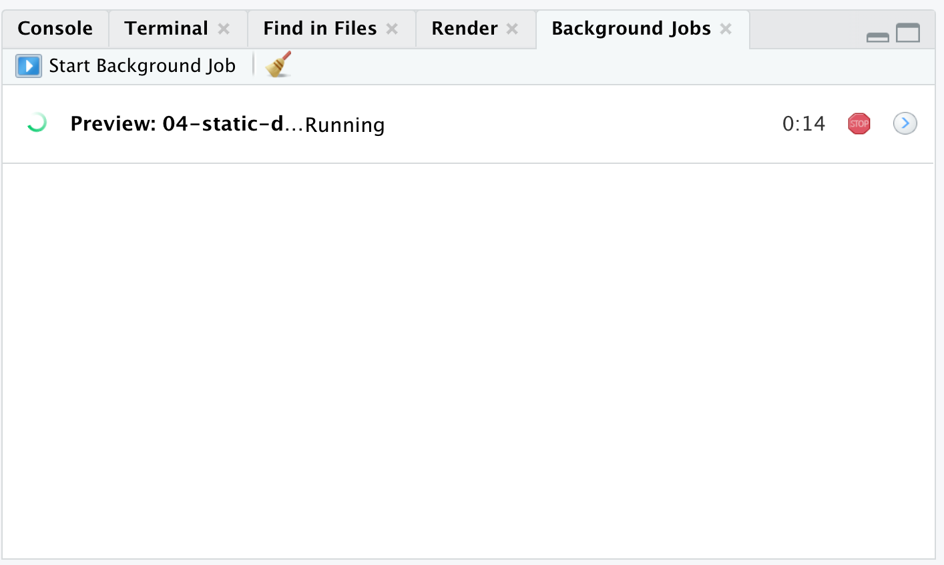
. . .
Then add option arguments!
--- format: html: toc: true code-fold: true ---
. . .
Sub-options should be below the main format output and spacing matters!
--- format: html: option1: "text" option2: logical option3: - sub-option - sub-option option4: [sub-option1, sub-option2] ---
Why YAML?
To avoid manually typing out all the options, every time!
. . .
terminal
quarto render document.qmd --to html
. . .
terminal
quarto render document.qmd --to html -M code fold:true
. . .
terminal
quarto render document.qmd --to html -M code-fold:true -P alpha:0.2 -P ratio:0.3
Quarto workflow
Executing the Quarto Render button in RStudio will call Quarto render in a background job - this will prevent Quarto rendering from cluttering up the R console, and gives you and easy way to stop.

Slide 16
Markdown Syntax | Output
*italics* and **bold** | italics and bold
superscript^2^ / subscript~2~ | superscript² / subscript₂
~~strikethrough~~ | strikethrough
`verbatim code` | verbatim code
Markdown
Quarto is based on Pandoc and uses its variation of markdown as its underlying document syntax. Pandoc markdown is an extended and slightly revised version of John Gruber’s Markdown syntax. . . .
Markdown is a plain text format that is designed to be easy to write, and, even more importantly, easy to read
Text Formatting

Slide 17
Markdown Syntax | Output
# Header 1 | Header 1
## Header 2 | Header 2
### Header 3 | Header 3
#### Header 4 | Header 4
##### Header 5 | Header 5
###### Header 6 | Header 6
Headings

Slide 18
Command | Action
pwd | Print name of current working directory
cd | Change current working directory
ls | List directory contents
quarto --help | Return quarto help docs
mkdir howdy | Make a new folder/directory called “howdy”
rm folder-name/some-file.qmd | Delete some-file.qmd in the folder-name directory
Code
```{r} #| output-location: column #| label: fig-airquality #| fig-cap: Temperature and ozone level. #| warning: false library(ggplot2) ggplot(airquality, aes(Temp, Ozone)) + geom_point() + geom_smooth(method = "loess") ```
Figure 1: Temperature and ozone level.
See here for the different execution options!
Navigating in the terminal
Because Quarto is a command line interface (CLI), there are times you’ll need to use it via the terminal. A great overview of using the command line and navigating files/directories is available via the Data Carpentries or a great interactive tool for understanding commands: https://tldr.ostera.io
. . .

Slide 19
Your Turn (15 min)
In RStudio, create a qmd project
add some code and some text to the .qmd file
Render with the RStudio Render -> button
Move to the (integrated) terminal and execute:
Render via terminal with quarto render ....qmd --to pdf
Compare to the HTML version

Slide 20
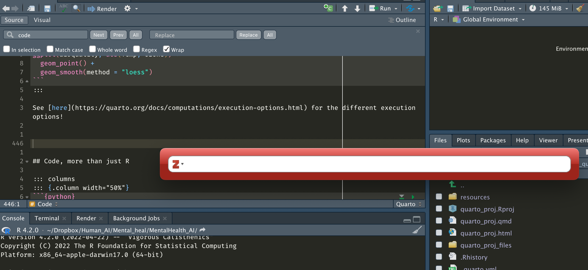
Using Zotero with R and Quarto
See instructions here

Slide 21
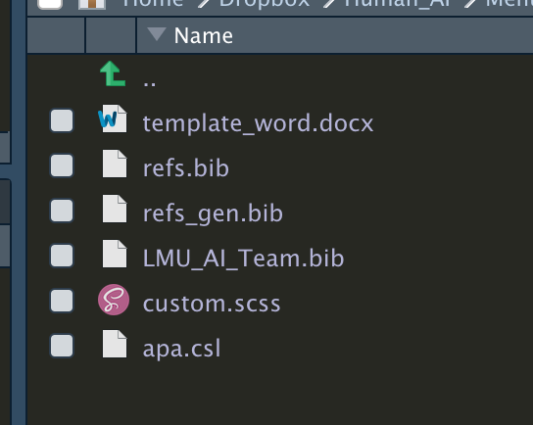
Creating APA style papers with R and Quarto
See instructions here

Slide 22
Code collaboration using Git and GitHub
Advantages of using Git and GitHub
. . .
Contribute to open source projects, see here (almost all open source projects use GitHub) 🎈
. . .
Showcase your work 🎤
. . .
Track changes across versions 🔍
. . .
Collaborate on projects 👨‍🔬 👷‍♀️
. . .
Various integration options 🤹‍♂️
Amazon and Google Cloud; or use GitHub pages or Netlify to build websites based on your R files
Version Control — Git and GitHub — Definitions
Git
a software that keeps track of versions of a set of files
it is local to you; the records are kept on your computer
GitHub
a hosting service that can keep the records
it is remote to you, like Dropbox
GitHub is specifically structured to keep records with Git
Repository, or repo
a set of files whose records are kept together, by Git and/or on GitHub
To commit
to take a snapshot of a repository
it is local, the records are kept on your computer unless you push
To push
to move a copy of the records from Git to GitHub, from your computer to online server
it is like uploading (the new versions of) your files and sub-folders to a website
Source: https://iqss.github.io/dss-rbuild/version-control.html

Slide 23
Quick excourse: Setting up Git and GitHub
Read the instructions in the Happy Git with R Book and the official GitHub guides to install Git. Installation instructions for Windows users
Register a GitHub account
Version Control — Git and GitHub — check setup
. . .
In the terminal 📱:
terminal
git --version
you should see the Git version ✅
. . .
In the terminal 📱:
terminal
git config --global user.name
you should see the Git user name ✅
. . .
🚫 If these steps did not work, go here and set up Git
You just don’t want to use the terminal ❓ ▶ For version control in RStudio, see here, and particularly this video
Version Control — Git and GitHub — connect local with remote

Slide 24
Go to GitHub and create a new repository
Fill in some info, create a public repository

Slide 25
Follow the steps in Option 1: “…create a new repository on the command line”
In the terminal 📱, navigate to your Quarto project folder:
terminal
cd project_folder
. . .
initialize a git repo on your local machine:
terminal
git init
. . .
create content you can then add in the next step (e.g., README file):
terminal
touch README.md
stage all the content in that folder to be added:
terminal
git add .
. . .
stage all the content in that folder to be committed:
terminal
git commit -m "add empty readme"
connect local repo to the remote repo. Substitute the link with your repo URL!
terminal
git remote add origin https://github.com/AnneOkk/testrepo.git
. . .
push all the content from Git to GitHub:
terminal
git push origin master
. . .
🎈 The pushed files should appear in your GitHub repository 🎈
Version Control — Git and GitHub — collaborating
Imagine… 🤔
. . .
you work in a team of data scientists/ data enthusiastic researchers 🧙🧙🏿🧙‍♀️🧙🏻‍♀️
. . .
you want to be able to work together on a data analysis project 👨‍💻👩‍💻 👨‍💻👩‍💻
. . .
you want to keep track of what the others do and finally merge individual contributions into one overall project ✨ 💾 ✨
. . .
But how ❓ 🤷

Slide 26
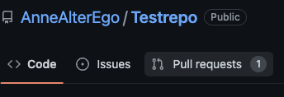
Version Control — Git and GitHub — collaborating
Scenario 1 - you are owner/ collaborator
Go to the GitHub repository you are working on as a team
. . .
In the terminal 📱, navigate to where you want to store the project files and type:
terminal
git clone https://github.com/AnneOkk/testrepo.git
. . .
Next, you would always want to make sure that you are up to date with what has changed in the remote repository
. . .
In the 📱 terminal 📱, type:
terminal
git pull origin master
. . .
Create a new branch to add changes that belong to a novel feature you are working on (this prevents messing up the master branch)
terminal
git checkout -b "cool-feature"
. . .
Now make some changes (e.g., add the new cool feature to the code)
Add and commit the files …through the usual workflow 😴
terminal
git add . git commit -m "new feature file added"
. . .
🚧 👀 BUT you push the changes to the newly created branch to prevent messing up the master branch! 👀 🚧
terminal
git push origin cool-feature
. . .
On GitHub, create a pull request
. . .
Once all issues are resolved, your changes will be merged into the master branch 🥳
Checkout to master branch
terminal
git checkout master
. . .
Pull changes
terminal
git pull origin master
. . .
Checkout a new branch for missing feature.
terminal
git checkout -b data-reader
. . .
… And so on …
Scenario 2 - you want to contribute to an open science project
. . .
In GitHub, navigate to the project you want to contribute to
. . .
Fork the repo!
. . .
Clone the new repo!
terminal
git clone https://github.com/AnneOkk/Testrepo-1.git
. . .
Make your changes and then add, commit, and push to your master branch
. . .
On GitHub, go back to the original repository and create a pull request.
You may need to click “compare across forks”
… On the other side (repo owner)

Slide 27
Open and review the pull request! 🔍
If you’re happy with the changes, merge! 👍
Otherwise, request additional changes in comments. 💬
. . .
🎊 Yey, you’re all set to contribute to open science projects on GitHub! 🎊

Slide 28
Your Turn (15 min)
[Get Git and GitHub up and running]
Connect your local R project folder with a GitHub repository
Change some of the content in R, save, and then push the changes to GitHub
terminal
git add . git commit -m "senseful commit message that describes the change(s)" git push origin master
[OPTIONAL] Create a pull request for your own repository and merge the changes into the master branch

Slide 29
Integrating osf with GitHub
Integrating osf with GitHub
Create your osf project
. . .
Enable GitHub in Add-ons
Import GitHub Account
4. Select Repo
. . .
🎊 Yey, you’re all set to connect your GitHub content to osf! 🎊
…And there is so much more!
Find me at:
@AnKaKleine
@AnneOkk
http://annekathrinkleine.com/

