Slide 1
How to Use the HomeBankCode Repository
HomeBank Workshop
5/25/2016

Slide 2
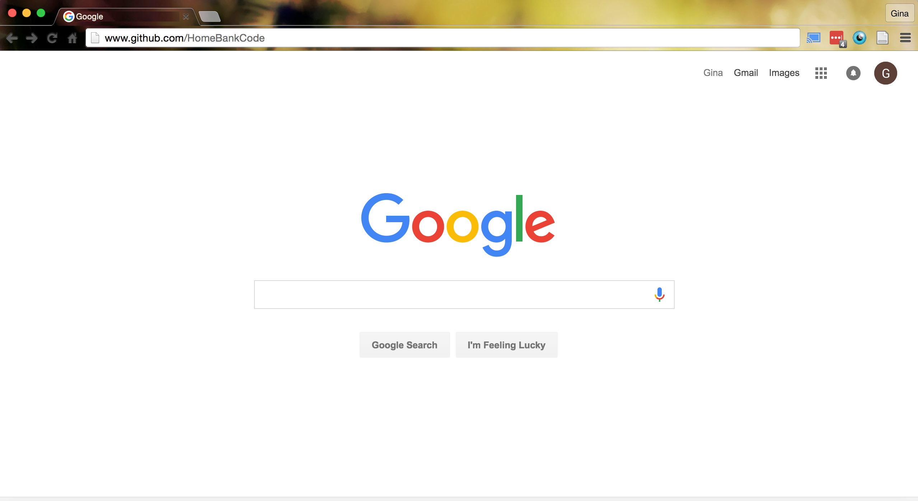
Go to github.com/HomeBankCode

Slide 3
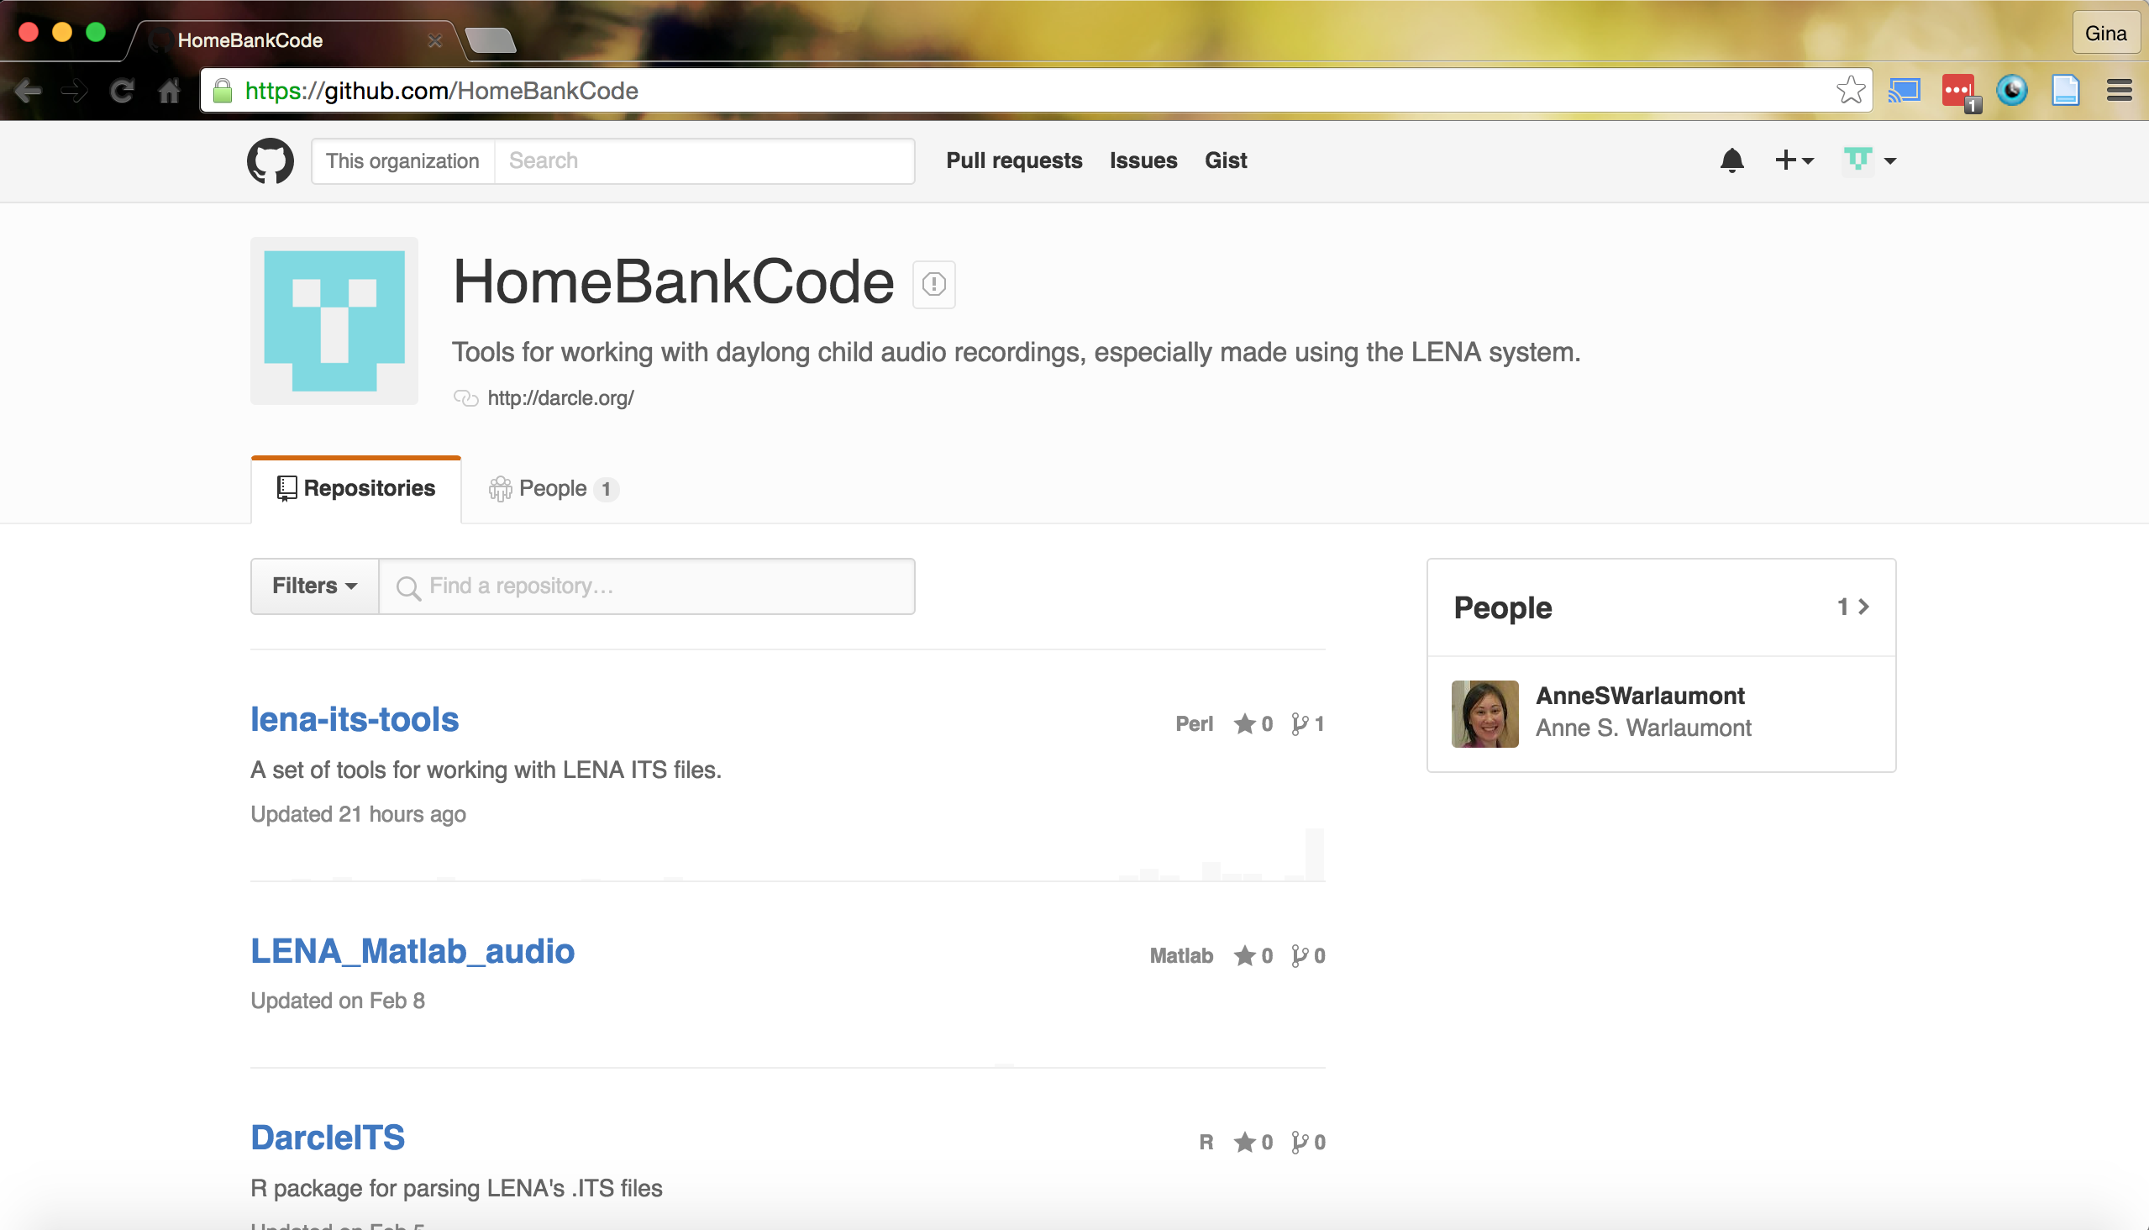
Go to the “lena-its-tools” repository

Slide 4
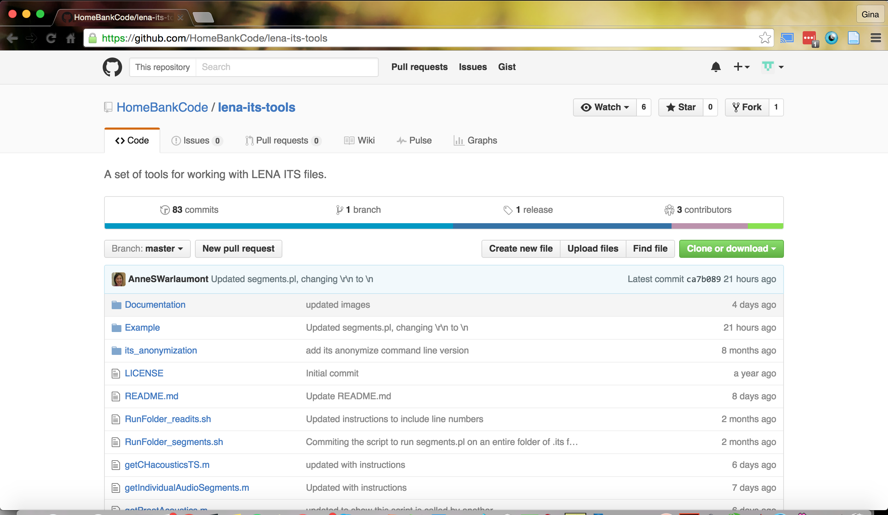
Here are documentation files for the scripts in this repository

Slide 5
This folder has the files we will use today

Slide 6
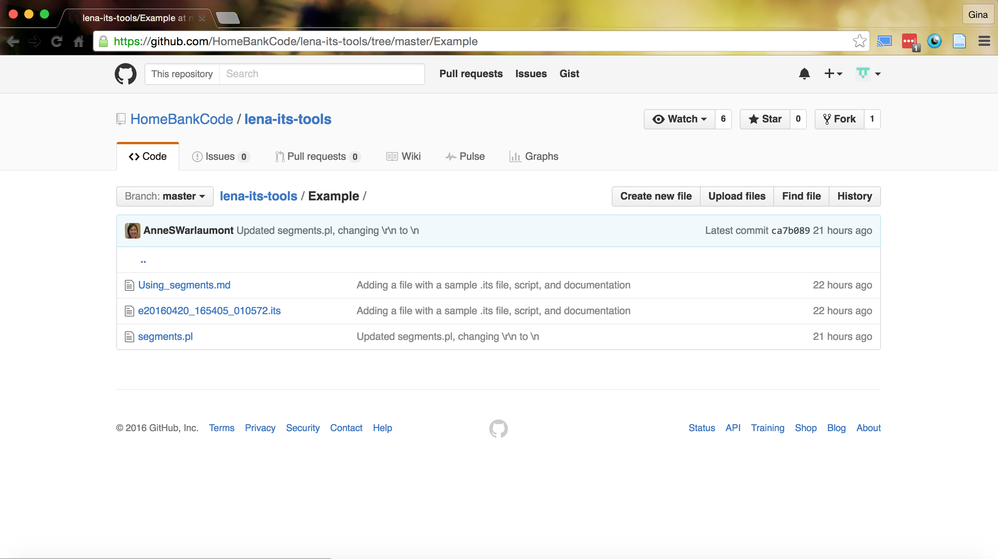
This is the documentation
This is the sample .its file
This is the perl script

Slide 7
Clone or Download the files

