Slide 1
Reliable broadcast library
Alessandro Annechini
Riccardo Fiorentini

Slide 2
Overview
Library for reliable broadcast communication among a set of faulty processes.
The library must guarantee virtual synchrony, while ordering should be at least fifo.
The sistem is simulated using OmNet++.
Assumptions: no processes fail during the time required for previous failures to be recovered.

Slide 3
Assumptions and guarantees
Links are reliable and FIFO
No node enters/leaves the network before the last view change has been handled
All nodes can fail, but at least one node is always functioning
Assumptions:
Reliability: All nodes receive and commit messages, even if they crash temporarily
Message ordering: Causal and total
Virtual synchrony: View changes are notified to the active nodes and correctly handled
Guarantees:

Slide 4
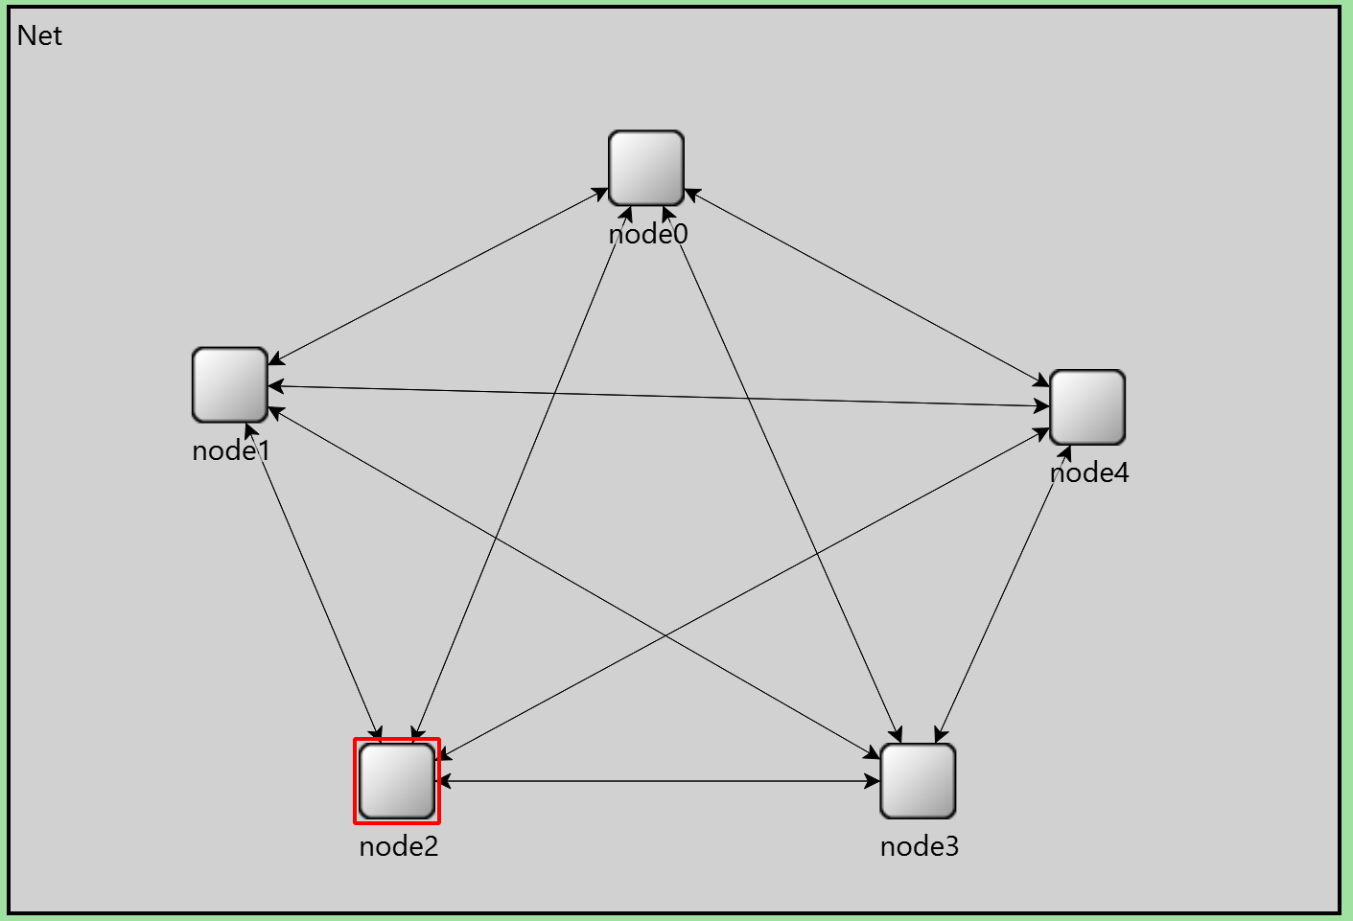
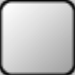



Network
N nodes with a unique id
The initial number of nodes is known
Nodes have a queue of received messages, that are delivered to the application when acked by the other nodes
Nodes can be in one of four states:
Normal: they can send/receive/commit messages
Fault recovery: messages and commits are temporarily blocked
Node insertion: messages and commits are temporarily blocked
Crashed: no possible actions

Slide 5
Total order of messages
Totally ordered multicast:
All nodes have a logical clock
Messages and acks include the logical clock of the sender
All messages are acked to all the nodes in the view, and kept in a stack
Messages are committed when they are on top of the stack and acked by all nodes in the view

Slide 6
Causal order of messages
When sending a broadcast message, the logical clock is increased only once. As a consequence, all the copies of a message have the same logical clock
When responding to a message with logical clock K, the answer will have a logical clock equal or greater than K+1
The response will have a logical clock >= K+1 > K on all nodes
Therefore, the messages are committed in causal order by all nodes

Slide 7
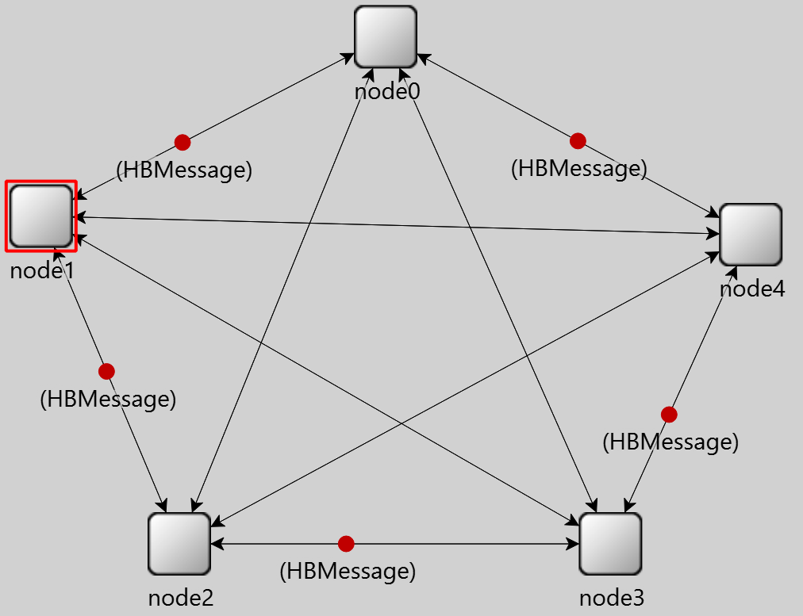
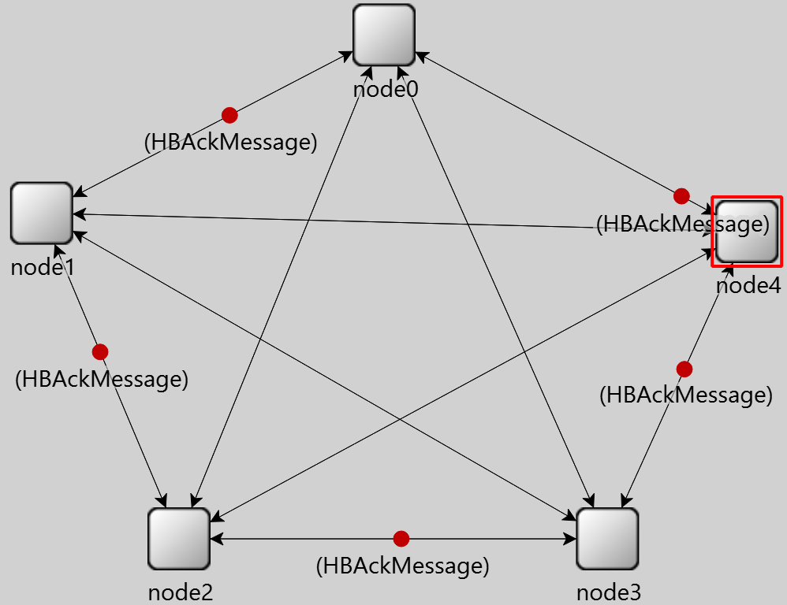
Failure detection
Timer-based detection:
Nodes are connected in a logical «ring»
Periodically, each node sends an HB request to their successors
If the message is not aswered within a certain time (100x the channel latency), then a fault is detected

Slide 8
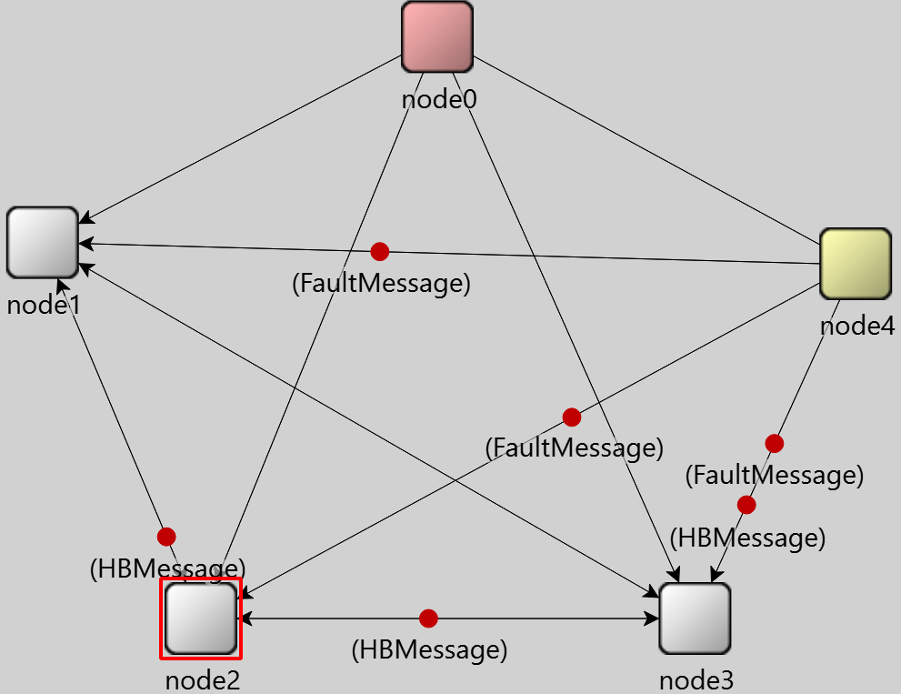
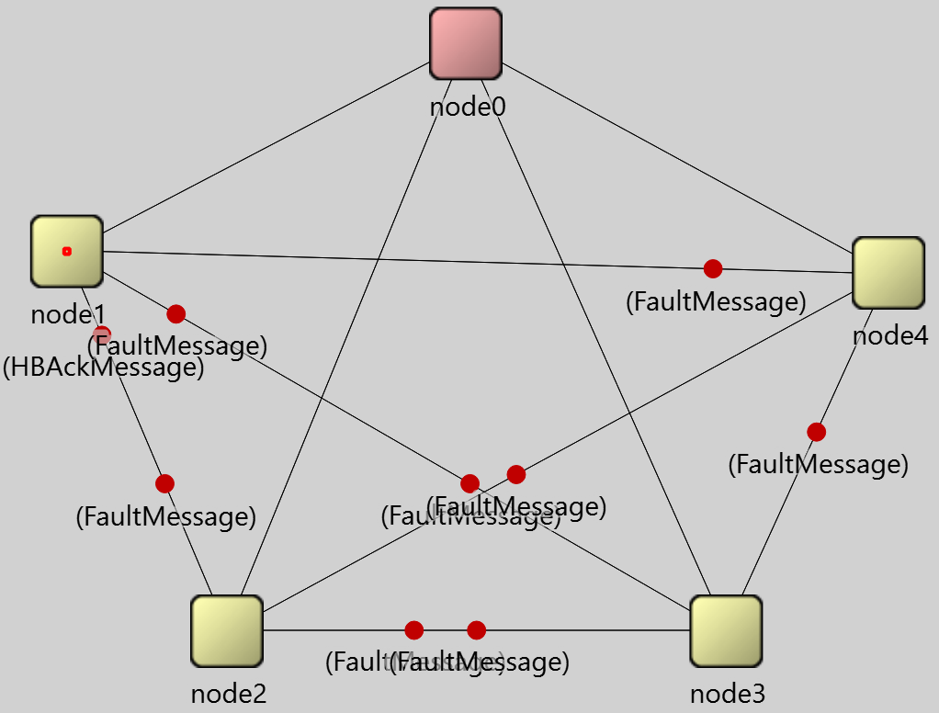
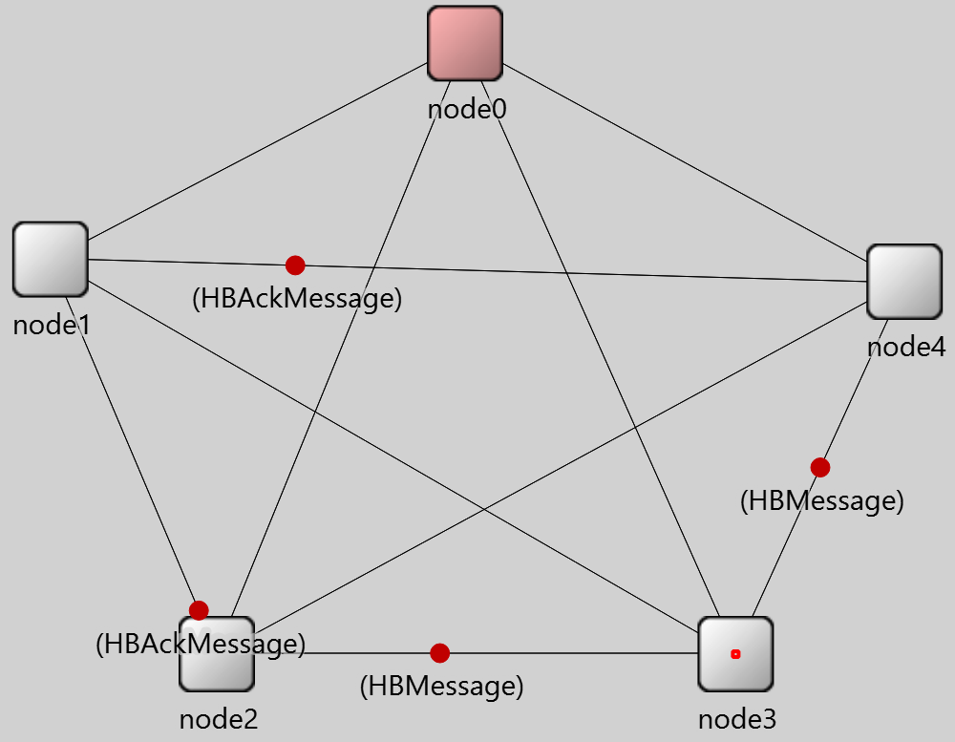
Failure recovery
When a node detects a failure, it transitions to fault detection and sends a warning, starting recovery procedure.
Nodes exchange uncommitted messages from the failed node, implicitly acknowledged by all.
When a node receives all recovery messages, it returns to normal and installs the new view

Slide 9
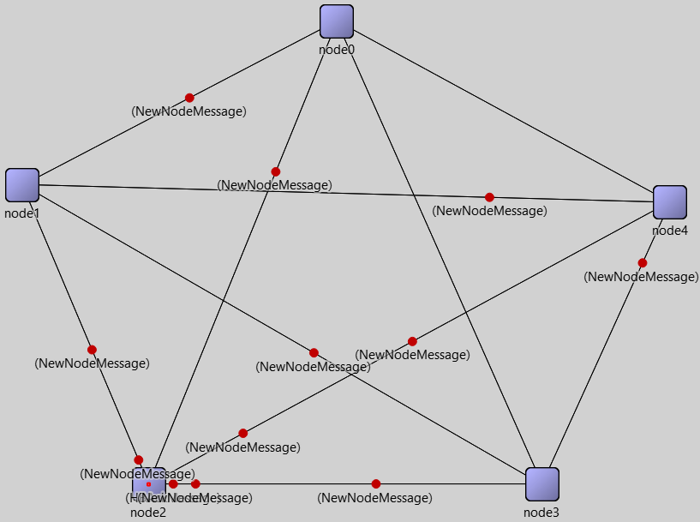
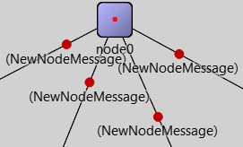
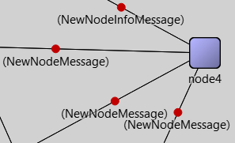
Node insertions
When a crashed node restarts, it transitions to node insertion and broadcasts a notification, starting the procedure.
Nodes exchange uncommitted messages, implicitly acknowledged by all.
An active node sends the new node additional information (for example, the updated view since the crash).
When a node receives all node insertion messages, it returns to the normal state and installs the new view

Slide 10
Reliability 1/2
All nodes maintain N-1 recovery queues with committed messages and store the last committed message (clock, id) pairs in a vector.
When a node sends a new message (including acks, HB requests, etc.), the vector is included.
Upon receiving a message, the vector is updated, and entries older than the last committed message are removed from the recovery queue.
This ensures that when a node crashes, other nodes track the messages lost by the failed node.

Slide 11
Reliability 2/2
When a node reenters the network, an active node sends its recovery queue, implicitly acknowledged by all others, along with all other restore queues.
Thus, the crashed node only needs to save the last committed message (clock, id), while its message/recovery queue and view can be lost or reset.

Slide 12
View change corner cases 1/4
View changes do not overlap by hypothesis, but the following cases have been covered:
A node recovers from a crash during the fault recovery phase
A node recovers from a crash before its fault has been detected
A node is incorrectly detected as crashed

Slide 13
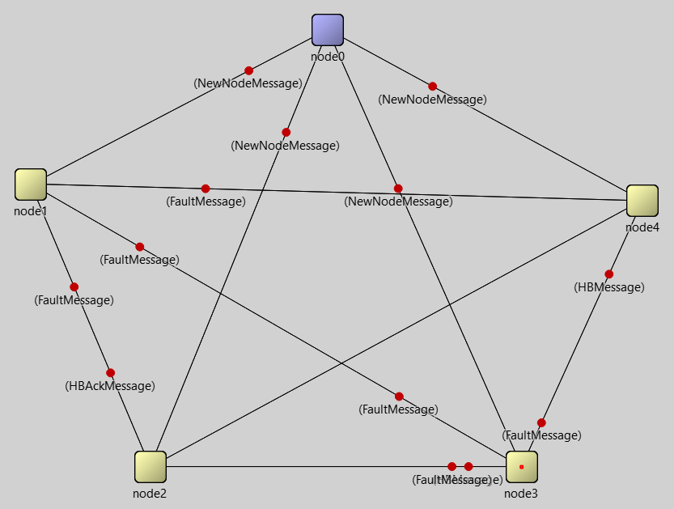
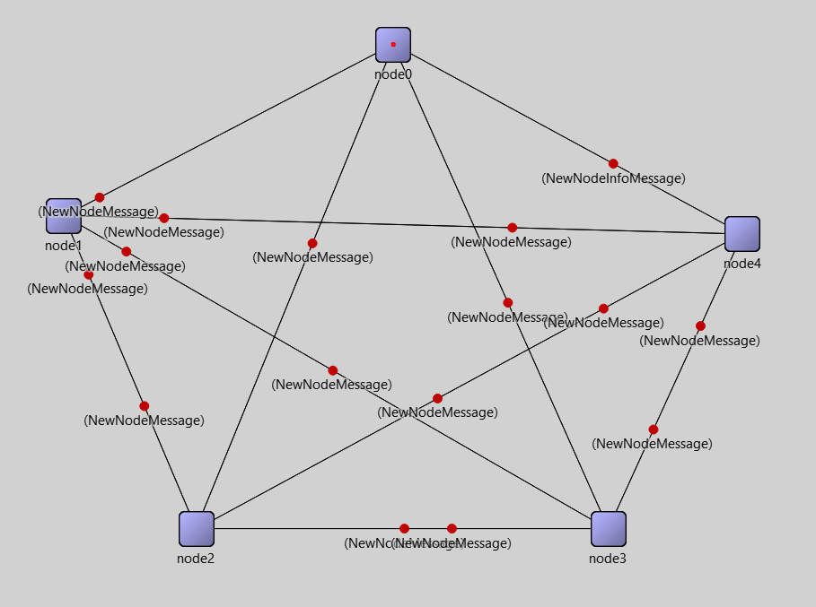
View change corner cases 2/4
A node recovers from a crash during the fault recovery phase
The active nodes store the notification in a buffer, answering to it at the end of the fault recovery phase

Slide 14
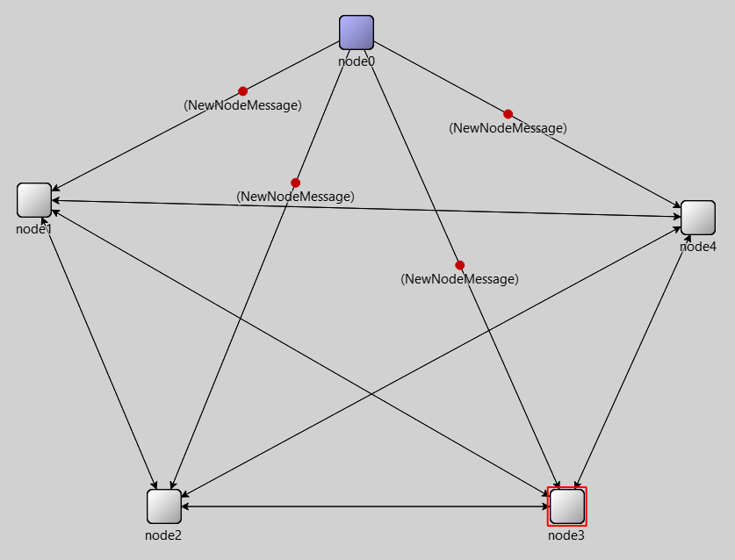
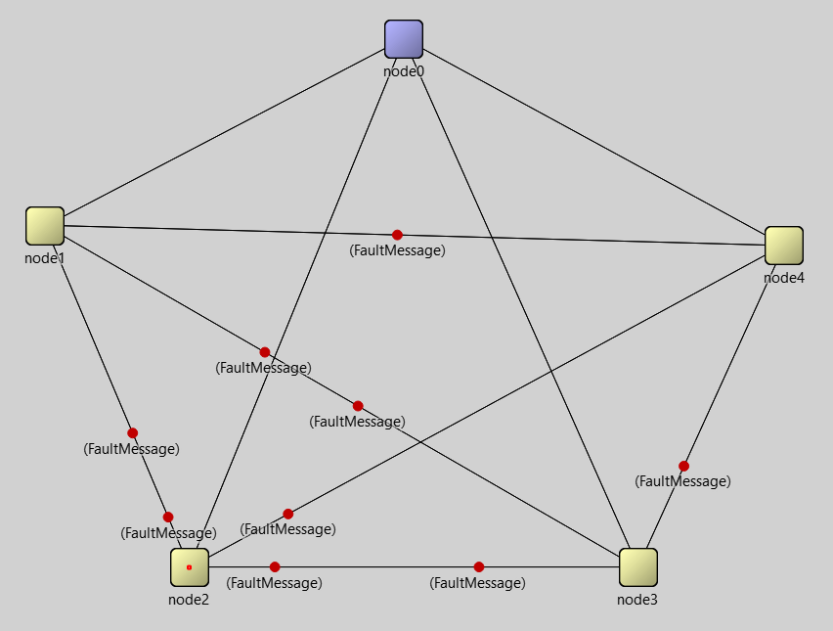
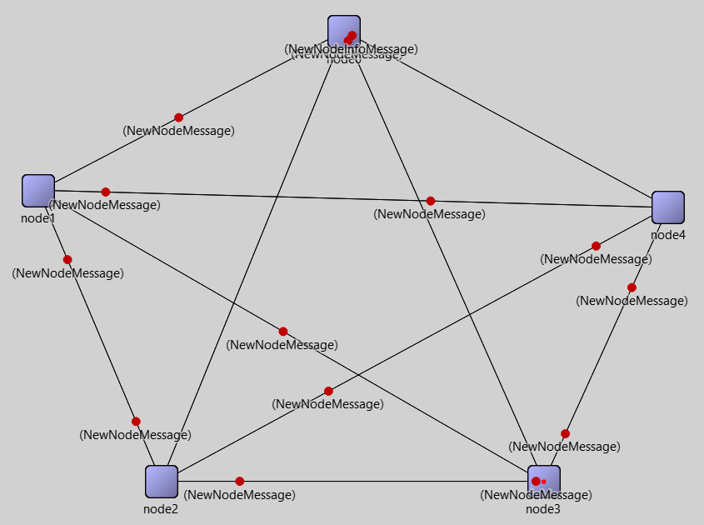
View change corner cases 3/4
A node recovers from a crash before its fault has been detected
When an active node receives a «node insertion» notification from a node still in the view, it triggers a fault recovery to the other nodes
When the fault detection has been handled, the node insertion message is answered and the node insertion procedure is completed

Slide 15
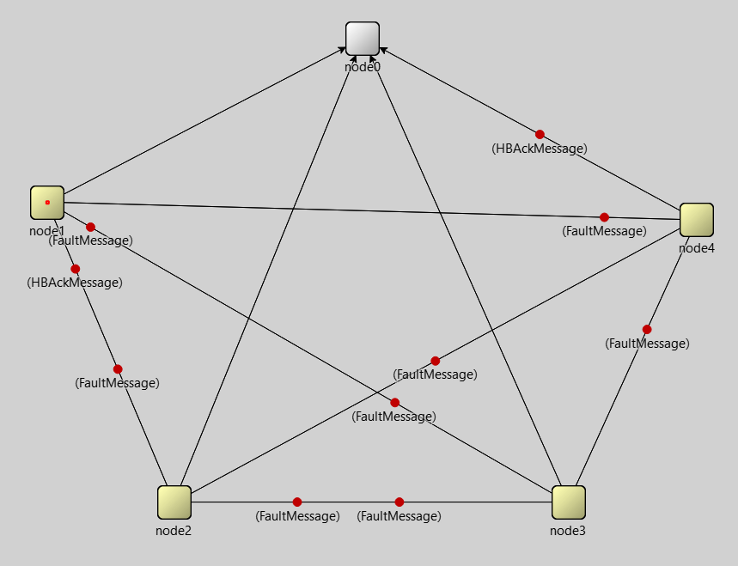
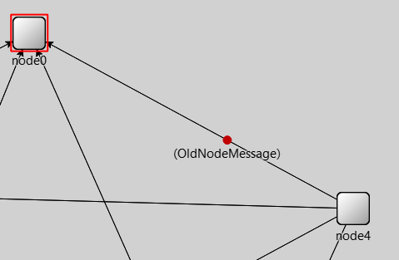
View change corner cases 4/4
A node is incorrectly detected as crashed:
Timer-based failure detections can lead to false positives
Whenever a message whose sender is outside the view is received, the response is a specific warning
If a node receives this warning, it acts as if it has just recovered from a crash and sends a «node insertion» message to the other nodes

Slide 16
thanks for the attention
Alessandro Annechini
Riccardo Fiorentini

