Slide 1
Becoming a Computer Science Major
My journey and passion behind becoming
a software engineer

Slide 2

Presentation Content:
Part 1 : How Did I Get Here
Part 2: Overview: What is Computer Science
Part 3:Computer Science BS
Part 4: Opportunities
Part 5: Global Reach
Part 6: Summary

Slide 3

How Did I Get Here
Before I got into Computer Science
I changed my major 3 times
3D animation
Graphic Design
Web design
None of the majors were challenging.
Notes:
Before I got into Computer Science I changed my major 3 times
3D animation
Graphic Design
Web design
None of the majors were challenging me.
I found myself board in my class.

Slide 4

One day I asked my web design teacher how to build a shopping cart.
His words changed my life
“Oh you just higher a Programmer.”
- David Correa (Web design II ACC)
Notes:
I was in classes wondering why I was paying people to teach me things I could already do and had learned to do in high school. I didn’t feel like I was getting a worthwhile education. I could have made a lot of money with 3D animation, but I didn’t like the software I was using and I noticed every time a Disney animator was interviewed they seemed stressed out or unhappy. Graphic design I already learned all the tools in high school and the professionals were a dime a dozen and started out at $15. Web design seemed like the field I could stick with. At first, I was learning new stuff even started building websites for people as a freelancer, got hired by a company to ever build websites and pay for my degree, but I noticed that tools like WordPress were coming out and replacing people in the field. I realized my degree was incomplete and it seemed like the technology field was taking over the building process. I had that light bulb moment one day in class when I asked my teacher how to build a shopping cart. What he said pivoted my entire career and direction with school. He told me that he would just hire a programmer to build a shopping cart. I was miffed. I thought that I was I in this degree to learn to build these tools.
After that I knew I was in the wrong major. The next semester I changed my major. At first I felt it might have been a mistake. It was hard. I wasn’t sure I was smart enough or good enough at math. I kept at it despite my reservations. Then I took a discrete mathematics course and I realized how much I loved my major. I realized what drew me to this major. I had that moment where everything clicked, my mind was already thinking like a software engineer. I loved solving these puzzles and I was really good at it. It was creative, technical, required learning new things every day, and I loved the feeling of accomplishment when I make code work.

Slide 5

Overview: What is Computer Science
Computer science is the study of
engineering and science behind developing the
design and usage of computer systems.
With this major, I was going to
still have the satisfaction of thinking
creatively and get paid well.

Slide 6
120 hours in Computer Science BS
Strong math skills and computer literacy
are highly recommended in this major
42 core curriculum hours
58 Computer Science credit hours.
20 hours overall for Mathematics Minor
Notes:
What’s in a Computer Science Bachelors of Science? The degree requires 120 credit hours which can be broken down into 20 hours towards a mathematics minor, 42 hours of core curriculum hours, and 58 hours of computer science credits. The Computer science department suggests a Math minor because the degree already requires 17 hours of advance math.

Slide 7


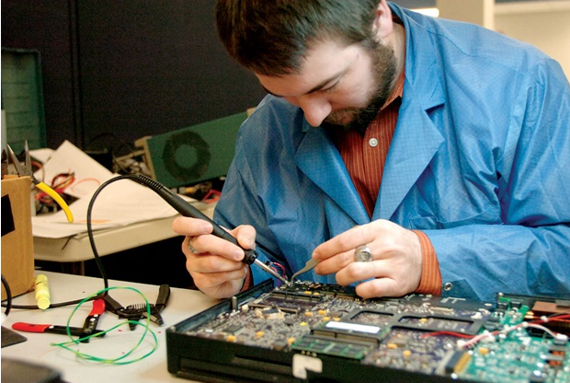
Opportunities
Computer Science careers all require some
specialization and knowledge of multiple programing
languages.
Computer Programmer
Systems Engineer
Network Administrator
Database Administrator
System Analyst
Security Analyst
Hardware Engineer
Software Developer
Systems Manager

Slide 8
Global Reach
The effects of computer Science are everywhere on our planet even reaching outer space. People are more connected than ever. We can talk to anyone across the world. We’re more aware than ever.

Slide 9
Summary
Computer Science is an advance degree which requires a high level of knowledge in math. However pursuing the degree leads to excellent career opportunities in well-paying jobs which have an expanding effect on the entire world.

Slide 10
References
http://www.careertoolkit.com/wp-content/uploads/2016/11/database-admin-500.jpg
http://www.computercareers.org/wp-content/uploads/Computer-Programmer-300x225.jpg
http://computerengineeringsalaryuk.com/wp-content/uploads/2015/03/How-does-a-computer-hardware-engineer-perform-his-duties.jpg
https://media.licdn.com/mpr/mpr/p/3/005/03e/00d/1c00898.jpg
https://www.strategy6.com/wp-content/uploads/2016/10/idea.jpg
http://www.icrewz.com/wp-content/files/Graphic-Designer-Experience.jpg
http://www.computerscience.org/careers/
http://mycatalog.txstate.edu/undergraduate/science-engineering/computer/computer-science-bs/

