Slide 1

Group 2
AirPods--Apple
Group member: 蔡昕炜（1220033000），黄蕾（1220033025）
李星辰（1220022625）徐子涵（1220032813）
余允中（1220022653），张盈盈（1220024446）

Slide 2
01
The background of Apple
02
The major features of the product
03
The customer portraits
Contents
04
The position of the brand by perceptual map
05
The distribution channel
06
The video of advertisement

Slide 3
PART ONE
The background Of Apple

Slide 4
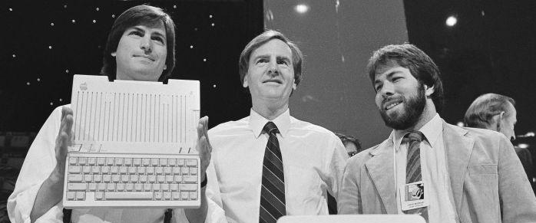
Background
One of the five biggest names in tech industry
Co-founders:
Ron Wayne, Stephen Gary Wozniak and Steve Jobs.(It was founded in April 1976)
It is headquartered in Cupertino, California, USA
Tim Cook has served as the company‘s Chief Executive Officer since August 2011.

Slide 5
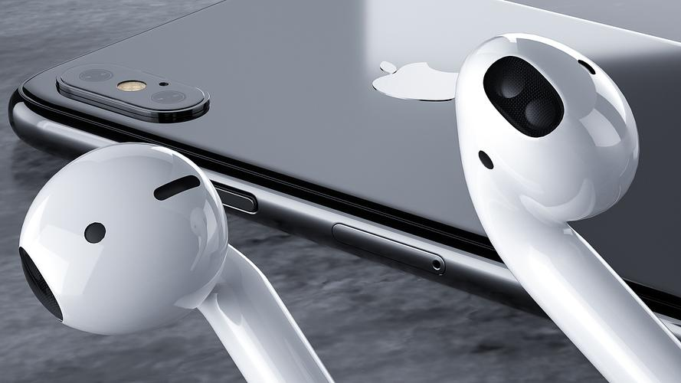
Background
Main content:
Design, manufacture and sale of smartphones, ipad, personal computers and wearable devices
Provides software applications and related services, accessories
Third-party digital content.

Slide 6
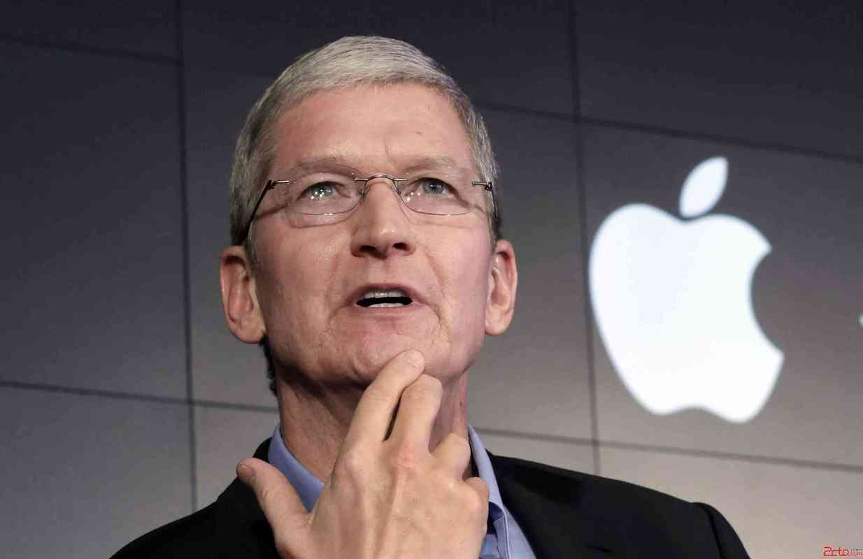
Background
Apple went public in 1980 on the Nasdaq stock Exchange
Within less than an hour of the public offering, all 4.6 million shares were snapped up, making it an immediate financial success.

Slide 7
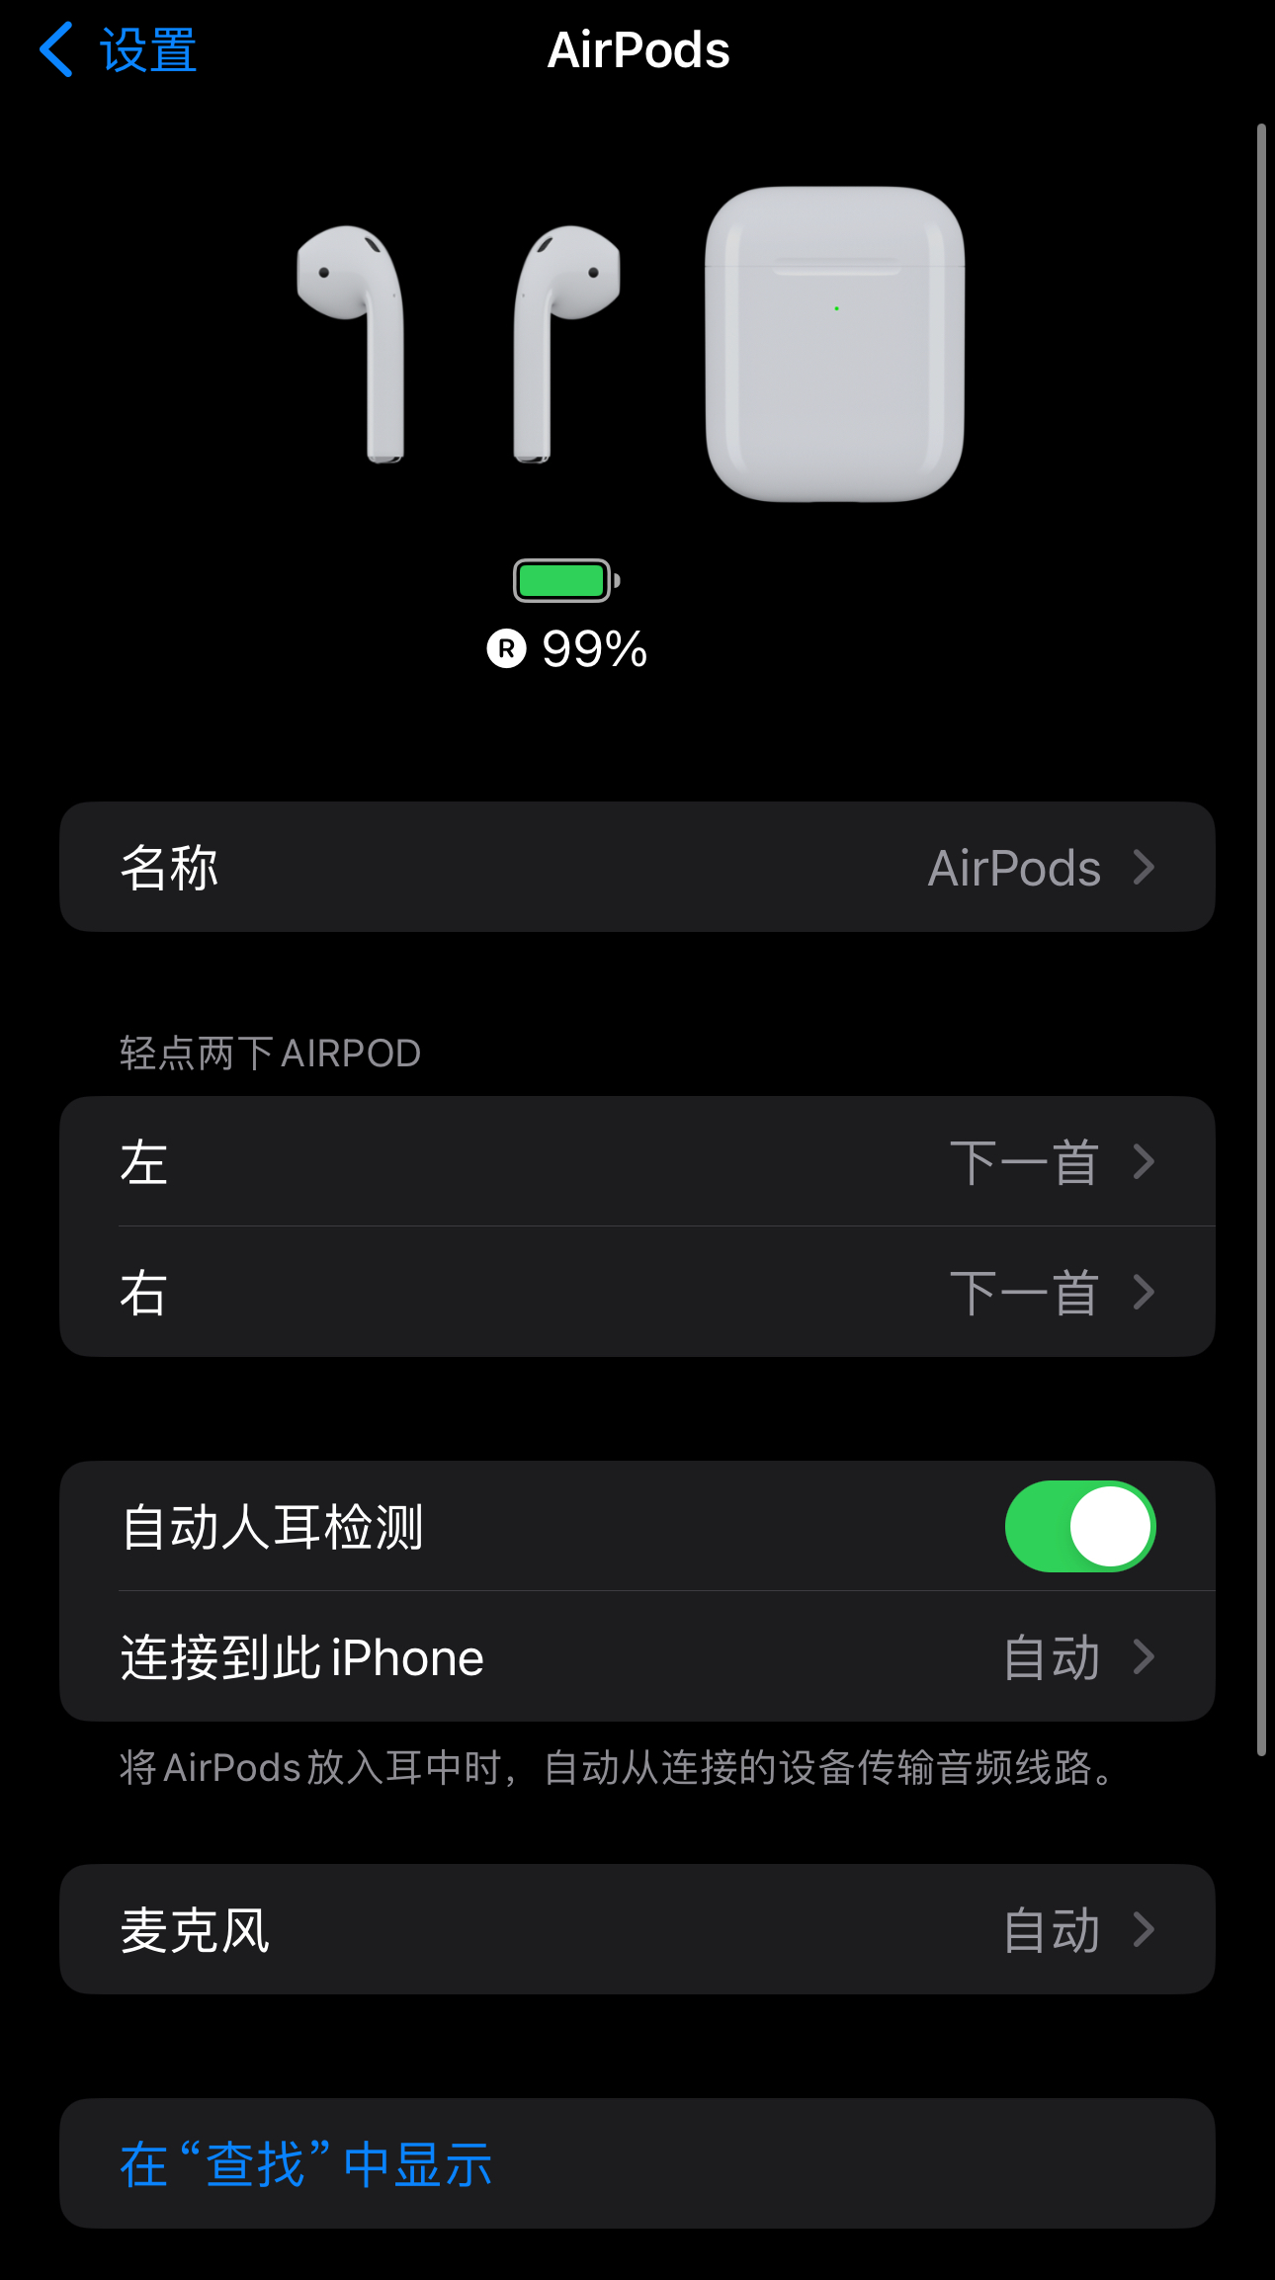
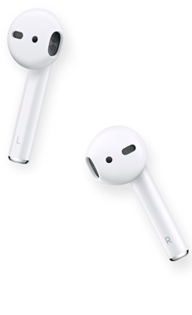
Background
Personalized setting
Name headphones
Tap the headset switch option

