Slide 1
Geolocation Extraction and Clustering
Belinda Welch
Akshay Rawat
Ruchira Nagle
Annesha Chowdhury
Lingyan Wu

Slide 2
OVERVIEW
Introduction
Tools and Terminations
Approach
Experimental Results
Future Work

Slide 3
Introduction
Why geolocation extraction?
Geographical data can be used to determine a variety of characteristics of population, geolocation extraction from newspapers enable us to know not just the what and when,but also the where of an event.
Why this topic?
Exploring the dominant topic in a specific district provides a different perspective to human geography research.

Slide 4
Google News API
Google News API is a simple HTTP REST API for searching and retrieving live article from all over the web.We need an API key to use API,which is a unique key that identifies the requests. It’s free for development, open-source, and non-commercial use

Slide 5
Geoparsing and Geoparser
Geoparsing is the process of converting free-text descriptions of places(such as ” twenty miles northeast of Jalalabad ”) into unamibiguous geographic identifiers,such as geographic coordinates expressed latitude-longitude.
With geographic coordinates the features can be mapped and entered into Geographic Information Systems.A geoparser is a piece of software or a (web) service that helps in this process.

Slide 6
gmplot
It’s an easy way to plot data on Google Maps.A matplotli-like interface to generate the HTML and javascript to render all the data you’d like on top of Google Maps.[7]The gmplot module supports location-based map initialization and zoom-level initialization.

Slide 7
k-means
k-means is one of the simplest unsupervised learning algorithm that solve the well known clustering problem.The procedure follows a simple way and easy way to classify a given data set through a certain number of clusters(assume k clusters) fixed apriori.The main idea is to define k centers,one for each cluster.These centers should be placed in a cunning way because of different location causes different result.

Slide 8

k-means
where,
‘||x_{i} - v_{j}||’ is the Euclidean distance between x_{i} and v_{j.}
‘c’ is the number of data points in i^{th} cluster.
‘c’ is the number of cluster centers.

Slide 9
Approach
The first challenge we came across is how to implement the location extraction.
There are serveral location extraction tools,such as Cliff-Clavin,Geoparser,Stanford CoreNLP,Mordecai,and Edinburgh.
After lots of research and comparison,we decided to use Geoparser.io,which is a RESTFUL web API that identifies place names mentioned in text,disambiguates those names and returns GeoJSON for the places found in the text.

Slide 10
Approach
The locations extracted from articles using Geoparser are labeled with latitude and longitude coordinates.Note that each article may include more than one locations.The locations extracted from the same article are associated with a unique articleID.
Due to tight deadline,we decided not to implement focus location extraction.You can find detailed information about focus location extraction in the paper “Focus Location Extraction from Political News Reports with Biased Correction”.

Slide 11
Approach
The next challenge is how to cluster those locations.An article might have multiple locations,we handle each location independently. Note that we allow an article assigned to different clusters if this article contains different locations
After clustering,we need to extract the critical words from each cluster and thus retrieve the main topic.We choose to use Word Count to obtain the importants words.We need to preprocess the data,here we use NLTK stopwords to filter out usless words like “is”,”a”,”that”,”in”.

Slide 12
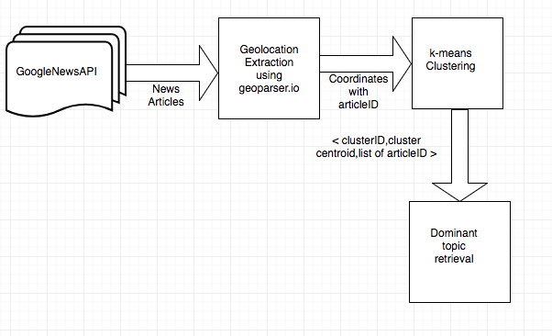
Approach

Slide 13
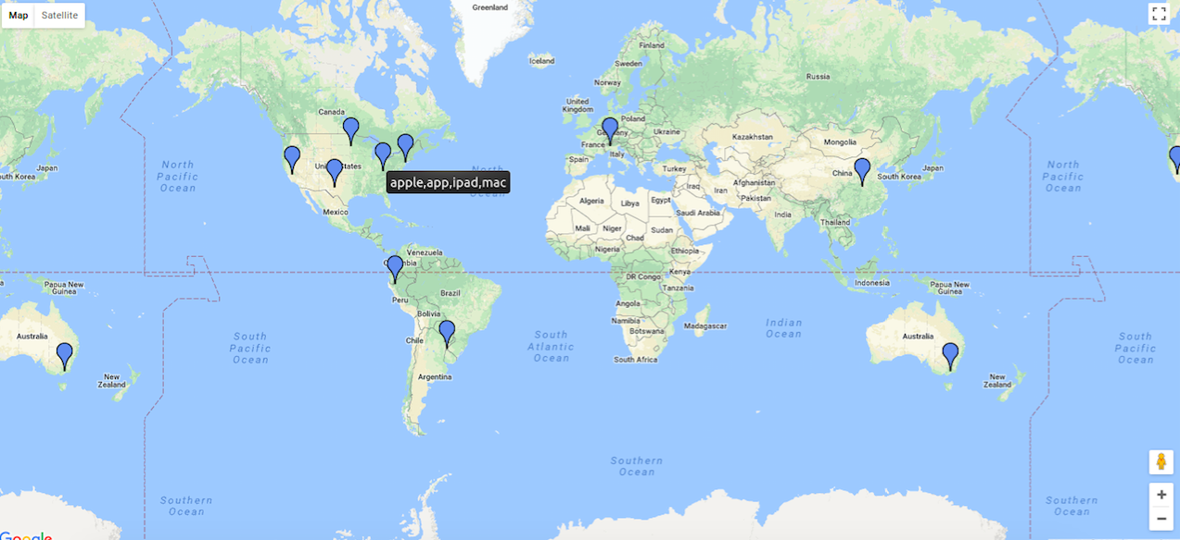
Visualization

Slide 14
Comparison with Other Work
In the paper “What’s missing in geographical parsing?”
They evaluated and analysed the performance of a number of leading geoparsers on a number of corpora and highlight the challenges in detail.They also published an automatically geotagged Wikepedia corpus to alleviate the dearth of (open source) corpora in this domain.
In the paper “Focus Location Extraction from Political News Reports with Bias Correction”
They have presented and developed a focus location extraction method executable on unstructured text-based new reports.They extract all of the possible locations with a named entity recognition tool,and propose a semantic approach to find the focus location.

Slide 15
Comparison with Other Work
In our project:
We combined the geoparser technology and “Focus Location Extraction” idea from the prior work .
we implemented k-mean clustering algorithm on the extracted geolocations. Then we retrieved the main topic from each cluster.
We didn’t make an intensive study of the methods or algrithms like the previous work.However,the result of our work-getting to know the dominant topic of a specific district-provides a different perspective to human geography reaserch.

Slide 16
Future Work
To extract focus geolocation in new articles in which more than one event is reported
To use different location extraction tools.

Slide 17
Acknowledgement
We greatly appreciate the help from Maryam Bahojb Imani.
Some of the terminations and ideas came from her paper “Focus Location Extraction from Political News Reports with Biased Correction”.

Slide 18
Reference
[1] Focus Location Extraction from Political News Reports with Biased Correction.
[2] https://newsapi.org/s/google-news-api
[3] https://geoparser.io/
[4] What’s Missing in Geographical Parsing?
[5] https://newsapi.org/docs
[6] https://en.wikipedia.org/wiki/Geoparsing
[7] https://github.com/vgm64/gmplot
[8]https://sites.google.com/site/dataclusteringalgorithms/k-means-clustering-algorith

Slide 19
Thank you!

