Slide 1
SDN FIREWALL
ANIRUDDH JHAVAR
ANNESHA CHOWDHURY
KEERTHI SANTHALINGAM
RUMELA SARASWATI
SUNNY ANAND

Slide 2
INTRODUCTION
SDN: According to the definition by ON Labs SDN is a dynamic,cost-effective, and adaptable architecture ideal for the dynamic nature of today's applications. Network control is directly programmable and network intelligence is centralized to maintain a global view of the network.
An OpenFlow controller is an application based on OpenFlow protocol that manages flow control in a SDN environment. It connects controller software to network devices so that server software can tell switches where to send packets.
Floodlight is an Open SDN Controller that works with physical and virtual switches and based on the OpenFlow protocol. Floodlight proposes a protocol, which allows us to use a remote controller to modify the behavior of networking devices with a set of well defined “forwarding instruction set. Some features are:
a. It offers a module loading system with high performance and multithreading.
b. Supports virtual as well as physical OpenFlow switches.

Slide 3
PROJECT DESCRIPTION
The project is focused on trying to understand how floodlight controller can help manipulate the flows between different hosts and switches in a network topology.
We focused our implementation on Access Control Rules in a linear & tree topology
We then checked how Access Control lists behave when we overlay them with firewall rules.
We also checked for the L2/L3 packet header information while manipulating these network topology.

Slide 4
PROJECT DESCRIPTION
ACL: The Floodlight controller enforces ACL rules without by monitoring Packet-in messages and then pushing relevant flow entries. We have added the features of Adding , Deleting all the rules and also Listing also the ACL rules.
Firewall features: The Firewall Module exposes REST interface implemented as RestletRoutable using Rest API Service. Some of the REST methods that we implemented were:
a. Enabling the firewall b. Disabling the firewall
Communication between two switches

Slide 5
PROJECT DESCRIPTION
L2/L3 Header Inspection: Developed a Floodlight module that listens for PACKET_IN messages sent to the controller by the switches. The MAC addresses are extracted by the switch at the controller.
L2 header inspection for PACKET_IN messages: The MAC addresses are extracted as seen by the switch at the controller. This information may be leveraged at a later point for designing some features.
L3 header inspection for PACKET_IN messages: Steps:
a.Ethernet packet is obtained and L2 information is extracted for this packet.
b. payload of this Ethernet packet is then obtained, which could be of IPv4 type or ARP type.
c. The IP protocol version of the IPv4 packet’s payload is then determined which could be TCP or UDP.
d. The payload is then handled appropriately to extract the source and destination ports.

Slide 6
TOOLS USED
Mininet : Mininet is a network emulator which creates a network of virtual hosts, switches, controllers, and links.
Floodlight Controller: An OpenFlow Controller
Floodlight GUI
WIRESHARK: Wireshark is a network packet analyzer which capture network packets and displays that packet data.
REST API
Virtual Box(VM): It is an emulation of a computer system

Slide 7
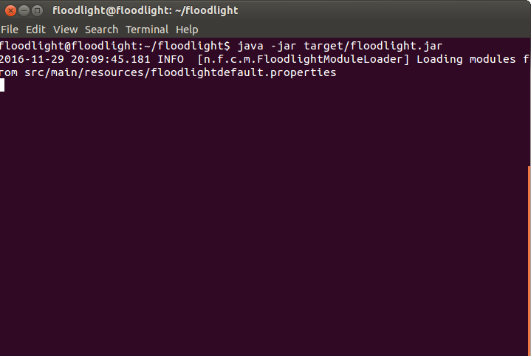
PROJECT STEPS AND SCREENSHOTS: Starting Floodlight

Slide 8
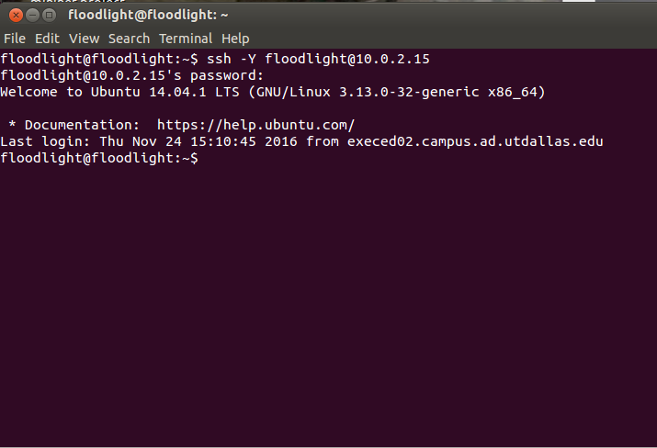
SSH-ing into controller to perform operations using IP

Slide 9
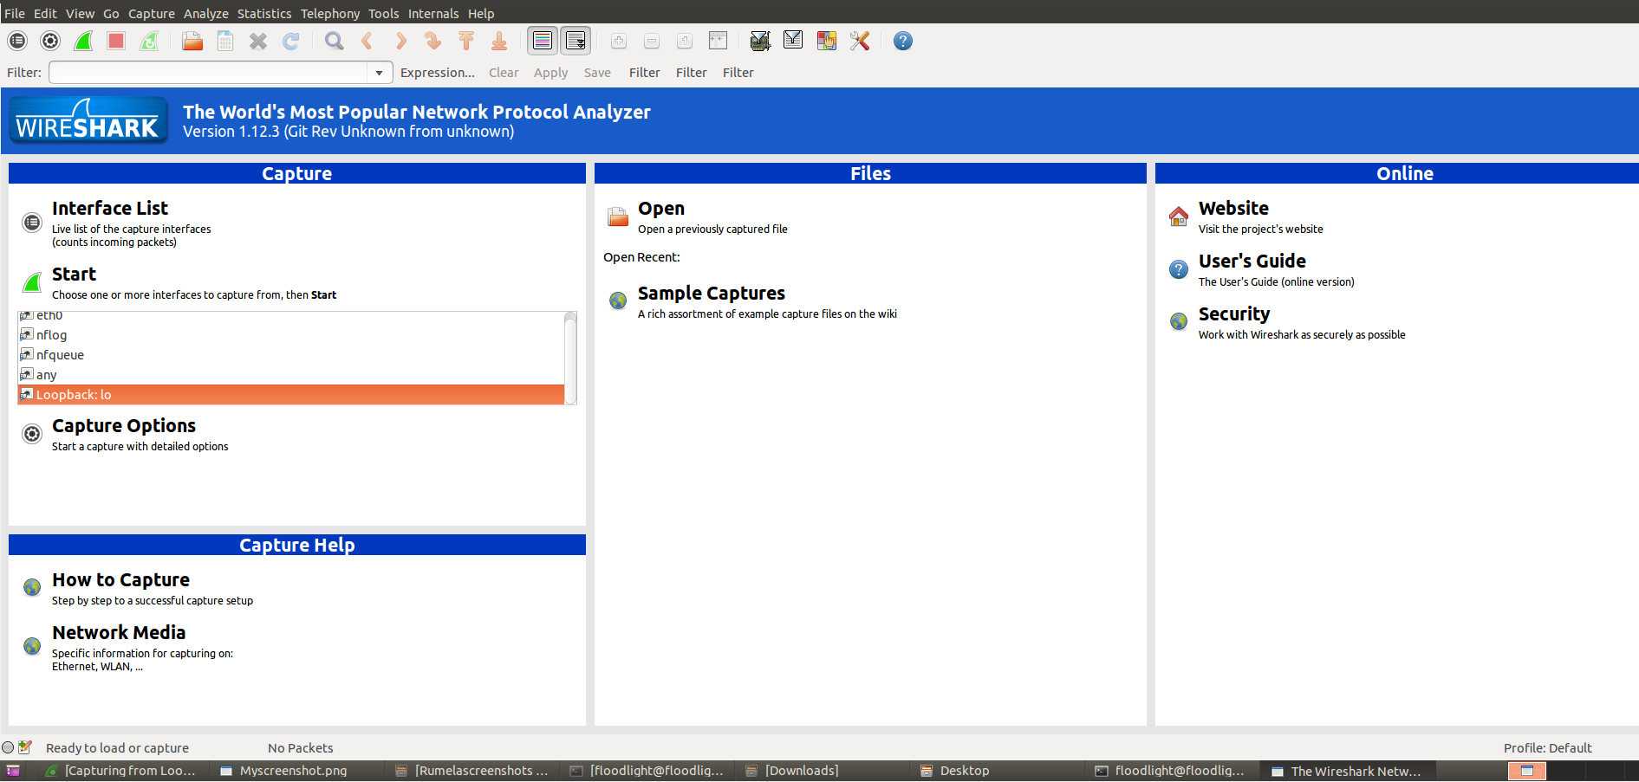
Wireshark: Using loopback.io to monitor all protocols and IP addresses

Slide 10
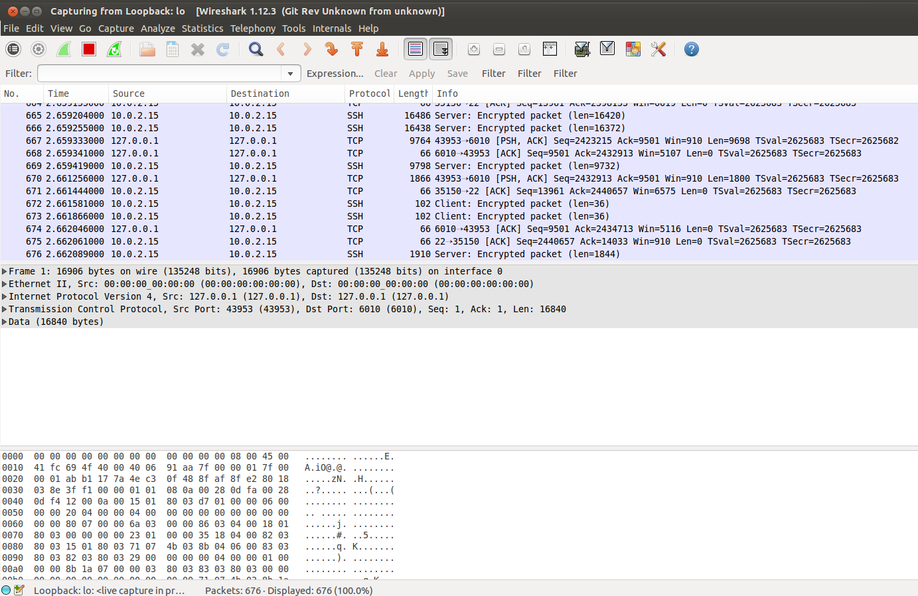
Loopback.io user interface
SOURCE IPs
PROTOCOLS
DESTINATION IPs

Slide 11
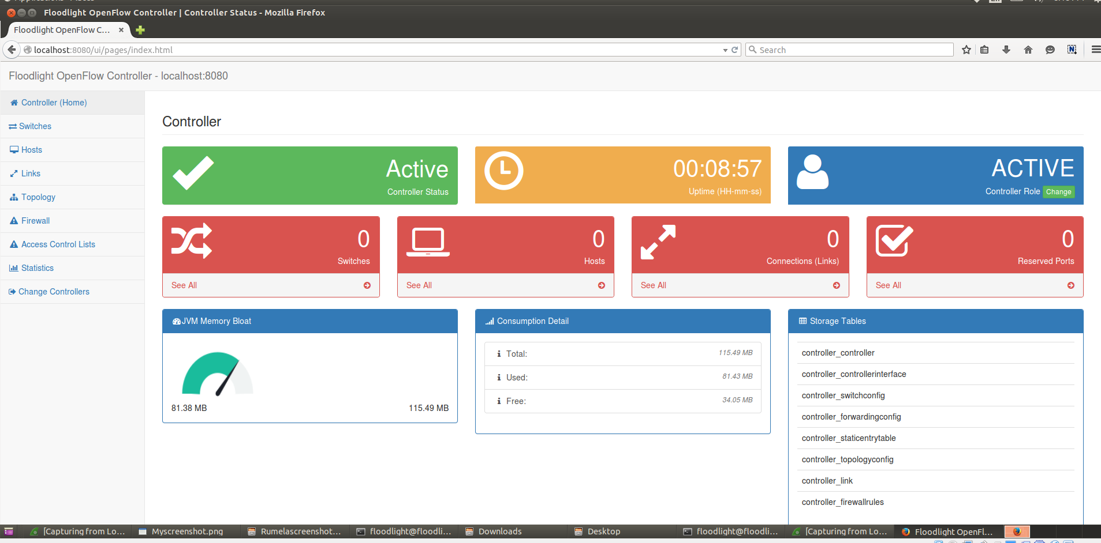
FLOODLIGHT: USER INTERFACE

Slide 12
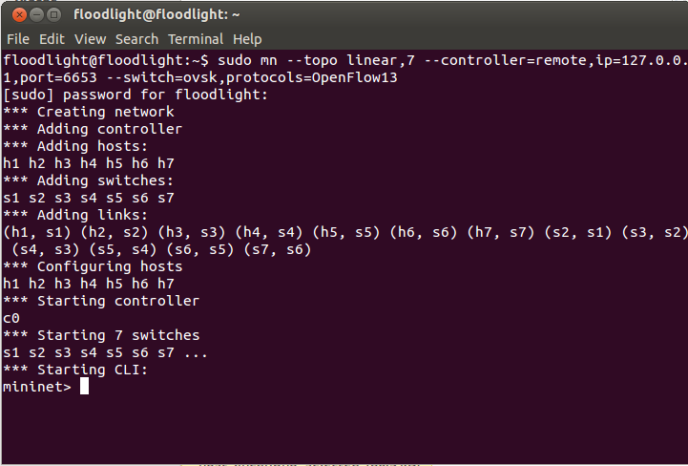
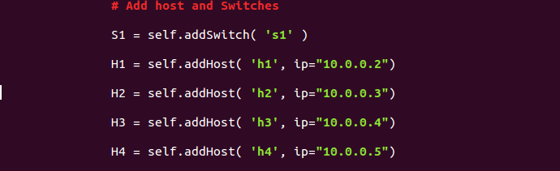
a. TOPOLOGIES | B. HOST IP(S)

Slide 13
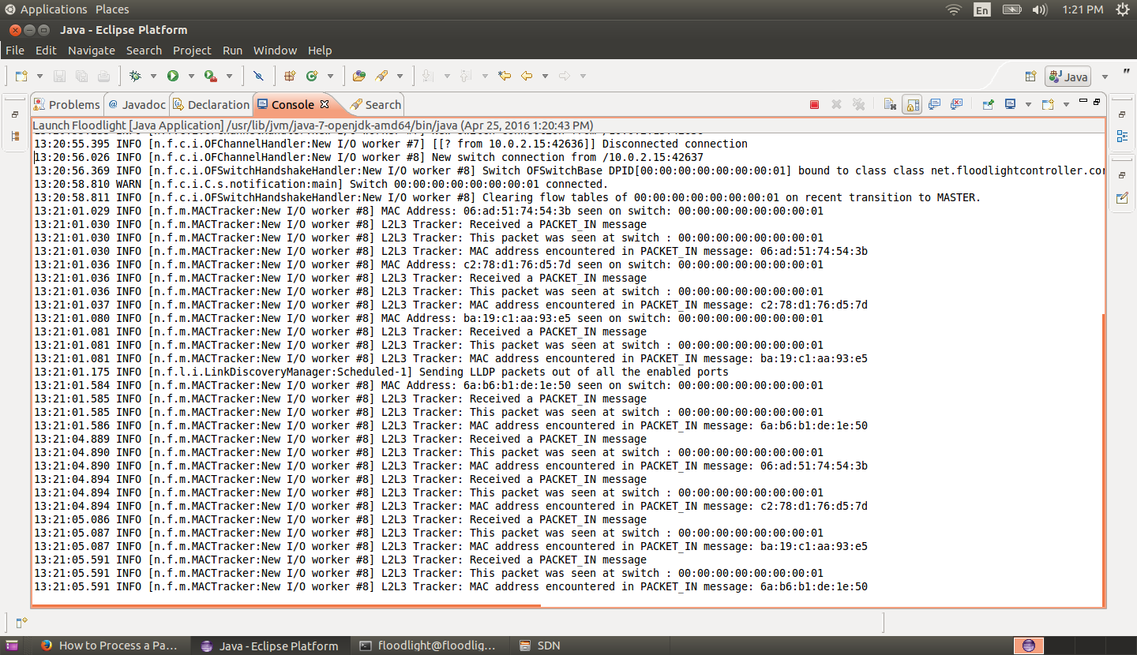
L2/L3 HEADER DESCRIPTION: After deploying topology

Slide 14
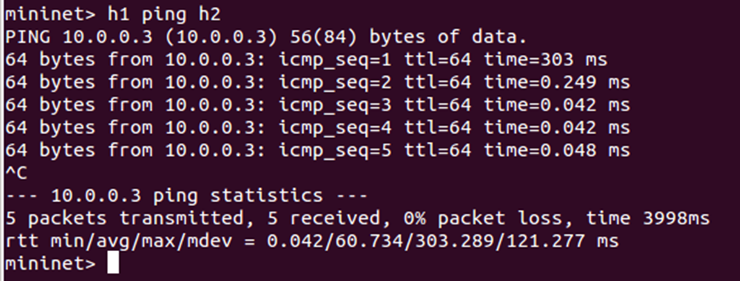
L2/L3 HEADER INSPECTION: Pinging h2 from h1

Slide 15
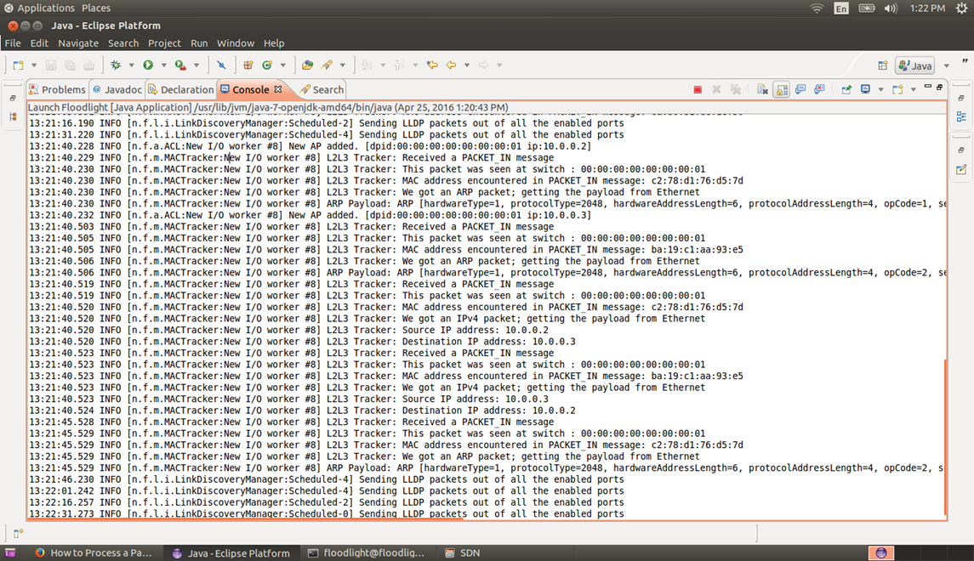
L2/L3 HEADER INSPECTION: After pinging floodlight console

Slide 16
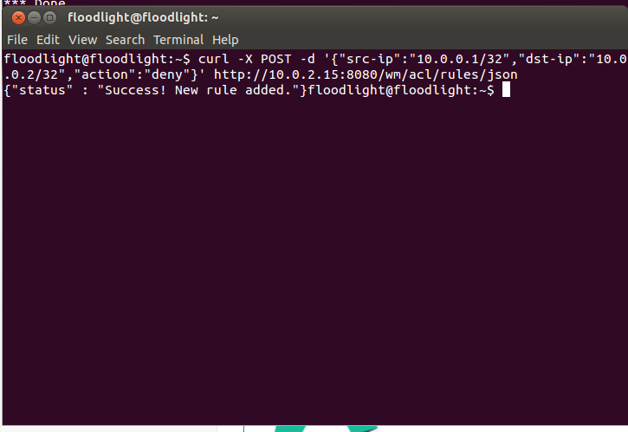
ACL : Creating deny rule and checking

Slide 17
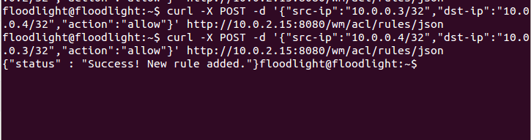
ACL: Bidirectional rule added

Slide 18
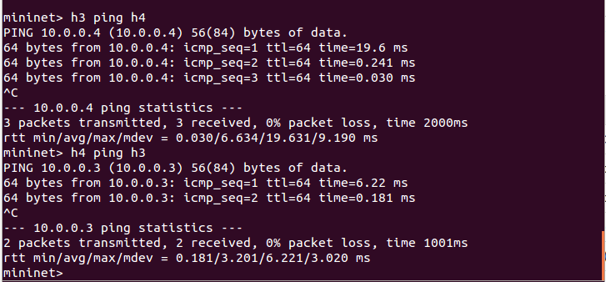
ACCESS CONTROL LIST: Listing rules

Slide 19
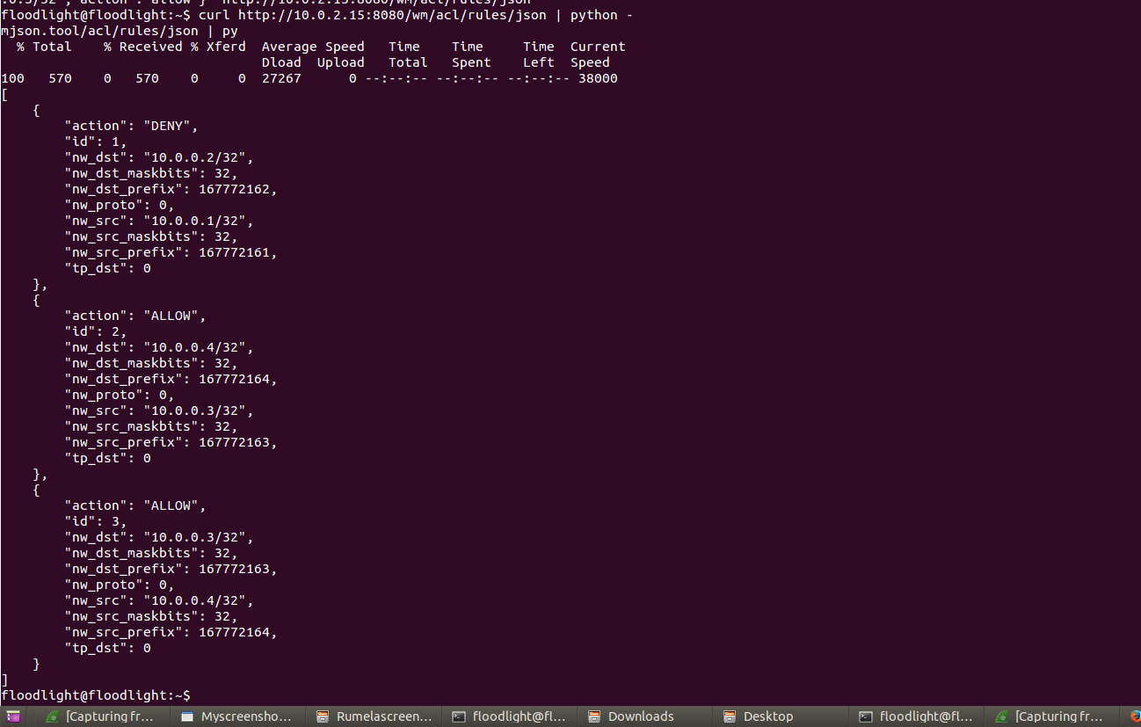
ACL : Listing rules

Slide 20
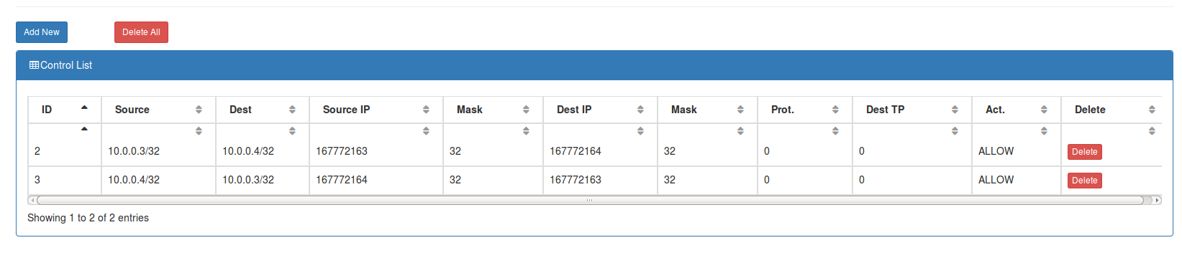
ACL: Deleting rule(one rule)

Slide 21
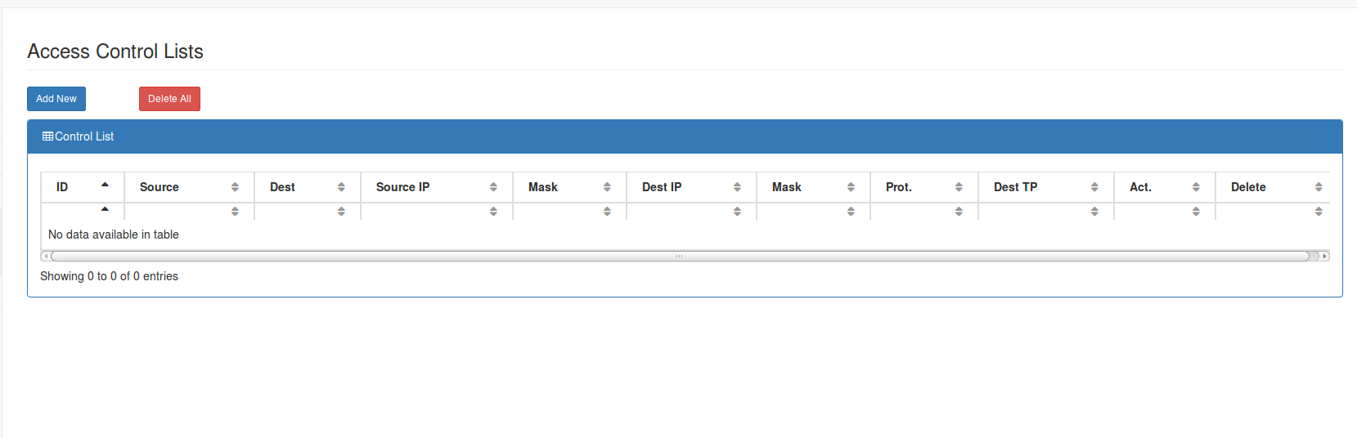
ACL : Deleting all acl rules

Slide 22
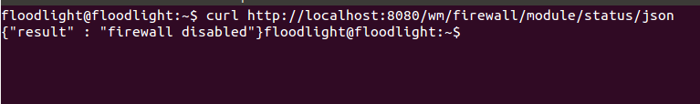
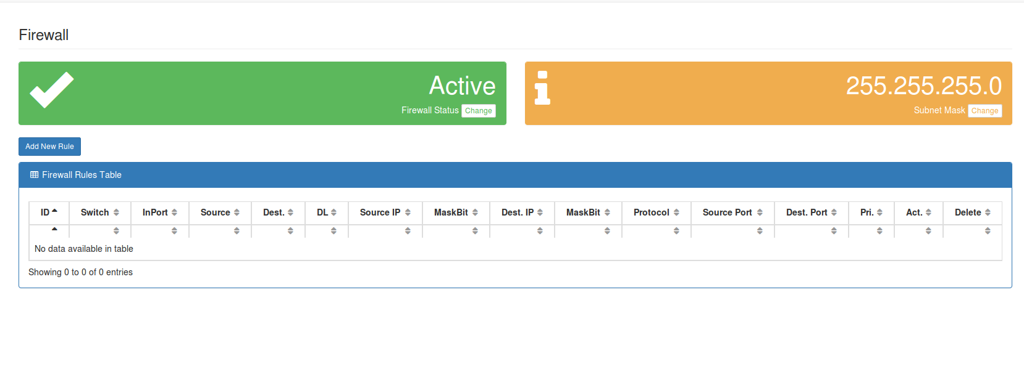
FIREWALL :Enabling firewall(active)

Slide 23
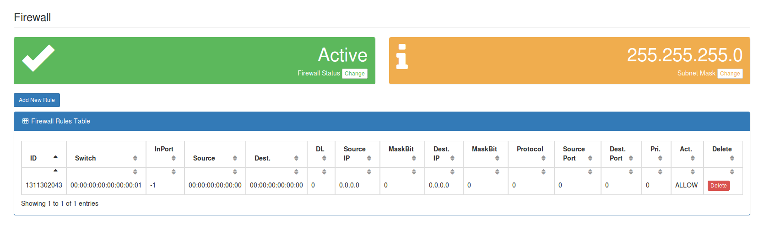
Adding Firewall rule for switch

Slide 24
ACHIEVEMENTS
We were able to add ACL rules and modify the flows with different options and different topology.
We were able to overlay the firewall control along with ACL rules.
We were able to analyze the flow between hosts during this topological changes

Slide 25
CHALLENGES
We tried to add another functionality to our firewall: firewall between two hosts – it was not working because of the multiple switches in the topology. Tried using tree topology between two hosts which was not working . we are still trying to figure it out.
The rest API for delete expected a parameter (“ruleid”). At the beginning we had trouble figuring out how to pass the parameter in the http request delete method.

Slide 26
FUTURE SCOPE
We can work on the following feature in future:
Adding a firewall between two hosts
Create hybrid topologies and try to implement the existing project features
Try the same project with multiple controllers to cover a larger network.

Slide 27
ACKNOWLEGEMENT
https://floodlight.atlassian.net
https://www.opennetworking.org
https://www.sdxcentral.com/

Slide 28


