Slide 1
Bio-Signal Studies for a Relaxation-Based Biofeedback Training of Robot Users in Surgical Tasks
MSc Robotics
Anni Gao (SID: 2543009)
Supervisor: Prof. Giacinto Barresi
28th August 2025

Slide 2
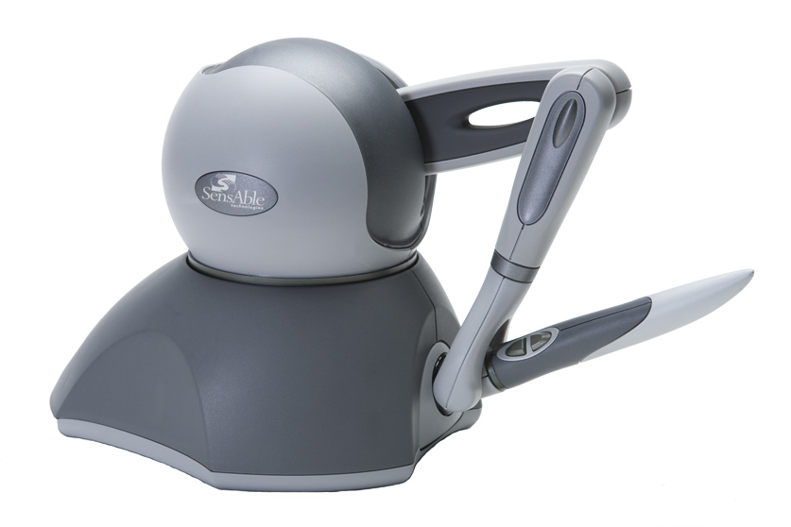
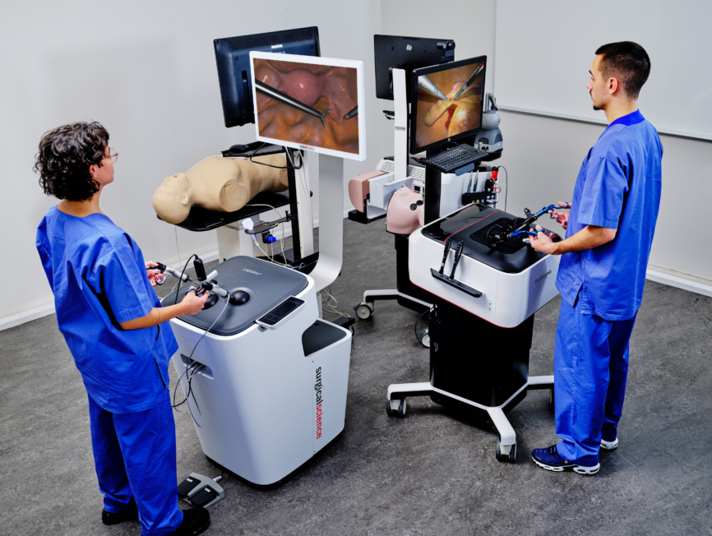
Scope & Motivation
Robot-assisted surgery
  Higher precision
  Shorter recovery
Surgeon state critically affects outcomes
  Attention
  Stress / Relaxation
Biofeedback – helps to self-regulate
  Research gap - Training systems rarely adapt to physiology
  Can we design training platforms that adapt in real time to the surgeon’s physiology?
Image source: https://surgicalscience.com/medical-specialities/general-surgery

Slide 3
Aims & Objectives
Aims:
  Investigate how operator stress and attention levels influence accuracy in robotic surgical tasks.
  Evaluate the effectiveness of real-time biofeedback in promoting physiological regulation and improving human-robot system performance.
  Assess user adaptation strategies in response to feedback-triggered task interruptions
Key objectives:
  Platform Design and Integration.
  Biofeedback Threshold Calibration.
  Comparative Evaluation of Biofeedback Modes
Question:
  Can real-time biofeedback control improve human–robot system performance?
  Which bio-signal is more effective for this purpose?

Slide 4
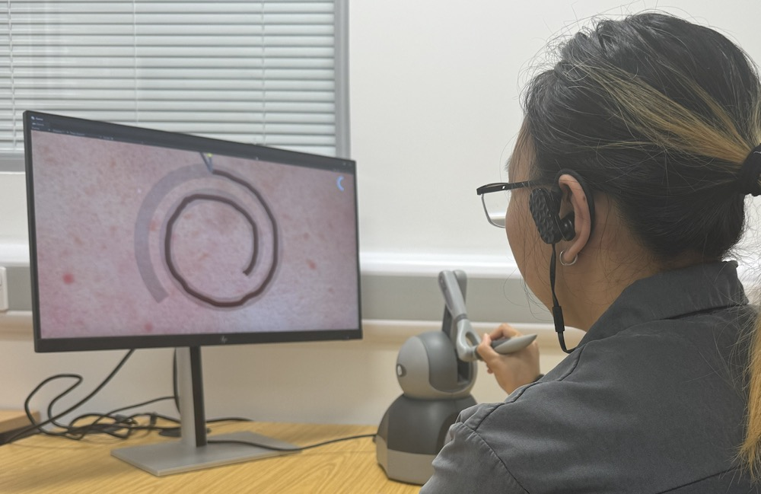
Task Design
Evaluate precision and self-regulation during simulated surgical tasks
Three types of trajectories
  Irregular Cloud-shaped
  Concentric circular
  Straight line
Three types of conditions
  HRV Bio-signal Control
  EEG Bio-signal Control
  Baseline Control (without bio-feedback)
5 training
1 test
only 1 test

Slide 5
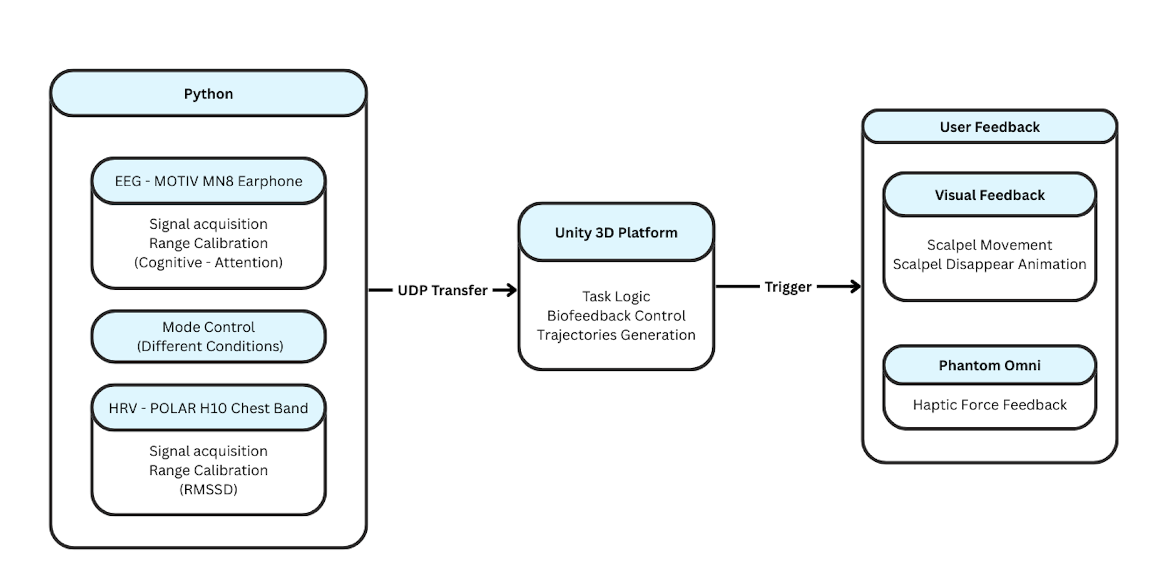
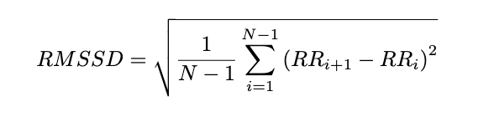
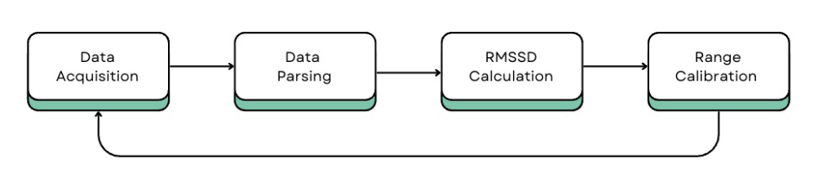

System Architecture
Raw EEG/HRV → preprocessing → thresholding → Unity feedback trigger

Slide 6










Performance Metrics
Objective Measures
  Trajectory MAE
  Completion Time
  Retraction Frequency
Subjective Measures
  (Post-task questionnaires)
  SUS
  NASA-TLX scale
  Platform Experience
    (Biofeedback & Animation)
  Training Effectiveness
MAE: symmetric difference area

Slide 7
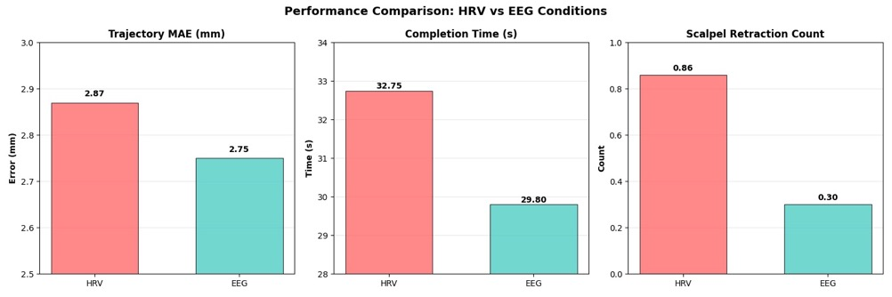
Performance Results
EEG is faster and more accurate

Slide 8
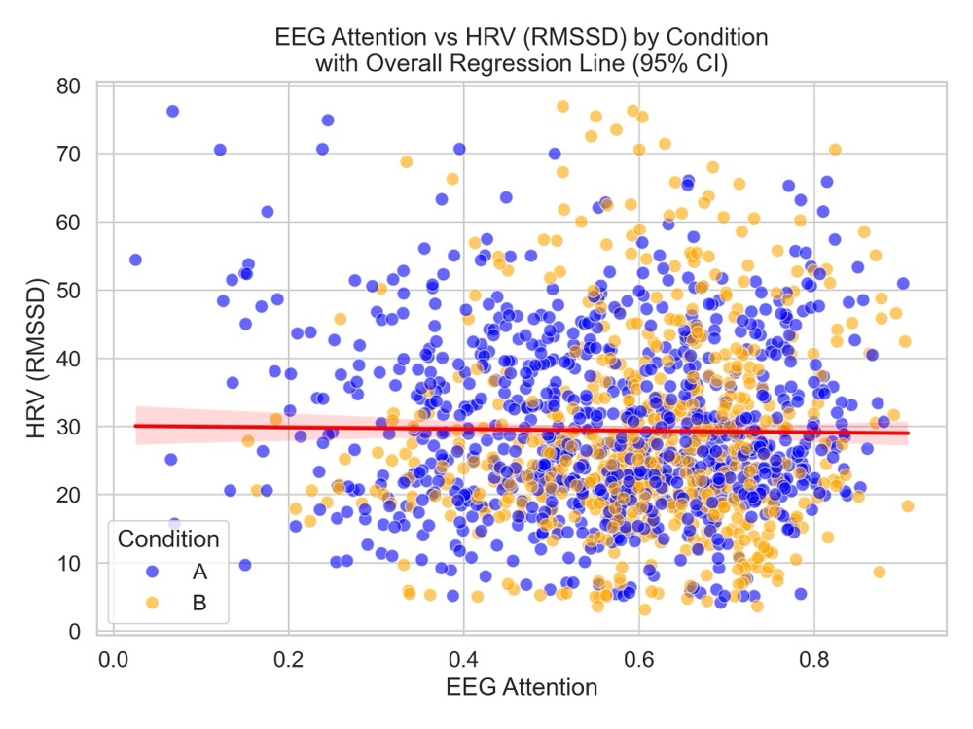
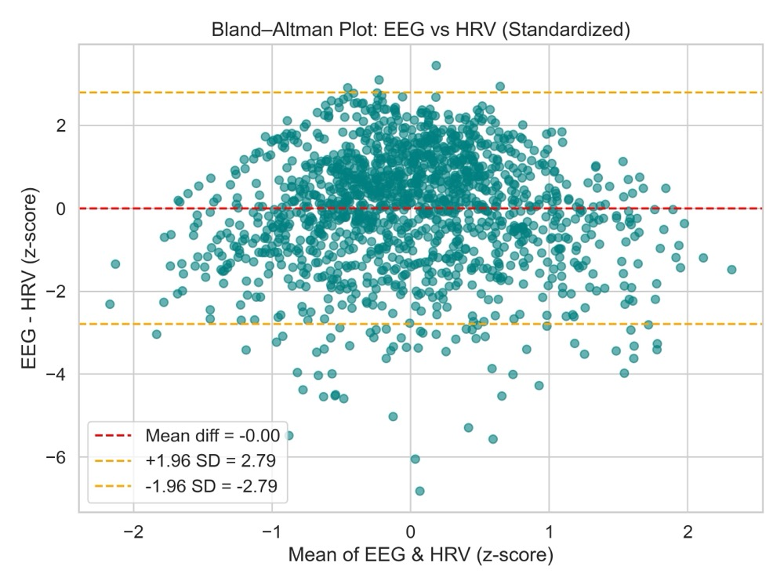
HRV vs EEG Comparison
HRV and EEG capture distinct physiological dimensions
Weak correlation

Slide 9
Evaluation & Conclusion
Aims:
  Investigate how operator stress and attention levels influence accuracy in robotic surgical tasks.
  Evaluate the effectiveness of real-time biofeedback in promoting physiological regulation and improving human-robot system performance.
  Assess user adaptation strategies in response to feedback-triggered task interruptions
✅
Key objectives:
  Platform Design and Integration.
  Biofeedback Threshold Calibration.
  Comparative Evaluation of Biofeedback Modes
✅
Question:
  Can real-time biofeedback control improve human–robot system performance?
  Which bio-signal is more effective for this purpose?
Yes
EEG
Combine
Future Work: Multi-signal fusion & Integration with a real robotic arm

Slide 10
THANK YOU FOR YOUR ATTENTION
REPORTER：ANNI GAO

