Slide 1
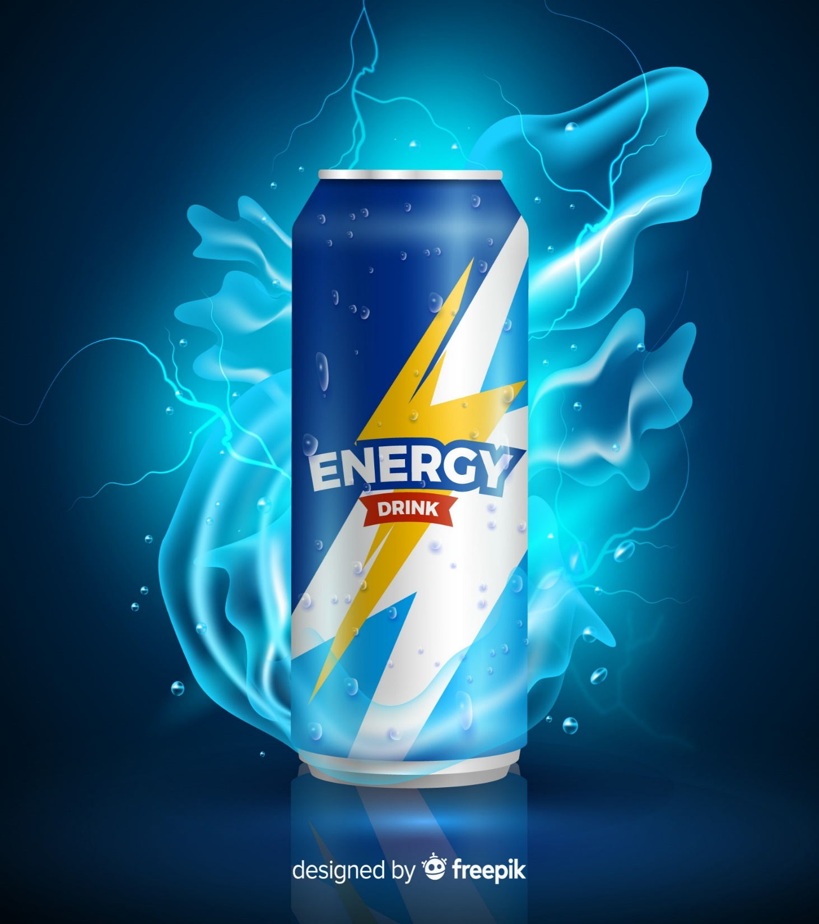

Codebasics: Resume Challenge 6
Provide Insights to the Marketing Team in Food & Beverage Industry

Slide 2
About The Company:
CodeX is a German beverage company that is aiming to make its mark in the Indian market. A few months ago, they launched their energy drink in 10 cities of India.
Project Objective:
CodeX conducted a survey in those 10 cities. Task is to convert these survey results to meaningful insights which can be used to drive actions by the Marketing team for increasing brand awareness, market share, and product development.

Slide 3
Data and the Data Model:
We have survey data from 10k respondents
The survey includes various categories of questions like:
Respondents Demographics
Consumption habits
Awareness about our brand and product experience
Which brand respondents prefer and why?
Ingredients , pricing and packaging they prefer.
Marketing channels
I have done data cleaning ,modelling and visualization in Power BI and attached a pdf file consisting of all the steps I performed.

Slide 4
Overview
Respondents demographics
Analysis, insights & Recommendation
Section A : The Customer (Consumption habits, reasons ,perceptions and suggestions)
Section B: The Competition ( Reasons for competing brand preference)
Section C: The pricing , packaging and distribution
Section D: The Marketing (Marketing Channels & Strategy)
Section E: The Product(Experience, Rating , Reasons for not trying)
5-Point action Plan
Notes:
This is the overview of my presentation: Specially mention that after each section we have recommendations:::

Slide 5
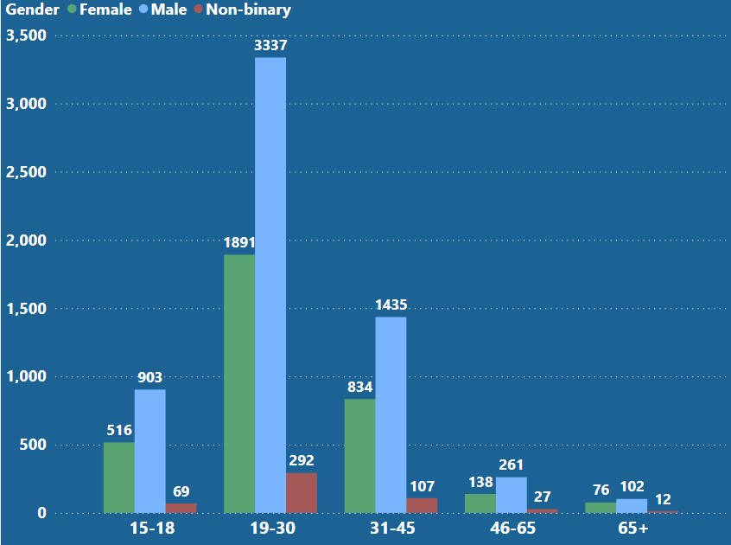
Demographics of the respondents
The majority of the survey participants are young men between the age of (15-45).
Notes:
During the analysis we would have to take this into consideration, so that we don’t infer any biased insights due to uneven distribution of the population.

Slide 6
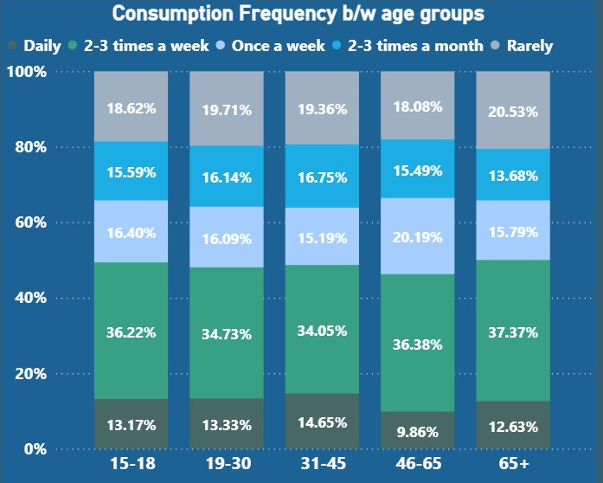
Section A: Lets understand The Customer
Consumption habits of different age groups
The consumption habits appears to be similar across different age groups.
Notes:
One of the reasons may be : The number of respondents for the older age group are less and these respondents were more likely to drink energy drinks

Slide 7
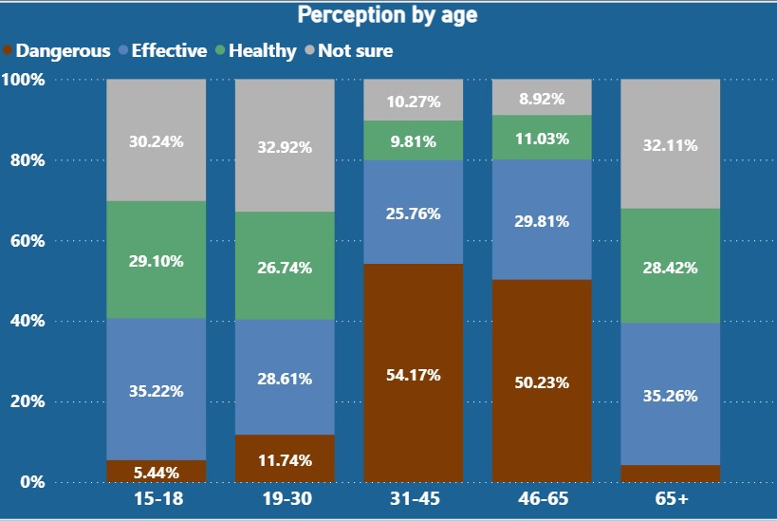
General Perception of energy drinks among different age groups
People in the older age groups tend to think of energy drinks as dangerous .
Maybe these people overestimated their consumption habits OR
Even though they consume it, they may still recognize it as harmful.
Notes:
Although the consumption habits are similar of the respondents , People in the older age groups tend to think of energy drinks as dangerous .
Maybe these people overestimated their consumption habits OR
Even though they consume it, they may still recognize its harmful aspects and view it as a guilty pleasure or an occasional indulgence.

Slide 8
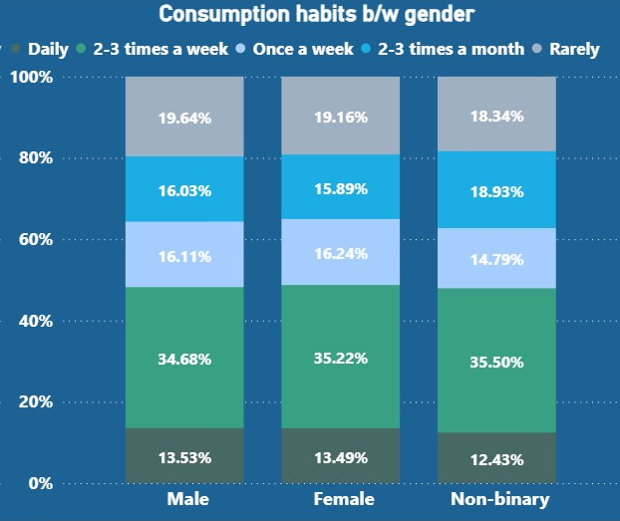
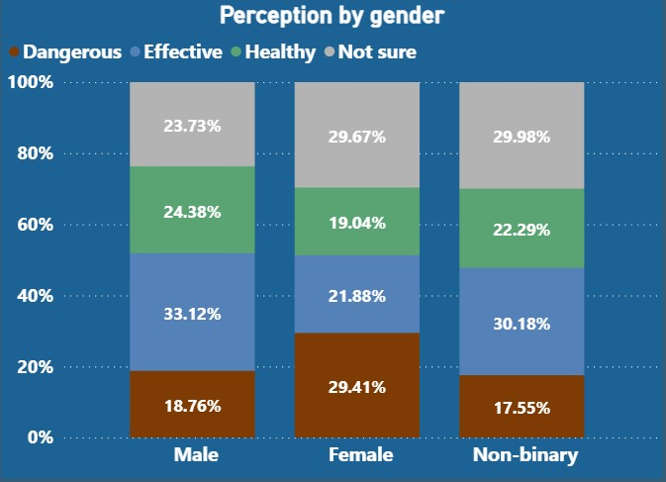
Consumption habits & Perceptions among Genders
The consumption habits appear to be similar across different genders
More women (around 30%) consider energy drinks to be dangerous.
Notes:
and gender.

Slide 9
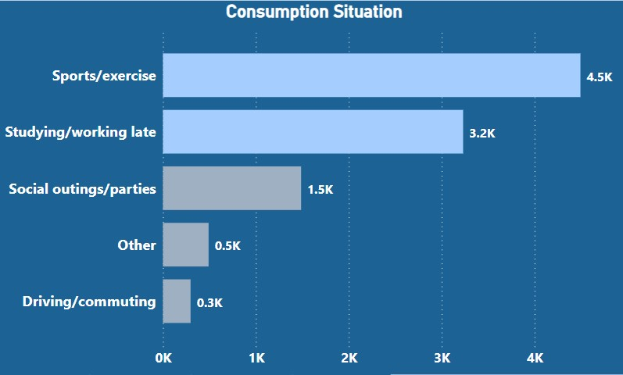
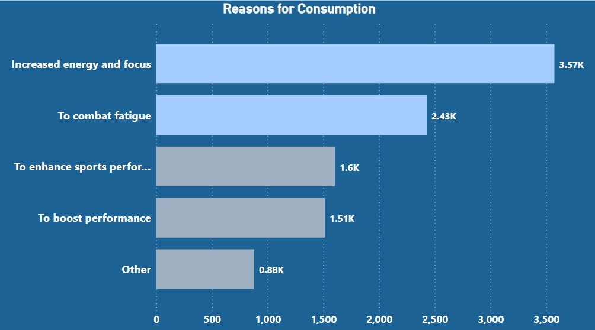
Why do customers purchase energy drinks?
Most people( around 60%) purchase energy drinks to combat fatigue and increase their energy and focus.

Slide 10
Why do customers purchase energy drinks?
Most of them (77%) do it for increase in focus for some physical or mental work .

Slide 11
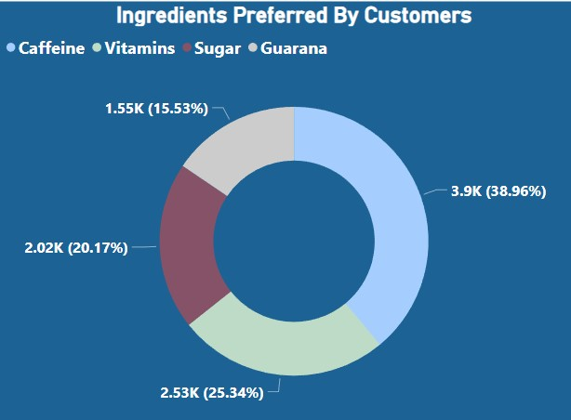
What ingredients customer want ?
Around 40% of the people prefer caffeine as the primary ingredient.
Also 25% of the respondents prefer vitamins.
It is evident that customers use energy drinks to combat fatigue and increase energy for some physical or mental activity
And for all those reasons they predominantly prefer caffeine
Notes:
Now lets look at some changes / betterment customer want to see in the current market

Slide 12
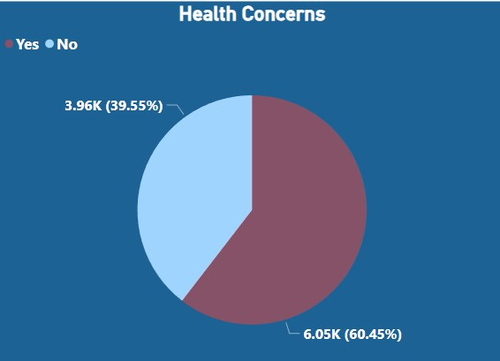
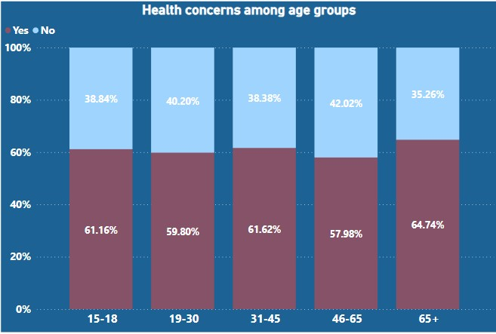
Concerns & Improvements Desired By Customers
Nearly 60% people have health concerns
Maybe due to high sugar content and preservatives of the drinks usually available in the market.
Notes:
and interestingly health concerns are not only in the age group(31-65) which considers these drinks dangerous but everyone , this is maybe due to high sugar content of the energy drinks available in the market.
This trend is also due to the fact that when asked specifically people become more conscious about it , although they consume it regularly.

Slide 13
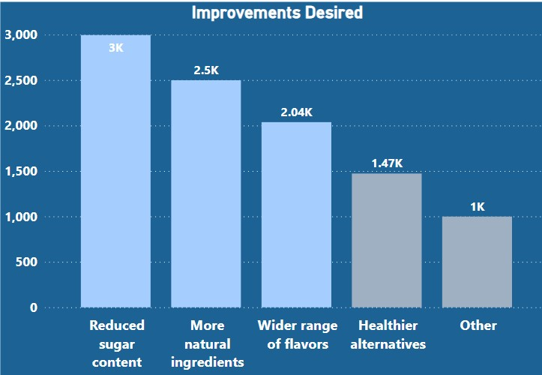
Nearly 70% People want improvements to make drinks healthier.

Slide 14
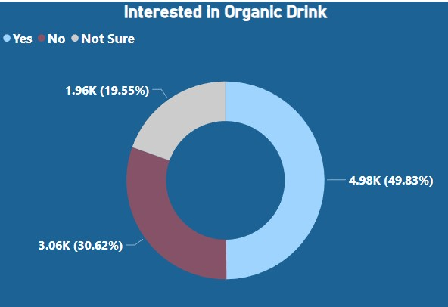
Half of the respondents exhibit an interest in organic drinks
Notes:
Further confirms our hypothysis.

Slide 15
Key Insights
People in the older age group and some women have a negative perception for energy drinks although their consumption habits are same.
People use energy drinks to combat fatigue and increase energy for physical or mental activity and they predominantly prefer caffeine for this.
A lot of people regardless of consumption habits are concerned about health impacts of energy drinks and desire improvement such as reduced sugar content, more natural ingredients.
People are also interested in organic drinks.
Recommendations:
Based upon the following insights we can devise 2 product lines. By catering to two distinct segments with different preferences, we can capture a wider market share.

Slide 16
1. Caffeine-rich Energy Drink for Young People: Focus on formulating drinks with a higher caffeine content to provide the desired energy boost. However, keep the sugar content low and minimize the use of artificial preservatives to address the health concerns of this demographic.
Position these drinks as a healthier alternative to traditional energy drinks, emphasizing their ability to provide sustained energy without compromising on Taste & Health
2. To tap into the growing interest in organic products, consider introducing an organic energy drink line. Use natural and organic ingredients in the formulation and clearly communicate the organic certification and benefits of the product. These drinks can be targeted towards older age groups who have a negative perception towards energy drinks.

Slide 17
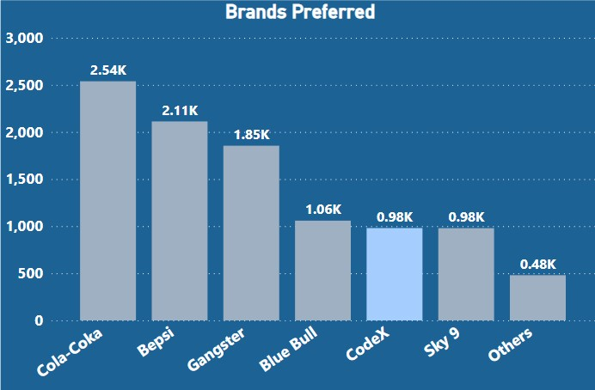
Section 2: The Competition
Out of all the respondents around 10% (1k) people prefer CodeX
Notes:
Let us now see why do people prefer these brands?

Slide 18
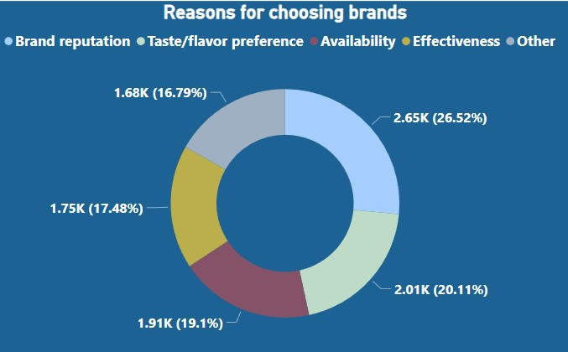
Brand reputation plays a significant role in influencing people's purchasing decision(26%)
Availability and taste also hold considerable importance.
Notes:
While branding remains crucial, ensuring a strong distribution network and delivering products with excellent taste are equally vital components for success in the market.

Slide 19
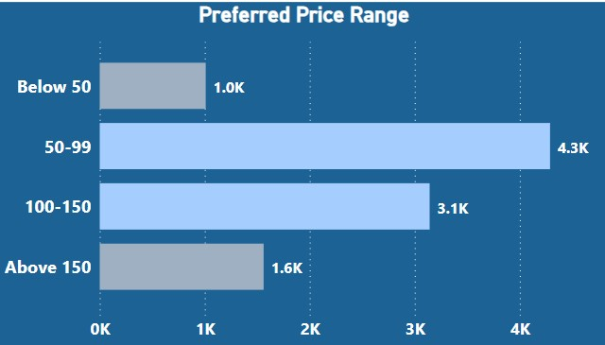
Section 3: The Pricing, Packaging & Distribution
43% of respondents prefer energy drink prices between 50-99,
30 % prefer prices between 100-150.
For the caffeine-rich energy drink line targeting young people, pricing can be (80-100).
Pricing for the organic drink line, aimed at older individuals, can be set higher (130-150).

Slide 20
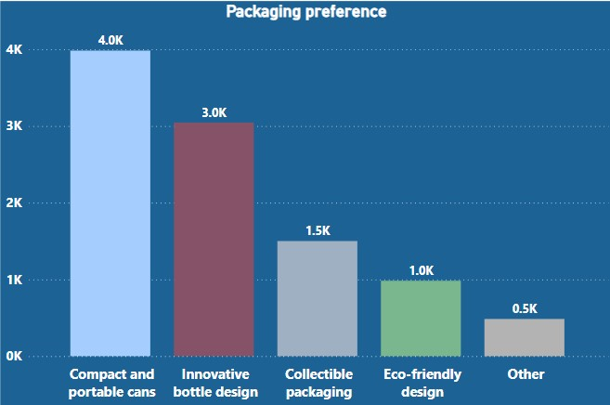
People show interest in both cans and bottle types of packaging.
We can Package the caffeine-rich energy drinks in cans, as it aligns with the traditional and familiar image of energy drinks
For the organic energy drinks, leverage innovative bottle designs to emphasize their unique positioning and premium qualities.
Notes:
. Cans are commonly associated with energy drinks and convey a sense of energy and vitality.

Slide 21
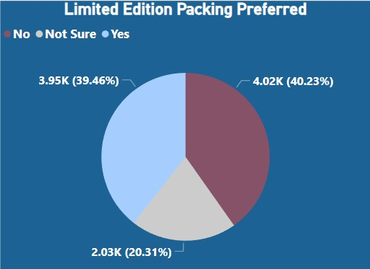
Limited edition packaging is not recommended as the responses point out its not worth investing.

Slide 22
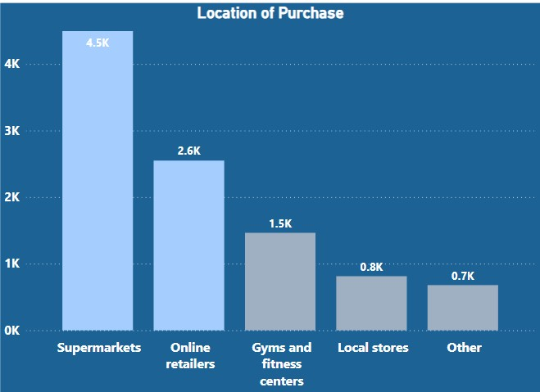
Location For Purchase
A majority of energy drink purchases, approximately 71 %, are made through two primary channels: 45% through supermarkets and 26% through online channels.
Gyms account for 15% of the purchases.
Establish strong partnerships with various supermarket chains.
Have robust online presence and efficient e-commerce capabilities.
Notes:
It is essential to establish strong partnerships with various supermarket chains. Things like Negotiating favorable shelf space, prominent product placement can help maximize visibility and availability in these retail outlets.

Slide 23
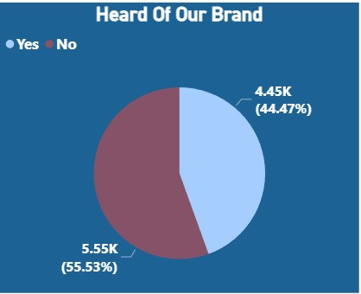
Section 3: Marketing Channels
Around 45 % people have heard about our brand .
Notes:
Let us see futher the efficiency of different marketing channels and what age groups they reach better

Slide 24
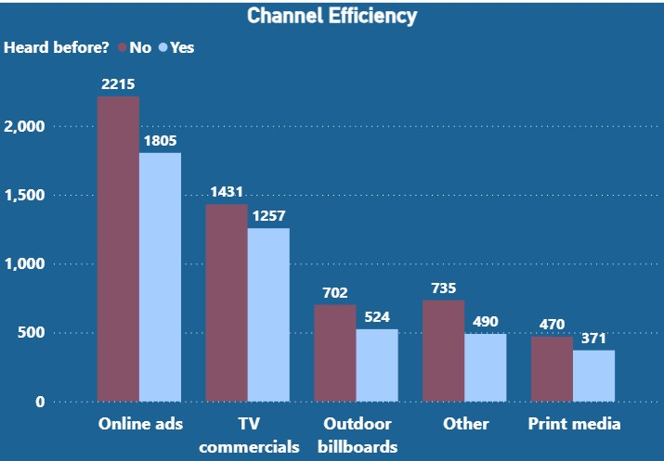
Each marketing channel has equal efficiency in terms of the people that have heard about us.
Notes:
Each channel is equally efficient

Slide 25
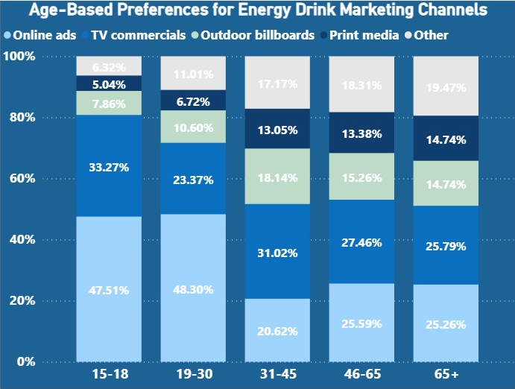
Marketing Channels & Age Groups
Online channels are a very effective means of reaching young people
We should focus on this channel to market caffeine rich energy drinks .
Organic drinks line can be promoted more on TV commercials and billboards near supermarkets.

Slide 26
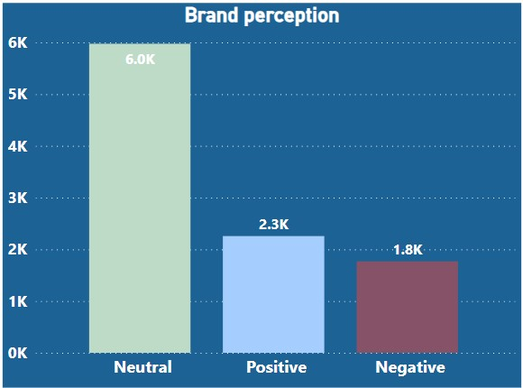
Section E: Brand Perception & Experience
60% respondents hold a neutral perception towards the energy drink's name, logo, and design.
A significant portion, 23%, express a positive perception.
Notes:
We can work on these things more , further branding also influences people’s perception to a great degree.

Slide 27
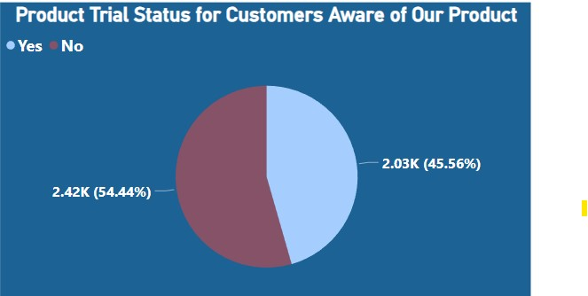
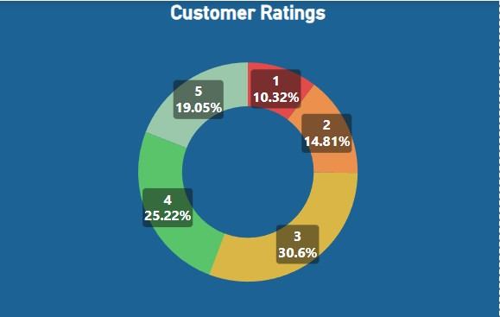
Product Experience
Out of the 45% people that have heard about our product nearly 2k of them have tried i.e. 20% of the total respondents.
Out of the people who have tried majority of them finds the drink good with a rating of 3 or 3+ by 75 % of the people.
Notes:
Only around 45% people had heard about our product . Out of those 45%

Slide 28
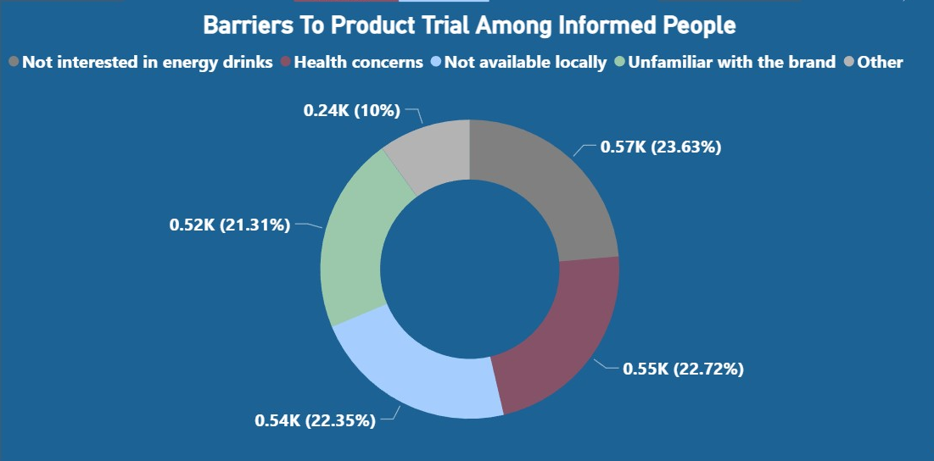
Health concerns is a reason for 22% of the respondents for not trying.
Availability is a big reason for not trying the product among informed customers (22%)
Notes:
We should work on distribution channels as discussed previously focusing on supermarkets and online channels.
We are already addressing the health concerns with our product and marketing
A gray area , maybe they have heard, here and there and not trying nor maybe they lied about the reaons

Slide 29
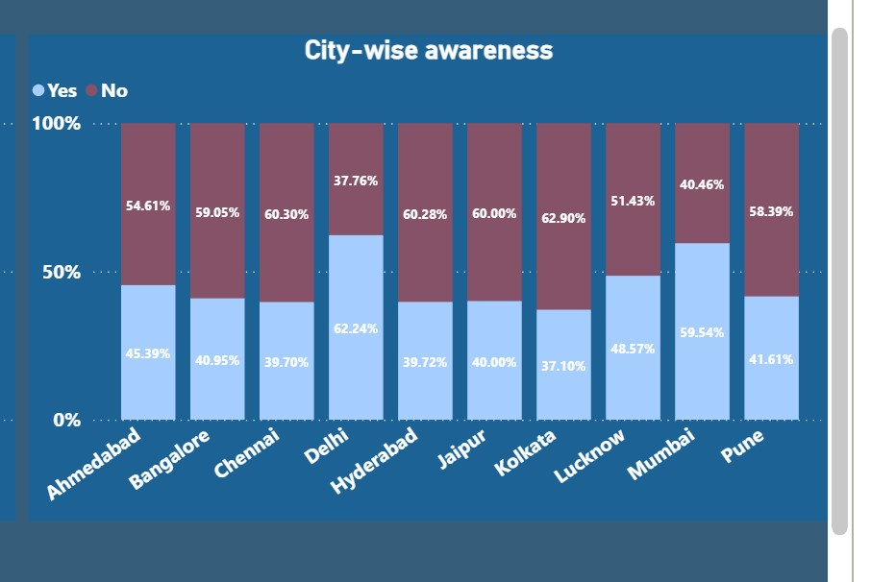
Which cities we need to focus more?
Across almost all cities, approximately 40% of the population is aware of our brand
Mumbai and Delhi stand out with higher brand awareness
Lucknow also exhibits a relatively high brand awareness.

Slide 30
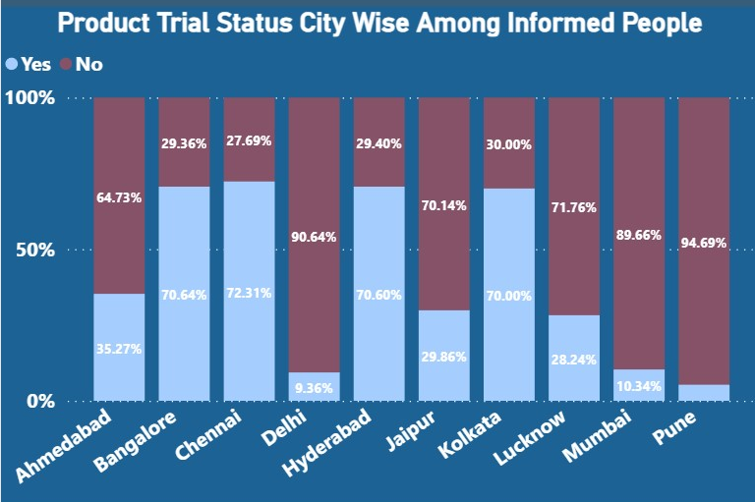
In Pune, a significant number of individuals have not yet tried our brand.
Despite the highest brand awareness in Delhi , Mumbai and Lucknow conversion to trial is comparatively low.
Further investigation is needed to identify potential issues related to distribution and promotions in these cities.

Slide 31
5-Point Action Plan
1. Introduce Caffeine-rich Energy Drinks for Young People:
Emphasize higher caffeine content for physical or mental work without sacrificing health considerations.
Address health concerns by reducing sugar content and using more natural ingredients.
Price it around 80-100
Market it using a sports person who is also known to be health conscious like Virat Kohli.
2. Introduce an organic energy drink line with natural and organic ingredients:
Communicate organic certification and benefits to attract health-conscious consumers.
Price it around 130-150
Market it using a celebrity who has more appeal to older people & known to be health conscious like Shilpa Shetty.
3. Branding and Packaging:
- Use cans for caffeine-rich energy drinks to align with the energy drink image.
Explore innovative bottle designs for organic energy drinks, emphasizing premium qualities.

Slide 32
4. Marketing and Promotion:
- Tailor marketing campaigns to reach target audiences through relevant channels.
Leverage digital platforms, influencers to engage with young people.
Use Tv Channels & Billboards to reach older audience.
5. Focus on marketing & distribution
- Provide transparent information about nutritional value, caffeine content, and benefits.
- Address concerns and misconceptions about through marketing
-Focus on distribution channels(supermarket chains and online)
Implementing these strategies will result in a substantial increase in sales and a significant expansion of our customer base.
By targeting health-conscious consumers with organic drinks, we can capture market segments that have untapped potential.
And by providing healthier alternative we can establish a unique position in the traditional competitive energy drinks market

Slide 33
Thank You !
Attributes:
Photo of energy Drink from freepik.com

