Slide 1
Programming Course Python
Elia Rühle & Anna Bothin

Slide 2
Contact
Contact
Anna: anna-maria.bothin@mailbox.tu-dresden.de
Elia: elia.ruehle@mailbox.tu-dresden.de

Slide 3
Unit 1- Introduction and Installation
General information
Why Python
Installation
Working with Python

Slide 4
general information
widely used in:
web developement
DataScience
MachineLearning
Scripting Language
Interpreter
slower
dynamically typed
reduced Syntax – close to the english language

Slide 5
Why Python?
directly, uncomplicated
perfect for fast Prototyping
beginner friendliy
easy to learn
easy but powerful

Slide 6
Installation

Slide 7
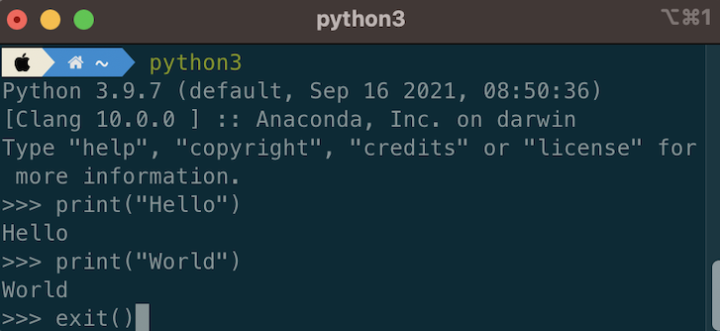
Working with Python
how to write and execute code:
interactive mode
write code directly on commandline
start | Use & execute | end
execute python or python3 in your terminal | Write code+ Enter | exit() + Enter

Slide 8
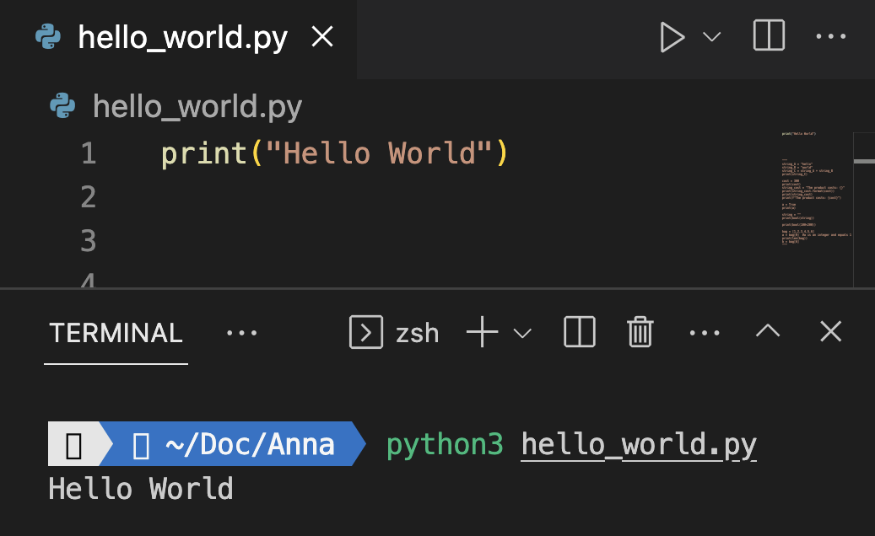
Working with Python
how to write and execute code:
interactive mode
executing files
write code in an IDE/ Editor
save it as a .py file
execute file in your Terminal:
write | execute
In your IDE | navigate to the directory whrer the file is saved execute python3 + file_name.py

Slide 9
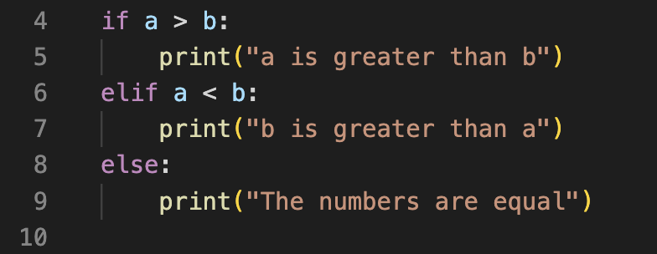
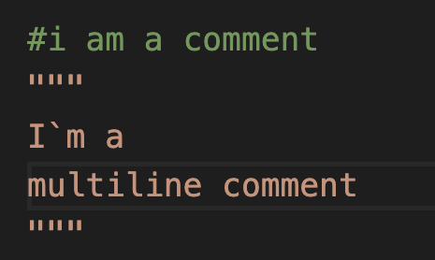
Working with Python
how to write and execute code:
interactive mode
executing files
syntax
indention to structure controll flow
comments
naming variables (A-z, 0-9, case-sensitive)
Pascal-Case: SomeUselessVariable
Camel-Case: someUselessVariable
Snake-Case: some_useless_variable

Slide 10
Python Doctumentation
https://docs.python.org/3/tutorial/interpreter.html
https://docs.python.org/3/tutorial/introduction.html

