Slide 1
Programming Course Python
Elia Rühle & Anna Bothin

Slide 2
Contact
Contact
Anna: anna-maria.bothin@mailbox.tu-dresden.de
Elia: elia.ruehle@mailbox.tu-dresden.de

Slide 3
Unit 2- Types & Collections
simple data types
collections
lists
tuple
sets
dictionaries

Slide 4
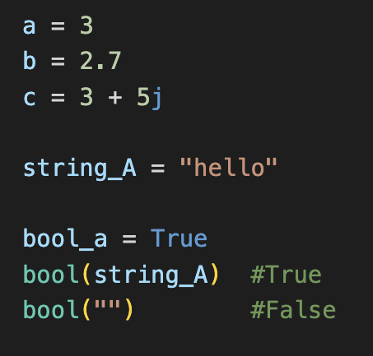
Simple Types
numeric types
Integer
Float
Complex
texts – String
boolean
True
False

Slide 5
Collections
 | Liste | Tupel | Set | Dictionary
Mutable? | ✅ | ❌ | ❌ | ✅
Duplicates? | ✅ | ✅ | ❌
Ordered? | ✅ | ✅ | ❌ | ✅ (seit 3.7)
Keys? | ❌ | ❌ | ❌ | ✅
 | list = [ ] | tuple = ( ) | set = { } | dict = {a:b}

Slide 6
Methods on lists
append( element )
insert( index, element)
extend( iterable )
remove( element )
pop( index )
count( element )
clear()
reverse()
sort()

Slide 7
Methods on Sets
add( element )
remove(element)
discard( element )
diference( set )
clear()
update( set )

Slide 8
Methods on Dictionaries
get( key )
keys() update( {key : value} )
pop( key )
items( )
clear( )
values( )

Slide 9
Exercises - Numbers
Write a programm that adds up two numbers and displays the result. Try to mix up integer and floating point numbers. What type is the result of?
Write a programm that adds two floating point numbers and displays the result as an integer. Try to round up or down explicitly. (Research for the functions or packages you need)

Slide 10
Exercises - Strings
Write a program that concatenates two strings and displays them. What happens if you calculate string1 += string2 and display it?
Define yourself a string and try out what the functions count(), find(), split(), upper(), lower() do!

Slide 11
Exercises - Lists
Write a list and add all the modules you are taking this semester. After that, output the last module you added to the list. Also display the number of all list items.
Create a list with items of at least 4 different data types. Output the type for 2 list elements. How can you access list elements?

Slide 12
Exercises - Tuples
Create a tuple with 3 entries and try to change one of them. Is this possible? What does the interpreter output?
Now create a tuple without initializing it with values, how can this be done?

Slide 13
Exercises - Sets
Try to create a set from a new or existing list. What is the difference between lists and sets?
Output the number of entries of the set, then add an element that already exists (research how to do this) and give the length again, what happens? Now add a new element, what do you observe now?

Slide 14
Exercises - Dictionaries
First, create an empty dictionary (What 2 methods can be used for this? Is there one that is "nicer"?). Then, add 5 lectures and the professor who holds them. For 2 lectures, indicate by which professor they are held.
A lecture can now be held by more than one professor. Change the dictionary accordingly, which data structure is suitable for storing several lectures?
(Addition:) Find out how to display all keys and all values of an existing dictionary and test it on your own example.

Slide 15
Python Documentation
https://docs.python.org/3/library/stdtypes.html

