Slide 1
Programming Course Python
Elia Rühle & Anna Bothin

Slide 2
Contact
Contact
Anna: anna-maria.bothin@mailbox.tu-dresden.de
Elia: elia.ruehle@mailbox.tu-dresden.de

Slide 3
Unit 2- Types & Collections
simple data types
collections
lists
tuple
sets
dictionaries

Slide 4
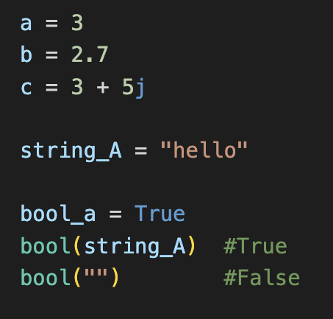
Simple Types
numeric types
Integer
Float
Complex
texts – String
boolean
True
False

Slide 5
Collections
 | Liste | Tupel | Set | Dictionary
Mutable? | ✅ | ❌ | ❌ | ✅
Duplicates? | ✅ | ✅ | ❌
Ordered? | ✅ | ✅ | ❌ | ✅ (seit 3.7)
Keys? | ❌ | ❌ | ❌ | ✅
 | list = [ ] | tuple = ( ) | set = { } | dict = {a:b}

Slide 6
Methods on lists
append( element )
insert( index, element)
extend( iterable )
remove( element )
pop( index )
count( element )
clear()
reverse()
sort()

Slide 7
Methods on Sets
add( element )
remove(element)
discard( element )
diference( set )
clear()
update( set )

Slide 8
Methods on Dictionaries
get( key )
keys() update( {key : value} )
pop( key )
items( )
clear( )
values( )

Slide 9
Python Documentation
https://docs.python.org/3/library/stdtypes.html

