Slide 1
Programming Course Python
Elia Rühle & Anna Bothin

Slide 2
Contact
Anna: anna-maria.bothin@mailbox.tu-dresden.de
Elia: elia.ruehle@mailbox.tu-dresden.de

Slide 3
Unit 3 – Control Flow: Statements & Functions
Statements
IF – Statements
Loops:
WHILE- Statement
FOR- Statement
MATCH- Statement
Functions

Slide 4
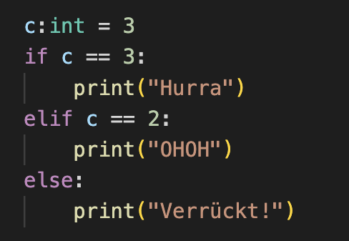
IF- Statement
conditional execution of code
possible to set alternate code
if condition :
statement
elif condition :
statement
else :
statement

Slide 5
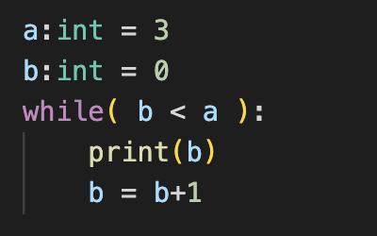
LOOPS – WHILE-Statement
repeated code execution
depending on a condition
break
ends whole while-loop
continue
ends current loop run
while condition :
statement

Slide 6
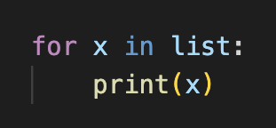
LOOPS – FOR-Statement
iteration over a collection
break
ends whole while-loop
continue
ends current loop run
for x in iterable :
statement

Slide 7
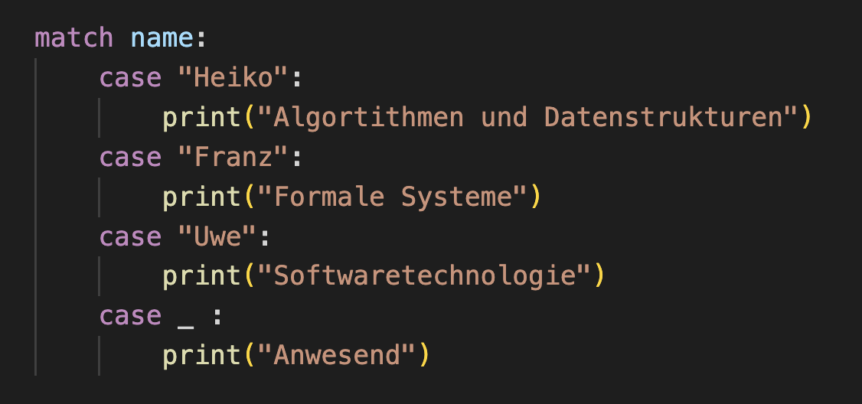
MATCH-Statement
selective code execution
depending on value of a variable
match variable :
case case1 :
statement1
case case2 :
statement2
…

Slide 8
Functions
outsourcing of code to reuse it
only runs when called
def function_name( parameter1,… ) :
statements
return
function_name (argument1,…)

Slide 9
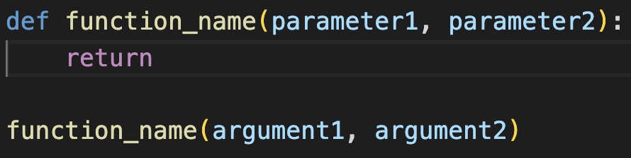
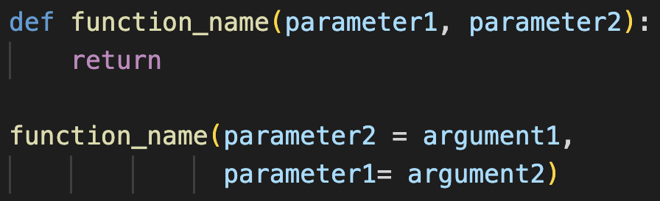
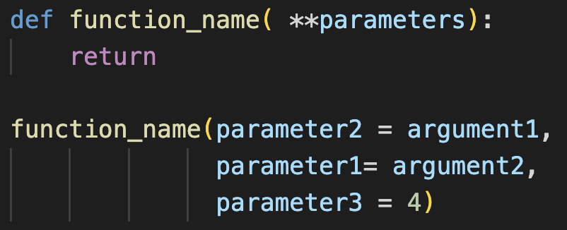
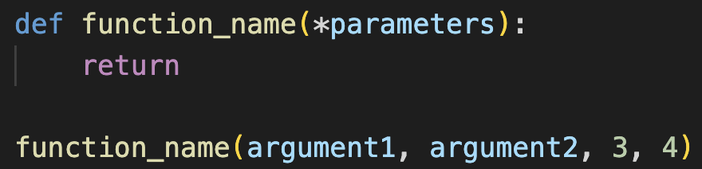
Functions
 |  | Identifikation der Parameter durch
 |  | sequence | name of parameters
Number of Parameters | known
 | unknown | = tuple of parameters | =dictionary of parameters

Slide 10
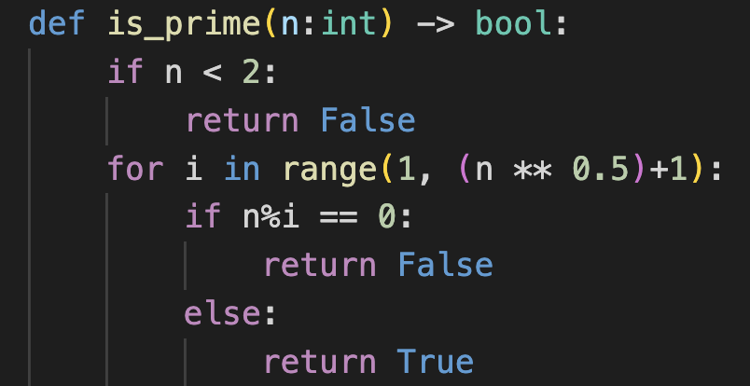
Exercises
Create a list with at least 5 strings. Iterate over the list and append "!" to each string element. Then print the list.
Create a list of integer/float values. Calculate the mean value of the elements in the list and output it. Caste the mean to an integer and check if the resulting value is even or odd.
Use the "match" statement and write a program that checks whether a given integer value is even or odd. Depending on the case, a corresponding string should be output.
Write a program which outputs the first
100 prime numbers.
You can use the following function:

Slide 11
Exercises
Write a function which gets a string as argument and judges for it whether it is a palindrome. e.g. the function should return True for "Anna" and False for "Elia".
Implement a linear search. In a linear search, an array of values is searched for a specific value. When the searched value is found, return the index where the value is located. Hint: The function enumerate() can help, what does it do?
Addition - (hard) Research how binary search works. Implement a function that searches the list [2,1,5,6,3,8,9,3,2,5,6,1] and returns the index where element 6 appears. What are requirements for the list before starting the search?

Slide 12
Python Documentation
https://docs.python.org/3/tutorial/controlflow.html

