Slide 1
ANALYSIS OF DIFFERENT TEXT SUMMARIZATION APPROACHES
ANANYA MUKHERJEE
UNIVERSITY ROLL NO. - 10400317204
SONAKSHI KUMARI
UNIVERSITY ROLL NO. - 10400317083
Under the supervision of prof. SOMA DAS

Slide 2
INTRODUCTION
Natural Language processing(NLP) is a subfield of Artificial Intelligence that gives machines the ability to read, understand and derive meaning from human language. Text summarization is one of those applications of Natural Language Processing (NLP) which is bound to have a huge impact on our lives. This is an incipient practice for verdict out the summary of the text article. In this digital era, people do not have much time to go through the whole textual data. Reduction of text is also a very complex problem.

Slide 3
PROBLEM STATEMENT
There are different text summarization algorithms. Here we will discuss and implement few of them and try to find out the best suitable algorithm for different contexts.

Slide 4
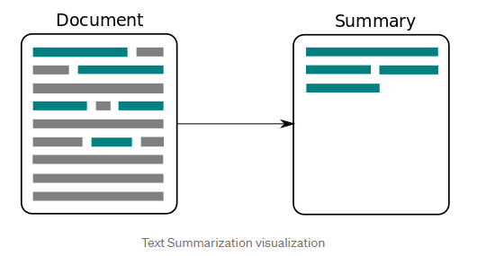
What is text summarization
Text summarization means to covert a large body of text(i.e. news article) to a few sentences without losing the key theme of the texts.

Slide 5
FORMS OF TEXT SUMMARIZATION
There are two different forms:-
Extractive Summarization: These methods rely on extracting several parts, such as phrases and sentences, from a piece of text and stack them together to create a summary. Therefore, identifying the right sentences for summarization is of utmost importance in an extractive method. No new text is generated in this approach.
Abstractive Summarization: These methods use advanced NLP techniques to generate an entirely new summary. Some parts of this summary may not even appear in the original text.

Slide 6
APPROACH OVERVIEW
Basically, there are three fairly independent tasks which all summarizer perform, as listed below. Here, we will look at different abstractive topic presentation approaches.
1.
Construct an intermediate representation of the input text which expresses the main aspects of the text.
2.
Score the sentences based on the representation.
3.
Select a summary comprising of several sentences.

Slide 7
Different approaches
Sentence Scoring based on Word Frequency
This is the simplest of all approaches. After preprocessing the text, we assign weights to each word based on the frequency of the word in the passage. For example, if “Soccer” occurs 4 times within the passage, it will have a weight of 4. using the weights assigned to each word, we will create a score for each sentence. To create the summary, we will take all the sentence that has a score that exceeds a threshold.

Slide 8
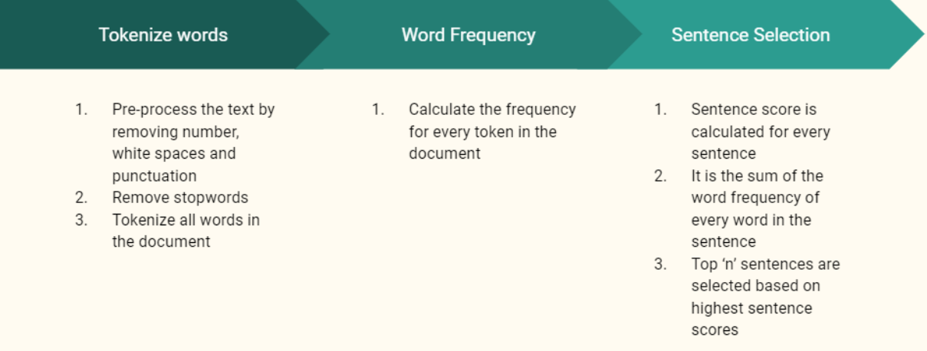

Slide 9
TextRank using Universal Sentence Embeddings
TextRank
This is a derivative of the famous PageRank created by the Google Cofounders. In PageRank, they generated a matrix that calculates the probability that a user will move from one page to another. In the case of TextRank, we generate a cosine similarity matrix where we have the similarity of each sentence to each other. The similarity matrix is then converted into a graph, with sentences as vertices and similarity scores as edges, for sentence rank calculation. The PageRank algorithm is then applied to this graph to evaluate the importance of each sentence. The top N sentences will then be used to generate the summary

Slide 10
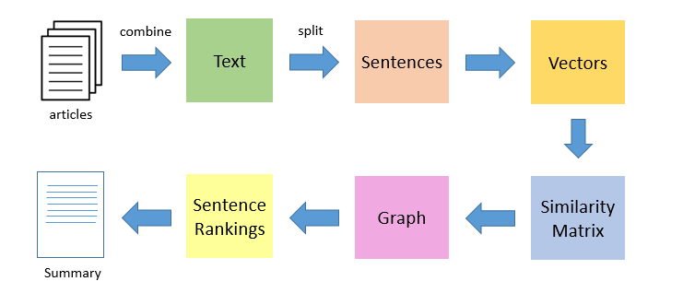

Slide 11

Unsupervised Learning using Skip Thought Vectors
3. Skip Thought Vectors
Here is the overall pipeline of this method

Slide 12
PROCEDURE
Here We use an encoder/decoder framework to generate feature vectors.
Encoder Network: The encoder is typically a GRU-RNN which generates a fixed length vector representation h(i) for each sentence S(i) in the input. The encoded representation h(i) is obtained by passing final hidden state of the GRU cell (i.e. after it has seen the entire sentence) to multiple dense layers.
Decoder Network: The decoder network takes this vector representation h(i) as input and tries to generate two sentences — S(i-1) and S(i+1), which could occur before and after the input sentence respectively. Separate decoders are implemented for generation of previous and next sentences, both being GRU-RNNs. The vector representation h(i) acts as the initial hidden state for the GRUs of the decoder networks.

Slide 13
K-Means Clustering
Similar to how Word2Vec embeddings are trained by predicting the surrounding words, the Skip Thought Vectors are trained by predicting surrounding sentences. As this model is trained, the learned representation (hidden layer) will now place similar sentences closer together which enables more semantically cohesive clustering.
As we are aware, each cluster will have some center point which, in the vector space, would indicate the point which closely represents the theme of that cluster. With this in mind, when trying to create a summary, we should only need the sentence which is the closest to the center of that cluster. The key here is choosing the correct number of clusters to do a good job of summarizing the content. we calculate the cluster size by taking 30% or more of the number of sentences depending on use case.

Slide 14
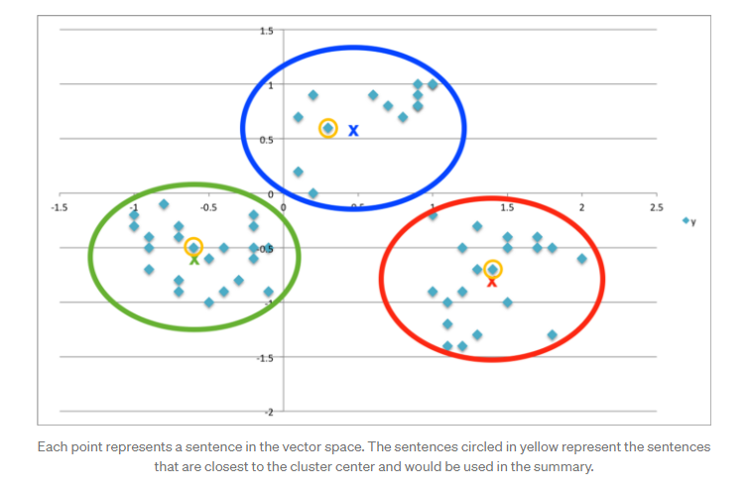

Slide 15
Input: SUMMARY
This was the summary that was fed to three different approaches:-
“If Cristiano Ronaldo didn’t exist, would Lionel Messi have to invent him? The question of how much these two other-worldly players inspire each other is an interesting one, and it’s tempting to imagine Messi sitting at home on Tuesday night, watching Ronaldo destroying Atletico, angrily glaring at the TV screen and growling: “Right, I’ll show him!” As appealing as that picture might be, however, it is probably a false one — from Messi’s perspective, at least he might show it in a different way, but Messi is just as competitive as Ronaldo. Rather than goals and personal glory, however, the Argentine’s personal drug is trophies. Ronaldo, it can be said, never looks happy on the field of play unless he’s just scored a goal — and even then he’s not happy for long, because he just wants to score another one. And that relentless obsession with finding the back of the net has undoubtedly played a major role in his stunning career achievements . Messi , though, is a different animal, shown by the generosity with which he sets up team-mates even if he has a chance to shoot, regularly hands over penalty-taking duties to others and invariably celebrates a goal by turning straight to the player who passed him the ball with an appreciative smile. Rather than being a better player than Ronaldo, Messi’s main motivations — according to the people who are close to him — are being the best possible version of Lionel Messi, and winning as many trophies as possible. That theory was supported by Leicester boss Brendan Rodgers when I interviewed him for a book I recently wrote about Messi.Do Messi and Ronaldo inspire each other? “Maybe subconsciously in some way they’ve driven each other on,” said Rodgers. “But I think both those players inherently have that hunger to be the best players they can be. With the very elite performers, that drive comes from within.” Messi and Ronaldo ferociously competing with each other for everyone else’s acclaim is a nice story for fans to debate and the media to spread, but it’s probably not particularly true.”

Slide 16
Output:SUMMARY COMPARISON
Sentence scoring based on word-frequency
The summary that came as output was:-
“If Cristiano Ronaldo didn't exist, would Lionel Messi have to invent him? As appealing as that picture might be, however, it is probably a false one - from Messi's perspective, at least. He might show it in a different way, but Messi is just as competitive as Ronaldo. Rather than goals and personal glory, however, the Argentine's personal drug is trophies. Do Messi and Ronaldo inspire each other? "Maybe subconsciously in some way they've driven each other on," said Rodgers. With the very elite performers, that drive comes from within."

Slide 17
1. Sentence scoring based on word-frequency
Now, although the sentence scoring method performs quite well, there are inherent issues that come with a method that is heavily reliant on the vocabulary in the article. A common issue here is that words that are semantically identical, are not being leveraged separately in our “word_freq” dictionary. For example, in the current approach, the terms person and people would be counted separately when they should considered the same term. This is why we shift to semantic embeddings to overcome this fact.

Slide 18
Output : SUMMARY COMPARISON
2. TextRank using Universal Sentence Encoder
The output that came in this approach was:-
"He might show it in a different way, but Messi is just as competitive as Ronaldo. Ronaldo, it can be said, never looks happy on the field of play unless he has / he is just scored a goal - and even then he has / he is not happy for long, because he just wants to score another one. Rather than being a better player than Ronaldo, Messi's main motivations - according to the people who are close tohim - are being the best possible version of Lionel Messi, and winning as many trophies as possible. Do Messi and Ronaldo inspire each other? Messi and Ronaldo ferociously competing with each other for everyone else's acclaim is a nice story for fans to debate and the media to spread, but it has / it is probably not particularly true."

Slide 19
2. TextRank using Universal Sentence Encoder
The TextRank approach also performs well but doesn’t highlight both Messi and Ronaldo’s personality. Perhaps the Universal Sentence Embeddings aren’t properly capturing sentence level feature which in turn would impact the cosine similarities and the graphs generated. This still needs to be explored further.

Slide 20
Output : SUMMARY COMPARISON
3. Unsupervised Learning using Skip-Thought Vectors
The output summary of this approach was:-
'Do Messi and Ronaldo inspire each other? Ronaldo, it can be said, never looks happy on the field of play unless he has / he is just scored a goal - and even then he has / he is not happy for long, because he just wants to score another one. Rather than being a better player than Ronaldo, Messi's main motivations - according to the people who are close to him - are being the best possible version of Lionel Messi, and winning as many trophies as possible. That theory was supported by Leicester boss Brendan Rodgers when I interviewed him for a book I recently wrote about Messi. With the very elite performers, that drive comes from within. But I think both those players inherently have that hunger to be the best players they can be.'

Slide 21
3. Unsupervised Learning using Skip-Thought Vectors
Unsupervised learning approach using skipthought vectors provides the best summary as it closely resembles a human summary. In particular, it provides content regarding both Messi and Ronaldo’s personalities where the other approaches focus on Messi’s perspective.

Slide 22

CONCLUSION
Till now the unsupervised learning approach using skipthought vectors provides the best summary.

Slide 23
Thank you...

