Slide 1
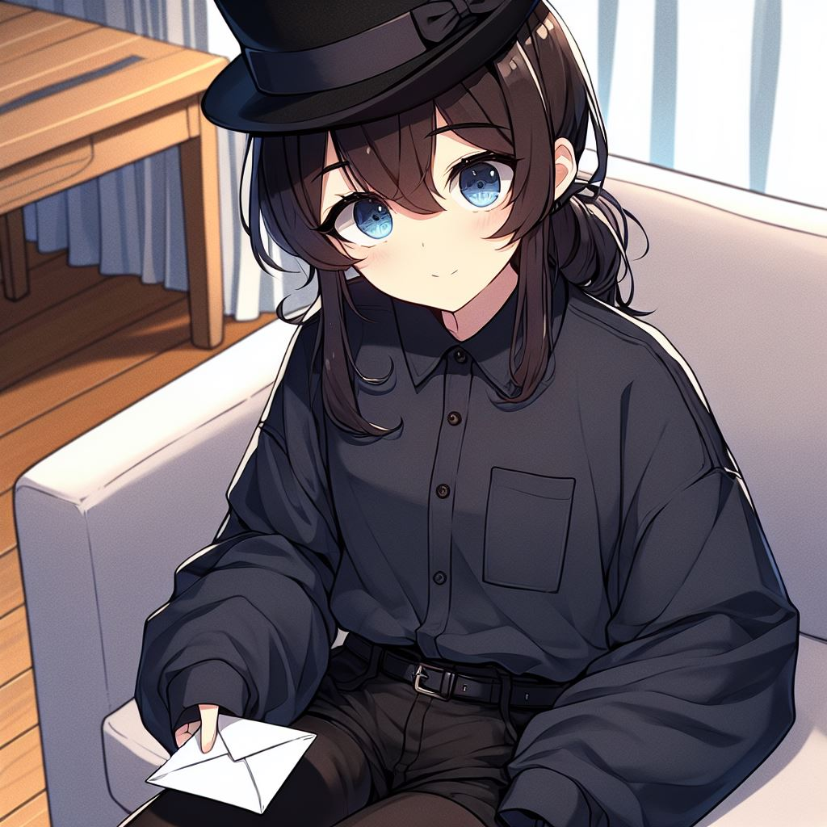
目標
Notes:
我收到一封信。是小阿尼斯城（Tiny Anis）的藝術節邀請，說明會在後天。
please draw a picture: A dark blue-eyed girl with low twintails brown hair, wearing a black top hat, and wearing a dark blue high collar long sleeve shirt and black pants. Sitting in the couch in the living room, holding a envelope with her hand. The scene is in a Japanese anime style.

Slide 2
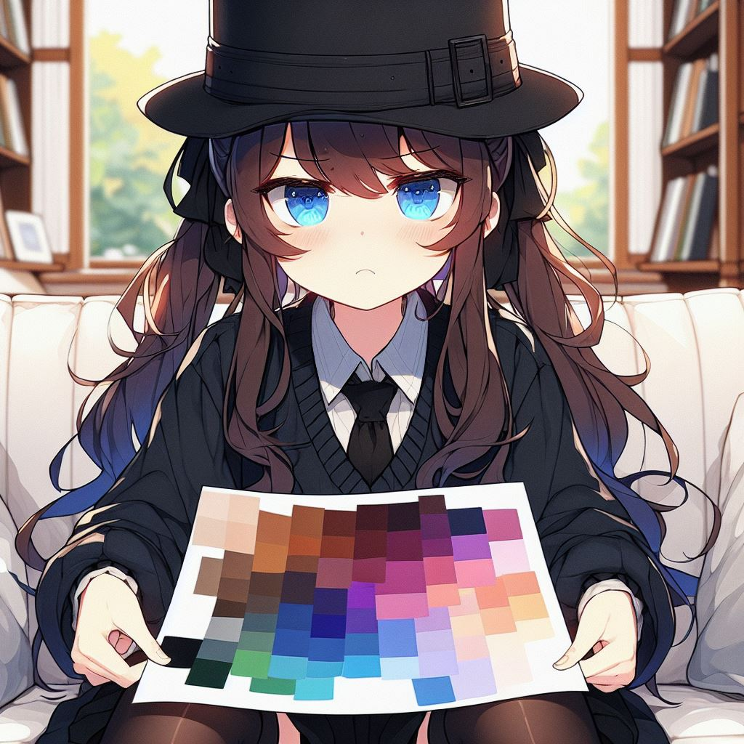
阻礙
Notes:
我從沒聽過小阿尼斯城。而且這傳單的美術設計很怪異，我有種不好的感覺。
Please draw this picture: A dark blue-eyed girl with low-pigtails brown hair, wearing a black top hat, and wearing a dark blue high collar long sleeve thick shirt and black pants, frowning. Sitting in the couch in the living room, holding a paper with many blending colors in her hand. The scene is in a Japanese anime style.

Slide 3
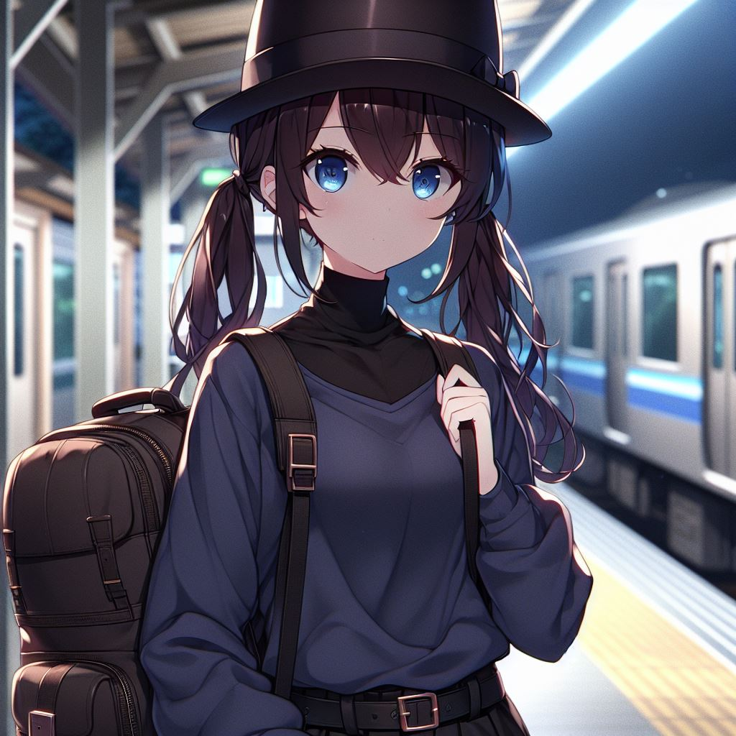
努力
Notes:
但我最近才剛結束一場大型表演，想創造些新舞步，也許這座城市能給我靈感。所以，我決定去聽說明會，順便看看小阿尼斯城。
Please draw this picture: A dark blue-eyed 16 year-old girl with low-pigtails brown hair, wearing a black top hat, and wearing a dark blue high collar long sleeve thick shirt and black pants. Standing in the train station at night carrying a big backpack. The scene is in a Japanese anime style.

Slide 4
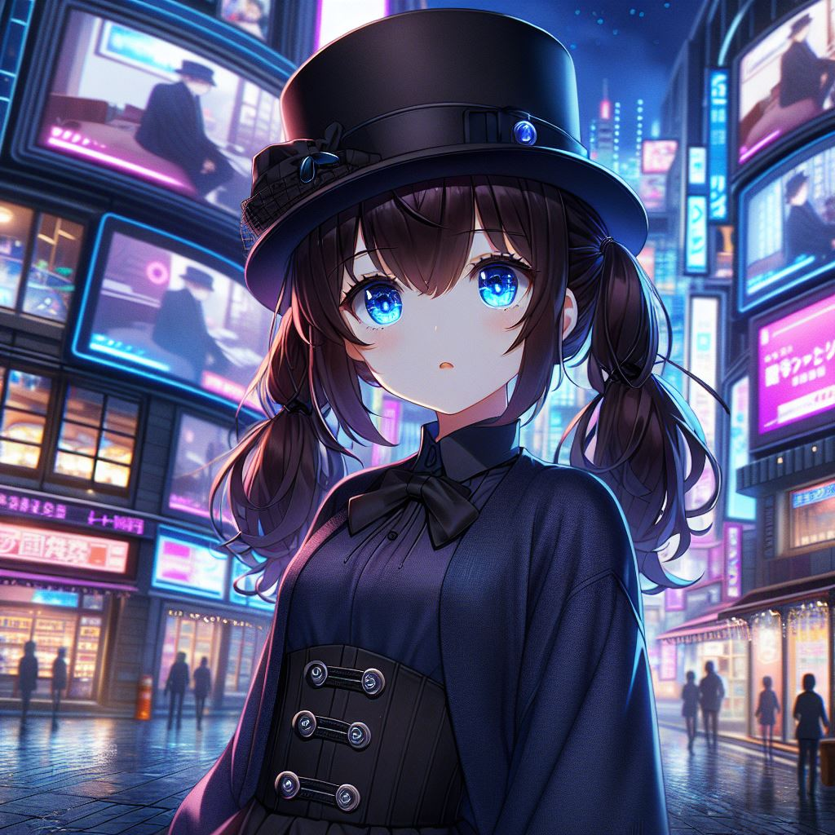
結果
Notes:
我晚上到。這座城市的風格很高科技，到處都是播著廣告的電視機。
Please draw this picture: A dark blue-eyed 16 year-old girl with low-pigtails brown hair, wearing a black top hat, and wearing a dark blue high collar long sleeve thick shirt and black pants. Standing in the high-tech city at night with many TV playing advertisement. The scene is in a Japanese anime style.

Slide 5
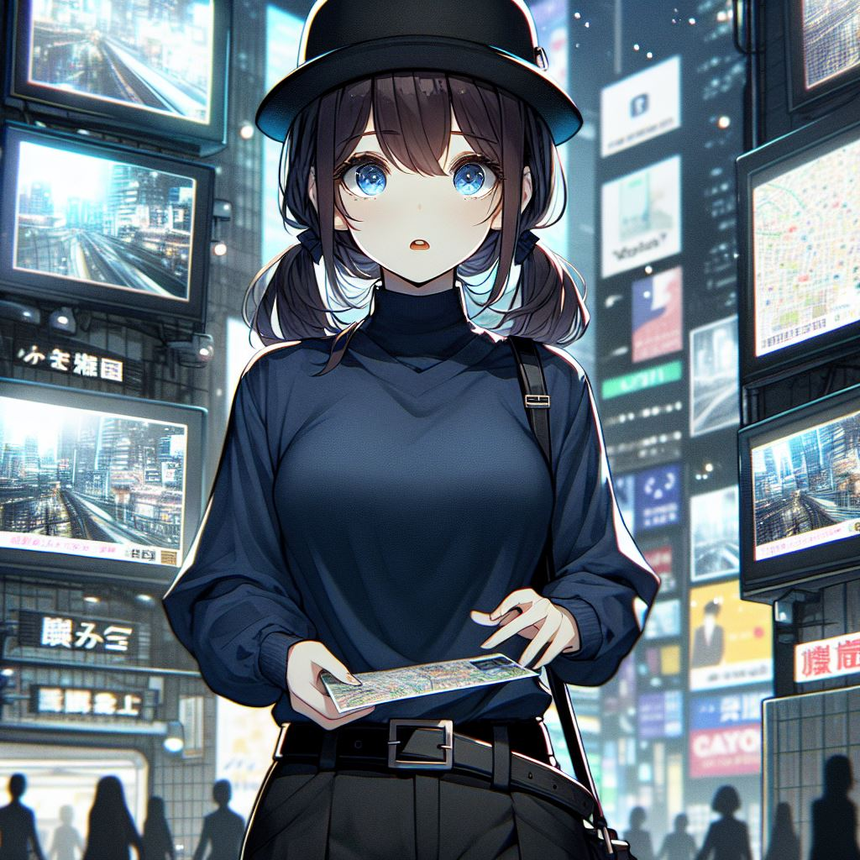
意外
Notes:
我看不懂傳單上的地圖，只知道我要去「資料處理中心」，位在城市中央。我決定問路。
Please draw this picture: A dark blue-eyed 16 year-old girl with low-pigtails brown hair, wearing a black top hat, and wearing a dark blue high collar long sleeve thick shirt and black pants. Standing in the high-tech city at night with many TV playing advertisement. Holding a Map and confusing. The scene is in a Japanese anime style.

Slide 6
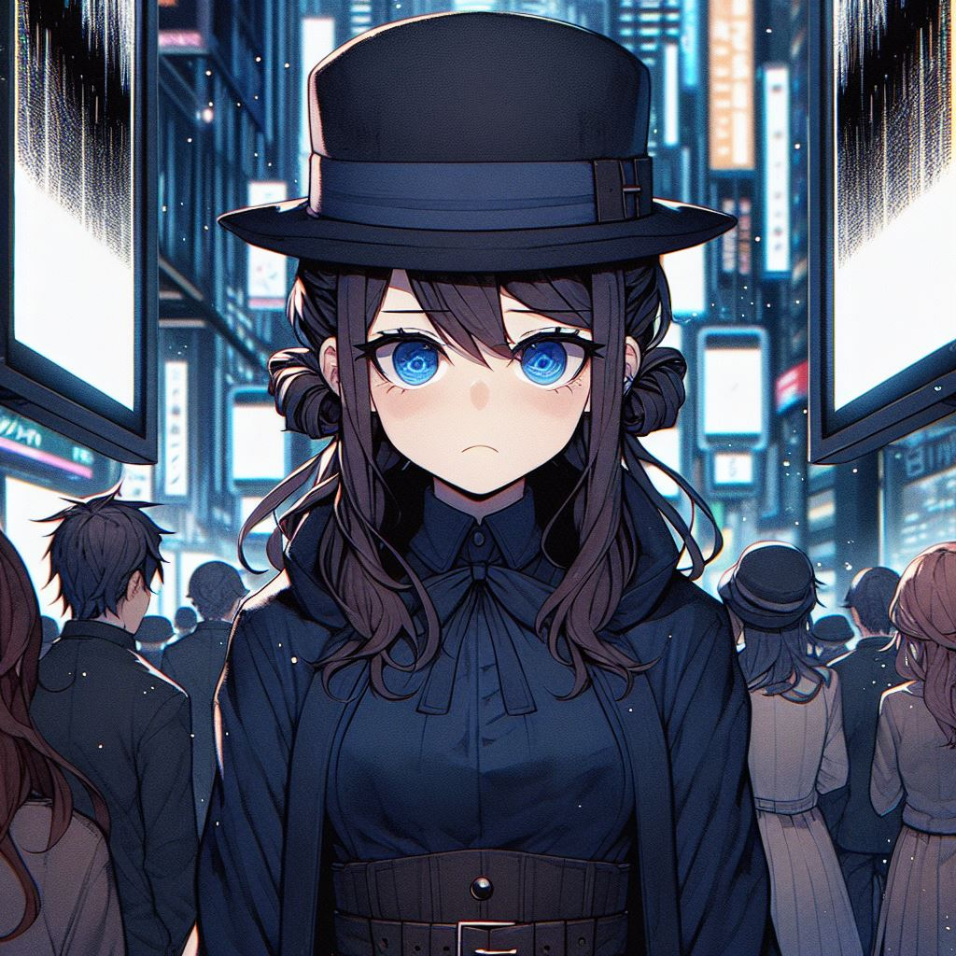
轉彎
Notes:
街上的人全忙著製造某種塑膠珠，沒注意到我，我走向一旁看電視的群眾。他們把塑膠珠投進電視上方的漏斗，這時影像會轉成雜亂的線條，這些人緊盯著線條看。「不好意思，」我說，「我想去資料處理中心，請問─」「我很忙」，有人說，還有人揮手想趕走我。
Please draw this picture: A dark blue-eyed 16 year-old girl with low-pigtails brown hair, wearing a black top hat, and wearing a dark blue high collar long sleeve thick shirt and black pants, frowning and sad. Standing in the high-tech city at night with many TV playing black lines. In front of her are people looking at the TV. The scene is in a Japanese anime style.

Slide 7
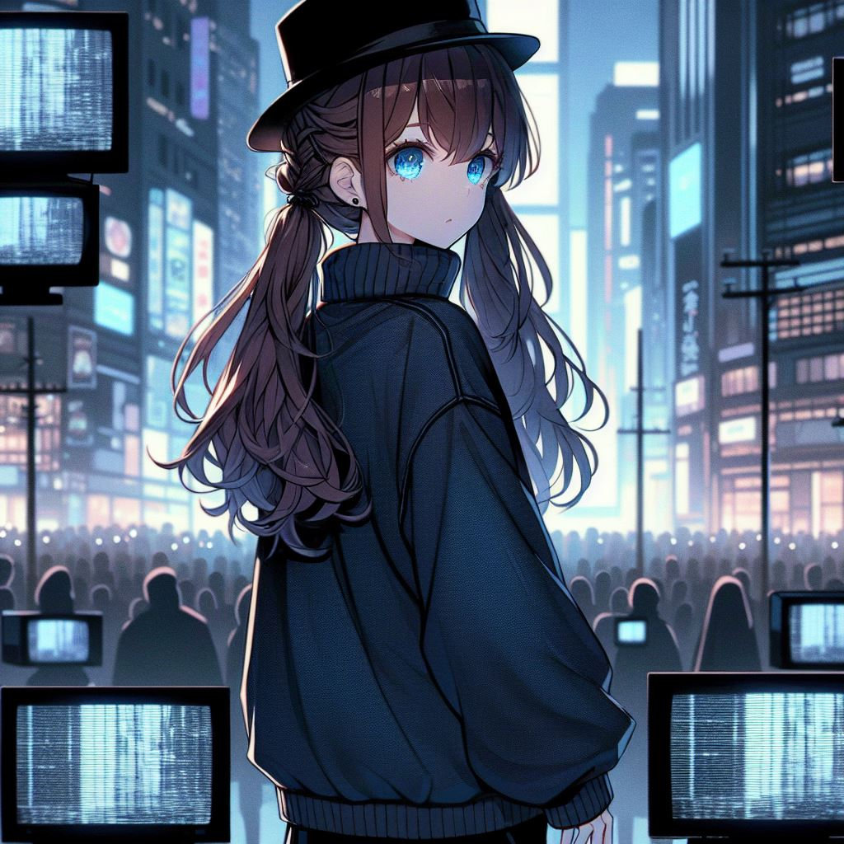
結果
Notes:
嗯，也許這是某種大型表演藝術，那些人是演員？我不知道。我只好自己研究這裡的道路。我發現所有的電視管線都延伸到同個方向，也許會通到城市中央。我跟著管線走，果然看到了資料處理中心。
Please draw this picture: A dark blue-eyed 16 year-old girl with low-pigtails brown hair, wearing a black top hat, and wearing a dark blue high collar long sleeve thick shirt and black pants, facing away looking at the middle of the the high-tech city at night with many TV playing black lines. The scene is in a Japanese anime style.

Slide 8
目標 | Vivi接到藝術節的邀請，地點在小阿尼斯城。他正考慮要不要接受
阻礙 | Vivi沒去過小阿尼斯城，只知道這是座新的城市；他也不知道該表演什麼
努力 | Vivi還是接受了邀請。他想去看看小阿尼斯城，也許他能得到表演的靈感
結果 | Vivi去了小阿尼斯城。整座城市造型非常新穎，科技發達，到處都是電視螢幕
意外 | Vivi找不到集合地點
轉彎 | 他詢問街上的人，但沒人願意和他說話。所有人不是忙著產生奇怪的塑膠珠，就是把塑膠珠投進電視上頭的漏斗、啟動電視，然後盯著電視螢幕的雜亂線條看
結局 | Vivi發現電視和塑膠珠的管線全都朝同個方向延伸，他朝管子的方向走，找到了集合地點

