Slide 1
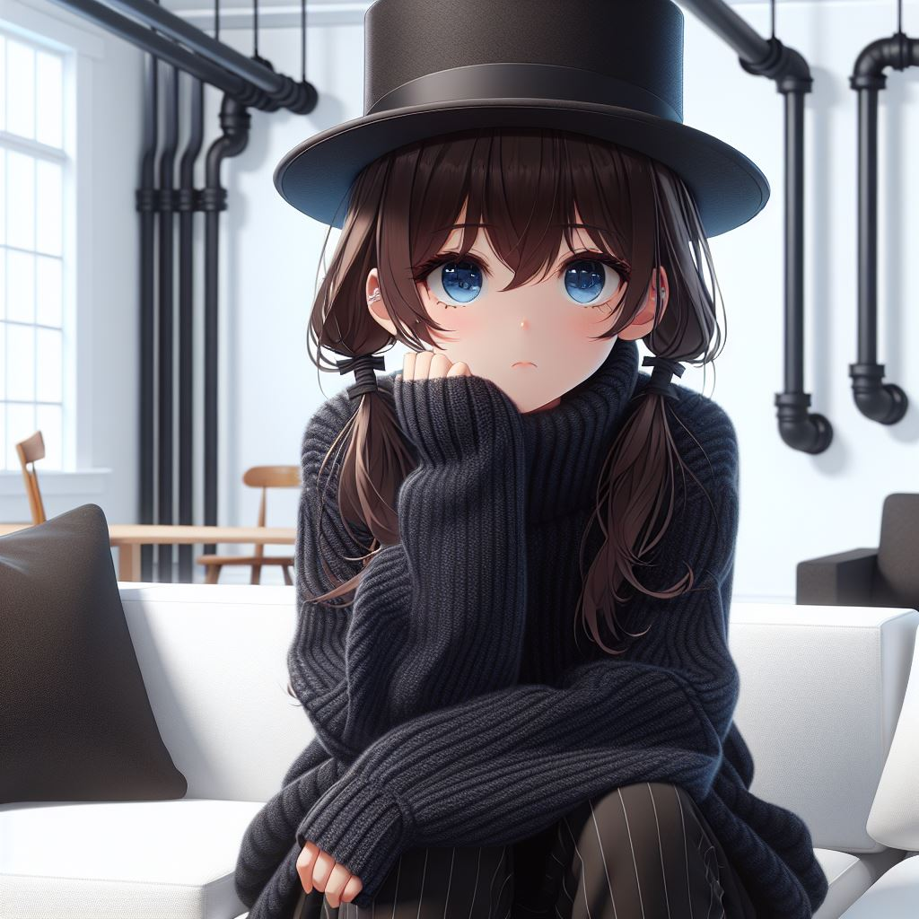
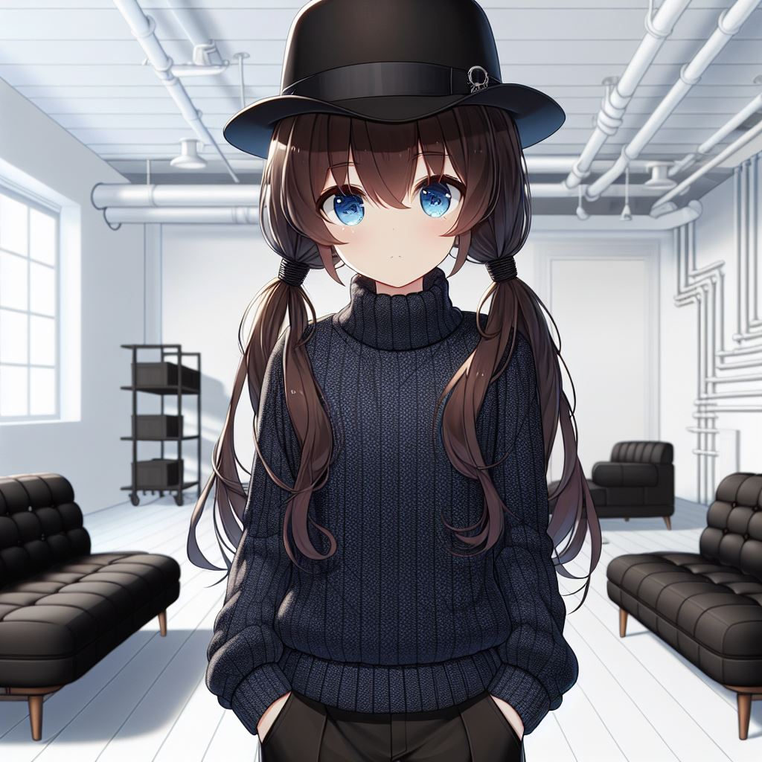
阻礙
努力
目標
結果
Notes:
Please draw this picture: A dark blue-eyed 16 year-old girl with low-pigtails brown hair, wearing a black top hat, and wearing a dark blue high collar long sleeve thick sweater and black pants, standing in a white room with two black sofa, there are many pipes in the wall.The scene is in a Japanese anime style.

Slide 2
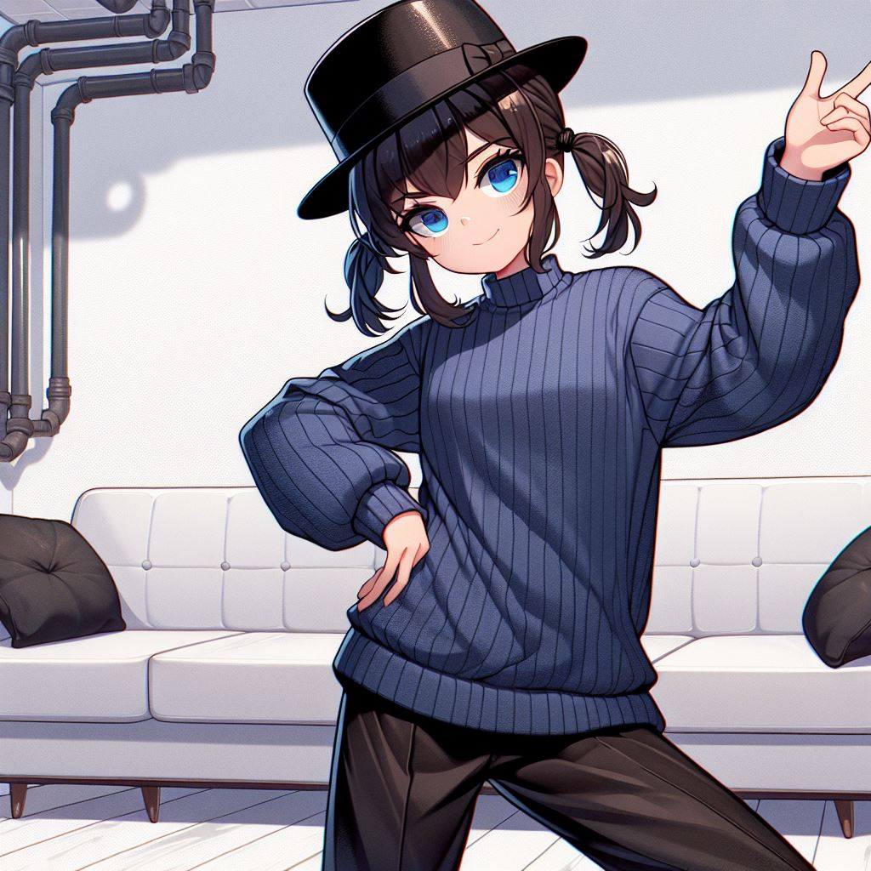
阻礙
努力
目標
結果
Notes:
Please draw this picture: A dark blue-eyed 16 year-old girl with low-pigtails brown hair, wearing a black top hat, and wearing a dark blue high collar long sleeve thick sweater and black pants, looking bored, sitting in the sofa in a white room with two black sofa, there are many large pipes in the wall.The scene is in a Japanese anime style.

Slide 3
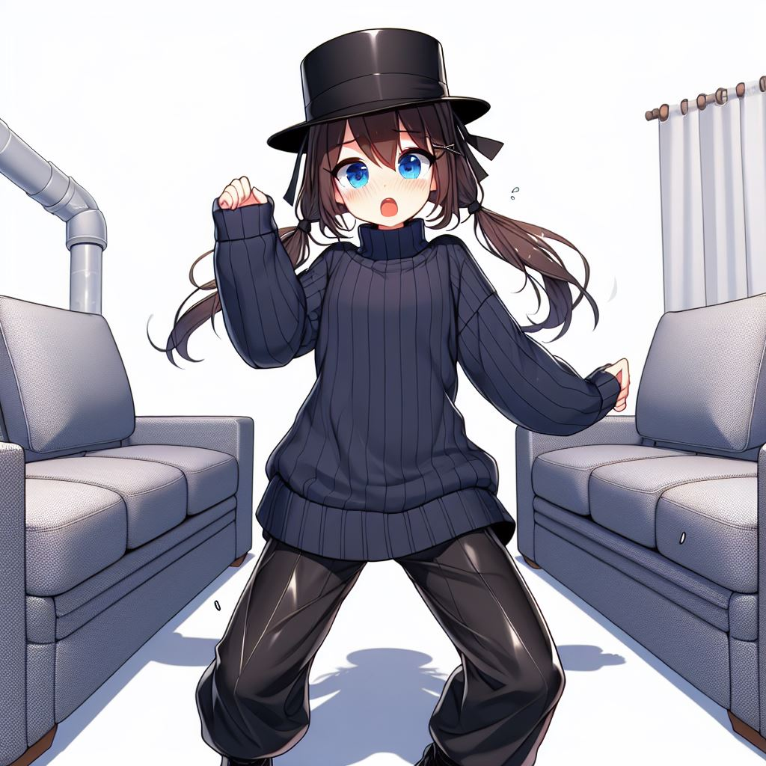
阻礙
努力
目標
結果
Notes:
Please draw this picture: A dark blue-eyed 16 year-old girl with low-pigtails brown hair, wearing a black top hat, and wearing a dark blue high collar long sleeve thick sweater and black pants, standing and looking cheerful, in a white room with two black sofa, there are many large pipes in the wall. The scene is in a Japanese anime style.

Slide 4
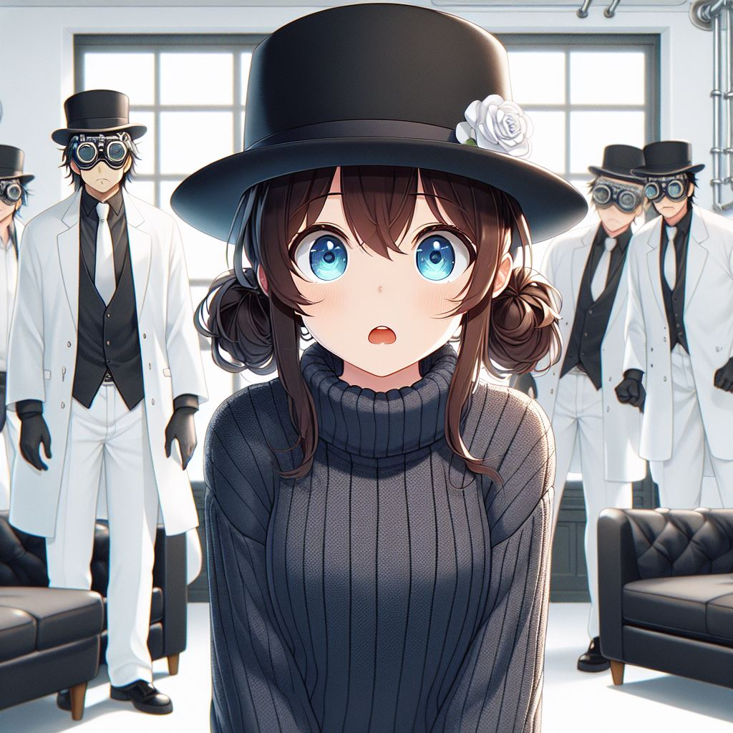
轉彎
阻礙
結局
努力
意外
目標
結果
結果
Notes:
Please draw this picture: A dark blue-eyed 16 year-old girl with low-pigtails brown hair, wearing a black top hat, and wearing a dark blue high collar long sleeve thick sweater and black pants, dancing and looking scared , in a white room with two black sofa, the sofa is moving, there are many large pipes in the wall. The scene is in a Japanese anime style.

Slide 5
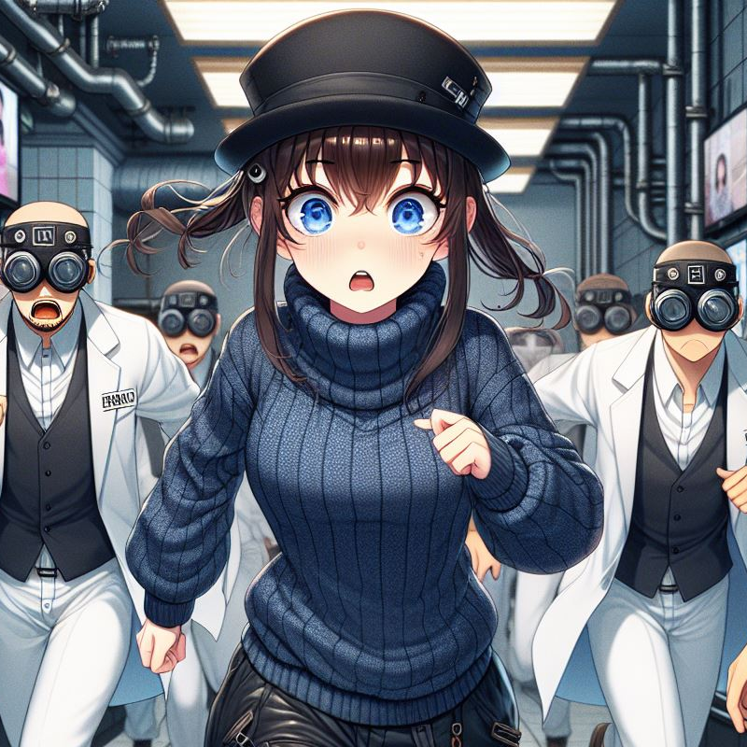
轉彎
結局
意外
結果
Notes:
Please draw this picture: A dark blue-eyed 16 year-old girl with low-pigtails brown hair, wearing a black top hat, and wearing a dark blue high collar long sleeve thick sweater and loose black pants, looking surprised. Behind her are four men wearing experiment goggles and white shirt and white pants. in a white room with two black sofa, there are many large pipes in the wall. The scene is in a Japanese anime style.

Slide 6
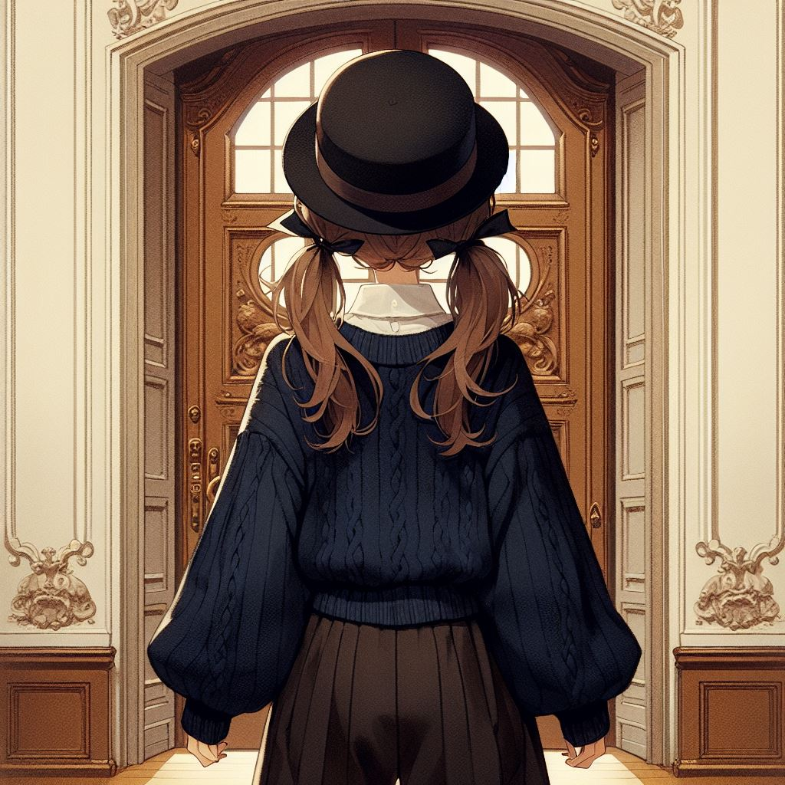
轉彎
結局
意外
結果
Notes:
Please draw this picture: A dark blue-eyed 16 year-old girl with low-pigtails brown hair, wearing a black top hat, and wearing a dark blue high collar long sleeve thick sweater and loose black pants, running, looking scared. Behind her are four men wearing experiment goggles in eyes and white shirt and white pants, looking serious, chasing behind the girl. in a hotel lobby with many large pipes and many tv in the wall. Some tv are playing advertisement some tv are black. The scene is in a Japanese anime style.

Slide 7
轉彎
結局
意外
結果
Notes:
Please draw this picture: A back view of a dark blue-eyed 16 year-old girl with low-pigtails brown hair, wearing a black top hat, and wearing a dark blue high collar long sleeve thick sweater and loose black pants, standing in front of a large beautiful elegant Renaissance style double door. The scene is in a Japanese anime style.

Slide 8
目標 | Vivi在集合地點找到自己的等候區，裡頭有好多管子。他正在等工作人員出現
阻礙 | Vivi覺得很無聊
努力 | Vivi跳舞打發時間
結果 | 當他跳舞時，現場所有物品開始移動，Vivi覺得頭很暈
意外 | 守衛衝了進來。Vivi開始跑，他發現有些電視壞了
轉彎 | Vivi想起這裡的人喜歡盯著電視螢幕的雜亂線條看，但他沒有塑膠珠啟動電視，於是他隨手畫了些線在牆上。警察果然開始盯著Vivi畫的線條看
結局 | 趁警察分心時Vivi趕快跑。最後他跑到一扇漂亮的大門前

