Slide 1
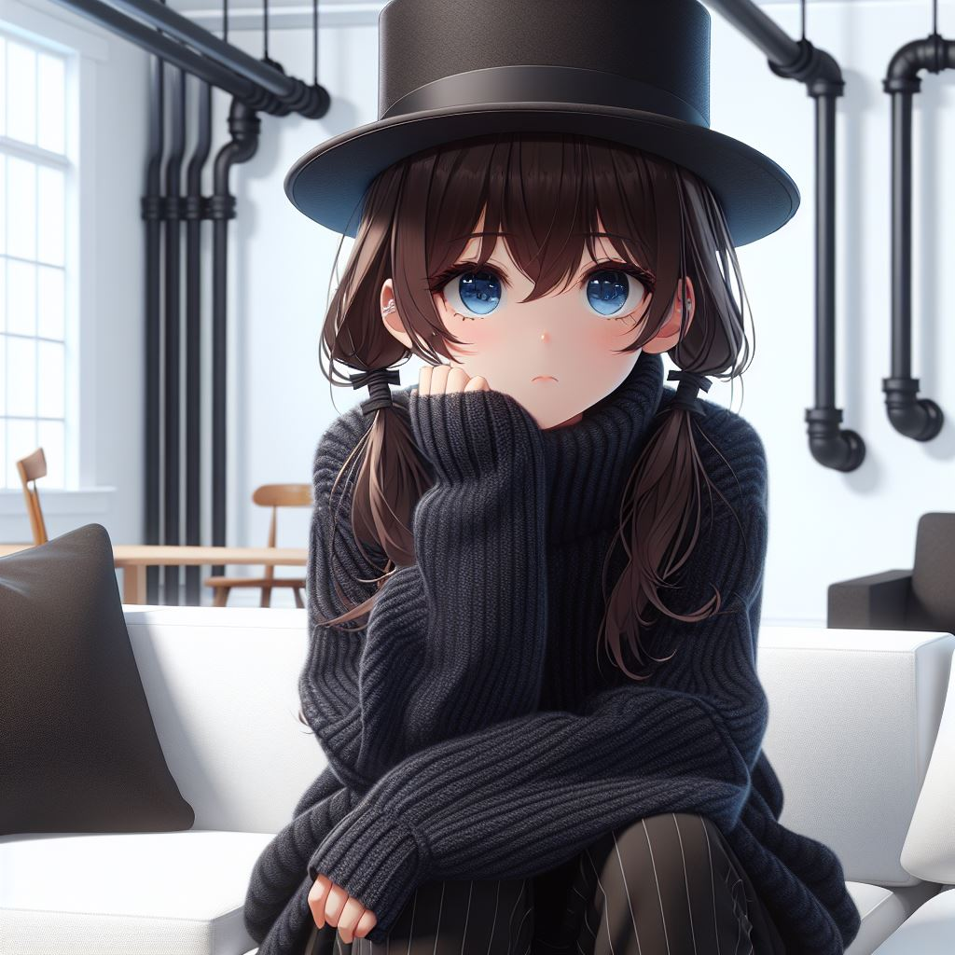
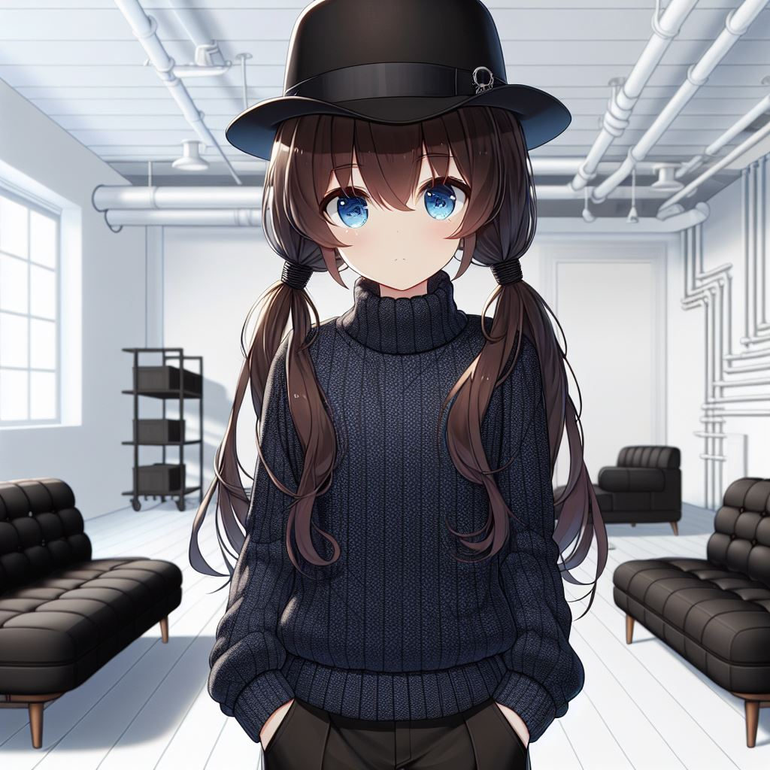
阻礙
努力
目標
結果
Notes:
我來到集合地點，房間裡沒有其他人，只有家具和牆上怪異的管子。也許工作人員晚點才會到。
Please draw this picture: A dark blue-eyed 16 year-old girl with low-pigtails brown hair, wearing a black top hat, and wearing a dark blue high collar long sleeve thick sweater and black pants, standing in a white room with two black sofa, there are many pipes in the wall. The scene is in a Japanese anime style.

Slide 2
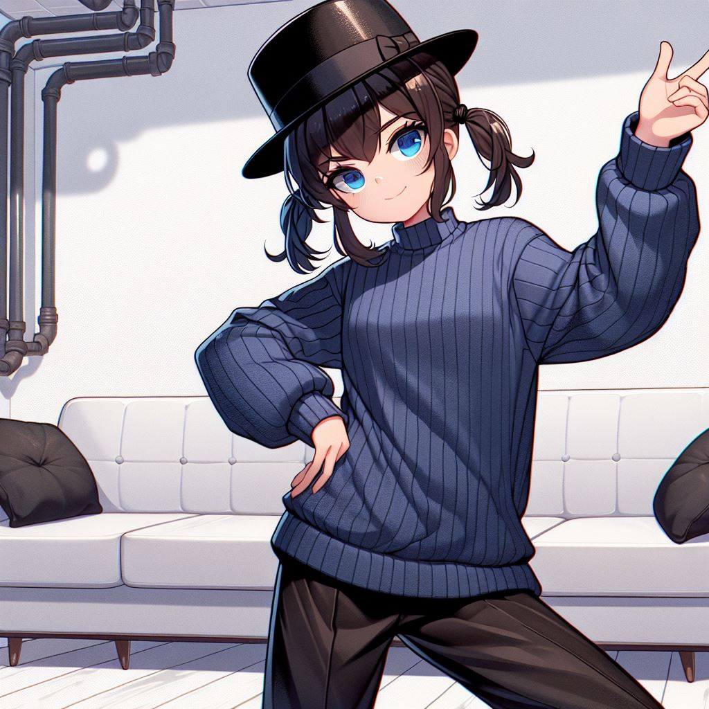
阻礙
努力
目標
結果
Notes:
但我等了快五分鐘，還是沒人來，外頭也空蕩蕩。
Please draw this picture: A dark blue-eyed 16 year-old girl with low-pigtails brown hair, wearing a black top hat, and wearing a dark blue high collar long sleeve thick sweater and black pants, looking bored, sitting in the sofa in a white room with two black sofa, there are many large pipes in the wall. The scene is in a Japanese anime style.

Slide 3
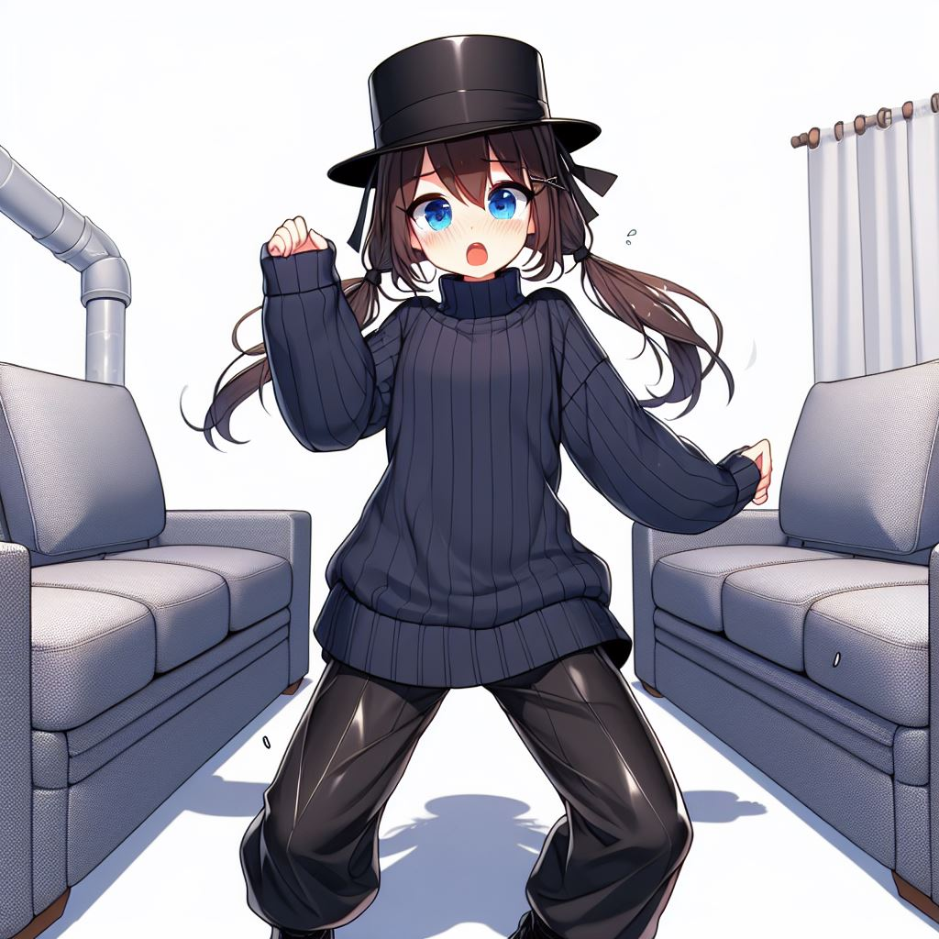
阻礙
努力
目標
結果
Notes:
我決定試試在車上想到的新舞步。我抓到大致方向了，但細部還要修。我在心裡數著節拍，開始跳舞。
Please draw this picture: A dark blue-eyed 16 year-old girl with low-pigtails brown hair, wearing a black top hat, and wearing a dark blue high collar long sleeve thick sweater and black pants, standing and looking cheerful, in a white room with two black sofa, there are many large pipes in the wall. The scene is in a Japanese anime style.

Slide 4
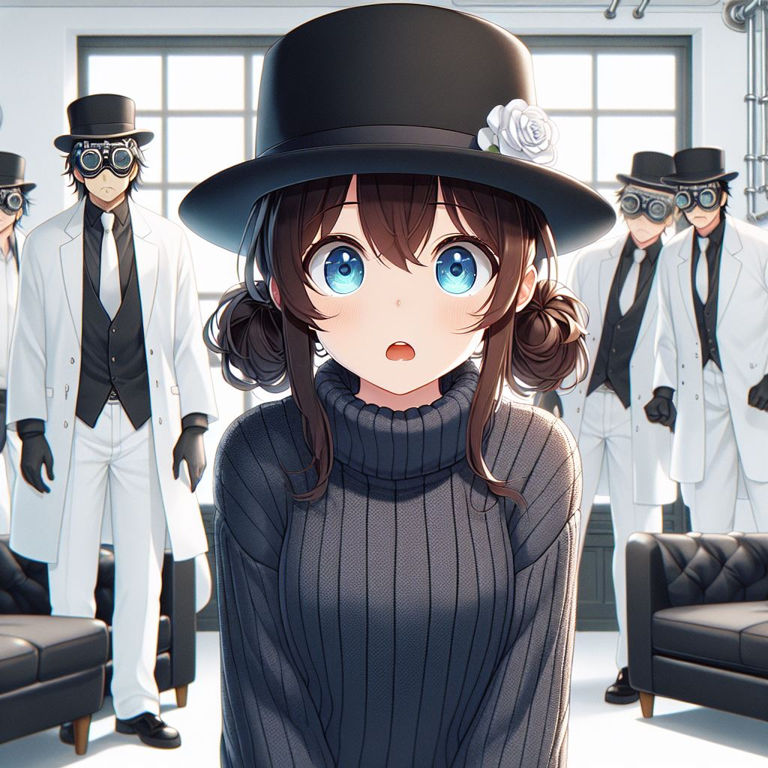
轉彎
阻礙
結局
努力
意外
目標
結果
結果
Notes:
我有種怪異的感覺。我踩了頭兩步，卻發現自己已經穿過整個房間，我只好轉向繼續跳。然後，我看見所東西都在移動。沙發、桌子、椅子，還有我，全往同個方向前進。我頭好暈，於是停了下來，所有東西又都靜止不動。房間盡頭的管子破了，我剛剛怎麼沒注意到？也許我太累了，身體不協調，才會有東西在動的錯覺。我挑了最簡單的舞步─走位，然後定點POSE─再跳一次。但還是一樣，當我跳舞時，所有東西又開始移動，但這次我無論怎麼走，我都在原地。
Please draw this picture: A dark blue-eyed 16 year-old girl with low-pigtails brown hair, wearing a black top hat, and wearing a dark blue high collar long sleeve thick sweater and black pants, dancing and looking scared , in a white room with two black sofa, the sofa is moving, there are many large pipes in the wall. The scene is in a Japanese anime style.

Slide 5
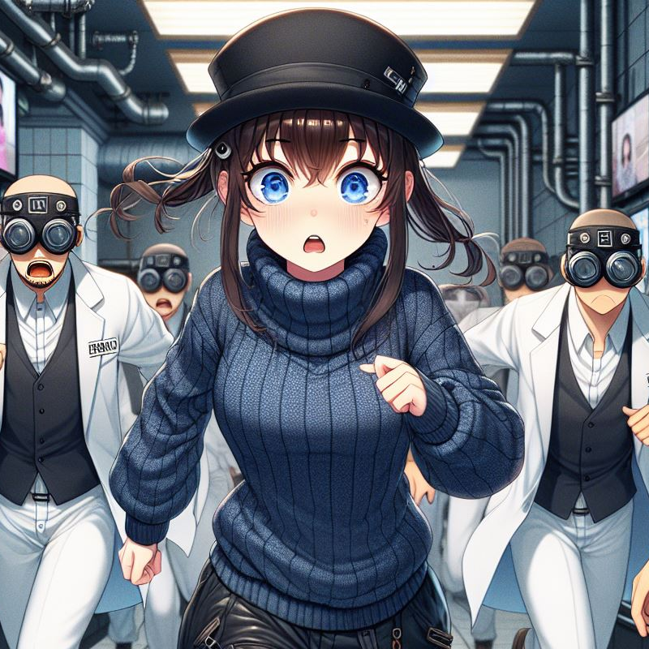
轉彎
結局
意外
結果
Notes:
這是主辦單位的考驗嗎？他們想測試我的舞蹈能耐，於是裝了會動的地板讓我跳舞？除此之外，我想不到其他可能。這時有人進來了，但不是工作人員，是四個守衛。他們一看見我，就向我丟網子。
Please draw this picture: A dark blue-eyed 16 year-old girl with low-pigtails brown hair, wearing a black top hat, and wearing a dark blue high collar long sleeve thick sweater and loose black pants, looking surprised. Behind her are four men wearing experiment goggles and white shirt and white pants. in a white room with two black sofa, there are many large pipes in the wall. The scene is in a Japanese anime style.

Slide 6
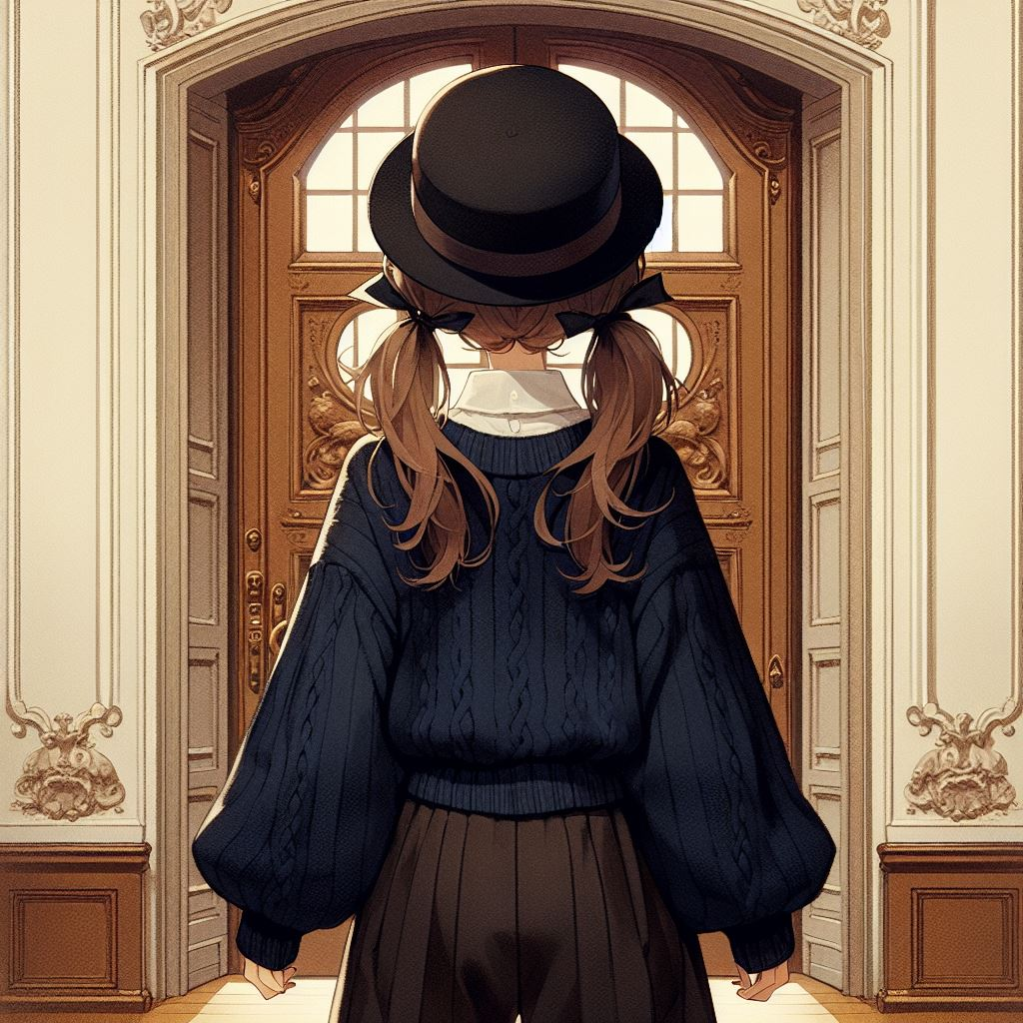
轉彎
結局
意外
結果
Notes:
我不知道這是什麼情況，但我知道被抓到肯定後果嚴重，於是我趕快跑。我穿過大廳，裡頭有些電視壞了，但我記得進來時電視全是好的。守衛離我越來越近，他們要丟第二次網子了，這時電視機讓我想起一件事：這裡的人喜歡看電視。我沒有啟動電視的塑膠珠，但我會畫螢幕裡的那些東西。我抓起大廳服務台的麥克筆，隨手在牆上畫些線條。果然，那些守衛聚到牆壁前，緊盯著那些線看。
Please draw this picture: A dark blue-eyed 16 year-old girl with low-pigtails brown hair, wearing a black top hat, and wearing a dark blue high collar long sleeve thick sweater and loose black pants, running, looking scared. Behind her are four men wearing experiment goggles in eyes and white shirt and white pants, looking serious, chasing behind the girl. in a hotel lobby with many large pipes and many tv in the wall. Some tv are playing advertisement some tv are black. The scene is in a Japanese anime style.

Slide 7
轉彎
結局
意外
結果
Notes:
趁守衛分心時我逃離大廳。我找不到進來的入口，但應該能從其他地方離開。我一直跑，眼前出現一扇漂亮的門，也許是大樓的出口。
Please draw this picture: A back view of a dark blue-eyed 16 year-old girl with low-pigtails brown hair, wearing a black top hat, and wearing a dark blue high collar long sleeve thick sweater and loose black pants, standing in front of a large beautiful elegant Renaissance style double door. The scene is in a Japanese anime style.

Slide 8
目標 | Vivi在集合地點找到自己的等候區，裡頭有好多管子。他正在等工作人員出現
阻礙 | Vivi覺得很無聊
努力 | Vivi跳舞打發時間
結果 | 當他跳舞時，現場所有物品開始移動，Vivi覺得頭很暈
意外 | 守衛衝了進來。Vivi開始跑，他發現有些電視壞了
轉彎 | Vivi想起這裡的人喜歡盯著電視螢幕的雜亂線條看，但他沒有塑膠珠啟動電視，於是他隨手畫了些線在牆上。警察果然開始盯著Vivi畫的線條看
結局 | 趁警察分心時Vivi趕快跑。最後他跑到一扇漂亮的大門前

