Slide 1
PROJECT NEXT — A PRODUCT PROPOSAL
PULSE
Unilever's Always-On Brand Nervous System
Turning a 3-second Rexona armband into the proof: brand teams don't need more AI features — they need the system that fires in minutes, not weeks.
How we'd architect the entire brand lifecycle if Unilever were founded today, AI-first
Ranjana Mainani — Product Manager, Project NEXT
cases/2026-08-project-next-unilever-brand-lifecycle

Slide 2
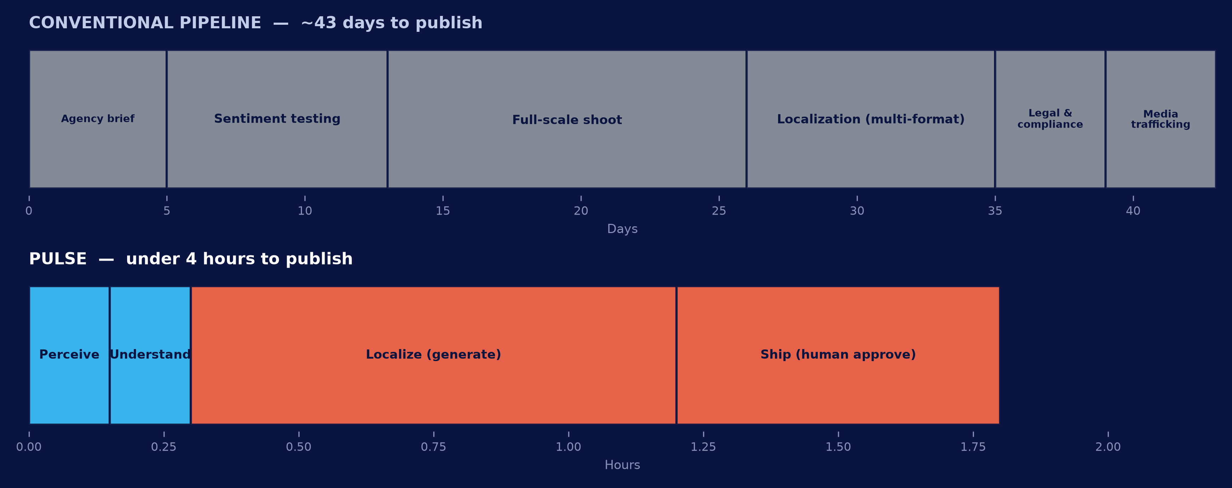
1 / 5 — THE PROBLEM
The viral window was minutes. Our pipeline is measured in weeks.
The fourth official's board carried a Rexona logo for 3 seconds. Fans memed it before the final whistle. Our process couldn't have shipped a response before the tournament ended.
THIS ISN'T A TOOLING GAP — IT'S A WIRING GAP
Social listening and web scraping already exist at Unilever — the brief says so directly. They just run independently, so a human has to manually notice, judge, brief, produce, clear, and publish — every single time. The fix isn't another dashboard. It's removing the human synthesis step from the critical path.
Project NEXT | PULSE — Unilever's Always-On Brand Nervous System
Page 2

Slide 3
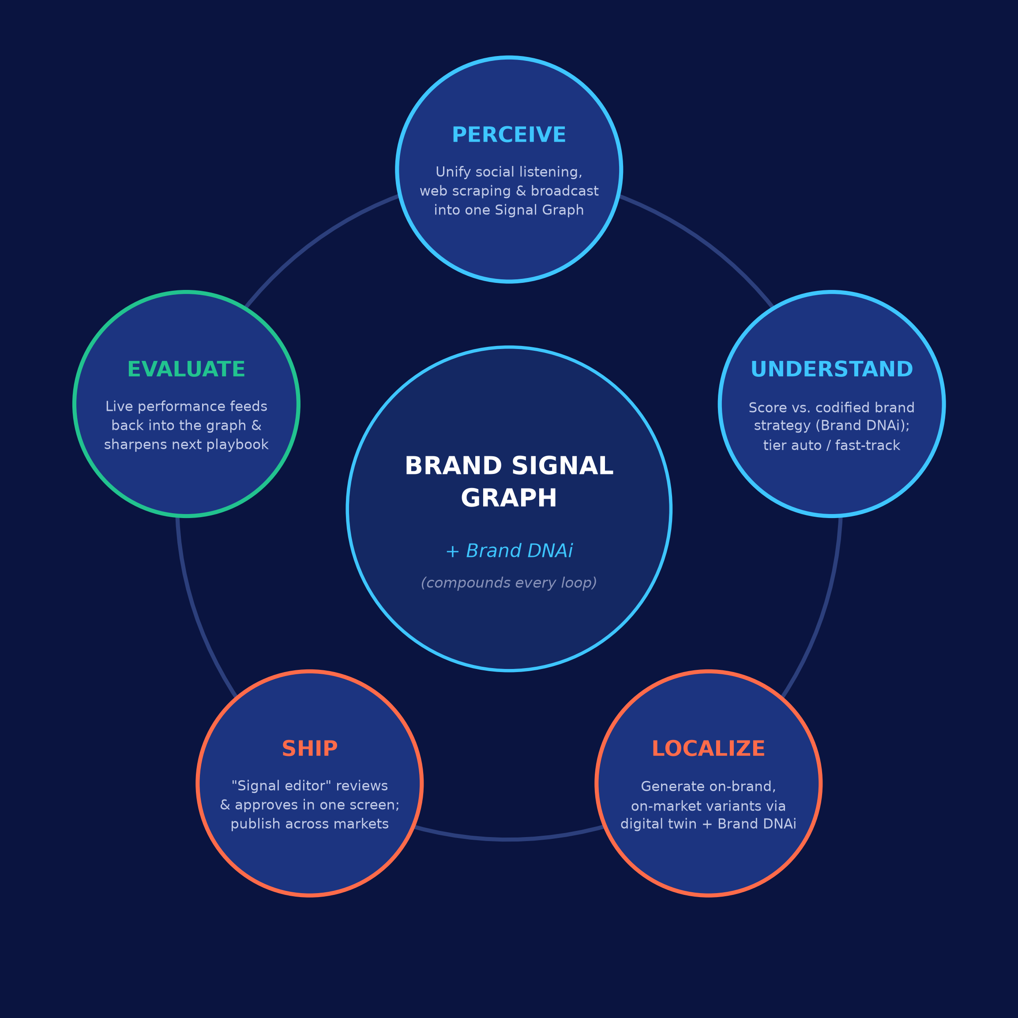
2 / 5 — THE SYSTEM
PULSE: one closed loop, not five more point solutions
Perceive → Understand → Localize → Ship → Evaluate — built on top of what Unilever already has, wired for the first time.
BUILT ON, NOT INSTEAD OF
WHAT'S ACTUALLY NEW
Brand DNAi — the safety & voice layer Understand/Localize score and generate against.
Digital-twin production — 2x faster, 50% cheaper product imagery, feeds Localize.
Desire at Scale — the multi-market activation engine PULSE's Ship stage drives.
One Brand Signal Graph per brand — listening + scraping + broadcast unified, not siloed.
Tiered autonomy — auto-publish / fast-track / escalate, decided before the moment, not during it.
A closed Evaluate loop — every result re-trains the next playbook, so the system compounds.
Brand DNAi, digital-twin production and Desire at Scale are real, existing Unilever capabilities — see appendix for sources.
Project NEXT | PULSE — Unilever's Always-On Brand Nervous System
Page 3

Slide 4
3 / 5 — PULSE IN ACTION
The Rexona armband, run through PULSE: under 4 hours, not 6 weeks
Stage | What happens | Elapsed
PERCEIVE | Broadcast + social monitoring flags the logo appearance and rising meme velocity across markets. | T+0 → T+10 min
UNDERSTAND | Signal scored against Rexona's codified strategy (composure under pressure); auto-classified Tier 1 — on-strategy, low-risk, high-velocity — triggers the pre-approved “cultural moment” playbook. | T+10 → T+20 min
LOCALIZE | Generative layer (Brand DNAi + digital twin) drafts caption + product-shot variants in brand voice, localized for priority markets. | T+20 min → T+1h20
SHIP | Brand manager — now a “signal editor” — reviews 3 AI-drafted options on one screen, edits, approves; publishes across markets simultaneously. | T+1h20 → T+3h50
EVALUATE | Real-time engagement feeds the media-amplification decision and updates the playbook for next time. | Continuous
The pre-built playbook is the point: the creative judgment happens calmly, in advance — the same composure the tagline promises, built into the process itself.
Illustrative timings for a system design proposal, not measured production data — see appendix.
Project NEXT | PULSE — Unilever's Always-On Brand Nervous System
Page 4

Slide 5
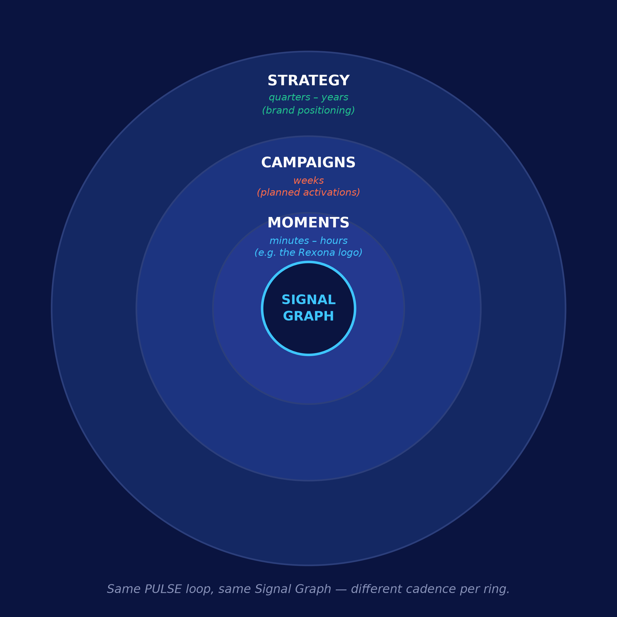
4 / 5 — THE WHOLE LIFECYCLE
Not just reactive moments — the same nervous system runs three clock speeds
One Brand Signal Graph, one Brand DNAi safety layer, three cadences of the same PULSE loop.
MOMENTS · minutes – hours
CAMPAIGNS · weeks
STRATEGY · quarters – years
Unscripted cultural moments. PULSE runs end-to-end inside tiered guardrails.
Planned activations — same graph informs the brief; same engine cuts production time.
Brand positioning — continuous signal replaces periodic research waves.
Project NEXT | PULSE — Unilever's Always-On Brand Nervous System
Page 5

Slide 6
5 / 5 — WHY THIS MAKES US INVINCIBLE
Competitors can buy the same models. They can't buy our signal graph.
COMPOUNDS OVER TIME
GOVERNED BY DESIGN
INSTITUTIONAL JUDGMENT, CODIFIED
A NEW ROLE, NOT A SMALLER ONE
The Brand Signal Graph and its playbooks accumulate with every loop — a rival starting today begins at zero, no matter which foundation model they license.
Tiered autonomy (auto / fast-track / escalate) means speed and brand safety were never a trade-off — Brand DNAi enforces voice and compliance at every tier.
Playbooks capture what brand teams already know works — built calmly in advance, so the in-the-moment step is a lookup, not a live debate.
The Brand Manager becomes a “signal editor” — setting playbook strategy and approving output — spending time on judgment, not chasing agency deliverables.
“It won't EVER let you down” isn't just the Rexona tagline anymore — it's the design spec for the process behind it.
Project NEXT | PULSE — Unilever's Always-On Brand Nervous System
Page 6

Slide 7
APPENDIX
Sources, assumptions & governance notes
SOURCES
• How Unilever is building an AI-first enterprise at scale — Unilever (unilever.com/news/news-search/2026)
• How AI is helping drive Desire at Scale across Unilever — Unilever (unilever.com/news/news-search/2025)
• Unilever reinvents product shoots with digital twins and AI — Unilever press release (unilever.com/news/press-and-media/2025)
• How AI is transforming Unilever's Personal Care business (names “Brand DNAi”) — Unilever (unilever.com/news/news-search/2025)
• Behind The Scenes Of Oreo's Real-Time Super Bowl Slam Dunk — Forbes, 2013 (forbes.com/sites/jenniferrooney)
• From ideation to execution: generative AI in modern digital marketing — ScienceDirect systematic review, 2025
• AI Marketing Case Studies 2026 — Pragmatic Digital (pragmatic.digital/blog)
ASSUMPTIONS & GOVERNANCE NOTES
• This is a conceptual system-design case with no dataset or slide limit provided; scope and format (cover + 5 content slides + appendix) were self-set.
• Timings in the Rexona walkthrough (“under 4 hours”) are illustrative targets for a system proposal, not measured data — the honest reference point is the cited literature's 30-50% production-time reduction from generative AI adoption.
• Real-time computer-vision detection of an unscripted brand appearance (e.g. spotting a logo on a match official's armband) is a genuinely hard sensing problem beyond text/social listening and is flagged as a build risk, not assumed solved.
• Tiered auto-publish carries brand-safety and legal risk if scoring is miscalibrated — recommend a narrow Tier-1 (auto-publish) scope at launch, expanding only as the Signal Graph accumulates evidence.
• PULSE is proposed as an orchestration layer over Unilever's existing Brand DNAi, digital-twin production and Desire at Scale capabilities — not a replacement for them.
Project NEXT | PULSE — Unilever's Always-On Brand Nervous System
Appendix

